Slide 1
Refactoring

Slide 2
Refactoring is a disciplined technique for restructuring an existing body of code, altering its internal structure without changing its external behavior.
Renaming
Renaming Variables and Methods
We can rename variables and methods by following these simple steps:
Select the element
Right-click the element
Click the Refactor > Rename option
Type the new name
Press Enter

Slide 3
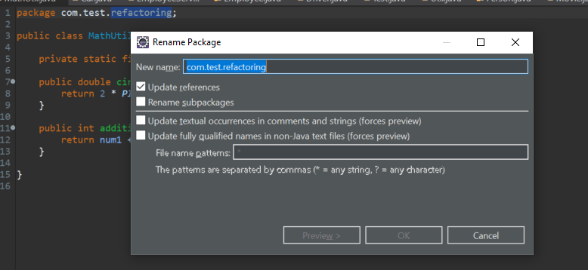
Renaming packages
We can rename a package by selecting the package name and performing the same actions as in the previous example. A pop-up will appear right away where we can rename the package, with options like updating references and renaming subpackages.

Slide 4
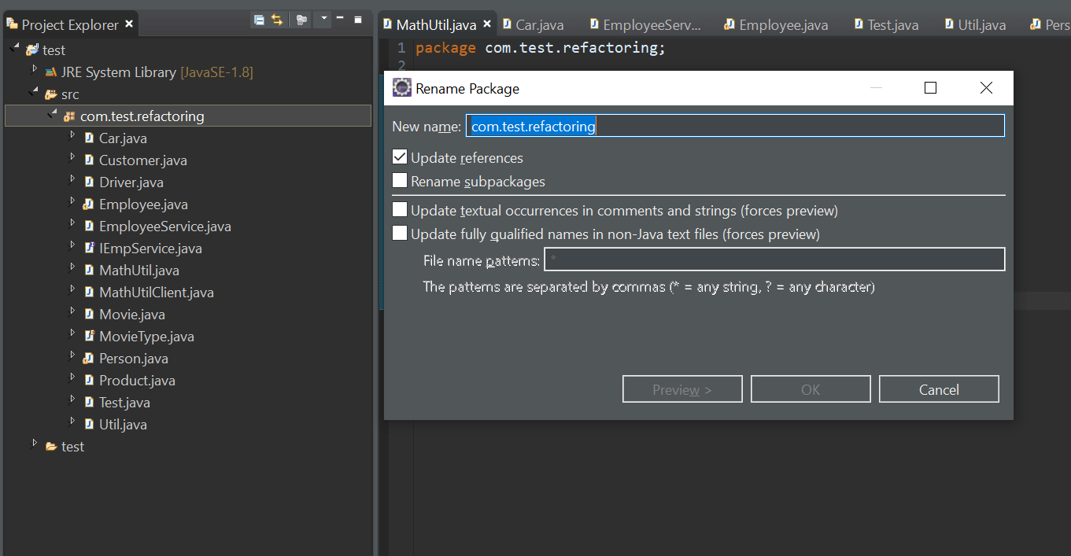
We can also rename the package from the Project Explorer view by pressing F2.

Slide 6
Renaming Classes and Interfaces
We can rename a class or interface by using the same actions or just by pressing F2 from Project Explorer. This will open up a pop-up with options to update references, along with a few advanced options:
Extracting Class
Extracting code means taking a piece of code and moving it.
For example, we can extract code into a different class, superclass or interface.
This will open up a pop-up where we can name the class and select which fields we want to move, along with few other options:

Slide 7
Extract Interface
We can extract an interface by right-clicking anywhere within the class and choosing the Refactor > Extract Interface option, or we can use the Alt+Shift+T shortcut key command to bring up the menu directly:
Extract Superclass
To extract items to a superclass, we can right-click anywhere in the class and choose the Refactor > Extract Superclass option, or use Alt+Shift+T to bring up the menu directly:
Extract Method
Sometimes, we might want to extract a certain piece of code inside our method to a different method to keep our code clean and easy to maintain.

Slide 8
Select the lines of code we want to extract
Right-click the selected area
Click the Refactor > Extract Method option
Extract Constant
We can extract expressions and literal values to static final class attributes.
Inlining
We can also go the other way and inline code.
Consider a Util class that has a local variable that's only used once.
We want to remove the result local variable and inline the method call.

Slide 9
Push Down and Pull Up
If we have a parent-child relationship between our classes, and we want to move certain methods or variables among them, we can use the push/pull options provided by Eclipse.
As the name suggests, the Push Down option moves methods and fields from a parent class to all child classes, while Pull Up moves methods and fields from a particular child class to parent, thus making that method available to all the child classes.
For moving methods down to child classes, we need to right-click anywhere in the class and choose the Refactor > Push Down option:

Slide 10
Moving
Sometimes, we simply want to move methods to another existing class to make our code more object-oriented.
Select the lines you want to move
Right-click and choose the Refactor > Move option

