Slide 1
MicroServices

Slide 2
What are Microservices?
Microservices is a service-oriented architecture pattern wherein applications are built as a collection of various smallest independent service units.
It is a software engineering approach that focuses on decomposing an application into single-function modules with well-defined interfaces.
These modules can be independently deployed and operated by small teams that own the entire lifecycle of the service.
The term "micro" refers to the sizing of a microservice which must be manageable by a single development team ( 5 to 10 developers). In this methodology, big applications are divided into smallest independent units.

Slide 3
What is Monolithic Architecture?
Monolithic architecture is like a big container in which all the software components of an application are clubbed into a single package.
In any e-commerce application, there are some standard features like Search, Review & Ratings, and Payments. These features are accessible to customers using their browser or apps.
When the developer of the eCommerce site deploys the application, it is a single Monolithic unit. The code for different features like Search, Review & Ratings, and Payments are on the same server.
To scale the application, you need to run multiple instances(servers) of these applications.

Slide 4
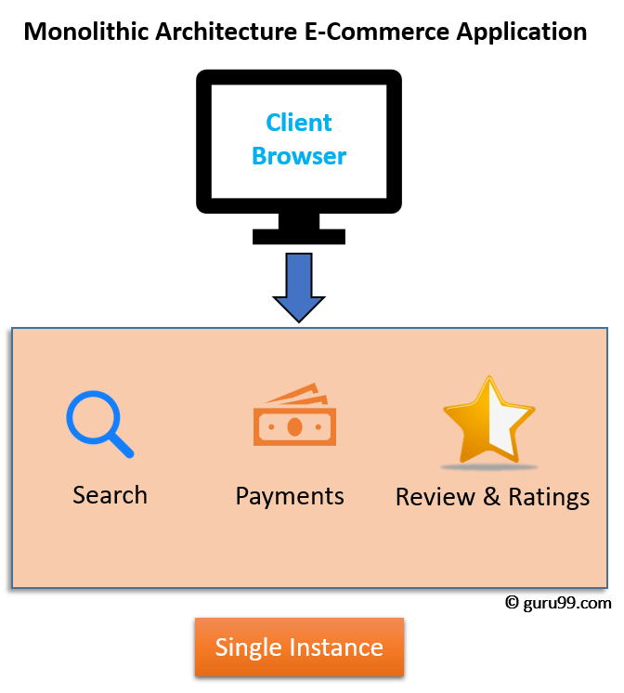

Slide 5
What is Microservice Architecture?
Microservice Architecture is an architectural development style that allows building applications as a collection of small autonomous services developed for a business domain.
It is a variant of structural style architecture that helps arrange applications as a loosely coupled service collection. The Microservice Architecture contains fine-grained services and lightweight protocols.

Slide 6
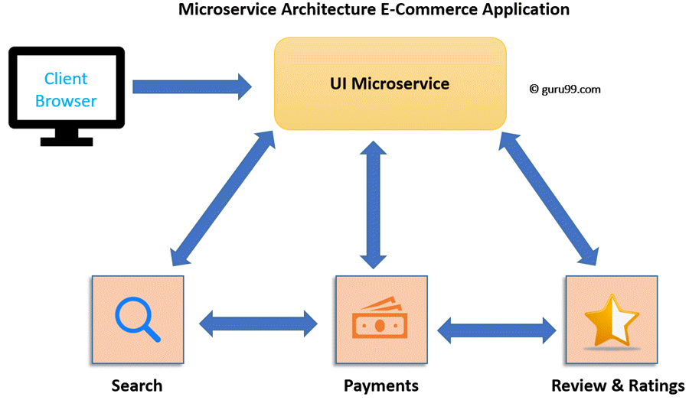

Slide 7
In Microservices architecture, each microservice is focused on single business capability. Search, Rating & Review and Payment each have their instance (server) and communicate with each other.

Slide 8
Microservices vs. Monolithic Architecture
Microservices | Monolithic Architecture
Every unit of the entire application should be the smallest, and it should be able to deliver one specific business goal. | A single code base for all business goals
Service Startup is relatively quick | Service startup takes more time
Fault isolation is easy. Even if one service goes down, other can continue to function. | Fault isolation is difficult. If any specific feature is not working, the complete system goes down. In order to handle this issue, the application needs to re-built, re-tested and also re-deployed.
All microservices should be loosely coupled so that changes made in one does not affect the other. | Monolithic architecture is tightly coupled. Changes in one module of code affect the other
Businesses can deploy more resources to services that are generating higher ROI | Since services are not isolated, individual resource allocation not possible

Slide 9
More hardware resources could be allocated to the service that is frequently used. In the e-commerce example above, more number of users check the product listing and search compared to payments. So, more resources could be allocated to the search and product listing microservice. | Application scaling is challenging as well as wasteful.
Microservices always remains consistent and continuously available. | Development tools get overburdened as the process needs to start from the scratch.
Data is federated. This allows individual Microservice to adopt a data model best suited for its needs. | Data is centralized.
Small Focused Teams. Parallel and faster development | Large team and considerable team management effort is required
Change in the data model of one Microservice does not affect other Microservices. | Change in data model affects the entire database
Interacts with other microservices by using well-defined interfaces | Not applicable
Microservices work on the principle that focuses on products, not projects | Put emphasize on the entire project
No cross-dependencies between code bases. You can use different technologies for different Microservices. | One function or program depends on others.

Slide 10
Microservices challenges
MicroServices rely on each other, and they will have to communicate with each other.
Compared to monolithic systems, there are more services to monitor which are developed using different programming languages.
As it is a distributed system, it is an inherently complex model.
Different services will have its separate mechanism, resulting in a large amount of memory for an unstructured data..

Slide 11
It is difficult to manage application when new services are added to the system
A wide array of skilled professionals is required to support heterogeneously distributed microservices
Microservice is costly, as you need to maintain different server space for different business tasks

Slide 12
SOA Vs. Microservices
SOA services are maintained in the organization by a registry which acts as a directory listing. Applications need to look up the services in the registry and invoke the service.
Microservices is a form of service-oriented architecture style wherein applications are built as a collection of different smaller services instead of one software or application

Slide 13
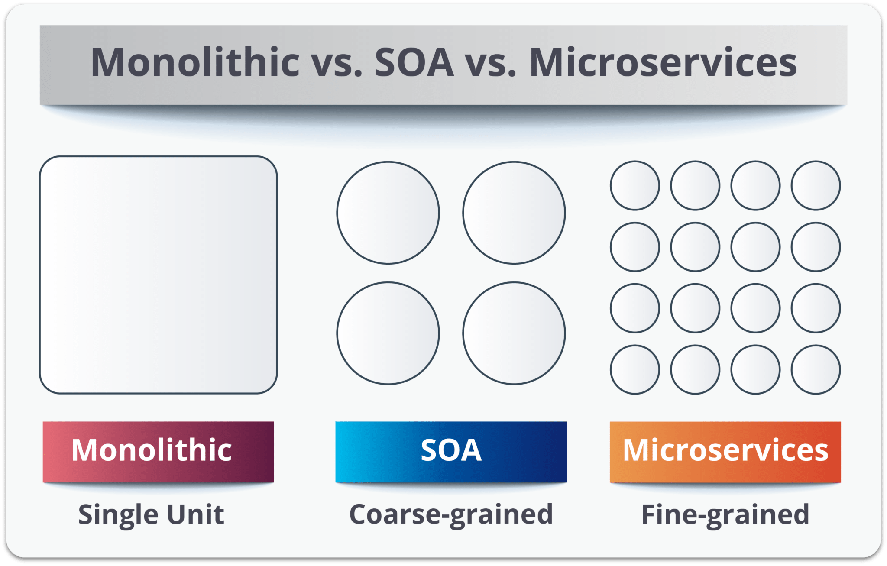

Slide 14
a monolith is similar to a big container wherein all the software components of an application are assembled together and tightly packaged.
Service-oriented architecture is essentially a collection of services. These services communicate with each other. The communication can involve either simple data passing or two or more services coordinating some activity. Some means of connecting services to each other is needed.
Microservices, microservices architecture, is an architectural style that structures an application as a collection of small autonomous services modeled around a business domain.

Slide 15
Principles Used to Design Microservice Architecture
The principles used to design Microservices are as follows:
Independent & Autonomous Services
Scalability
Decentralization
Resilient Services
Real-Time Load Balancing
Availability
Continuous delivery through DevOps Integration
Seamless API Integration and Continuous Monitoring
Isolation from Failures
Auto -Provisioning

Slide 16
Design Patterns of Microservices
Aggregator
API Gateway
Chained or Chain of Responsibility
Asynchronous Messaging
Database or Shared Data
Event Sourcing
Branch
Command Query Responsibility Segregator
Circuit Breaker
Decomposition

Slide 17
Aggregator Pattern
Aggregator in the computing world refers to a website or program that collects related items of data and displays them. So, even in Microservices patterns, Aggregator is a basic web page which invokes various services to get the required information or achieve the required functionality.
Since the source of output gets divided on breaking the monolithic architecture to microservices, this pattern proves to be beneficial when you need an output by combining data from multiple services.
If we have two services each having their own database, then an aggregator having a unique transaction ID, would collect the data from each individual microservice, apply the business logic and finally publish it as a REST endpoint.
Later on, the data collected can be consumed by the respective services which require that collected data.

Slide 18
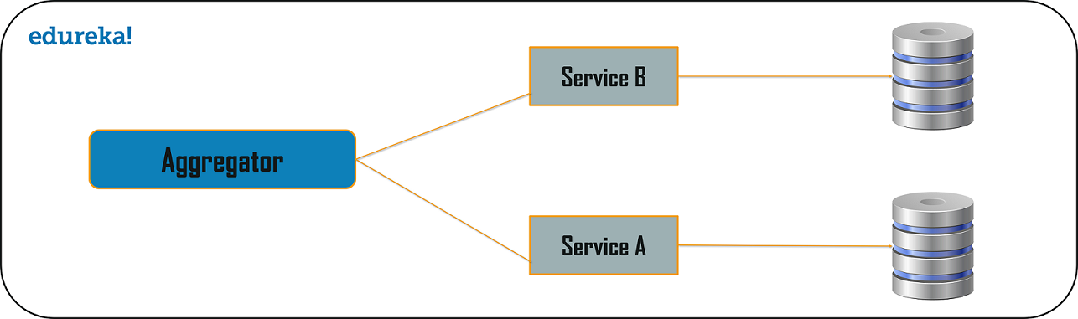

Slide 19
API Gateway Design Pattern
Microservices are built in such a way that each service has its own functionality. But, when an application is broken down into small autonomous services, then there could be few problems that a developer might face. The problems could be as follows:
How can I request information from multiple microservices?
Different UI require different data to respond to the same backend database service
How to transform data according to the consumer requirement from reusable Microservices
How to handle multiple protocol requests?
The solution to these kinds of problems could be the API Gateway Design Pattern.
This microservice design pattern can also be considered as the proxy service to route a request to the concerned microservice.

Slide 20
It can send the request to multiple services and similarly aggregate the results back to the composite or the consumer service.
API Gateway also acts as the entry point for all the microservices and creates fine-grained APIs’ for different types of clients.
The API gateways can convert the protocol request from one type to other. Similarly, it can also offload the authentication/authorization responsibility of the microservice.
Once the client sends a request, these requests are passed to the API Gateway which acts as an entry point to forward the clients’ requests to the appropriate microservices.
Then, with the help of the load balancer, the load of the request is handled and the request is sent to the respective services.
Microservices use Service Discovery which acts as a guide to find the route of communication between each of them. Microservices then communicate with each other via a stateless server i.e. either by HTTP Request/Message Bus.

Slide 21
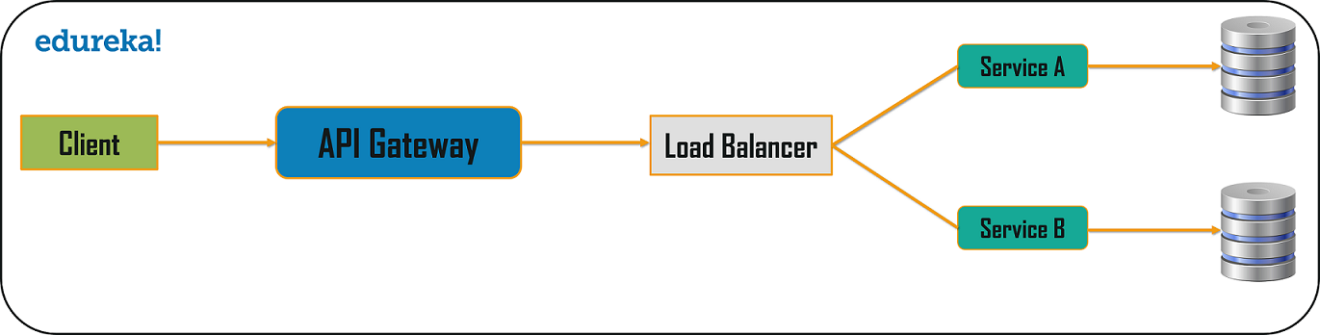

Slide 22
Chained or Chain of Responsibility Pattern
Chained or Chain of Responsibility Design Patterns produces a single output which is a combination of multiple chained outputs.
If three services lined up in a chain, then, the request from the client is first received by Service A. Then, this service communicates with the next Service B and collects data.
Finally, the second service communicates with the third service to generate the consolidated output. All these services use synchronous HTTP request or response for messaging.
Until the request passes through all the services and the respective responses are generated, the client doesn’t get any output. So, it is always recommended to not to make a long chain, as the client will wait until the chain is completed.

Slide 23
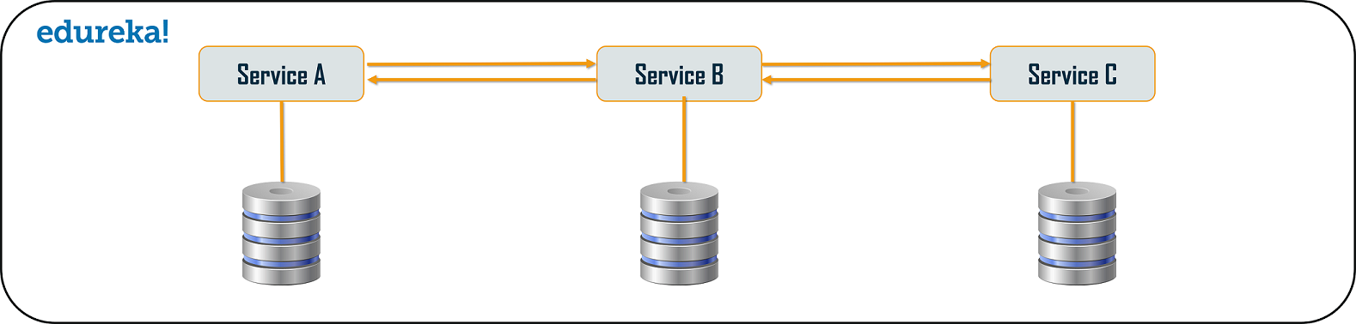

Slide 24
Asynchronous Messaging Design Pattern
From the above pattern, it is quite obvious that the client gets blocked or has to wait for a long time in synchronous messaging.
But, if you do not want the consumer, to wait for a long time, then you can opt for the Asynchronous Messaging. In this type of microservices design pattern, all the services can communicate with each other, but they do not have to communicate with each other sequentially.
So, if you consider 3 services: Service A, Service B, and Service C. The request from the client can be directly sent to the Service C and Service B simultaneously. These requests will be in a queue. Apart from this, the request can also be sent to Service A whose response need not have to be sent to the same service through which request has come.

Slide 25
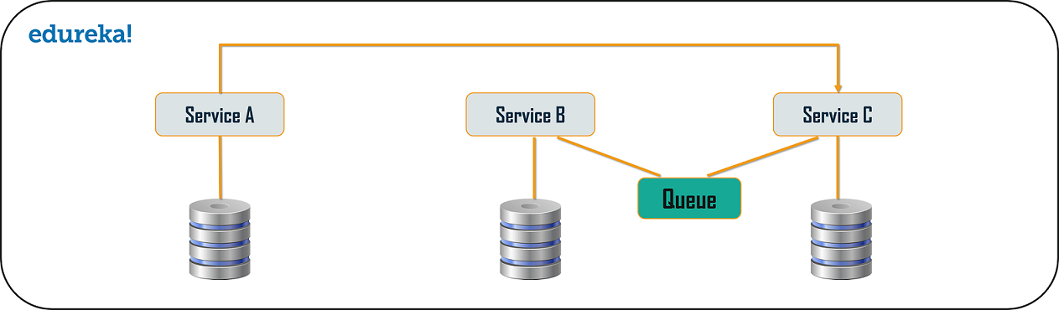

Slide 26
Database or Shared Data Pattern
For every application, there is humongous amount of data present. So, when we break down an application from its monolithic architecture to microservices, it is very important to note that each microservice has sufficient amount of data to process a request.
So, either the system can have a database per each service or it can have shared database per service. You can use database per service and shared database per service to solve various problems. The problems could be as follows:
Duplication of data and inconsistency
Different services have different kinds of storage requirements
Few business transactions can query the data, with multiple services
De-normalization of data
To solve the first three problems, we can go for database per service, as it will be then accessed by the microservice API itself. So, each microservice will have its own database ID, which thereafter prevents the other services in the system to use that particular database.

Slide 27
To solve the issue of de-normalization, you can choose shared databases per service, to align more than one database for each microservice.
This will help you gather data, for the monolithic applications which are broken down into microservices. But, you have to limit these databases to 2-3 microservices; else, scaling these services will be a problem.

Slide 28
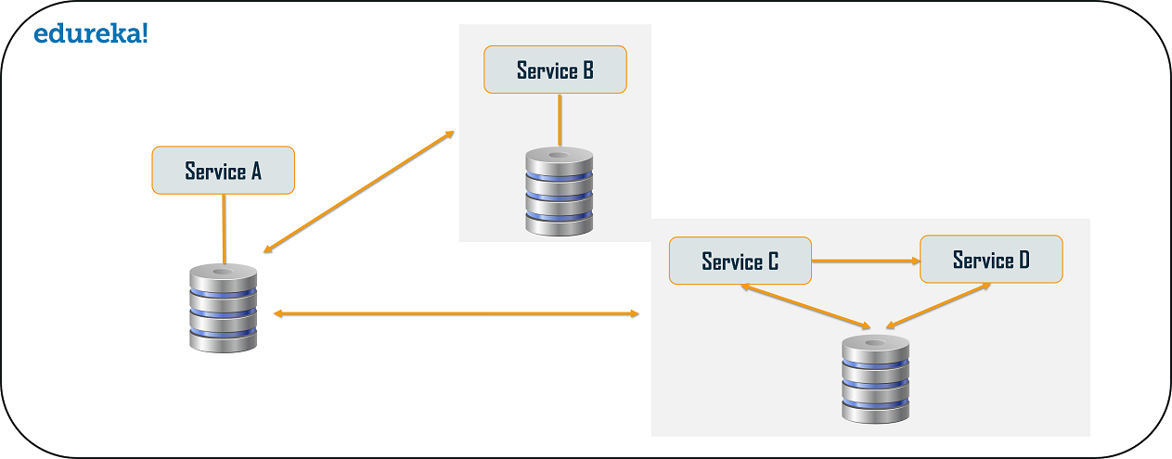

Slide 29
Event Sourcing Design Pattern
The event sourcing design pattern creates events regarding the changes in the application state.
Also, these events are stored as a sequence of events to help the developers track which change was made when. So, with the help of this, you can always adjust the application state to cope up with the past changes.
You can also query these events, for any data change and simultaneously publish these events from the event store. Once the events are published, you can see the changes of the application state on the presentation layer.

Slide 30
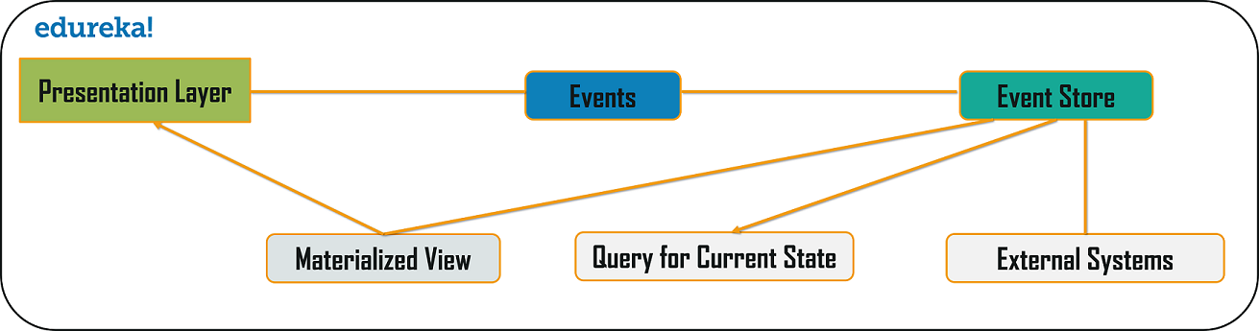

Slide 31
Branch Pattern
Branch microservice design pattern is a design pattern in which you can simultaneously process the requests and responses from two or more independent microservices.
So, unlike the chained design pattern, the request is not passed in a sequence, but the request is passed to two or more mutually exclusive microservices chains.
This design pattern extends the Aggregator design pattern and provides the flexibility to produce responses from multiple chains or single chain.
For example, if you consider an e-commerce application, then you may need to retrieve data from multiple sources and this data could be a collaborated output of data from various services. So, you can use the branch pattern, to retrieve data from multiple sources.

Slide 32
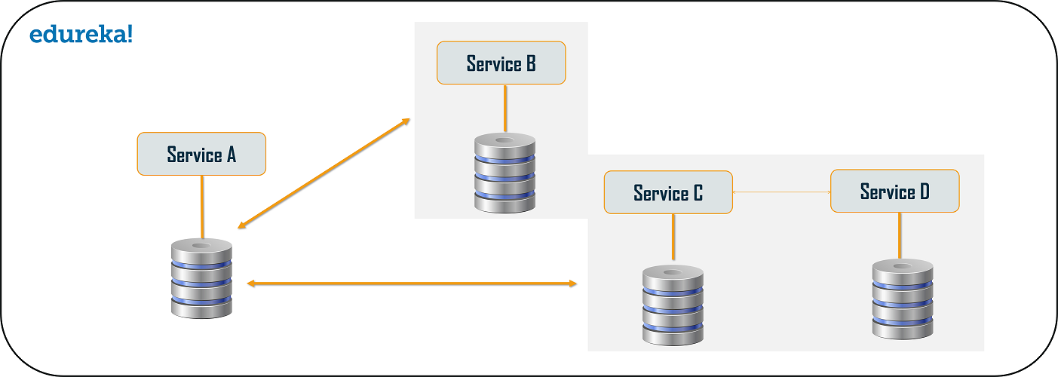

Slide 33
Command Query Responsibility Segregator (CQRS) Design Pattern
Every microservices design has either the database per service model or the shared database per service.
But, in the database per service model, we cannot implement a query as the data access is only limited to one single database. So, in such scenario you can use the CQRS pattern.
According to this pattern, the application will be divided into two parts: Command and Query. The command part will handle all the requests related to CREATE, UPDATE, DELETE while the query part will take care of the materialized views.

Slide 34
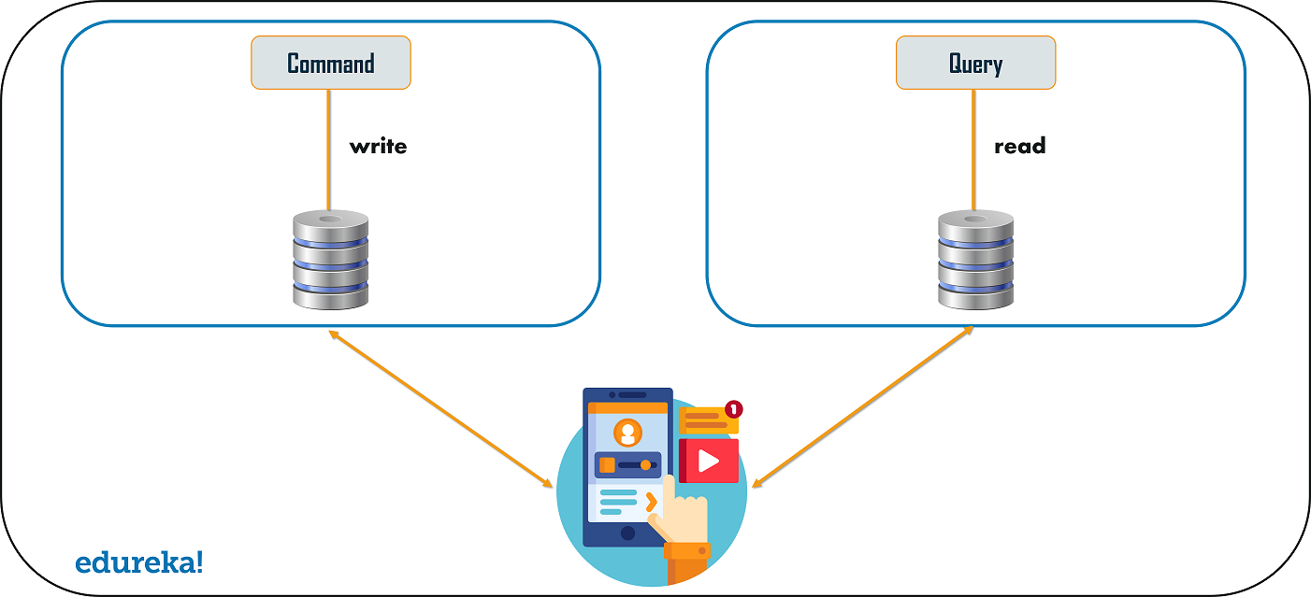

Slide 35
Circuit Breaker Pattern
As the name suggests, the Circuit Breaker design pattern is used to stop the process of request and response if a service is not working.
For example, if a a client is sending a request to retrieve data from multiple services. But, due to some issues, one of the services is down. Now, there are mainly two problems you will face: first, since the client will not have any knowledge about a particular service being down, the request will be continuously sent to that service. The second problem is that the network resources will be exhausted with low performance and bad user experience.
To avoid such problems, you can use the Circuit Breaker Design Pattern. With the help of this pattern, the client will invoke a remote service via a proxy. This proxy will basically behave as a circuit barrier.

Slide 36
So, when the number of failures crosses the threshold number, the circuit breaker trips for a particular time period. Then, all the attempts to invoke the remote service will fail in this timeout period.
Once that time period is finished, the circuit breaker will allow a limited number of tests to pass through and if those requests succeed, the circuit breaker resumes back to the normal operation. Else, if there is a failure, then the time out period begins again.

Slide 37
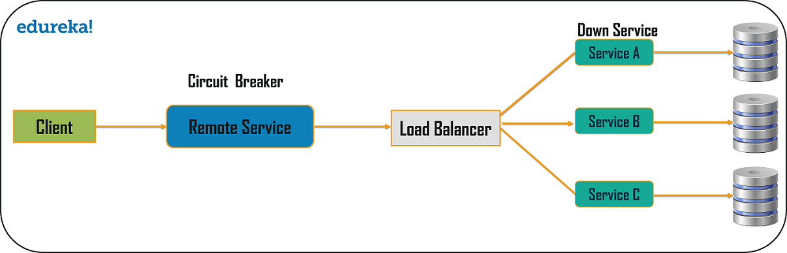

Slide 38
Decomposition Design Pattern
Microservices are developed with an idea on developers mind to create small services, with each having their own functionality. But, breaking an application into small autonomous units has to be done logically. So, to decompose a small or big application into small services, you can use the Decomposition patterns.
With the help of this pattern, either you can decompose an application based on business capability or on based on the sub-domains. For example, if you consider an e-commerce application, then you can have separate services for orders, payment, customers, products if you decompose by business capability.
But, in the same scenario, if you design the application by decomposing the sub-domains, then you can have services for each and every class. Here, in this example, if you consider the customer as a class, then this class will be used in customer management, customer support, etc.

Slide 39
But, in the same scenario, if you design the application by decomposing the sub-domains, then you can have services for each and every class. Here, in this example, if you consider the customer as a class, then this class will be used in customer management, customer support, etc.
So, to decompose, you can use the Domain-Driven Design through which the whole domain model is broken down into sub-domains. Then, each of these sub-domains will have their own specific model and scope(bounded context). Now, when a developer designs microservices, he/she will design those services around the scope or bounded context.
Though these patterns may sound feasible to you, they are not feasible for big monolithic applications. This is because of the fact that identifying sub-domains and business capabilities is not an easy task for big applications. So, the only way to decompose big monolithic applications is by following the Vine Pattern or the Strangler Pattern.

Slide 40
Strangler Pattern or Vine Pattern
The Strangler Pattern or the Vine Pattern is based on the analogy to a vine which basically strangles a tree that it is wrapped around. So, when this pattern is applied on the web applications, a call goes back and forth for each URI call and the services are broken down into different domains. These domains will be hosted as separate services.
According to the strangler pattern, two separate applications will live side by side in the same URI space, and one domain will be taken in to account at an instance of time. So, eventually, the new refactored application wraps around or strangles or replaces the original application until you can shut down the monolithic application.

Slide 41
Microservices testing tools
Testing microservices gets messy as services are independent and communicate often. Here are tests necessary for microservices, and popular tools developers use to perform them.
The six essential microservices tests
There are six main types of microservices tests that software teams should focus on to ensure that they can avoid problems with functionality and communication:
Unit test. Looks at the smallest piece of testable software code to ensure it behaves correctly.
Integration test. Verifies communication and interactions between components are accurate.
Component test. Tests microservices in isolation, with the use of mock doubles as needed, to verify they meet requirements.

Slide 42
Contract test. Vets the interactions at the boundary of an external service to ensure it meets the contract that is expected by the consuming service.
End-to-end test. Ensures all the components work together and they meet external requirements and achieve the intended functionality.
Performance test. Ensures that services and applications maintain high availability, viable resource consumption and distribute workloads appropriately.
Popular microservices testing tools
There are many tools available to track, monitor and remediate microservices operation and design as needed. Here are some microservices testing tools commonly used in the development industry.

Slide 43
Gatling. Gatling is a load testing tool written in Scala, which enables it to run simulations on multiple platforms. At the end of a simulation, Gatling automatically reports on metrics such as active user numbers and response times. It's typically used to test the performance of microservices and web applications.
Hoverfly. Hoverfly is an open source, automated API communication simulation tool that helps with integration testing. The user can test how APIs respond to specific events, such as latency in the network, and rate limits.
It also performs test calls between microservices by simulating communications, and then captures requests and responses in proxy mode to verify they work as expected.
Jaeger. Jaeger is an open source, end-to-end distributed tracing tool that monitors and troubleshoots microservices-based systems.

Slide 44
By tracking services across the software's operations environment, it can perform root-cause analysis, monitor key service dependencies and identify areas to optimize performance.
Pact. Pact is a contract testing tool that examines HTTP and message interactions to ensure applications are working in a consumer-driven contract manner. Essentially, the consuming services dictate how the providing services should provide them the data they need.
The providing service then continuously tests to ensure they stay in line with these contracts, thus providing an individualized testing method that should ideally cut down on large unit tests.

