Slide 1
Introduction to PL/SQL

Slide 2
Objectives
After completing this lesson, you should be able to do the following:
  Explain the need for PL/SQL
  Explain the benefits of PL/SQL
  Identify the different types of PL/SQL blocks
  Use iSQL*Plus as a development environment for PL/SQL
  Output messages in PL/SQL
Notes:
Lesson Aim
This lesson introduces PL/SQL and PL/SQL programming constructs. You learn about the benefits of PL/SQL. You also learn to use iSQL*Plus as a development environment for PL/SQL.

Slide 3





What Is PL/SQL?
PL/SQL:
  Stands for Procedural Language extension to SQL
  Is Oracle Corporation’s standard data access language for relational databases
  Seamlessly integrates procedural constructs with SQL
Notes:
What Is PL/SQL?
Structured Query Language (SQL) is the primary language used to access and modify data in relational databases. There are only a few SQL commands, so you can easily learn and use them. Consider an example:
SELECT first_name, department_id, salary FROM employees;
The SQL statement shown above is simple and straightforward. However, if you want to alter any data that is retrieved in a conditional manner, you soon encounter the limitations of SQL.
Consider a slightly modified problem statement: For every employee retrieved, check the department_id and the salary. Depending on the department’s performance and also the employee’s salary, you may want to provide varying bonuses to the employees.
Looking at the problem, you know that you have to execute the preceding SQL statement, collect the data, and apply logic to the data. One solution is to write a SQL statement for each department to give bonuses to the employees in that department. Remember that you also have to check the salary component before deciding the bonus amount. This makes it a little complicated. You now feel that it would be much easier if you had conditional statements. PL/SQL is designed to meet such requirements. It provides a programming extension to already-existing SQL.

Slide 4
About PL/SQL
PL/SQL:
  Provides a block structure for executable units of code. Maintenance of code is made easier with such a well-defined structure.
  Provides procedural constructs such as:
    Variables, constants, and types
    Control structures such as conditional statements and loops
    Reusable program units that are written once and executed many times
Notes:
About PL/SQL
PL/SQL defines a block structure for writing code. Maintaining and debugging the code is made easier with such a structure. One can easily understand the flow and execution of the program unit.
PL/SQL offers modern software engineering features such as data encapsulation, exception handling, information hiding, and object orientation. It brings state-of-the-art programming to the Oracle server and toolset. PL/SQL provides all the procedural constructs that are available in any third-generation language (3GL).

Slide 5

PL/SQL Environment
PL/SQL engine
procedural
Procedural
Statement
Executor
PL/SQL
Block
SQL
SQL Statement
Executor
Oracle Database Server
Notes:
PL/SQL Environment
The slide shows the PL/SQL execution environment in the Oracle database server. A PL/SQL block contains procedural statements and SQL statements. When you submit the PL/SQL block to the server, the PL/SQL engine first parses the block. The PL/SQL engine identifies the procedural statements and SQL statements. It passes the procedural statements to the procedural statement executor and passes the SQL statements to the SQL statement executor individually.
The diagram in the slide shows the PL/SQL engine within the database server. The Oracle application development tools can also contain a PL/SQL engine. The tool passes the blocks to its local PL/SQL engine. Therefore, all procedural statements are executed locally and only the SQL statements are executed in the database. The engine used depends on where the PL/SQL block is being invoked from.

Slide 6


Benefits of PL/SQL
  Integration of procedural constructs with SQL
  Improved performance
SQL 1
SQL 2
…
SQL
IF...THEN
SQL
ELSE
SQL
END IF;
SQL
Notes:
Benefits of PL/SQL
Integration of procedural constructs with SQL: The most important advantage of PL/SQL is the integration of procedural constructs with SQL. SQL is a nonprocedural language. When you issue a SQL command, your command tells the database server what to do. However, you cannot specify how to do it. PL/SQL integrates control statements and conditional statements with SQL, giving you better control of your SQL statements and their execution. Earlier in this lesson, you saw an example of the need for such integration.
Improved performance: Without PL/SQL, you would not be able to logically combine SQL statements as one unit. If you have designed an application containing forms, you may have many different forms with fields in each form. When a form submits the data, you may have to execute a number of SQL statements. SQL statements are sent to the database one at a time. This results in many network trips and one call to the database for each SQL statement, thereby increasing network traffic and reducing performance (especially in a client/server model).
With PL/SQL, you can combine all these SQL statements into a single program unit. The application can send the entire block to the database instead of sending the SQL statements one at a time. This significantly reduces the number of database calls. As the slide illustrates, if the application is SQL intensive, you can use PL/SQL blocks to group SQL statements before sending them to the Oracle database server for execution.

Slide 7
Benefits of PL/SQL
  Modularized program development
  Integration with Oracle tools
  Portability
  Exception handling
Notes:
Benefits of PL/SQL (continued)
Modularized program development: A basic unit in all PL/SQL programs is the block. Blocks can be in a sequence or they can be nested in other blocks. Modularized program development has the following advantages:
You can group logically related statements within blocks.
You can nest blocks inside larger blocks to build powerful programs.
You can break your application into smaller modules. If you are designing a complex application, PL/SQL allows you to break down the application into smaller, manageable, and logically related modules.
You can easily maintain and debug the code.
Integration with tools: The PL/SQL engine is integrated in Oracle tools such as Oracle Forms, Oracle Reports, and so on. When you use these tools, the locally available PL/SQL engine processes the procedural statements; only the SQL statements are passed to the database.

Slide 8

PL/SQL Block Structure
  DECLARE (optional)
    Variables, cursors, user-defined exceptions
  BEGIN (mandatory)
    SQL statements
    PL/SQL statements
  EXCEPTION (optional)
    Actions to perform
    when errors occur
  END; (mandatory)
Notes:
PL/SQL Block Structure
The slide shows a basic PL/SQL block. A PL/SQL block consists of three sections:
Declarative (optional): The declarative section begins with the keyword DECLARE and ends when the executable section starts.
Executable (required): The executable section begins with the keyword BEGIN and ends with END. Observe that END is terminated with a semicolon. The executable section of a PL/SQL block can in turn include any number of PL/SQL blocks.
Exception handling (optional): The exception section is nested within the executable section. This section begins with the keyword EXCEPTION.

Slide 9
Block Types
Anonymous Procedure Function
[DECLARE]
BEGIN
--statements
[EXCEPTION]
END;
PROCEDURE name
IS
BEGIN
--statements
[EXCEPTION]
END;
FUNCTION name
RETURN datatype
IS
BEGIN
--statements
RETURN value;
[EXCEPTION]
END;
Notes:
Block Types
A PL/SQL program comprises one or more blocks. These blocks can be entirely separate or nested within another block. There are three types of blocks that make up a PL/SQL program. They are:
Anonymous blocks
Procedures
Functions
Anonymous blocks: Anonymous blocks are unnamed blocks. They are declared inline at the point in an application where they are to be executed and are compiled each time the application is executed. These blocks are not stored in the database. They are passed to the PL/SQL engine for execution at run time. Triggers in Oracle Developer components consist of such blocks. These anonymous blocks get executed at run time because they are inline. If you want to execute the same block again, you have to rewrite the block. You are unable to invoke or call the block that you wrote earlier because blocks are anonymous and do not exist after they are executed.

Slide 10
Program Constructs
Tools Constructs
Database Server
Constructs
Anonymous blocks
Anonymous blocks
Application procedures
or functions
Stored procedures or
functions
Application packages
Stored packages
Application triggers
Database triggers
Object types
Object types
Notes:
Program Constructs
The following table outlines a variety of different PL/SQL program constructs that use the basic PL/SQL block. The program constructs are available based on the environment in which they are executed.

Slide 11
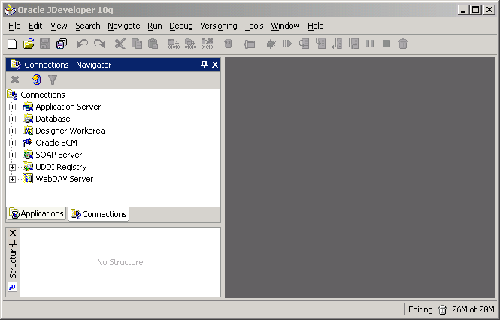
PL/SQL Programming Environments
Notes:
PL/SQL Programming Environments
Oracle JDeveloper 10g: An integrated development environment (IDE) that provides end-to-end support for building, testing, and deploying J2EE applications, Web services, and PL/SQL
You can use Oracle JDeveloper 10g to do the following:
Establish connection to the database with a user-friendly wizard
Browse through the objects in the database you are connected to
Create database users and objects
Create, run, and debug PL/SQL programs such as procedures, functions, and packages
Note: Oracle JDeveloper 10g and iSQL*Plus can both be used as programming environments. However, this course uses iSQL*Plus for all demonstrations and practices.

Slide 12
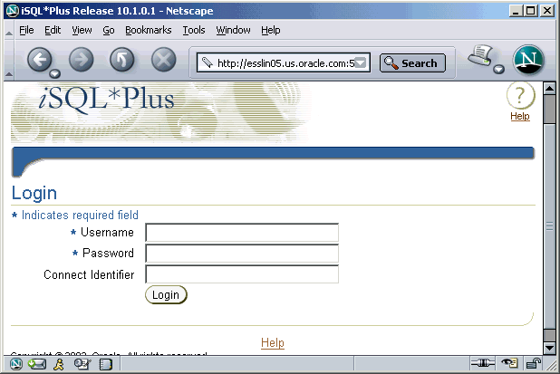
PL/SQL Programming Environments
iSQL*Plus
Notes:
PL/SQL Programming Environments (continued)
iSQL*Plus: A browser-based interface to SQL*Plus. You can connect to the local database or remote database by using iSQL*Plus. It enables you to perform all the operations that you can perform with the command-line version of SQL*Plus.

Slide 13
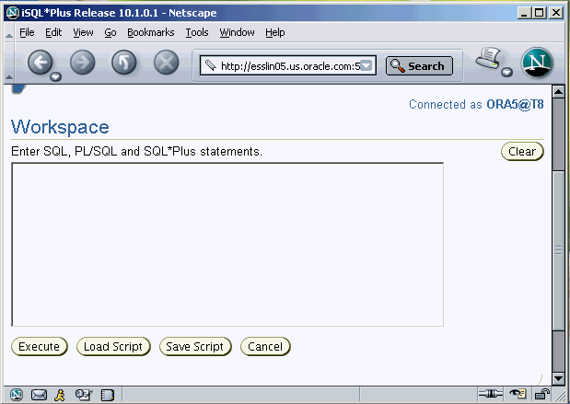
PL/SQL Programming Environments
Notes:
PL/SQL Programming Environments (continued)
When you log in to iSQL*Plus, you see the screen shown in the slide. Note that you have a workspace to enter SQL, PL/SQL, and SQL*Plus statements. Click the Execute button to execute your statements in the workspace. Click the Save Script button when you want to save all the commands in the workspace in a script file. You can save the script as a *.sql file. If you want to execute any script file, click the Load Script button and browse to select the script file. All the statements in the script file are loaded to the workspace and you can click the Execute button to execute the statements. The Clear button is used to clear the workspace.

Slide 14
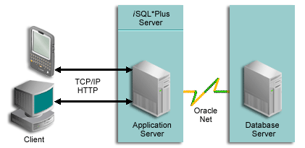
iSQL*Plus Architecture
Notes:
iSQL*Plus Architecture
iSQL*Plus uses a three-tier model as shown in the slide. The three tiers in the architecture are:
Client tier: The client is a typical HTTP client. Any browser connected to the intranet or Internet can access the iSQL*Plus user interface.
Middle tier: The application server forms the middle tier in the iSQL*Plus architecture. The application server is installed when the database is installed. The iSQL*Plus server must be installed on the same machine as the application server. The middle tier is a Java2 Enterprise Edition (J2EE)–compliant application server. The application server enables communication between iSQL*Plus and the database. The three tiers in the architecture need not be on the same machine. However, the HTTP Server and iSQL*Plus Server should be on the same machine. iSQL*Plus manages a unique identity for each session. The advantage of this is that many concurrent users can use iSQL*Plus to access the database.
Database tier: The database tier has the database server. The Oracle Net components enable communication between the iSQL*Plus Server and the database.

Slide 15
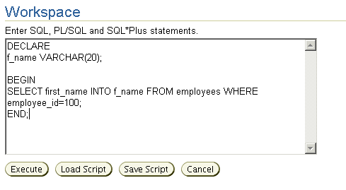
Create an Anonymous Block
Type the anonymous block in the iSQL*Plus workspace:
Notes:
Create an Anonymous Block
To create an anonymous block using iSQL*Plus, enter the block in the workspace (as shown in the slide). The block has the declarative section and the executable section. You need not pay attention to the syntax of statements in the block; you learn the syntax later in the course. The anonymous block gets the first_name of the employee whose employee_id is 100 and stores it in a variable called f_name.

Slide 16
Execute an Anonymous Block
Click the Execute button to execute the anonymous block:
PL\SQL procedure successfully completed.
Notes:
Execute an Anonymous Block
Click the Execute button to execute the anonymous block in the workspace. Note that the message “PL\SQL procedure successfully completed” is displayed after the block is executed.

Slide 17
Test the Output of a PL/SQL Block
  Enable output in iSQL*Plus with the following command:
  SET SERVEROUTPUT ON
  Use a predefined Oracle package and its procedure:
    DBMS_OUTPUT.PUT_LINE
SET SERVEROUTPUT ON
…
DBMS_OUTPUT.PUT_LINE(' The First Name of the Employee is ' || f_name);
…
Notes:
Test the Output of a PL/SQL Block
In the example shown in the previous slide, we have stored a value in the variable f_name. However, we have not printed the value. You now learn how to print the value.
PL/SQL does not have built-in input or output functionality. Therefore, we use predefined Oracle packages for input and output. To generate output, you must:
Enable output in iSQL*Plus by using the SET SERVEROUTPUT ON command. SET SERVEROUTPUT ON is a SQL*Plus command that is also supported by iSQL*Plus.
Use the procedure PUT_LINE of the package DBMS_OUTPUT to display the output. Pass the value that has to be printed as argument to this procedure (as shown in the slide). The procedure then outputs the arguments.

Slide 18
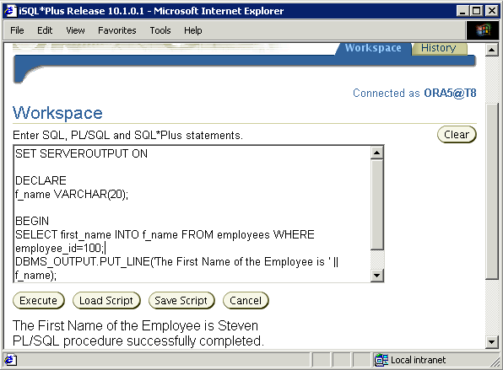
Test the Output of a PL/SQL Block
Notes:
Test the Output of a PL/SQL Block (continued)
The slide shows the output of the PL/SQL block after the inclusion of the code for generating output.

Slide 19
Summary
In this lesson, you should have learned how to:
  Integrate SQL statements with PL/SQL program constructs
  Identify the benefits of PL/SQL
  Differentiate different PL/SQL block types
  Use iSQL*Plus as the programming environment for PL/SQL
  Output messages in PL/SQL
Notes:
Summary
PL/SQL is a language that has programming features that serve as an extension to SQL. SQL, which is a nonprocedural language, is made procedural with PL/SQL programming constructs. PL/SQL applications can run on any platform or operating system on which an Oracle server runs. In this lesson, you learned how to build basic PL/SQL blocks.

Slide 20
Practice 1: Overview
This practice covers the following topics:
  Identifying which PL/SQL blocks execute successfully
  Creating and executing a simple PL/SQL block
Notes:
Practice 1: Overview
This practice reinforces the basics of PL/SQL covered in this lesson.
Exercise 1 is a paper-based exercise in which you identify PL/SQL blocks that execute successfully.
Exercise 2 involves creating and executing a simple PL/SQL block.

