Slide 1
REACT

Slide 2
Single Page Application
Single page application (SPA) is a single page (hence the name) where a lot of information stays the same and only a few pieces need to be updated at a time.
The SPA only sends what you need with each click, and your browser renders that information. This is different to a traditional page load where the server re-renders a full page with every click you make and sends it to your browser.
This piece by piece, client side method makes load time must faster for users and makes the amount of information a server has to send a lot less and a lot more cost efficient

Slide 3
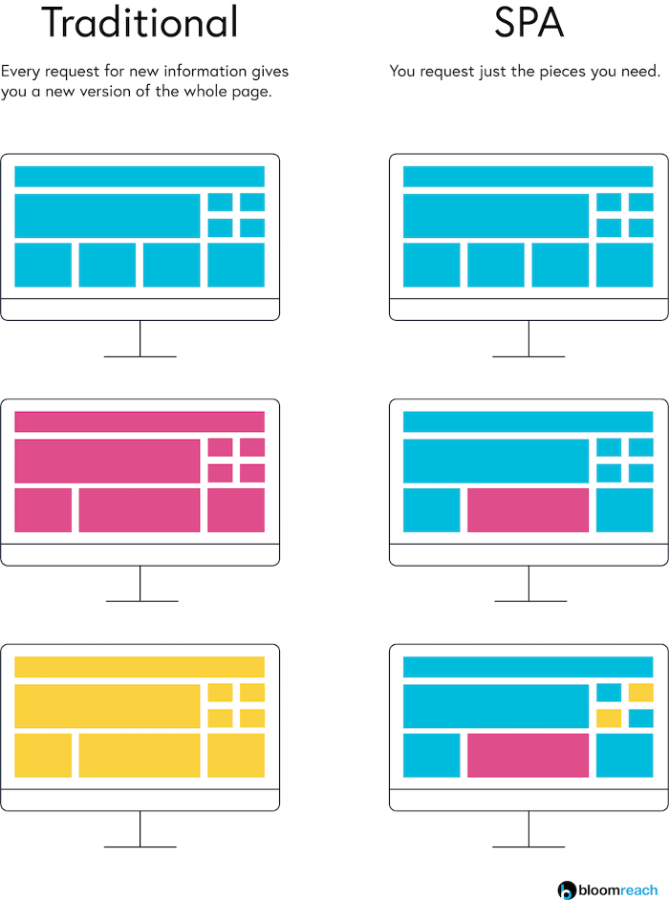
Difference between SPA MPA

Slide 4
Single Page Applications Advantages
There are many benefits to SPA solutions such as improved application performance and consistency, and reduced development time and infrastructure costs.
By separating the presentation from the content and data, development teams can work at different speeds while still being integrated for the overall solution. SPA is good for making responsive design for mobile, desktop and tablet.

Slide 5
Single Time File Load Each of HTML, CSS, JS.Single Page Application, after the initial page load, the server doesn’t send any more HTML to you - you download it all right at the beginning.
Fast and Responsive Front-end Built
SPAs also let developers build the front-end a lot faster. This is due to the decoupled architecture of SPAs, or a separation of back-end services and front-end display.
By decoupling that back-end logic & data from how it’s presented you turn it into a “service”, and developers can build many different front-end ways to show and use that service.

Slide 6
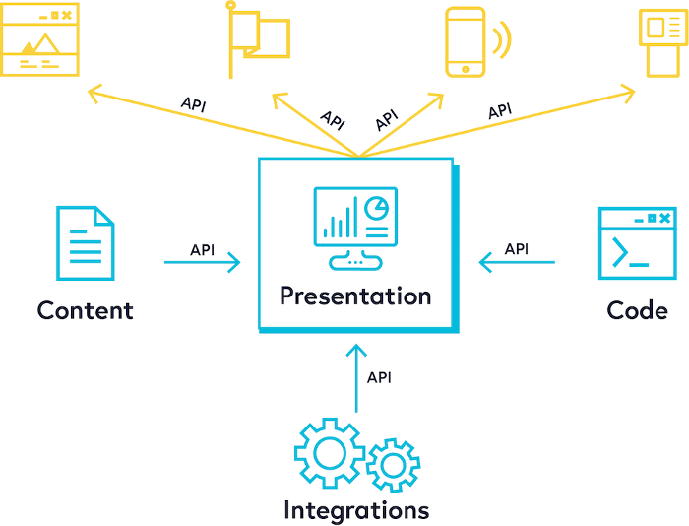

Slide 7
They design how they want the user experience to look and feel, and then pull in the content, data, and functionality through those services. This is done using APIs, which are a standard set of rules between applications on how they will structure, exchange, and reassemble data.
Angular and React (and many others such as Ember and Vue) are frameworks that developers use to create SPAs efficiently and eloquently. Simply put, these frameworks are a collection of reusable components, that many developers have contributed to, that follow a defined set of building rules.

Slide 8
React
React is a JavaScript library created by Facebook for building user interfaces.
React is used to build single page applications.
React allows us to create reusable UI components.
How React Works?
React creates a VIRTUAL DOM in memory.
Instead of manipulating the browser's DOM directly, React creates a virtual DOM in memory, where it does all the necessary manipulating, before making the changes in the browser DOM.
React only changes what needs to be changed!

Slide 9

React Features

Slide 10
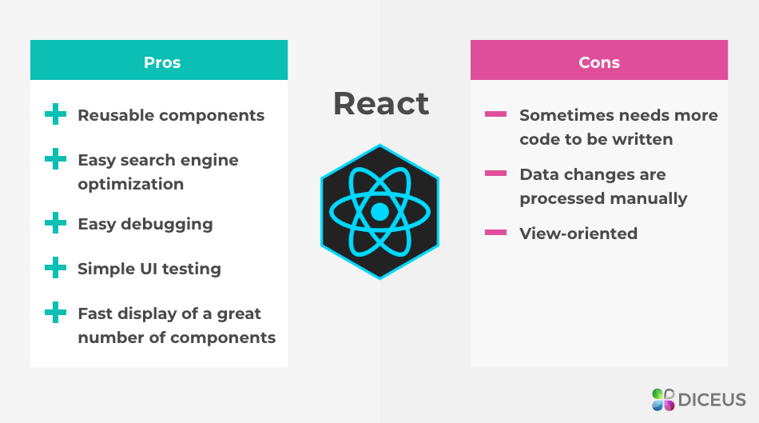
React Pros and Cons

Slide 11
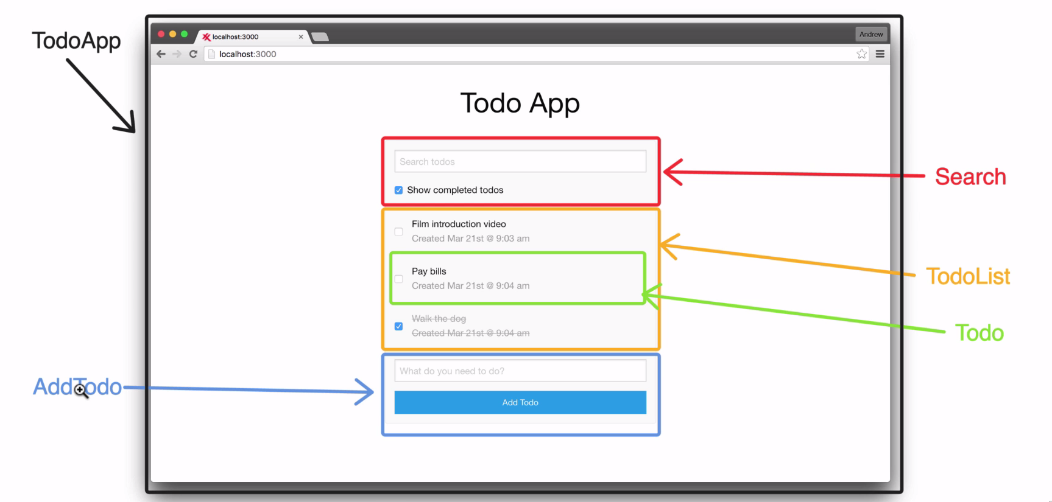

Slide 12
NPM
npm is the world's largest Software Library (Registry)
npm is also a software Package Manager and Installer
The registry contains over 800,000 code packages.
Open-source developers use npm to share software.
Many organizations also use npm to manage private development.
npm is installed with Node.js
This means that you have to install Node.js to get npm installed on your computer.
npm can manage dependencies.
npm can (in one command line) install all the dependencies of a project.
Dependencies are also defined in package.json.

Slide 13
Nodejs
Node.js is an open source server environment.
Node.js allows you to run JavaScript on the server.
Node.js runs on various platforms (Windows, Linux, Unix, Mac OS X, etc.)
NPM is a package manager for Node.js packages, or modules if you like.
A package in Node.js contains all the files you need for a module.
Modules are JavaScript libraries you can include in your project.

Slide 14
React environment setup
The create-react-app is used to create React applications.
npm install –g create-react-app
Npx create-react-app myfirstreact
The create-react-app will set up everything to run the React application.
npm start to run the application in the browser

Slide 15
React files
index.js
index.js typically handles your app startup, routing and other functions of your application and does require other modules to add functionality.
App.js
This is the file for App Component. App Component is the main component in React which acts as a container for all other components. src/App.css : This is the CSS file corresponding to App Component.

Slide 16
React Components
Components are independent and reusable bits of code. They serve the same purpose as JavaScript functions, but work in isolation and return HTML via a render() function.
Components come in two types, Class components and Function components
The component has to include the extends React.Component statement, this statement creates an inheritance to React.Component, and gives your component access to React.Component's functions.

Slide 17
React JSX
What is JSX?
JSX stands for JavaScript XML.
JSX is a syntax extension to JavaScript.
JSX allows us to write HTML in React.
JSX makes it easier to write and add HTML in React.
JSX allows us to write HTML elements in JavaScript and place them in the DOM without any createElement() or appendChild() methods.
JSX produces React “elements”.
You can put any valid JavaScript expression inside the curly braces in JSX.

Slide 18
JSX Represents Objects
Const element=(<h1 className=“greeting”>Hello world</h1>);
Const element=React.createElement(‘h1’,
{ className:“greeting”>}, ‘Hello World’
);
Const element={
Type:’h1’,
Props:{className:’greeting’,
Children:’Hello world’}
};

Slide 19
These objects are called “React elements”. You can think of them as descriptions of what you want to see on the screen. React reads these objects and uses them to construct the DOM and keep it up to date.

Slide 20
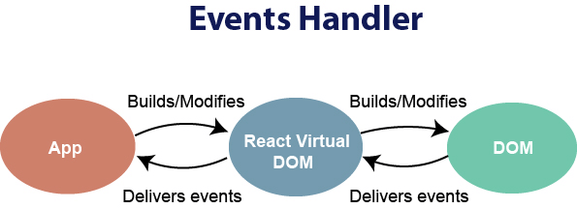
React Events

Slide 21
React has its own event handling system which is very similar to handling events on DOM elements. The react event handling system is known as Synthetic Events. The synthetic event is a cross-browser wrapper of the browser's native event.
React events are named as camelCase instead of lowercase.
With JSX, a function is passed as the event handler instead of a string. For example:
Event declaration in plain HTML:
<button onclick="showMessage()">
Hello JavaTpoint
</button>
Event declaration in React:
<button onClick={showMessage}>
Hello JavaTpoint
</button>
3. In react, we cannot return false to prevent the default behavior. We must call preventDefault event explicitly to prevent the default behavior.

Slide 22
In plain HTML, to prevent the default link behavior of opening a new page, we can write:
<a href="#" onclick="console.log('You had clicked a Link.'); return false">
Click_Me
</a>
In React, we can write it as:
function ActionLink() {
function handleClick(e) {
e.preventDefault();
console.log('You had clicked a Link.');
}
return (
<a href="#" onClick={handleClick}>
Click_Me
</a> ); } -e - SyntheticEvent

Slide 23
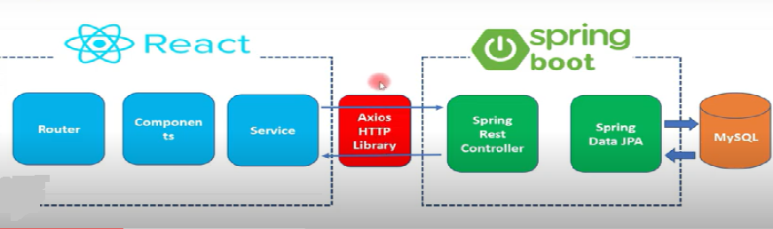
React – Spring Boot

