Slide 1
Spring Introduction

Slide 2
What is Spring?
Spring is an open source framework created to address the complexity of enterprise application development.
It was developed by Rod Johnson in 2003. Spring framework makes the easy development of Java EE application.
One of the chief advantages of the Spring framework is its layered architecture.
It allows you to be selective about which of its components you use while also providing a cohesive framework for J2EE application development.

Slide 3
Features of Spring
Lightweight
Spring is a lightweight framework. It can be thought of as a framework of frameworks because it provides support to various frameworks such as Struts, Hibernate, EJB, JSF etc. It is lightweight when it comes to size and transparency.
Spring framework is lightweight because of its POJO implementation. The Spring Framework doesn't force the programmer to inherit any class or implement any interface. That is why it is said non-invasive.

Slide 4
Predefined Templates
Spring framework provides templates for JDBC, Hibernate, JPA technologies. So there is no need to write too much code. It hides the basic steps of these technologies.
Loose Coupling
The Spring applications are loosely coupled because of dependency injection.
Easy to test
The Dependency Injection makes easier to test the application. The EJB or Struts application require server to run the application but Spring framework doesn't require server.

Slide 5
Aspect oriented (AOP):
Spring supports Aspect oriented programming and enables cohesive development by separating application business logic from system services.
Container:
Spring container manages the life cycle and configuration of application objects.

Slide 6
MVC Framework:
Spring comes with MVC web application framework, built on core Spring functionality. This framework accommodates multiple view technologies like JSP, Velocity, Tiles etc.
Transaction Management:
Spring framework provides a generic abstraction layer for transaction management. Spring's transaction support is not tied to J2EE environments and it can be also used in container less environments.

Slide 7
JDBC Exception Handling:
The JDBC abstraction layer of the Spring offers a meaningful exception hierarchy, which simplifies the error handling strategy. Spring provides best Integration services with Hibernate, JDO and iBATIS.
Fast Development
The Dependency Injection feature of Spring Framework and its support to various frameworks makes the easy development of Java EE application.

Slide 8
Spring Modules
The Spring framework comprises of many modules such as core, beans, context, expression language, AOP, Aspects, Instrumentation, JDBC, ORM, OXM, JMS, Transaction, Web, Servlet, Struts etc. These modules are grouped into Test, Core Container, AOP, Aspects, Instrumentation, Data Access / Integration, Web MVC etc.

Slide 9
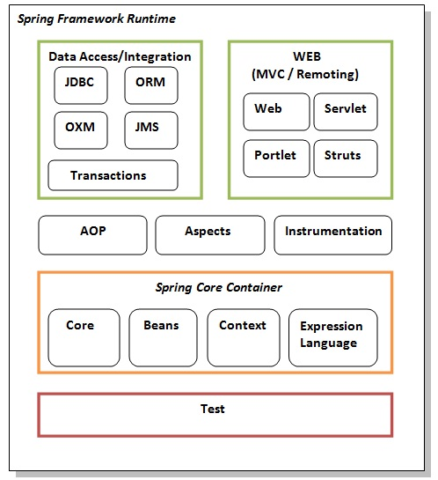

Slide 10
The core container:
The core container provides the essential functionality of the Spring framework. A primary component of the core container is the BeanFactory, an implementation of the Factory pattern.
Spring context:
The Spring context is a configuration file that provides context information to the Spring framework. The Spring context includes enterprise services such as JNDI, EJB, e-mail, internalization, validation, and scheduling functionality.

Slide 11
Spring AOP:
The Spring AOP module integrates aspect-oriented programming functionality directly into the Spring framework, through its configuration management feature. The Spring AOP module provides transaction management services for objects in any Spring-based application.
Spring DAO:
The Spring JDBC DAO abstraction layer offers a meaningful exception hierarchy for managing the

Slide 12
exception handling and error messages thrown by different database vendors. The exception hierarchy simplifies error handling and greatly reduces the amount of exception code you need to write, such as opening and closing connections.
Spring ORM:
The Spring framework plugs into several ORM frameworks to provide its Object Relational tool, including JDO, Hibernate, and iBatis SQL Maps.

Slide 13
Spring Web module:
The Web context module builds on top of the application
context module, providing contexts for Web-based applications. As a result, the Spring framework supports integration with Jakarta Struts.
Spring MVC framework:
The Model-View-Controller (MVC) framework is a full-featured MVC implementation for building Web applications. The MVC framework accommodates numerous view technologies including JSP, Velocity, Tiles.

Slide 14
Spring First example:
SpringHelloWorld.java
package com.sample; public class SpringHelloWorld { public void sayHello(){ System.out.println("Hello Spring World"); }}
SpringHelloWorld.xml
<?xml version="1.0" encoding="UTF-8"?> <beans xmlns="http://www.springframework.org/schema/beans" xmlns:xsi="http://www.w3.org/2001/XMLSchema-instance" xsi:schemaLocation="http://www.springframework.org/schema/beans http://www.springframework.org/schema/beans/spring-beans-3.0.xsd"> <bean id="SpringHelloWorldBean" class=“com.sample.SpringHelloWorld" /> </beans>

Slide 15
package com.client; import org.springframework.context.ApplicationContext;
import org.springframework.context.support.ClassPathXmlApplicationContext; public class SpringHelloWorldClient { public static void main(String[] args) { ApplicationContext context = new ClassPathXmlApplicationContext("Beans.xml"); SpringHelloWorld myBean = (SpringHelloWorld) context .getBean("SpringHelloWorldBean"); myBean.sayHello(); } }

Slide 16
IoC Container
The IoC container is responsible to instantiate, configure and assemble the objects. The IoC container gets information from the XML file and works accordingly. The main tasks performed by IoC container are:
to instantiate the application class
to configure the object
to assemble the dependencies between the objects
There are two types of IoC containers. They are:
BeanFactory
ApplicationContext

Slide 17
Difference between BeanFactory and the ApplicationContext
The org.springframework.beans.factory.BeanFactory and the org.springframework.context.ApplicationContext interfaces acts as the IoC container. The ApplicationContext interface is built on top of the BeanFactory interface. It adds some extra functionality than BeanFactory such as simple integration with Spring's AOP, message resource handling (for I18N), event propagation, application layer specific context (e.g. WebApplicationContext) for web application. So it is better to use ApplicationContext than BeanFactory.

Slide 18
Using BeanFactory
The XmlBeanFactory is the implementation class for the BeanFactory interface. To use the BeanFactory, we need to create the instance of XmlBeanFactory class as given below:
Resource resource=new ClassPathResource("applicationContext.xml");
BeanFactory factory=new XmlBeanFactory(resource);
The constructor of XmlBeanFactory class receives the Resource object so we need to pass the resource object to create the object of BeanFactory.

Slide 19
Using ApplicationContext
The ClassPathXmlApplicationContext class is the implementation class of ApplicationContext interface. We need to instantiate the ClassPathXmlApplicationContext class to use the ApplicationContext as given below:
ApplicationContext context =
new ClassPathXmlApplicationContext("applicationContext.xml");
The constructor of ClassPathXmlApplicationContext class receives string, so we can pass the name of the xml file to create the instance of ApplicationContext.

Slide 20

Spring Beans
They are the objects that form the backbone of the user’s application.
Beans are managed by the Spring IoC container.
They are instantiated, configured, wired and managed by a Spring IoC container.
Beans are created with the configuration metadata that the users supply to the container.

Slide 21
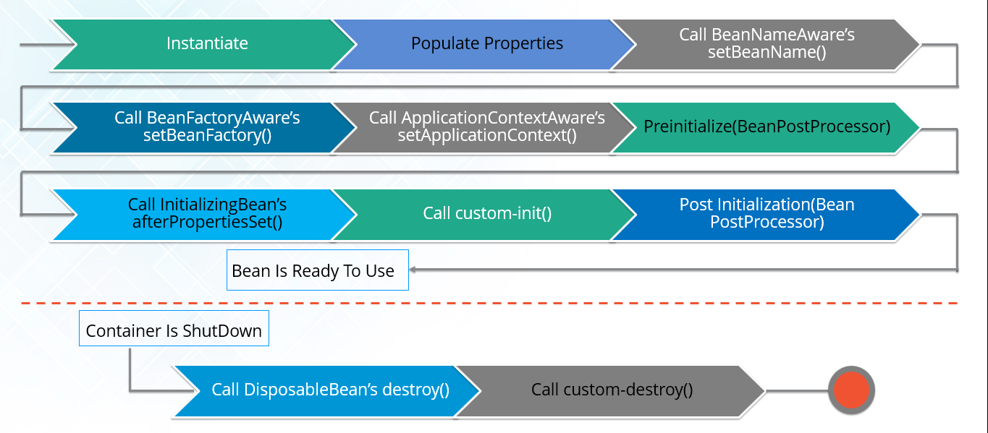
Bean Life Cycle

Slide 22
Aware Interfaces
Spring provides several aware interfaces. These are used to access the Spring Framework infrastructure. The aware interfaces are largely used within the framework.
BeanFactoryAware: Provides setBeanFactory(), a callback that supplies the owning factory to the bean instance.
BeanNameAware: ThesetBeanName() callback of this interface supplies the name of the bean.
ApplicationContextAware: ThesetApplicationContext() method of this interface provides the ApplicationContext object of this bean.

Slide 23
Bean Post Processor
Spring provides the BeanPostProcessor interface that gives you the means to tap into the Spring context lifecycle and interact with beans as they are processed.
postProcessBeforeInitialization: Spring calls this method after calling the methods of the aware interfaces and before any bean initialization callbacks, such as InitializingBean’s afterPropertiesSet or a custom init-method.
postProcessAfterInitialization: Spring calls this method after any bean initialization callbacks.

Slide 24
InitializingBean and DisposableBean
InitializingBean: Declares the afterPropertiesSet() method which can be used to write the initialization logic. The container calls the method after properties are set.
DisposableBean: Declares the destroy() method which can be used to write any clean up code. The container calls this method during bean destruction in shutdown.

Slide 25
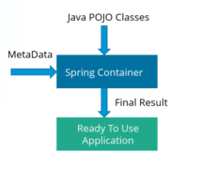
Spring IOC Container
At the core of the Spring Framework, lies the Spring container. The container creates the object, wires them together, configures them and manages their complete life cycle.

Slide 26
The Spring container makes use of Dependency Injection to manage the components that make up an application. The container receives instructions for which objects to instantiate, configure, and assemble by reading the configuration metadata provided. This metadata can be provided either by XML, Java annotations or Java code.

Slide 27

Dependency Injection in Spring
DI is a design pattern that removes the dependency from the code. That is, the Spring Framework provides the dependencies of the class itself so that it can be easy to manage and test the application.

Slide 28
In Dependency Injection, you do not have to create your objects but have to describe how they should be created. You don’t connect your components and services together in the code directly, but describe which services are needed by which components in the configuration file. The IoC container will wire them up together.

Slide 29
Dependency Injection and IOC
Dependency injection is a pattern through which to implement IoC, where the control being inverted is the setting of object’s dependencies.
Inversion of Control is a principle in software engineering by which the control of objects or portions of a program is transferred to a container or framework. Inversion of Control can be achieved through various mechanisms such as: Strategy design pattern, Service Locator pattern, Factory pattern, and Dependency Injection.

Slide 30
Types of Dependency Injection
In Spring, dependencies can be injected in two ways:
By constructor
By setter method
By Constructor
The <constructor-arg> subelement of <bean> is used for constructor injection. e.g:
<constructor-arg value=“10” type=“int”/>
By default when the Spring container loads the bean, it instantiates the bean with the default constructor. But you can also define a constructor argument in bean definition, using an argument constructor.

Slide 31
By setter method
The <property> subelement of <bean> is used for setter injection. e.g:
<property name=“id” value=“101”/>
Setter-based Dependency Injection is accomplished by the container calling setter methods on your beans after invoking a no-argument constructor.

Slide 32
Traditional Approach of Dependency
QuizMaster.java
package com.ioc;
public interface QuizMaster {
public String popQuestion();
}
StrutsQuizMaster.java
package com.ioc;
public class StrutsQuizMaster implements QuizMaster {
public String popQuestion() {
return "Are you new to Struts?";
}}

Slide 33
SpringQuizMaster.java
package com.ioc;
public class SpringQuizMaster implements QuizMaster {
public String popQuestion() {
return "Are you new to Spring?";
}}
QuizMasterService.java
package com.ioc;
public class QuizMasterService {
private QuizMaster quizMaster = new SpringQuizMaster();
public void askQuestion()
{
System.out.println(quizMaster.popQuestion());
} }

Slide 34
QuizProgram.java
package com.ioc;
public class QuizProgram {
public static void main(String[] args) {
QuizMasterService quizMasterService = new QuizMasterService();
quizMasterService.askQuestion();
}
}

Slide 35
Dependency in IOC
QuizMasterService.java
package com.ioc;
public class QuizMasterService {
private QuizMaster quizMaster;
public void setQuizMaster(QuizMaster quizMaster) {
this.quizMaster = quizMaster;
}
public void askQuestion()
{
System.out.println(quizMaster.popQuestion());
}
}

Slide 36
xml would be,
<bean id="springQuizMaster" class="com.ioc.SpringQuizMaster"></bean>
<bean id="strutsQuizMaster" class="com.ioc.StrutsQuizMaster"></bean>
<bean id="quizMasterService" class="com.ioc.QuizMasterService">
<property name="quizMaster">
<ref local="springQuizMaster"/>
</property>
</bean>
</beans>

Slide 37
Benefits of IOC
Minimizes the amount of code in your application. With IOC containers you do not care about how services are created and how you get references to the ones you need.
Make your application more testable by not requiring any singletons or JNDI lookup mechanisms in your unit test cases. IOC containers make unit testing and switching implementations very easy by manually allowing you to inject your own objects into the object under test.

Slide 38
Loose coupling is promoted with minimal effort and least intrusive mechanism.
In IOC the dependency is injected into requesting piece of code.
IOC containers support eager instantiation and lazy loading of services. Containers also provide support for instantiation of managed objects, life cycles management, and dependency resolution between managed objects etc.

Slide 39
Spring Autowiring
We declare beans using the <bean> element and inject <bean> using <constructor-arg> and <property> elements in XML configuration file.
The Spring container can autowire relationships between collaborating beans without using <constructor-arg> and <property> elements, which helps cut down on the amount of XML configuration you write for a big Spring-based application.

Slide 40
Autowiring Modes
no - This is default setting which means no autowiring and you should use explicit bean reference for wiring. You have nothing to do special for this wiring.
byName - Autowiring by property name. Spring container looks at the properties of the beans on which autowire attribute is set to byName in the XML configuration file. It then tries to match and wire its properties with the beans defined by the same names in the configuration file.

Slide 41
byType - Autowiring by property datatype. Spring container looks at the properties of the beans on which autowire attribute is set to byType in the XML configuration file. It then tries to match and wire a property if its type matches with exactly one of the beans name in configuration file. If more than one such beans exists, a fatal exception is thrown.
constructor - Similar to byType, but type applies to constructor arguments.

Slide 42
If there is not exactly one bean of the constructor argument type in the container, a fatal error is raised.
Limitations with Autowiring
Overriding possibility
You can still specify dependencies using <constructor-arg> and <property> settings which will always override autowiring.
Primitive data types
You cannot autowire so-called simple properties such as primitives and Strings.

Slide 43
Java Based Configuration
Spring allows a developer to manage bean dependencies by using XML-based configuration.
There is an alternative way to define beans and their dependencies. This method is a Java-based configuration.
Unlike the XML approach, Java-based configuration allows you to manage bean components programmatically. That’s why Spring annotations were introduced.

Slide 44
Spring Annotations
@Configuration Used to indicate that a class declares one or more @Bean methods. These classes are processed by the Spring container to generate bean definitions and service requests for those beans at runtime.
@Bean: Indicates that a method produces a bean to be managed by the Spring container. This is one of the most used and important spring annotation. @Bean annotation also can be used with parameters like name, initMethod and destroyMethod.

Slide 45
name – allows you give name for bean
initMethod – allows you to choose method which will be invoked on context register
destroyMethod – allows you to choose method which will be invoked on context shutdown.
@PreDestroy and @PostConstruct are alternative way for bean initMethod and destroyMethod. It can be used when the bean class is defined by us.

Slide 46
@ComponentScan Configures component scanning directives for use with @Configuration classes. Here we can specify the base packages to scan for spring components.
@Component Indicates that an annotated class is a “component”. Such classes are considered as candidates for auto-detection when using annotation-based configuration and classpath scanning.

Slide 47
@Service Indicates that an annotated class is a “Service”. This annotation serves as a specialization of @Component, allowing for implementation classes to be autodetected through classpath scanning.
@Repository Indicates that an annotated class is a “Repository”. This annotation serves as a specialization of @Component and advisable to use with DAO classes.
@Autowired is used for automatic injection of beans.
@Qualifier annotation is used in conjunction with Autowired to avoid confusion when we have two of more bean configured for same type.

Slide 48
Spring i18n – ResourceBundleMessageSource
For an application to support internationalization (i18n), it requires the capability of resolving text messages for different locales.
Spring’s application context is able to resolve text messages for a target locale by their keys. Typically, the messages for one locale should be stored in separate properties file. This properties file is called a resource bundle.

Slide 49
MessageSource is an interface that defines several methods for resolving messages. The ApplicationContext interface extends this interface so that all application contexts are able to resolve text messages.
An application context delegates the message resolution to a bean with the exact name messageSource.
ResourceBundleMessageSource is the most common MessageSource implementation that resolves messages from resource bundles for different locales.

Slide 50
Spring AOP
Most of the enterprise applications have some common crosscutting concerns that are applicable to different types of Objects and modules. Some of the common crosscutting concerns are logging, transaction management, data validation, etc.
In Object Oriented Programming, modularity of application is achieved by classes whereas in Aspect Oriented Programming application modularity is achieved by Aspects and they are configured to cut across different classes.

Slide 51
AOP Core Concepts
Aspect: An aspect is a class that implements enterprise application concerns that cut across multiple classes, such as transaction management. Aspects can be a normal class configured through Spring XML configuration or we can use Spring AspectJ integration to define a class as Aspect using
@Aspect annotation.
JoinPoint A join point is a specific point in the application such as method execution, exception handling, changing object variable values, etc. In Spring AOP a join point is always represents a method execution.

Slide 52
Advice: Advices are actions taken for a particular join point. In terms of programming, they are methods that get executed when a certain join point with matching pointcut is reached in the application.
Pointcut is a predicate or expression that matches join points.
Spring uses the AspectJ pointcut expression language by default.

Slide 53
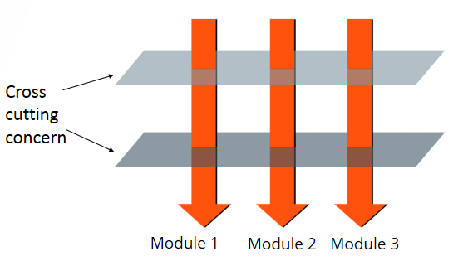
A cross-cutting concern is a concern that affects the whole application and is centralized in one location in code like transaction management, authentication, logging, security etc. Spring AOP hijacks the executing method, and adds extra functionality before or after the method execution.

Slide 54
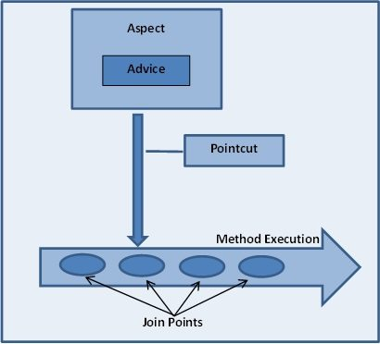

Slide 55
Types of AOP Advices
Before advice: Advice that executes before a join point, but which does not have the ability to prevent execution flow proceeding to the join point (unless it throws an exception).
After returning advice: Advice to be executed after a join point completes normally: for example, if a method returns without throwing an exception.
After throwing advice: Advice to be executed if a method exits by throwing an exception.

Slide 56
4. After advice: Advice to be executed regardless of the means by which a join point exits (normal or exceptional return).
5. Around advice: Advice that surrounds a join point such as a method invocation. This is the most powerful kind of advice. Around advice can perform custom behavior before and after the method invocation.

Slide 57
Spring JDBC
Spring framework provides excellent integration with JDBC API and provides JdbcTemplate utility class that we can use to avoid boiler-plate code from our database operations logic such opening/closing Connection, ResultSet, PreparedStatement etc.
All the classes in Spring JDBC are divided into four separate packages:
core — the core functionality of JDBC. Some of the important classes under this package

Slide 58
include JdbcTemplate, SimpleJdbcInsert, SimpleJdbcCall and NamedParameterJdbcTemplate.
datasource — utility classes to access a data source. It also has various data source implementations for testing
JDBC code outside the Jakarta EE container.
object — DB access in an object-oriented manner. It allows running queries and returning the results as a business object. It also maps the query results between the columns and properties of business objects.

Slide 59
support — support classes for classes under core and object packages, e.g., provides the SQLException translation functionality.
JdbcTemplate Class
The JDBC template is the main API through which we’ll access most of the functionality that we're interested in:
creation and closing of connections
running statements and stored procedure calls
iterating over the ResultSet and returning results

Slide 60
The JDBCTemplate class executes SQL queries, updates statements, stores procedure calls, performs iteration over ResultSets, and extracts returned parameter values.
It also catches JDBC exceptions and translates them to the generic, more informative, exception hierarchy defined in the org.springframework.dao package.
Instances of the JdbcTemplate class are threadsafe once configured. So you can configure a single instance of a JdbcTemplate and then safely inject this shared reference into multiple DAOs.

Slide 61
Executing SQL Statements
Querying for an Integer
String sql=select count(*) from person;
int rowCount=jdbcTemplate.queryForInt(sql);
A simple query using a bind variable
String sql=select age from person where id=?;
int age=jdbcTemplate.queryForInt(sql,new Object[]{10});
Querying for String
String sql=select name from person where id=?;

Slide 62
String name=jdbcTemplate.queryForInt(sql,new Object[]{10},String.class);
Inserting into database
String sql=insert into from person(name,age) values(?,?);
int age=jdbcTemplate.update(sql,new Object[]{“sai”,10});
SimpleJdbcClass
SimpleJdbc classes provide an easy way to configure and run SQL statements. These classes use database metadata to build basic queries. SimpleJdbcInsert and SimpleJdbcCall classes provide an

Slide 63
easier way to run insert and stored procedure calls.
public int addEmplyee(Employee emp)
{ Map<String, Object> parameters = new HashMap<String, Object>();
parameters.put("ID", emp.getId()); parameters.put("FIRST_NAME", emp.getFirstName()); parameters.put("LAST_NAME", emp.getLastName()); parameters.put("ADDRESS", emp.getAddress());
return simpleJdbcInsert.execute(parameters); }

Slide 64
Spring MVC
Spring MVC helps in building flexible and loosely coupled web applications. The Model-View-Controller design pattern helps in separating the business logic, presentation logic and navigation logic. It provides an elegant solution to use MVC in Spring Framework with the help of DispatcherServlet.

Slide 65
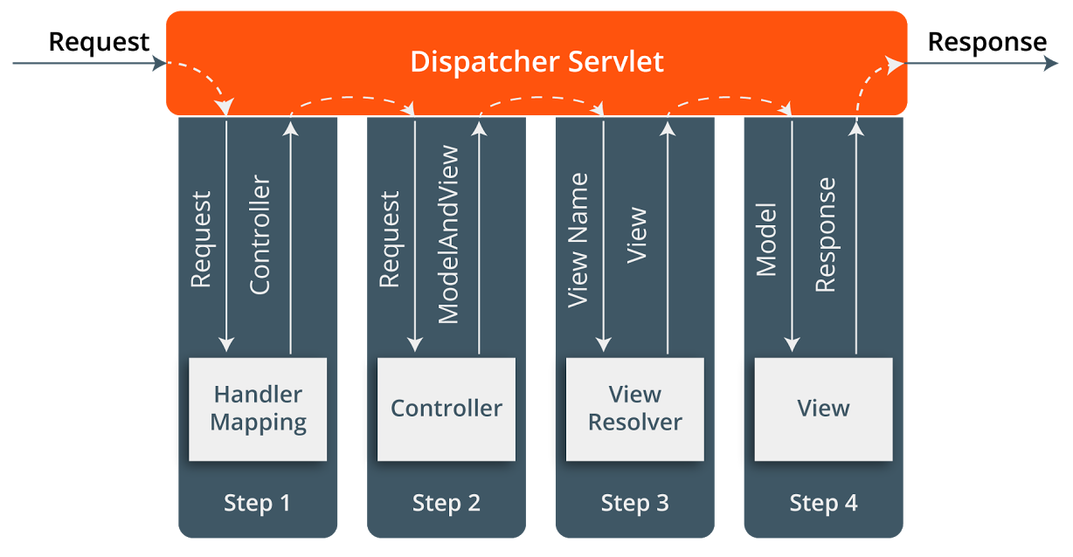

Slide 66
When a request is sent to the Spring MVC Framework, the following takes place.
A request is received by DispatcherServlet.
The DispatcherServlet communicates with HandlerMapping and calls the Controller associated with the request.
The request is processed by the Controller by calling the appropriate service methods and a ModelAndView object to the DispatcherServlet is returned.

Slide 67
Now the model object DispatcherServlet is passed to View to render the result.
With the help of the model data, the View renders the result back to the user.
The view name is sent to a ViewResolver by the DispatcherServlet to find the actual View to invoke.

