Slide 1
TypeScript

Slide 2
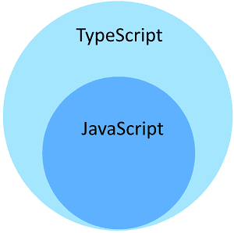
What is TypeScript
Typescript is nothing but a superset of JavaScript. It is built on top of javascript and introduces syntax enhancements. It brings support for types and class-based object-oriented programming paradigm to the world of Javascript. When compiled (or transpiled) it produces Javascript.

Slide 3
Any valid Javascript code is also a valid Typescript code. It uses the same syntax and semantics as the javascript
Typescript is open source and free to use. It is designed, developed and maintained by Microsoft.
What TypeScript is not
Typescript is not a new programming language. It just a syntactic sugar added over Javascript. You can write pure javascript code and typescript still compiles it just as it is to Javascript.

Slide 4
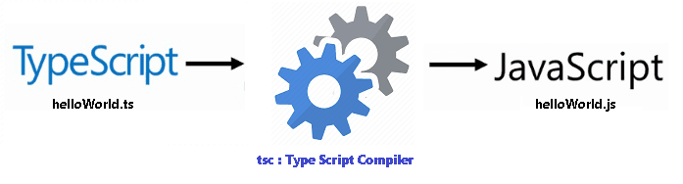

Slide 5
Benefits of TypeScript
Since in the end Typescript produces Javascript, you may wonder why not use javascript directly. The Benefit of TypeScript comes with its type system, which provides several benefits over javascript.
Optional Type System
TypeScript provides the static type system which provides great help in catching programming errors at compile time.
Intellisense & syntax checking
The static Type system helps in provide better tooling support in IDE. The intellisense, syntax checking & code completion are few of the major benefits you get with the tooling support.

Slide 6
Maintainable code
Typescript brings Types, Classes, interfaces & modules. it makes the code more maintainable and scalable. It much easier to organize the Typescript code, than a Javascript code.
Language Enhancement
Typescript comes with several language features. It supports Encapsulation through classes and modules. Supports constructors, properties & functions. It has support for Interfaces. You can make use of Arrow functions or lambdas or anonymous functions.

