Slide 1


BLACK FRIDAY SALES ANALYSIS ALY 6015 Intermediate Analytics Professor: Dr. Roy Wada Jun 24th 2020
Group A – Parveen A Tuhena Sen

Slide 2
Introduction
This report will explore the likely amount of purchase by customers during Black Friday Sale. We have extracted the data set from Kaggle website. The variable of interest in this report is the purchase amount between period 2005 and 2013. The data also contains demographic information on customers that shopped at ABC Private Limited for the previous years. This demographic information includes age, gender, occupation, city category, stay in current city and marital status. It also contains information on the products purchased, such as their ID and different product category information. Using this information, we have built various machine learning models that will predict the purchase amount based on the customer’s demographics and the categories of the products. In the end, ABC Private Limited will have information that they can use to offer customers products that will be appropriate for them.

Slide 3
Summary Statistics of the Black Friday Data Set
User_ID | Product_ID | Gender | Age | Occupation
1001680: 1025 | P00265242: 1858 | F:132197 | 0-17 : 14707 | 4 : 70862
1004277: 978 | P00110742: 1591 | M:405380 | 18-25 : 97634 | 0 : 68120
1001941: 898 | P00025442: 1586 |  | 26-35: 214690 | 7 : 57806
1001181: 861 | P00112142: 1539 |  | 36-45 : 107499 | 1 : 45971
1000889: 822 | P00057642: 1430 |  | 46-50 : 44526 | 17 : 39090
1003618: 766 | P00184942: 1424 |  | 51-55 : 37618 | 20 : 32910
(Other):532227 | (Other) :528149 |  | 55+ : 20903 | (Other):222818
City_Category | Stay_In_Current_City_Years | Marital_Status | Product_Category_1 | Product_Category_2
A:144638 | 0: 72725 | 0 : 317817 | Min. : 1.000 | 8 : 63058
B:226493 | 1:189192 | 1 : 219760 | 1st Qu.: 1.000 | 14 : 54158
C:166446 | 2: 99459 |  | Median : 5.000 | 2 : 48481
 | 3: 93312 |  | Mean : 5.296 | 16 : 42602
 | 4: 82889 |  | 3rd Qu.: 8.000 | 15 : 37317
 | NA |  | Max. :18.000 | (Other):124975
 | NA |  | NA | NA's :166986
Product_Category_3 | Purchase
16 : 32148 | Min. : 185
15 : 27611 | 1st Qu.: 5866
14 : 18121 | Median : 8062
17 : 16449 | Mean : 9334
5 : 16380 | 3rd Qu.:12073
(Other): 53569 | Max. :23961
NA's :373299 | NA
The observation on the Black Friday data set consists of 537577 rows and 12 predictor variables listed in the summary statistics.

Slide 4
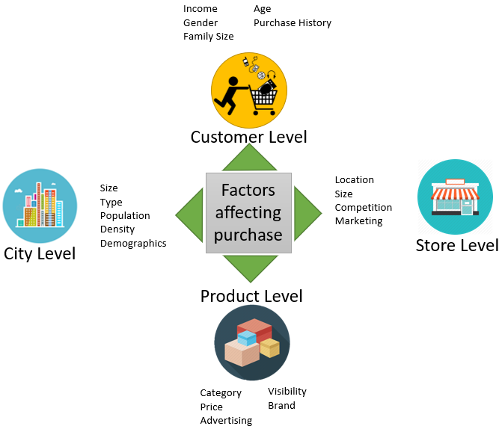
Predictor Variables for Predicting the Purchase Behavior
Parameters that might influence the amount a client spends on Black Friday.

Slide 5
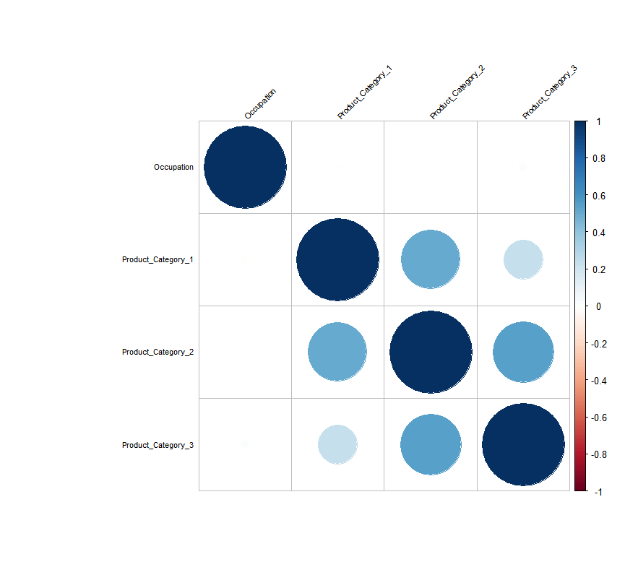
Exploratory Analysis
The very first step in analyzing data set is to understand the packages and load the respective libraries. Next step is to find and impute the missing values in the data set. The predictor variables Product_Category_2 and Product_Category_3 have missing values and are imputed to 0 based on the correlation matrix.
Identifying multicollinearity
Since the correlation between Product_Category 1,2,3 are strong, Product_Category 2 and 3 with NA values are dropped in order to avoid multicollinearity.

Slide 6
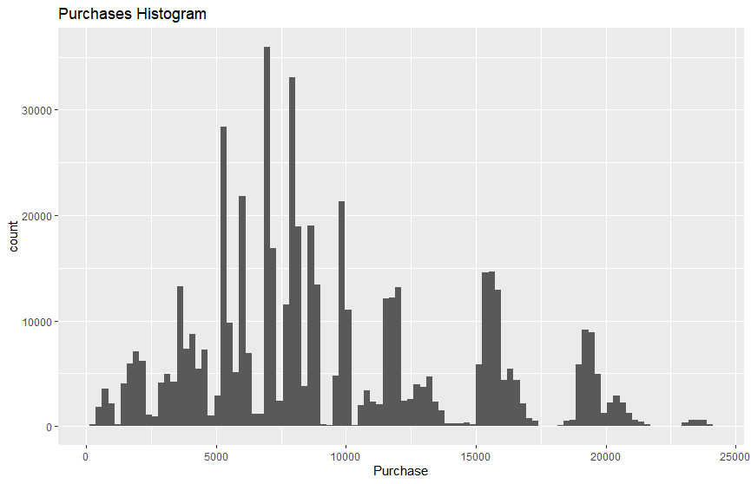
Histogram of Purchase
From this histogram we can see that the
Mean value of purchase lies between
$5k-10k and the mean quantity purchased
Is above 30k.

Slide 7
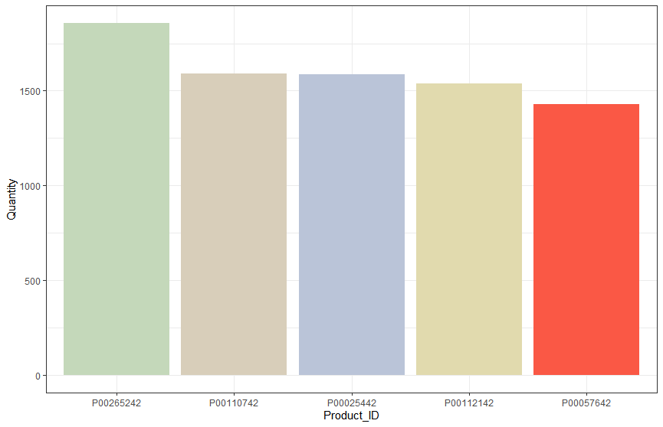
Top Five Products Accounting for Highest Purchase Quantity

Slide 8
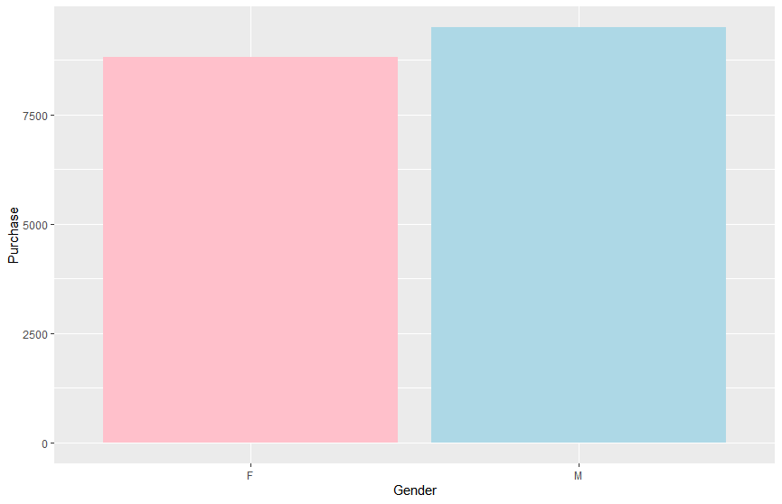
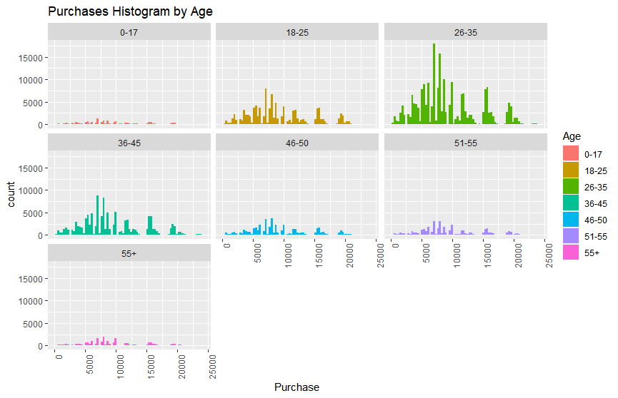
According to age and sex what is the amount spend on Black Friday?
Purchase By Gender Purchase By Age Category

Slide 9
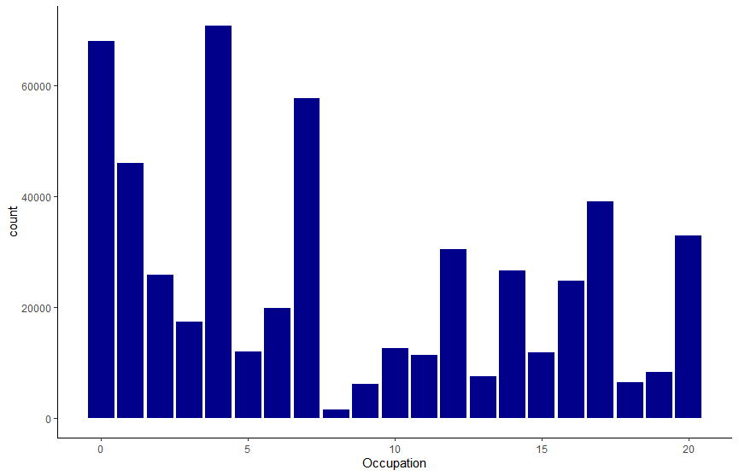
Does client’s occupation has an impact on his/her purchase?

Slide 10
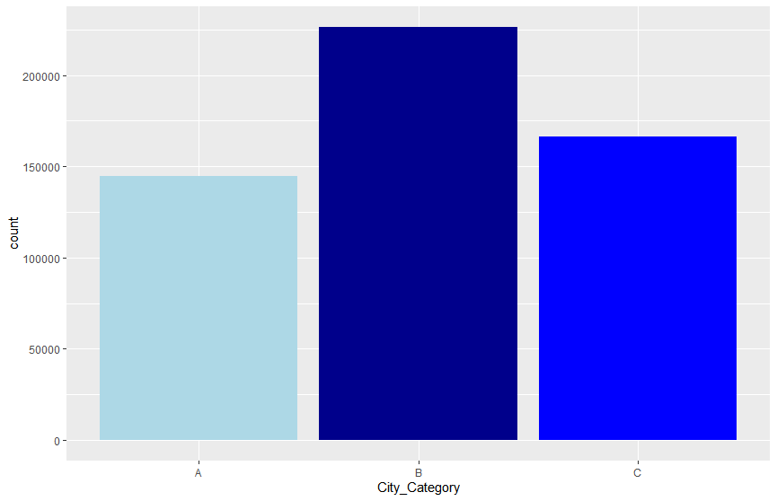
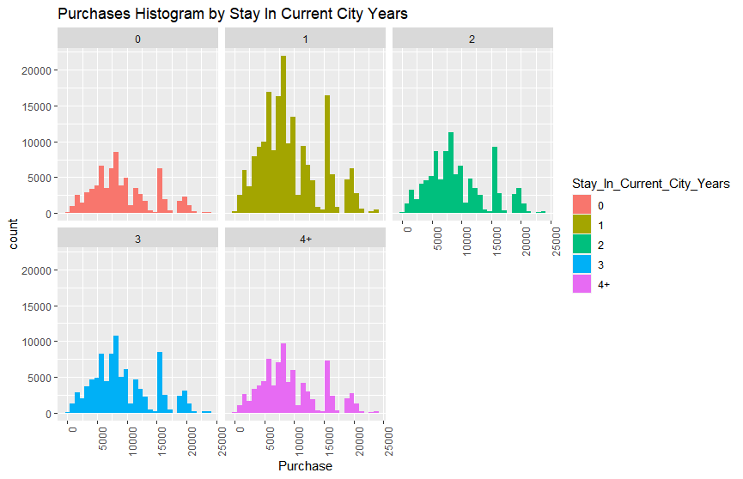
Which cities spend the most? Whether their number of years of stay matters on their spending?
Shop By No. of Stay in Current City
Shop By City

Slide 11
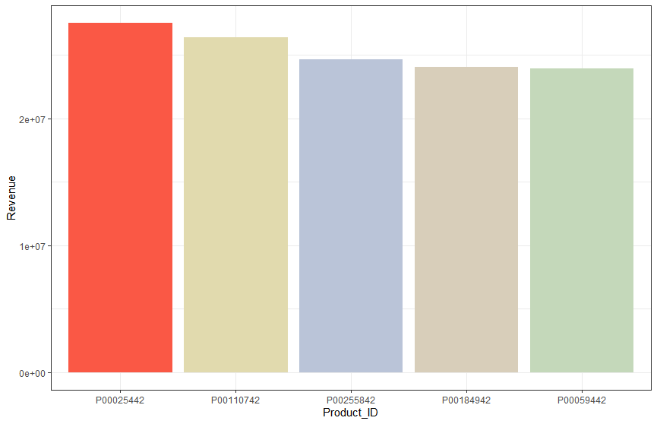
Which cities spend the most? Whether their number of years of stay matters on their spending?
Since our model needs to be trained on the purchase amount of the data set we are interested to know which Product_ID yields the highest revenue during the Black Friday sales. The bar chart lists the top 5 Product_IDs which account for highest revenue .

Slide 12
Machine Learning Models- Linear Regression
Once the near zero variance variables are removed, we create a random sample from the data. This sample is created since the data set is huge. Its size may cause trouble while building ML models. The sample size 10% of the data. Once the sample is selected, the next step in building the model can be performed.
Cross Validation of the Sample data:
Training data → Includes 80% of the sampled data
Test data → Remaining 20% of the sampled data
Building Linear Regression Model:
When we apply LM model on the training data we get the below coefficients for the predictor variables. We have used the root mean squared error (RMSE) metric for evaluating the model when compared to the Mean Absolute Error, since RMSE punishes large errors.

Slide 13
Does client’s occupation has an impact on his/her purchase?

Slide 14
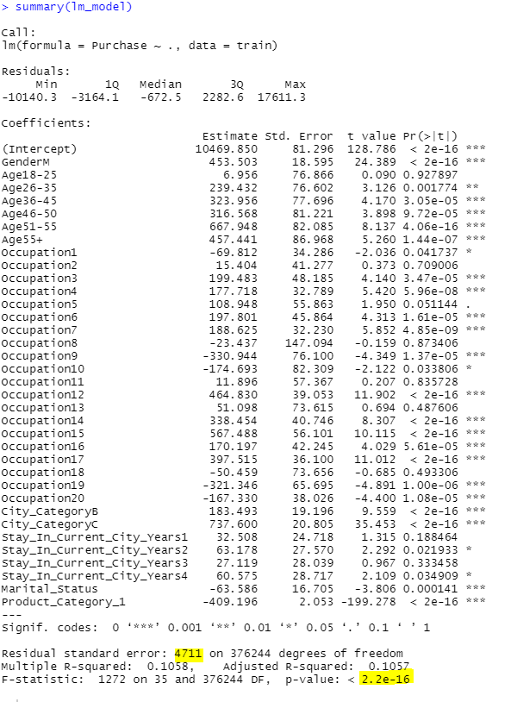
Summary Statistics of LM Model

Slide 15
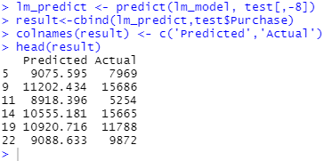
Prediction Values of LM Model
When we apply the training model on the test data we get the below list of Actual and Predicted purchase values.
RMSE of LM Model :
sqrt(mean((result$Actual - result$Predicted)^2))
[1] 4695.367

Slide 16
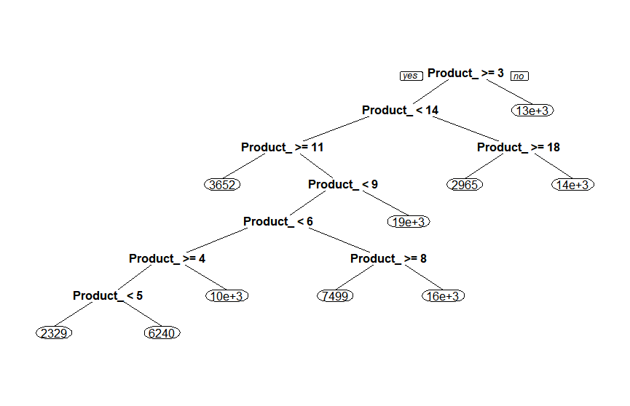
Building Decision Tree Model

Slide 17
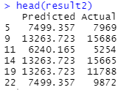
Prediction Made by Decision Tree Model
When we apply decision tree on the test data we get the below list of actual and predicted purchase amounts:
RMSE of Decision Tree Model:
sqrt(mean((result2$Actual - result2$Predicted)^2))
[1] 3103.864

Slide 18
Conclusion
From the above plots observed on the predictor variables, we were able to derive various associations and the inferences and are easily observed. Also the most import part od ML is designing the algorithm to yield the most suitable training model with highest accuracy rate and least RMSE error possible. So from our analysis, among the above two model’s decision tree model is computationally intensive when compared to the LM model based on the RMSE error. Feature engineering and model architecture can further improve the performance of our model, but lots of experimentation is needed to figure out the best model.

Slide 19
References
https://www.kaggle.com/sdolezel/black-friday

