Slide 1
Object Oriented Programming Lab CSE 1206
Lab 6

Slide 2
Remember the inheritance example?
Shape | -color -filled -calculateArea()
Circle | -radius -calculateArea()
Rectangle | -length -width -calculateArea()
Square

Slide 3
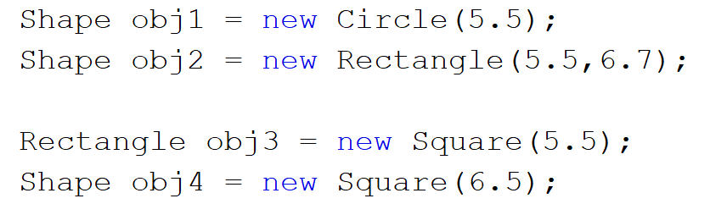
A superclass reference variable can refer to a subclass object.
This is also known as upcasting. Java uses this fact to resolve calls to overridden methods at run time.

Slide 4
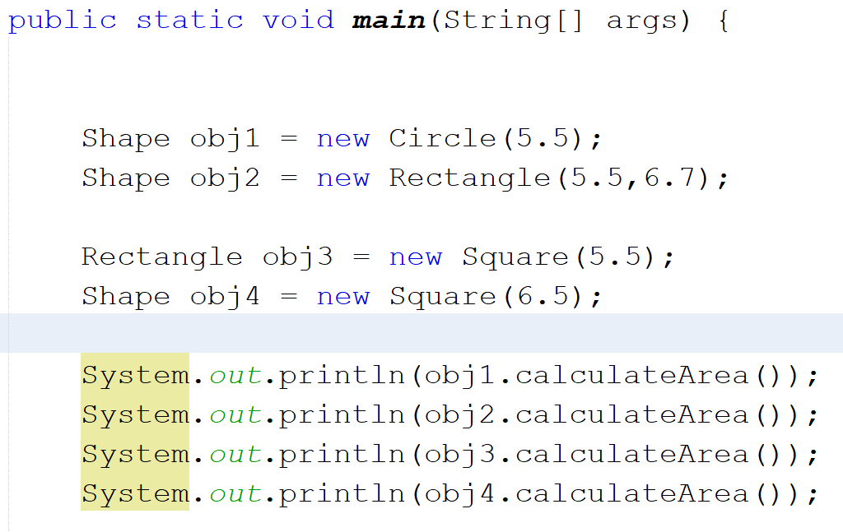

Slide 5
Dynamic Method Dispatch
This upcasting is used to call overridden methods.
The super class variable will only recognize the overridden methods.
When an overridden method is called through a superclass reference, Java determines which version(superclass/subclasses) of that method is to be executed based upon the type of the object being referred to at the time the call occurs.
Thus, this determination is made at run time.

Slide 6
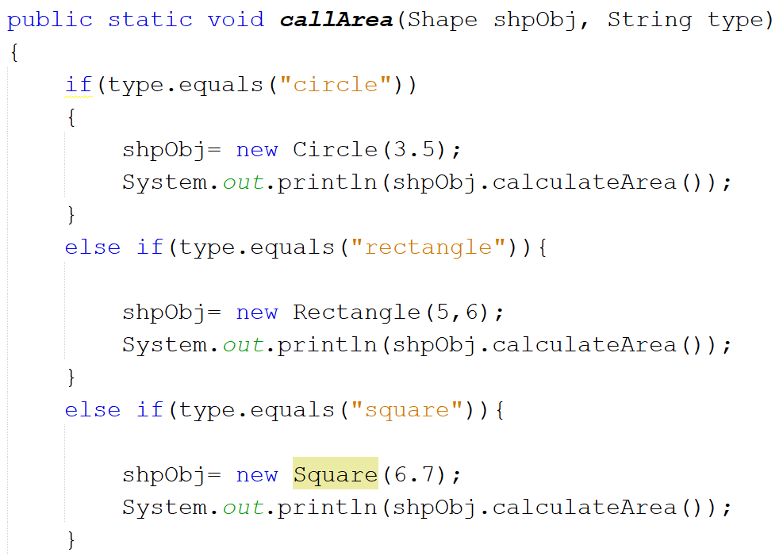
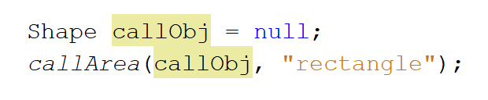
Example

Slide 7
Preventing Inheritance Using Final keyword

Slide 8
Final keyword is used to prevent a class from being inherited.
Syntax
final class A{
}
class B extends A { // Error
}

Slide 9
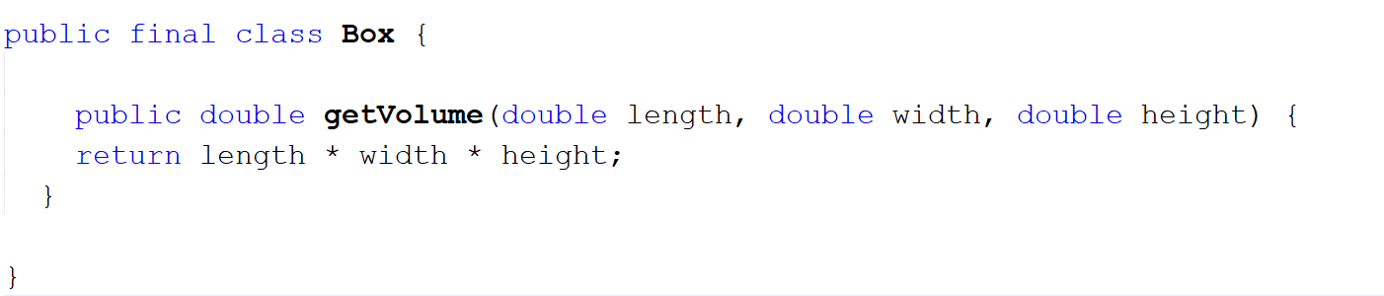

Slide 10
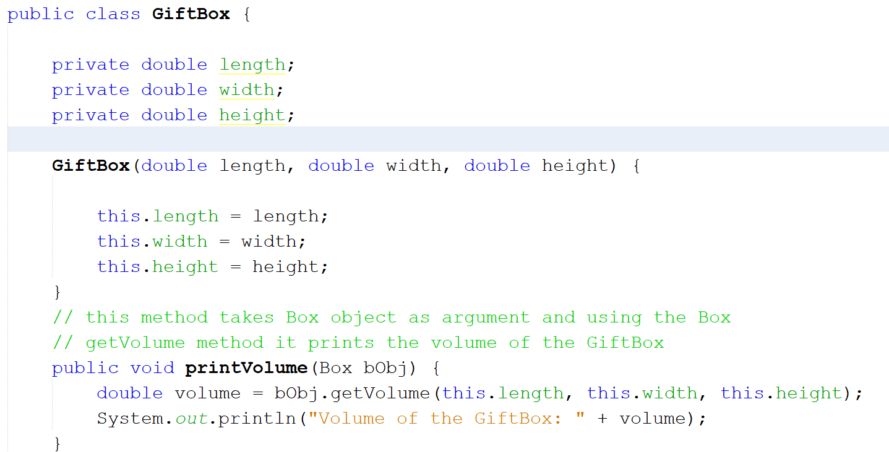

Slide 11
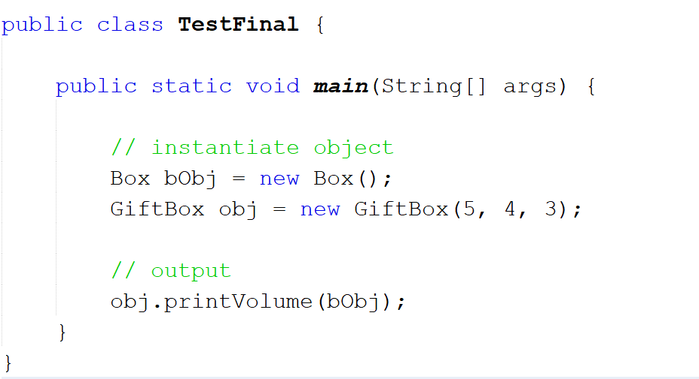

Slide 12
Other Uses of Final
Final variable -> used to create constant variables
Final methods -> prevents method overriding

Slide 13
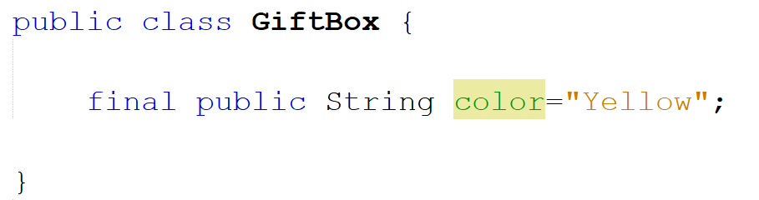
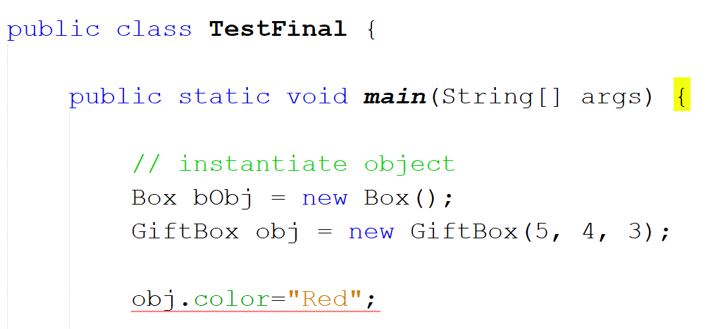
Final
Variable

Slide 14
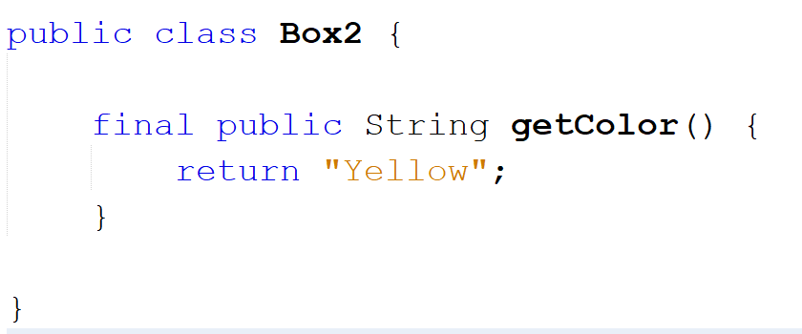
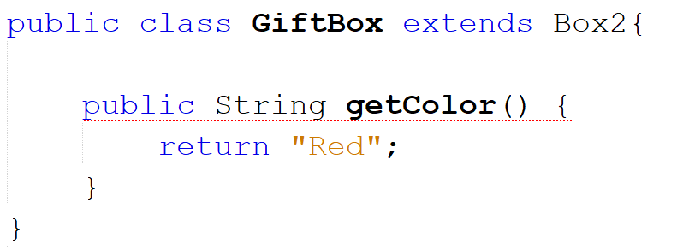
Final
Method

Slide 15
Arrays in Java

Slide 16
Declaring one dimensional Arrays
dataType array[];
dataType[] array;
dataType []array;
Instantiation of an Array in java
array=new datatype[size]; size-> integer value
*new keyword allocates memory to the array.
Why using new?
https://www.geeksforgeeks.org/array-primitive-type-object-java/

Slide 17
Declaring two-dimensional Arrays
dataType[][] multiArray;
dataType [][]multiArray;
dataType multiArray[][];
dataType []multiArray[];
Instantiation of an Array in java
datatype [][]multiArray=new datatype[size][size];
new keyword allocates memory to the array.

Slide 18
Declaring multidimensional Arrays
dataType[][][] multiArray;
dataType [][][]multiArray;
dataType multiArray[][][];
dataType []multiArray[][];
Instantiation of an Array in java
datatype multiArray[][][] =new datatype[size][size][size];

Slide 19
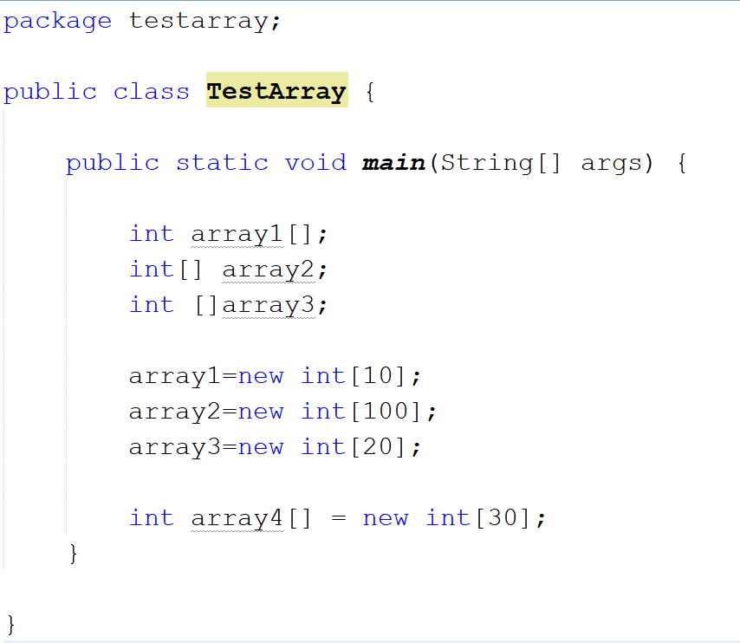
One Dimensional Arrays

Slide 20
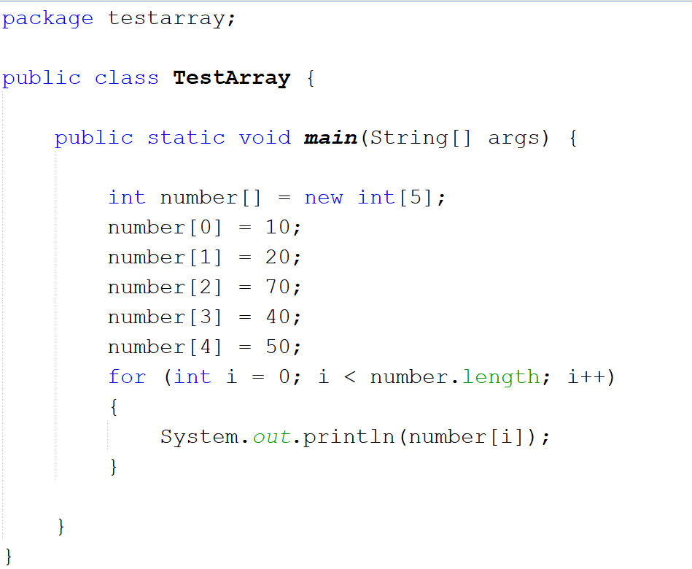
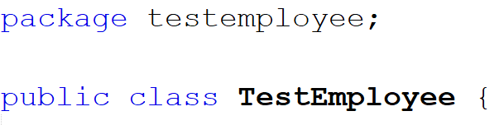
Way-1

Slide 21
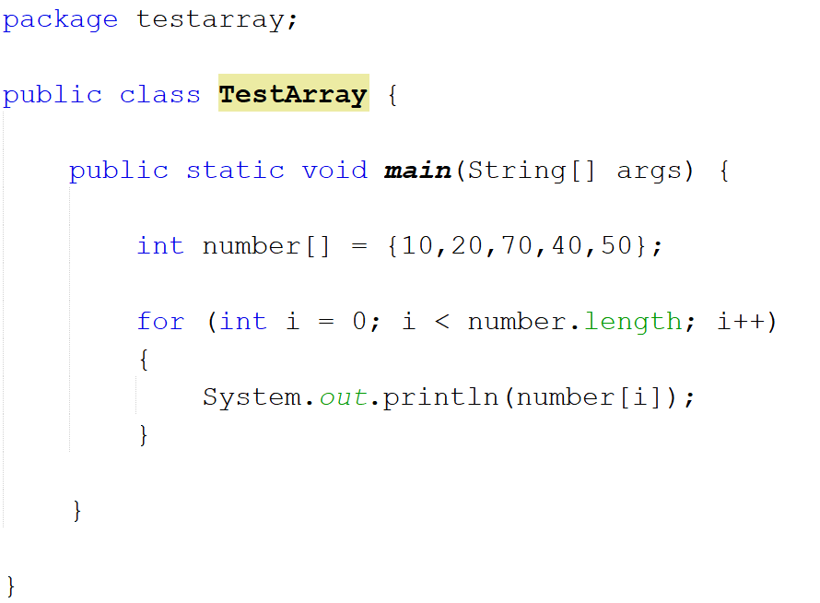
Way-2

Slide 22
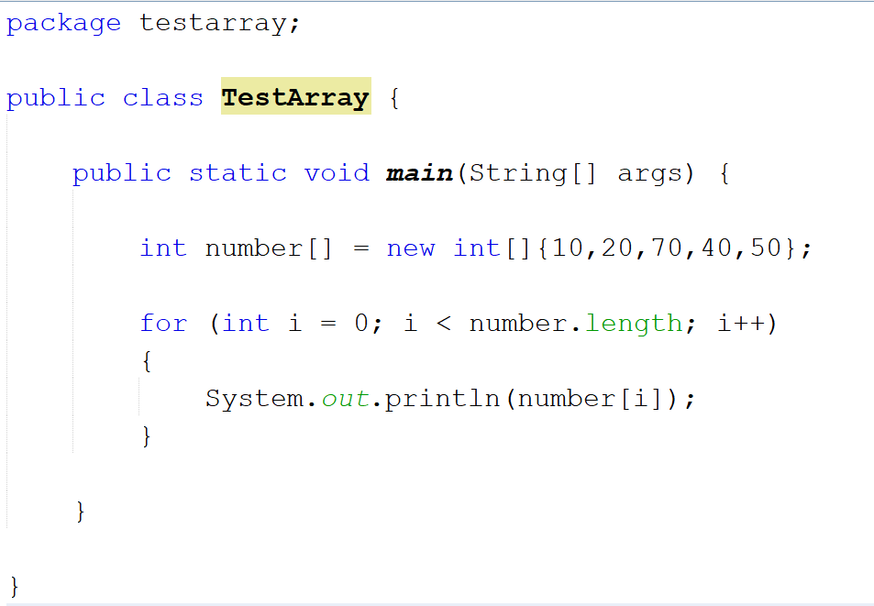
Way-3

Slide 23
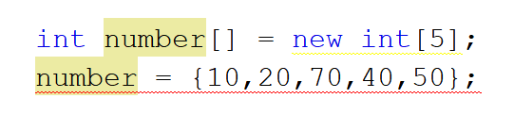
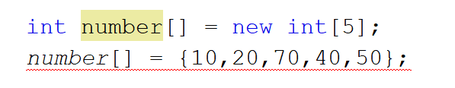
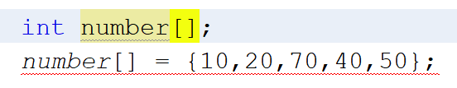
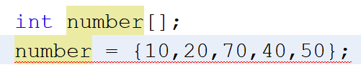
But you cannot initialize array like this

Slide 24
User Input for Array Elements

Slide 25
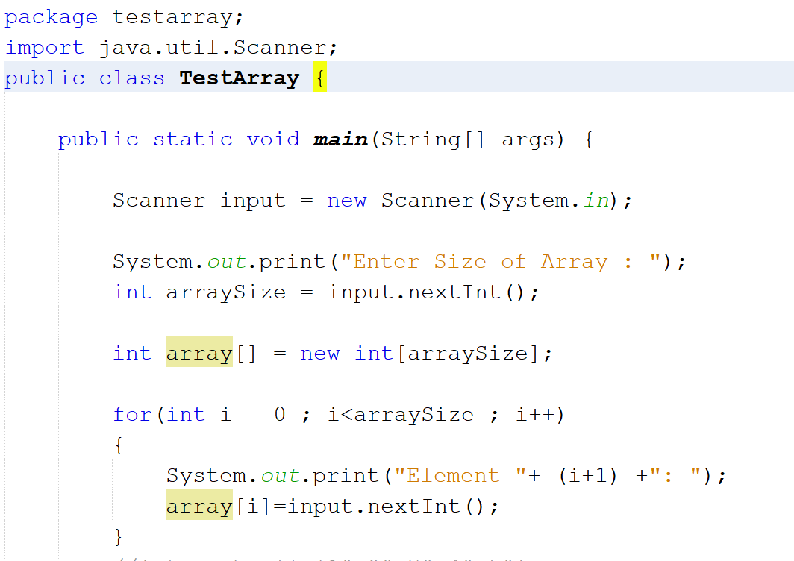
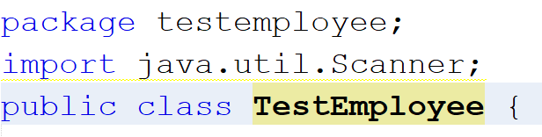

Slide 26
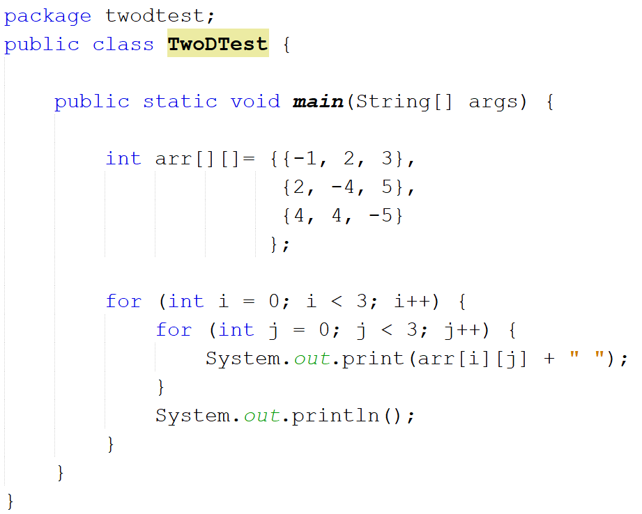
Two Dimensional Arrays

Slide 27
 | Column 0 | Column 1 | Column 2
Row 0 | -1 arr[0][0] | 2 arr[0][1] | 3 arr[0][2]
Row 1 | 2 arr[1][0] | -4 arr[1][1] | 5 arr[1][2]
Row 2 | 4 arr[2][0] | 4 arr[2][1] | -5 arr[2][2]

Slide 28
Using Arrays as Method Parameters

Slide 29
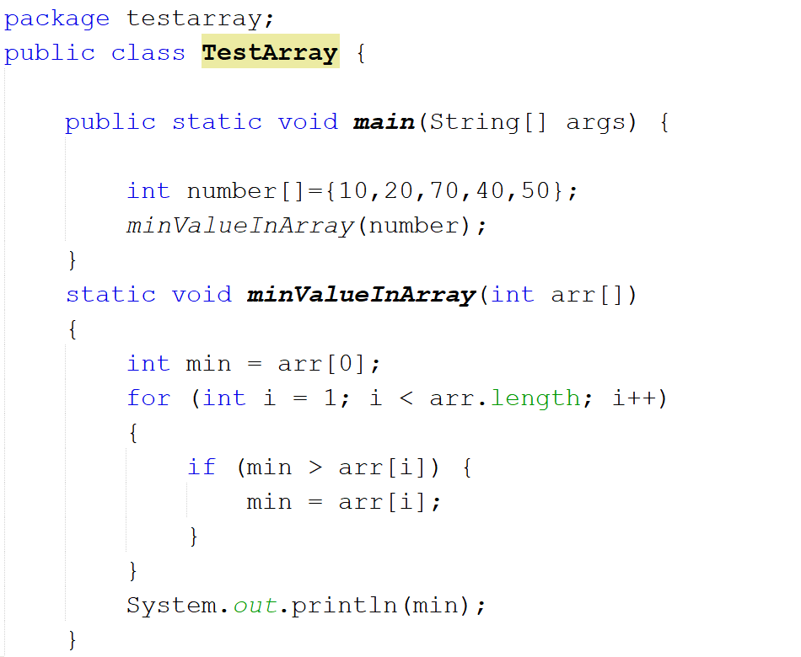

Slide 30
Using Arrays as Return Type of Method

Slide 31
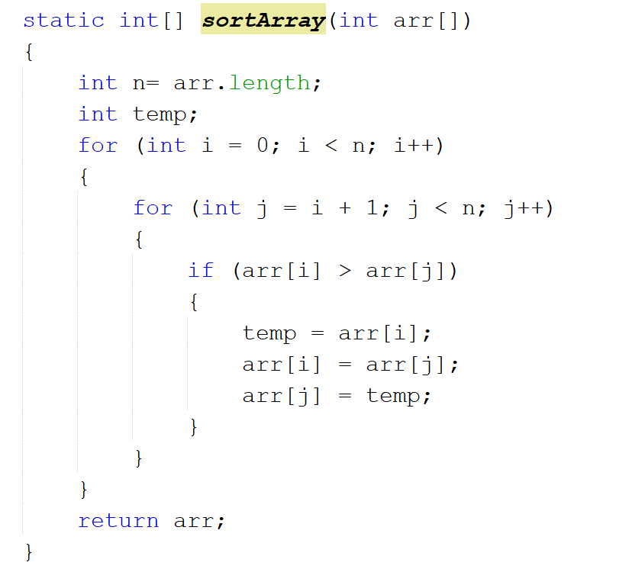

Slide 32
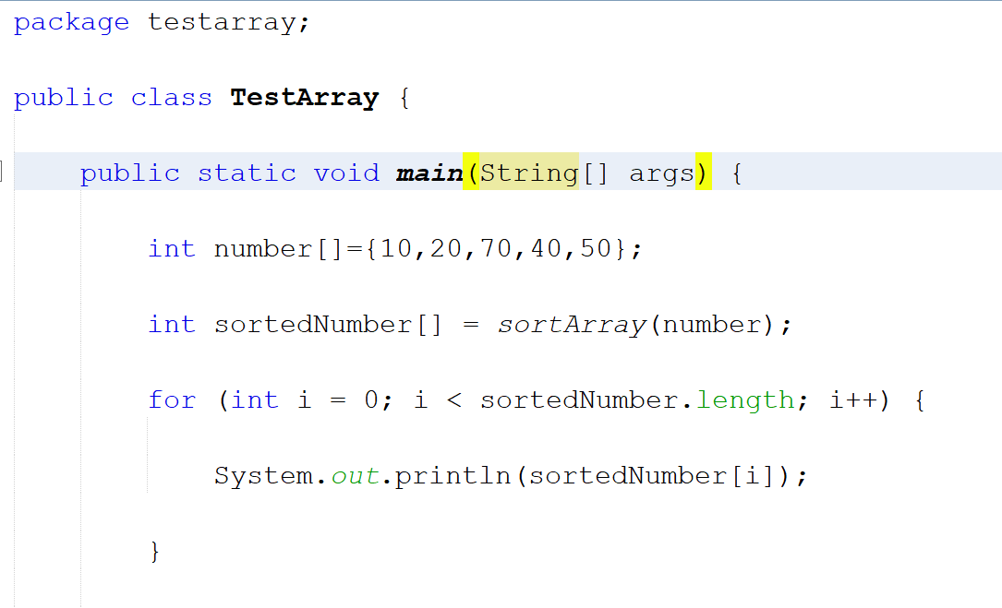

Slide 33
Array of Objects

Slide 34
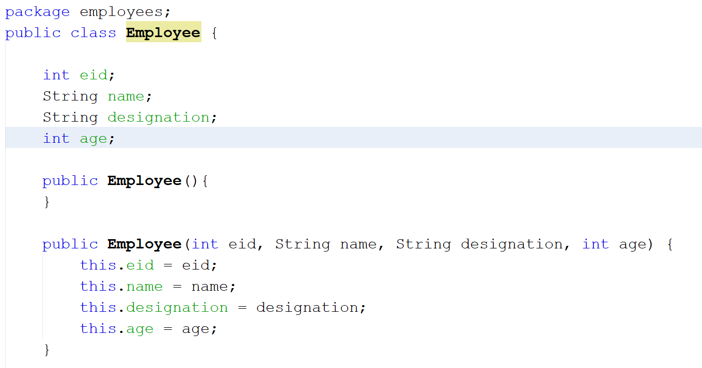
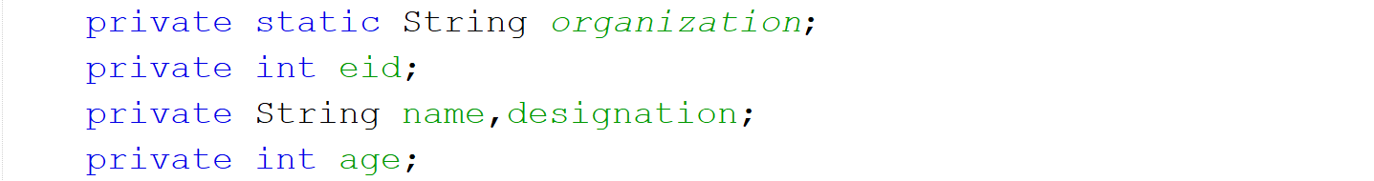

Slide 35
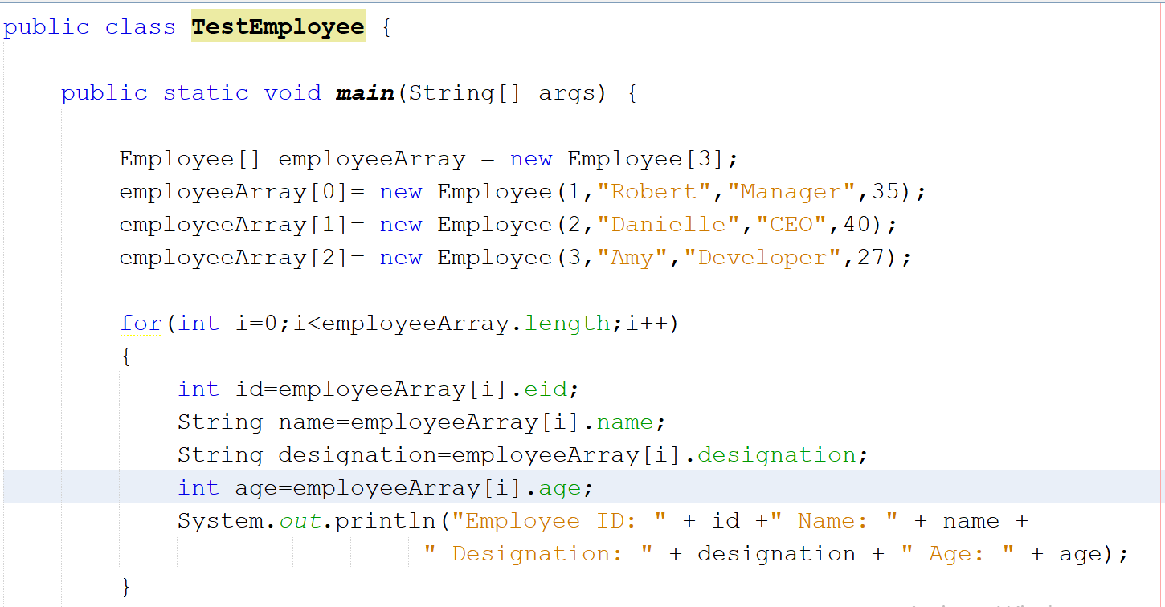
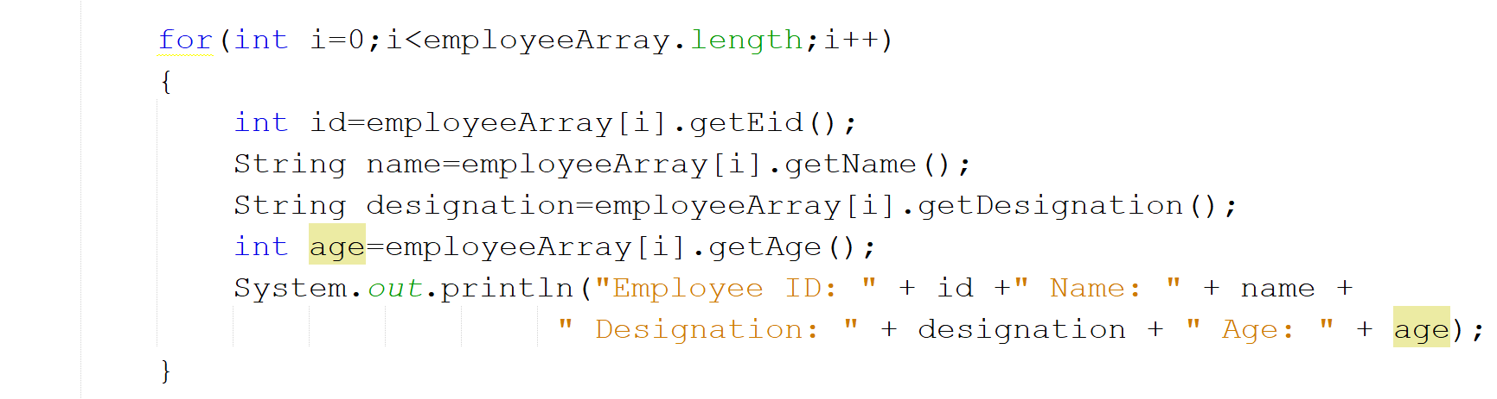

Slide 36
Now we will search for an employee from this employee array using method overloading concept.
The Search will Occur in 3 ways:
Search by EID
Search by Name
Search by Designation and Age

Slide 37
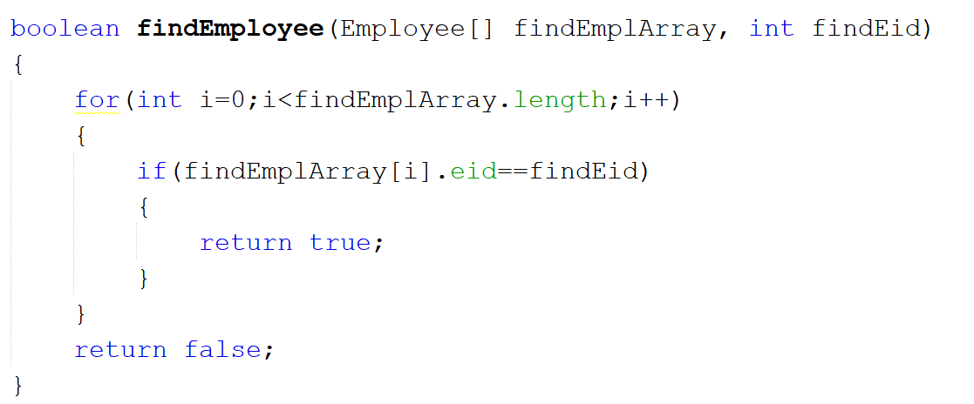
Method-1: Search Using EID

Slide 38
Try to create the other methods yourself
Strings are compared using ‘equals’ keyword instead of ‘==’
Example: str1.equals(str2)

Slide 39
Links to learn Java Arrays:
https://www.geeksforgeeks.org/arrays-in-java/
https://www.guru99.com/java-arrays.html
https://www.tutorialspoint.com/java/java_arrays

