Slide 1
Knowledge and reasoning
Knowledge representation
Logic and representation
Propositional (Boolean) logic
Normal forms
Inference in propositional logic
Wumpus world example
‹#›

Slide 2
Knowledge Based System
Knowledge-based system are a form of artificial intelligent (AI) designed to capture the knowledge of human experts to support decision making.
The central component of a knowledge-based agent is its knowledge base (KB). Informally a KB is a set of sentences. Each sentence is expressed in a language called knowledge representation language and represents some assertion about the world.
CS 561, Sessions 10-11
‹#›

Slide 3
Knowledge-Based Agent
Agent that uses prior or acquired knowledge to achieve its goals
Can make more efficient decisions
Can make informed decisions
Knowledge Base (KB): contains a set of representations of facts about the Agent’s environment or world
Each individual representation is called a sentence
Use some knowledge representation language, to TELL it what to know e.g., (temperature 72F)
ASK agent to query what to do
Agent can use inference to deduce new facts from TELLed facts
It performs the chosen action
Domain independent algorithms
ASK
Inference engine
TELL
Knowledge Base
Domain specific content
‹#›

Slide 4
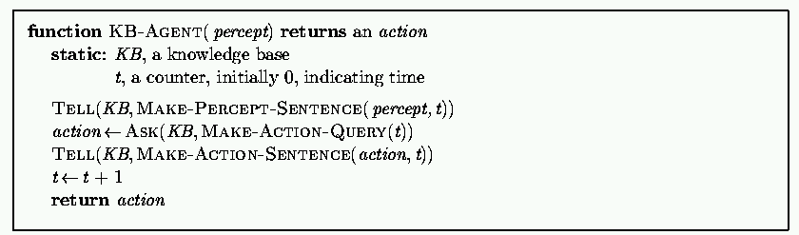
Generic knowledge-based agent
TELL KB what was perceived Uses a Knowledge Representation Language to insert new sentences, representations of facts, into KB
ASK KB what to do. Uses logical reasoning/Inference to examine actions and select best.
‹#›

Slide 5
Generic knowledge-based agent
The agent must be able to
Represent states, actions
Incorporate new percepts
Update internal representation of the world or agent environment
Deduce hidden properties of the world or agent environment
Deduce appropriate actions
‹#›

Slide 6
Architecture of a knowledge-based agent
Knowledge Level.
The most abstract level: describe agent by saying what it knows.
Example: A taxi agent might know that the Golden Gate Bridge connects San Francisco with the Marin County.
Logical Level.
The level at which the knowledge is encoded into sentences.
Example: Links(GoldenGateBridge, SanFrancisco, MarinCounty).
Implementation Level.
The physical representation of the sentences in the logical level.
Example: ‘(links goldengatebridge sanfrancisco marincounty)
‹#›

Slide 7
Wumpus world example
Cave consisting of rooms connected by passways.
There is Wumpus (a beast) in the cave.
The agent can shoot the Wumpus but it has only one arrow.
Some rooms contain bottomless pits that will trap anyone except the Wumpus.
Agents objective is to find a heap of gold.
CS 561, Sessions 10-11
‹#›

Slide 8
The Wumpus World
The precise definition of the task environment is given by the PEAS description:
Performance measure: +I000 for piclung up the gold, -1000 for falling into a pit or being eaten by the wumpus, -1 for each action taken and -10 for using up the arrow.
Environment: A 4 x 4 grid of rooms. The agent always starts in the square labeled [1,1], facing to the right. The locations of the gold and the wumpus are chosen randomly, with a uniform distribution, from the squares other than the start square. In addition, each square other than the start can be a pit, with probability 0.2.

Slide 9
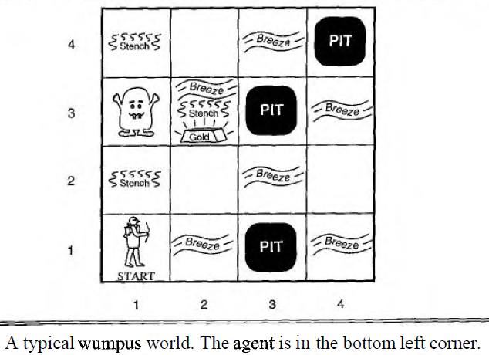
The Wumpus World

Slide 10
The Wumpus World
Actuators: The agent can move forward, turn left by 90°, or turn right by 90". The agent dies a miserable death if it enters a square containing a pit or a live wumpus. (It is safe, to enter a square with a dead wunlpus.) The action Grab can be used to pick up an object that is in the same square as the agent. The action Shoot can be used to fire an arrow in a straight line in the direction the agent is facing. The arrow continues until it either hits (and hence kills) the wumpus or hits a wall. The agent only has one arrow, so only the first Shoot action has any effect.

Slide 11
The Wumpus World
Sensors: The agent has five sensors, each of which gives a single bit of information:
- In the square containing the wumpus and in the directly (not diagonally) adjacent squares the agent will perceive a stench.
- In the squares directly adjacent to a pit, the agent will perceive a breeze.
- In the square where the gold is, the agent will perceive a glitter.
- When an agent walks into a wall, it will perceive a bump.
- When the wumpus is killed, it emits a woeful scream that can be perceived anywhere in the cave.

Slide 12
The Wumpus World
The percepts will be given to the agent in the form of a list of five symbols; for example, if there is a stench and a breeze, but no glitter, bump, or scream, the agent will receive the percept
[Stench, Breeze, None, None, None].
knowledge-based wumpus agent explore the environment. The agent's initial knowledge base contains the rules of the environment.

Slide 13
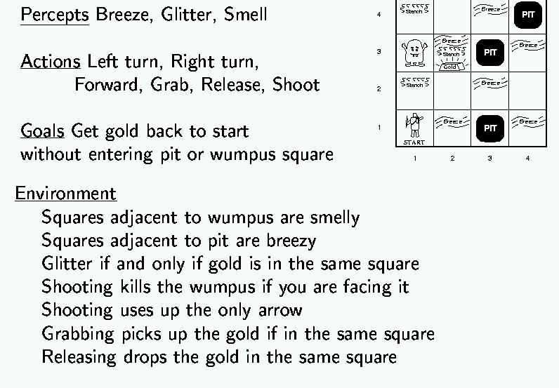

Wumpus world example
‹#›

Slide 14
Wumpus world characterization
Deterministic?
Fully observable?
Static?
Discrete?
Episodic?
‹#›

Slide 15
Wumpus world characterization
Deterministic? Yes – outcome exactly specified.
Fully observable? No – only local perception.
Static? Yes – Wumpus and pits do not move.
Discrete? Yes
Episodic? (Yes) – because static.
‹#›

Slide 16
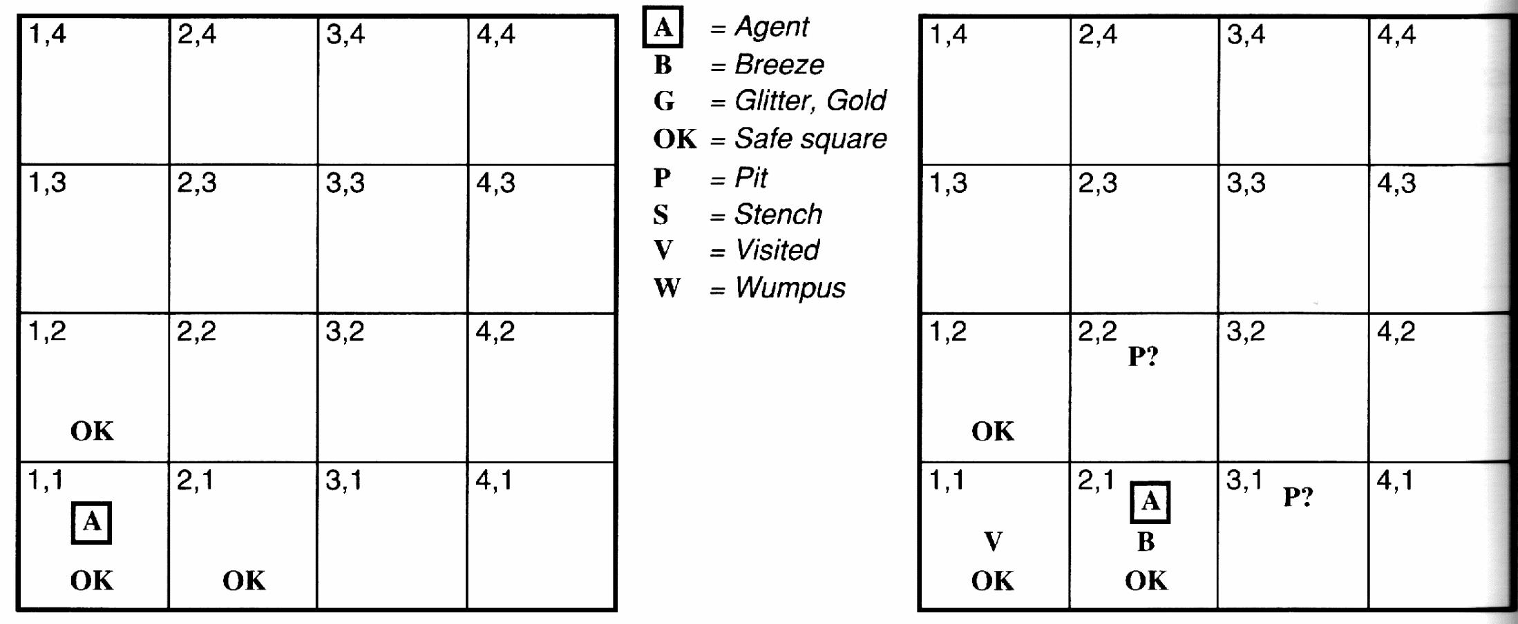
Example
No perception 🡪 1,2 and 2,1 OK
Move to 2,1
B in 2,1 🡪 2,2 or 3,1 P?
1,1 V 🡪 no P in 1,1
Move to 1,2 (only option)
‹#›

Slide 17
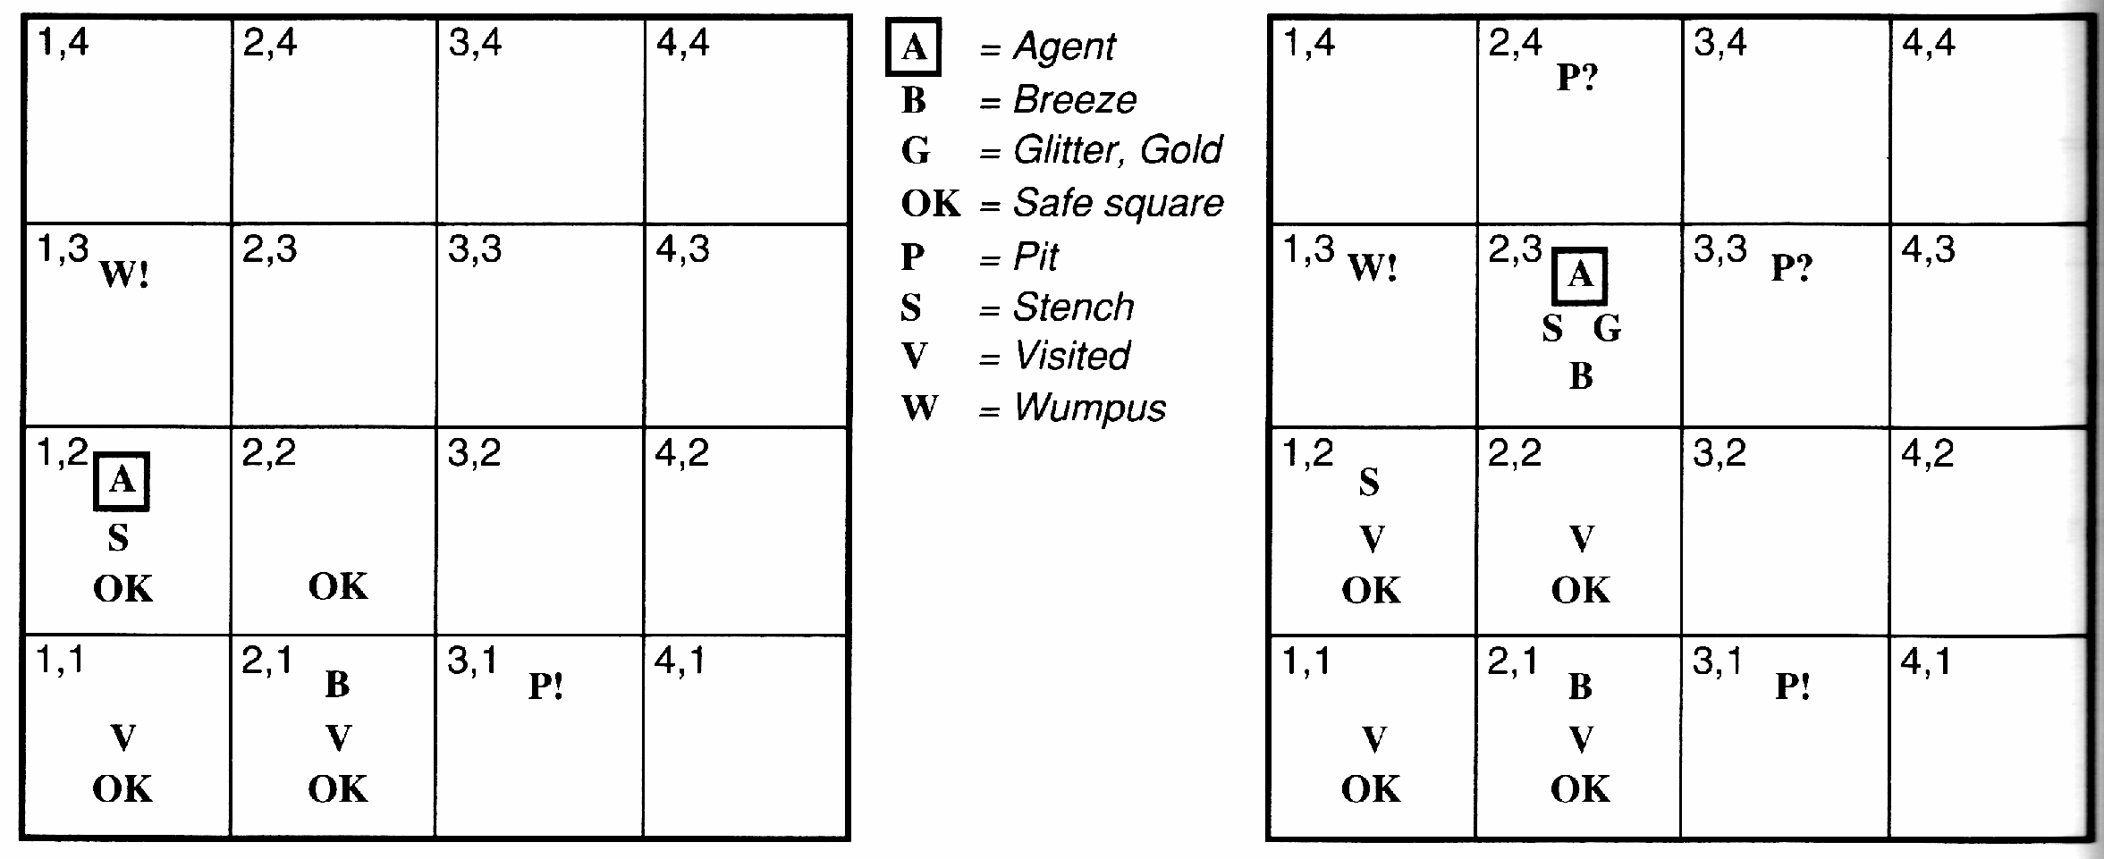
Example
S and No S when in 2,1 🡪 1,3 or 1,2 has W
1,2 OK 🡪 1,3 W
No B in 1,2 🡪 2,2 OK & 3,1 P
CS 561, Sessions 10-11
‹#›

Slide 18
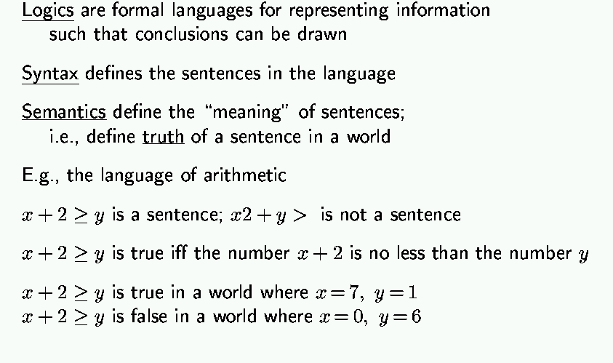
Logic in general
‹#›

Slide 19
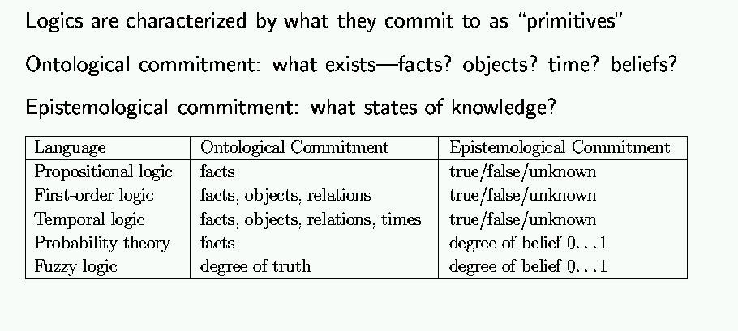
Types of logic
‹#›

Slide 20
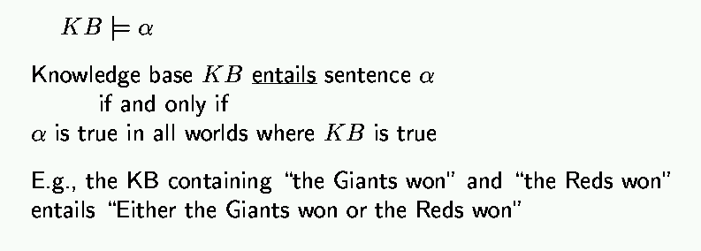
Entailment
Entailment is different than inference
‹#›

Slide 21
Example KB
Logical Entailment
“KB logically entails S” if all the models that evaluate KB to True also evaluate S to True.
Denoted by: KB |= S
Note: We do not care about those models that evaluate KB to False. The result of evaluating S for these models is irrelevant.
A | B | C | KB
F | F | F | F
F | F | T | F
F | T | F | T
F | T | T | F
T | F | F | T
T | F | T | T
T | T | F | T
T | T | T | T
KB:
A ∨ B
¬C ∨ A

Slide 22
Example KB
A | B | C | KB | S
F | F | F | F | F
F | F | T | F | F
F | T | F | T | F
F | T | T | F | F
T | F | F | T | F
T | F | T | T | T
T | T | F | T | F
T | T | T | T | T
KB:
A ∨ B
¬C ∨ A
S:
A ∧ C
KB |= S
because KB is true but S is false
Example KB
 | A | B | C | KB | S
 | F | F | F | F | F
KB: A ∨ B ¬C ∨ A S: A ∨ B ∨ C
 | F | F | T | F | T | KB |= S because S is true for all the assignments for which KB is true
 | F | T | F | T | T
 | F | T | T | F | T
 | T | F | F | T | T
 | T | F | T | T | T
 | T | T | F | T | T
 | T | T | T | T | T
‹#›

Slide 23

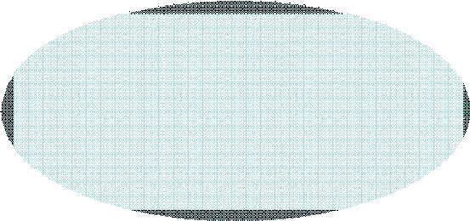

Logical Entailment
Assignments for which KB is True
KB
KB
S
S
KB |= S
KB |= S
KB
S
KB |= S
‹#›

Slide 24
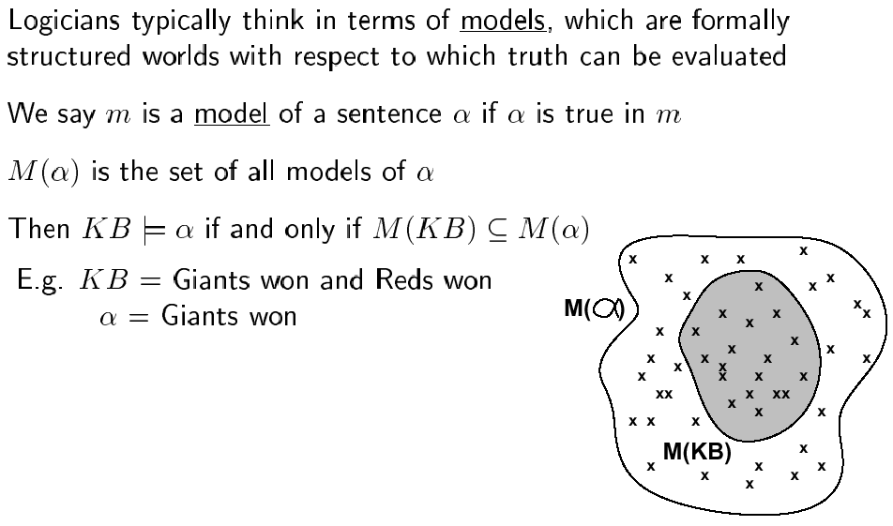
Models
CS 561, Sessions 10-11
‹#›

Slide 25
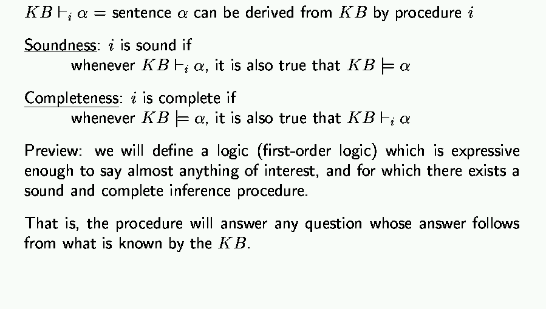
Inference
CS 561, Sessions 10-11
‹#›

Slide 26
Basic symbols
Expressions only evaluate to either “true” or “false.”
P “P is true”
¬P “P is false” negation
P V Q “either P is true or Q is true or both” disjunction
P ^ Q “both P and Q are true” conjunction
P => Q “if P is true, the Q is true” implication
P ⬄ Q “P and Q are either both true or both false” equivalence
CS 561, Sessions 10-11
‹#›

Slide 27
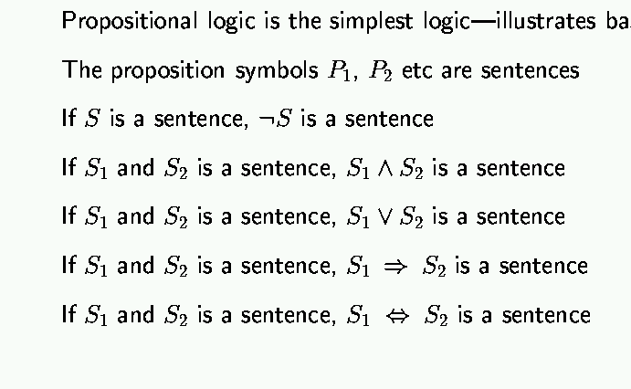
Propositional logic: syntax
‹#›

Slide 28
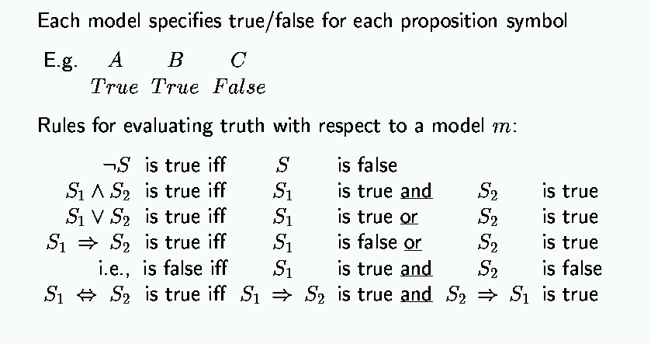
Propositional logic: semantics
‹#›

Slide 29
Truth tables
Truth value: whether a statement is true or false.
Truth table: complete list of truth values for a statement given all possible values of the individual atomic expressions.
Example:
P Q P V Q
T T T
T F T
F T T
F F F
‹#›

Slide 30
Truth tables for basic connectives
P Q ¬P ¬Q P V Q P ^ Q P=>Q P⬄Q
T T F F T T T T
T F F T T F F F
F T T F T F T F
F F T T F F T T
CS 561, Sessions 10-11
‹#›

Slide 31
Propositional logic: basic manipulation rules
¬(¬A) = A Double negation
¬(A ^ B) = (¬A) V (¬B) Negated “and”
¬(A V B) = (¬A) ^ (¬B) Negated “or”
A ^ (B V C) = (A ^ B) V (A ^ C) Distributivity of ^ on V
A => B = (¬A) V B by definition
¬(A => B) = A ^ (¬B) using negated or
A ⬄ B = (A => B) ^ (B => A) by definition
¬(A ⬄ B) = (A ^ (¬B))V(B ^ (¬A)) using negated and & or
…
CS 561, Sessions 10-11
‹#›

Slide 32
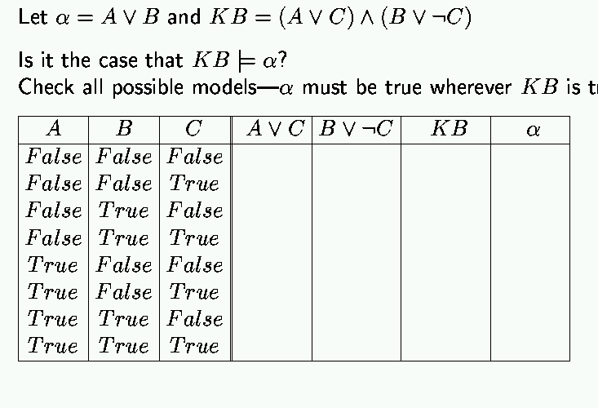
Propositional inference: enumeration method
CS 561, Sessions 10-11
‹#›

Slide 33
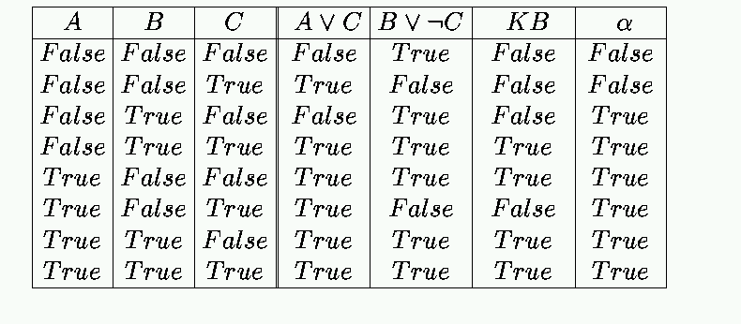
Enumeration: Solution
‹#›

Slide 34
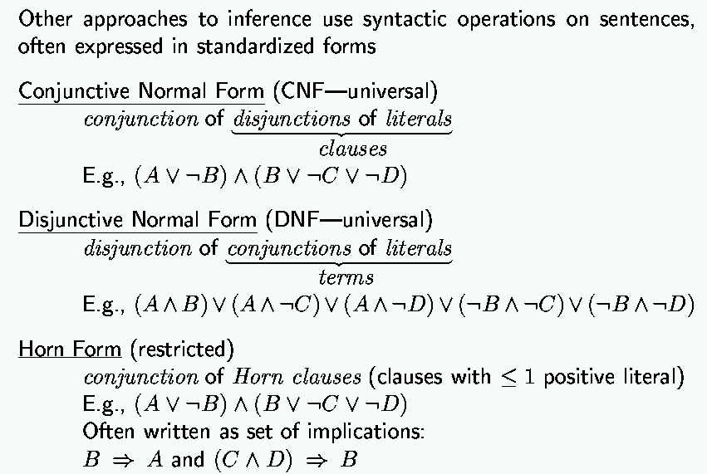
Propositional inference: normal forms
“product of sums of
simple variables or
negated simple variables”
“sum of products of
simple variables or
negated simple variables”
CS 561, Sessions 10-11
‹#›

Slide 35
Deriving expressions from functions
Given a boolean function in truth table form, find a propositional logic expression for it that uses only V, ^ and ¬.
Idea: We can easily do it by disjoining the “T” rows of the truth table.
Example: XOR function
P Q RESULT
T T F
T F T P ^ (¬Q)
F T T (¬P) ^ Q
F F F
RESULT = (P ^ (¬Q)) V ((¬P) ^ Q)
CS 561, Sessions 10-11
‹#›

Slide 36
A more formal approach
To construct a logical expression in disjunctive normal form from a truth table:
Build a “minterm” for each row of the table, where:
- For each variable whose value is T in that row, include
the variable in the minterm
- For each variable whose value is F in that row, include
the negation of the variable in the minterm
- Link variables in minterm by conjunctions
‹#›

Slide 37
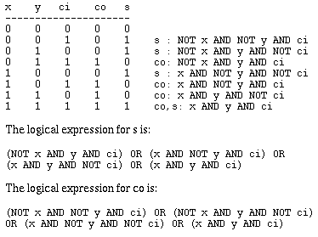
Example: adder with carry
Takes 3 variables in: x, y and ci (carry-in); yields 2 results: sum (s) and carry-out (co). To get you used to other notations, here we assume T = 1, F = 0, V = OR, ^ = AND, ¬ = NOT.
co is:
s is:
CS 561, Sessions 10-11
‹#›

Slide 38
Tautologies
Logical expressions that are always true. Can be simplified out.
Examples:
T
T V A
A V (¬A)
¬(A ^ (¬A))
A ⬄ A
((P V Q) ⬄ P) V (¬P ^ Q)
(P ⬄ Q) => (P => Q)
CS 561, Sessions 10-11
‹#›

Slide 39
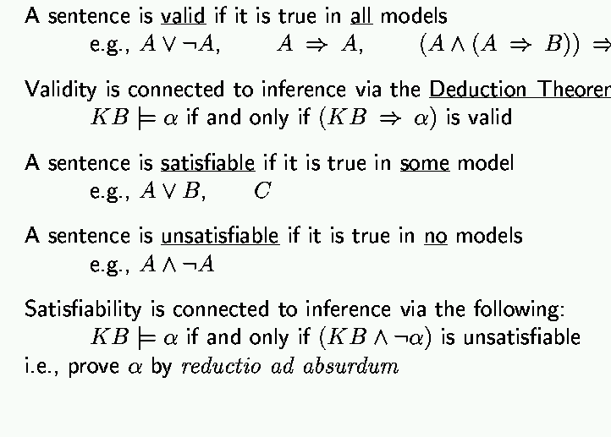
Validity and satisfiability
CS 561, Sessions 10-11
‹#›

Slide 40
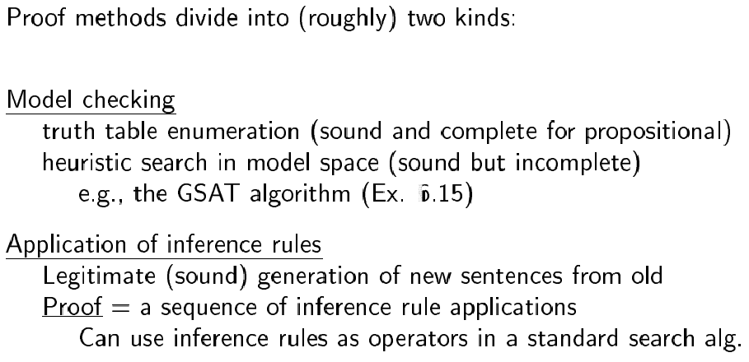
Proof methods
‹#›

Slide 41
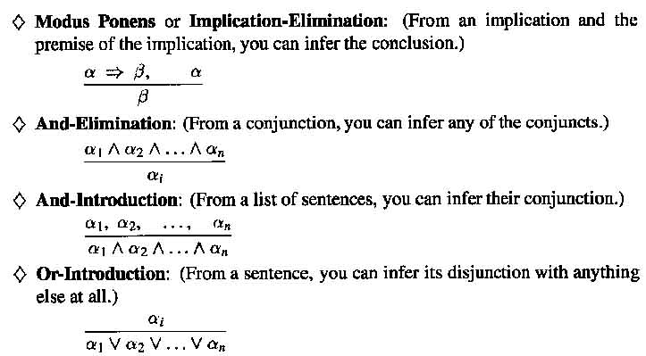
Inference Rules
‹#›

Slide 42
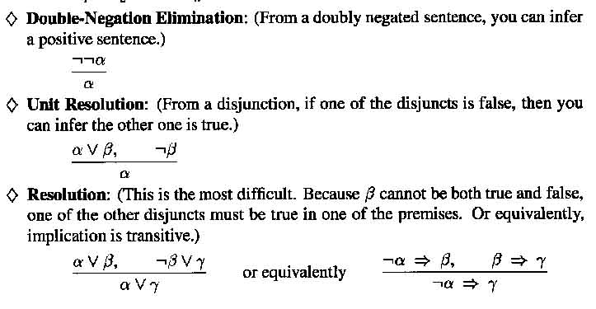
Inference Rules
‹#›

Slide 43
Wumpus world: example
Facts: Percepts inject (TELL) facts into the KB
[stench at 1,1 and 2,1] 🡪 S1,1 ; S2,1
Rules: if square has no stench then neither the square or adjacent square contain the wumpus
R1: !S1,1 ⇒!W1,1 ∧ !W1,2 ∧ !W2,1
R2: !S2,1 ⇒!W1,1 ∧!W2,1 ∧ !W2,2 ∧ !W3,1
…
Inference:
KB contains !S1,1 then using Modus Ponens we infer !W1,1 ∧ !W1,2 ∧ !W2,1
Using And-Elimination we get: !W1,1 !W1,2 !W2,1
…
‹#›

Slide 44
Limitations of Propositional Logic
1. It is too weak, i.e., has very limited expressiveness:
Each rule has to be represented for each situation: e.g., “don’t go forward if the wumpus is in front of you” takes 64 rules
2. It cannot keep track of changes:
If one needs to track changes, e.g., where the agent has been before then we need a timed-version of each rule. To track 100 steps we’ll then need 6400 rules for the previous example.
Its hard to write and maintain such a huge rule-base
Inference becomes intractable
‹#›

Slide 45
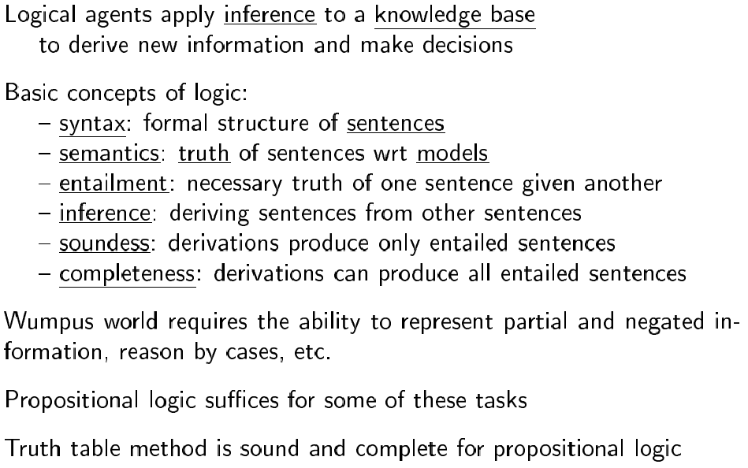
Summary
CS 561, Sessions 10-11
‹#›

Slide 46
Next time
First-order logic: [AIMA] Chapter 7
‹#›

