Slide 1
Last time: Logic and Reasoning
Knowledge Base (KB): contains a set of sentences expressed using a knowledge representation language
  TELL: operator to add a sentence to the KB
  ASK: to query the KB
Logics are KRLs where conclusions can be drawn
  Syntax
  Semantics
Entailment: KB |= a iff a is true in all worlds where KB is true
Inference: KB |–_{i} a = sentence a can be derived from KB using procedure i
  Sound: whenever KB |–_{i} a then KB |= a is true
  Complete: whenever KB |= a then KB |–_{i} a

Slide 2
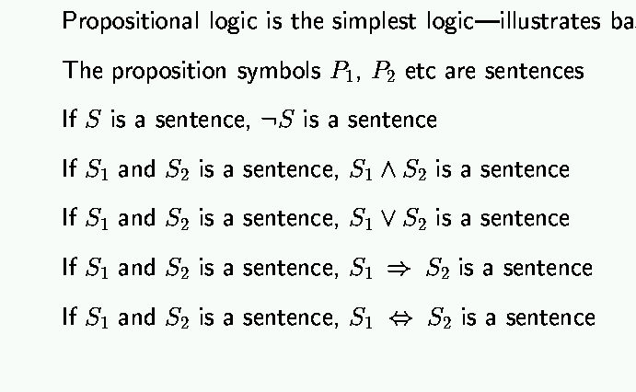
Last Time: Syntax of propositional logic

Slide 3
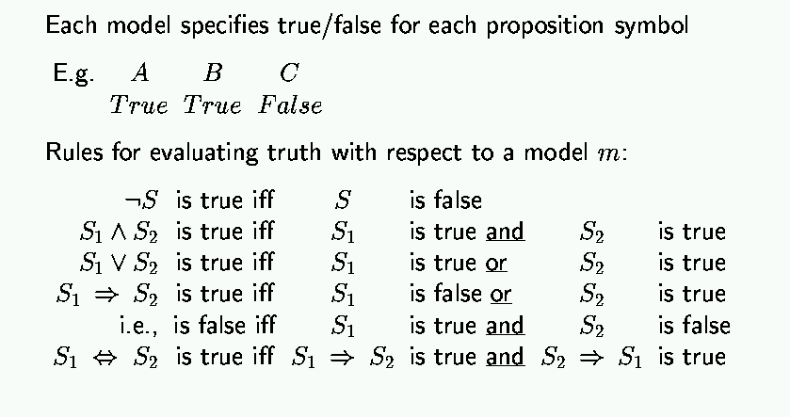
Last Time: Semantics of Propositional logic

Slide 4
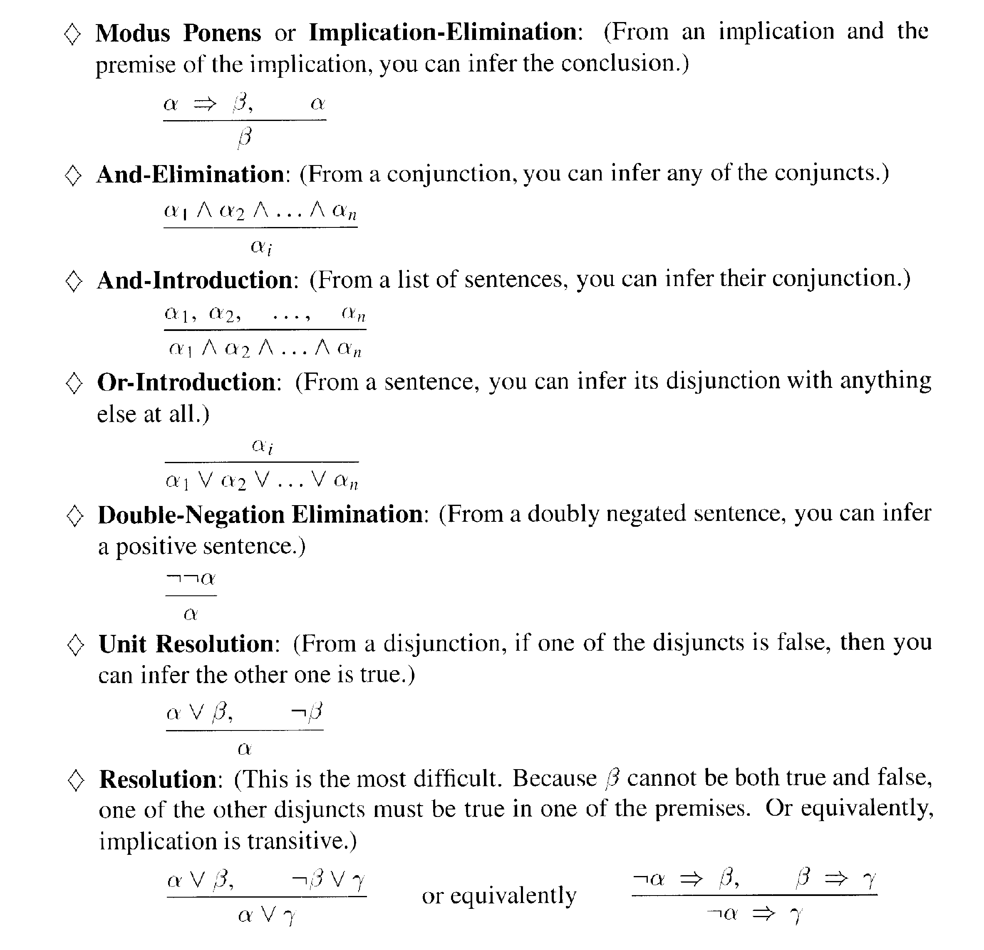
Last Time: Inference rules for propositional logic
CS 561, Session 12-13

Slide 5
This time
First-order logic
  Syntax
  Semantics
  Wumpus world example
Ontology (ont = ‘to be’; logica = ‘word’): kinds of things one can talk about in the language

Slide 6
Why first-order logic?
We saw that propositional logic is limited because it only makes the ontological commitment that the world consists of facts.
Difficult to represent (complex sentences or natural language statements) even simple worlds like the Wumpus world;
e.g.,
“don’t go forward if the Wumpus is in front of you” takes 64 rules

Slide 7
Why first-order logic?
First-order logic is also known as Predicate logic or First-order predicate logic. First-order logic is a powerful language that develops information about the objects in a more easy way and can also express the relationship between those objects.
CS 561, Session 12-13

Slide 8
First-order logic (FOL)
First-order logic (like natural language) does not only assume that the world contains facts like propositional logic but also assumes the following things in the world:
  Objects: wheel, door, body, engine, seat, car, passenger, driver
  Relations: Inside(car, passenger), Beside(driver, passenger)
  Functions: ColorOf(car)
  Properties: Color(car), IsOpen(door), IsOn(engine)

Slide 9
Semantics
there is a correspondence between
  functions, which return values
  predicates, which are true or false
  Function: father_of(Mary) = Bill
  Predicate: father_of(Mary, Bill)
Notes:
more formally, this is how build interpretation of whole from interpretation of parts.
predicate and relation used interchangeably; here predicate is the formal symbol and relation the real world relation
give example of tuples for functions and relations (e.g. son-of, son)

Slide 10
Examples:
“One plus two equals three”
Objects:
Relations:
Properties:
Functions:
“Squares neighboring the Wumpus are smelly”
Objects:
Relations:
Properties:
Functions:

Slide 11
Examples:
“One plus two equals three”
Objects: one, two, three
Relations: equals
Properties: --
Functions: plus (one , two)
“Squares neighboring the Wumpus are smelly”
Objects: Wumpus, square
Relations: neighboring
Properties: smelly
Functions: --

Slide 12
FOL: Syntax of basic elements
Constant symbols: 1, 5, A, B, USC, JPL, Alex, Manos, …
Predicate symbols: >, Friend, Student, Colleague, …
Function symbols: +, sqrt, SchoolOf, TeacherOf, ClassOf, …
Variables: x, y, z, next, first, last, …
Connectives: ∧, ∨, ⇒, ⇔
Quantifiers: ∀, ∃
Equality: =

Slide 13
FOL: Atomic sentences
Atomic sentences are the most basic sentences of first-order logic. These sentences are formed from a predicate symbol followed by a parenthesis with a sequence of terms.
We can represent atomic sentences as Predicate (term1, term2, ......, term n).
An atomic sentence predicate(term₁, …, term_{n}) is true iff the relation referred to by predicate holds between the objects referred to by term₁, …, term_{n}
Examples:
  SchoolOf(Manos)
  Colleague(TeacherOf(Alex), TeacherOf(Manos))

Slide 14
FOL: Complex sentences
Complex sentences are made by combining atomic sentences using connectives.
Sentence → AtomicSentence
| Sentence Connective Sentence
| Quantifier Variable, … Sentence
| ¬ Sentence
| (Sentence)
Examples:
  S1 ∧ S2, S1 ∨ S2, (S1 ∧ S2) ∨ S3, S1 ⇒ S2, S1⇔ S3
  Colleague(Paolo, Maja) ⇒ Colleague(Maja, Paolo)
  Student(Alex, Paolo) ⇒ Teacher(Paolo, Alex)

Slide 15
Quantifiers
Expressing sentences about collections of objects without enumeration (naming individuals)
E.g., All Trojans are clever
Someone in the class is sleeping
Universal quantification (for all): ∀
Existential quantification (three exists): ∃

Slide 16
Universal quantification (for all): ∀
∀ <variables> <sentence>
“Every one in the cse3.2 class is smart”:
∀ x In(cse3.2, x) ⇒ Smart(x)

Slide 17
Universal quantification (for all): ∀
⇒ is a natural connective to use with ∀
Common mistake: to use ∧ in conjunction with ∀
e.g: ∀ x In(cse3.2, x) ∧ Smart(x)
means “every one is in cse3.2 and everyone is smart”

Slide 18
Existential quantification (there exists): ∃
∃ <variables> <sentence>
“Someone in the cse3.2 class is smart”:
∃ x In(cse3.2, x) ∧ Smart(x)

Slide 19
Existential quantification (there exists): ∃
∧ is a natural connective to use with ∃
Common mistake: to use ⇒ in conjunction with ∃
e.g: ∃ x In(cse3.2, x) ⇒ Smart(x)
is true if there is anyone that is not in cse3.2!
(remember, false ⇒ true is valid).

Slide 20
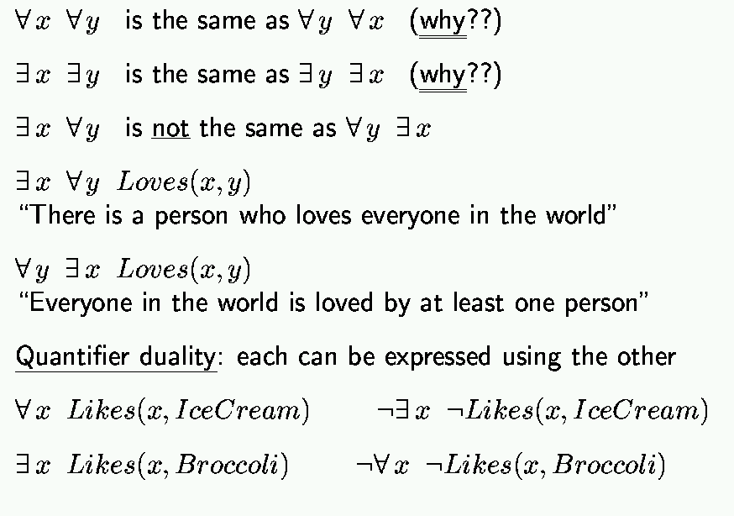
Properties of quantifiers
CS 561, Session 12-13

Slide 21
Proof
In general we want to prove:
∀ x P(x) <=> ¬ ∃ x ¬ P(x)
∀ x P(x) = ¬(¬(∀ x P(x))) = ¬(¬(P(x1) ^ P(x2) ^ … ^ P(xn)) ) = ¬(¬P(x1) v ¬P(x2) v … v ¬P(xn)) )
∃ x ¬P(x) = ¬P(x1) v ¬P(x2) v … v ¬P(xn)
¬∃ x ¬P(x) = ¬(¬P(x1) v ¬P(x2) v … v ¬P(xn))

Slide 22
Example sentences
Brothers are siblings
.
Sibling is transitive
.
One’s mother is one’s sibling’s mother
.
A first cousin is a child of a parent’s sibling
.

Slide 23
Example sentences
Brothers are siblings
∀ x, y Brother(x, y) ⇒ Sibling(x, y)
Sibling is transitive
∀ x, y, z Sibling(x, y) ∧ Sibling(y, z) ⇒ Sibling(x, z)
One’s mother is one’s sibling’s mother
∀ m, c ,d Mother(m, c) ∧ Sibling(c, d) ⇒ Mother(m, d)
A first cousin is a child of a parent’s sibling
∀ c, d FirstCousin(c, d) ⇔
∃ p, ps Parent(p, d) ∧ Sibling(p, ps) ∧ Parent(ps, c)

Slide 24
Example sentences
One’s mother is one’s sibling’s mother
∀ m, c,d Mother(m, c) ∧ Sibling(c, d) ⇒ Mother(m, d)
∀ c,d ∃m Mother(m, c) ∧ Sibling(c, d) ⇒ Mother(m, d)
m
c
Mother of
d
sibling

Slide 25
Translating English to FOL
Every gardener likes the sun.
  ∀ x gardener(x) => likes(x,Sun)
You can fool some of the people all of the time.
  ∃ x ∀ t (person(x) ^ time(t)) => can-fool(x,t)

Slide 26
Translating English to FOL
You can fool all of the people some of the time.
  ∀ x ∃ t (person(x) ^ time(t) =>
  can-fool(x,t)
All purple mushrooms are poisonous.
  ∀ x (mushroom(x) ^ purple(x)) => poisonous(x)

Slide 27
Translating English to FOL…
No purple mushroom is poisonous.
¬(∃ x) purple(x) ^ mushroom(x) ^ poisonous(x)
or, equivalently,
(∀ x) (mushroom(x) ^ purple(x)) => ¬poisonous(x)

Slide 28
Translating English to FOL…
There are exactly two purple mushrooms.
(∃ x)(∃ y) mushroom(x) ^ purple(x) ^ mushroom(y) ^ purple(y) ^ ¬(x=y) ^ (∀ z) (mushroom(z) ^ purple(z)) => ((x=z) v (y=z))
Deb is not tall.
¬tall(Deb)

Slide 29
Translating English to FOL…
X is above Y if X is on directly on top of Y or else there is a pile of one or more other objects directly on top of one another starting with Y and ending with X.
(∀ x)(∀ y) above(x,y) <=> (on(x,y) v (∃ z) (on(x,z) ^ above(z,y)))

Slide 30
Higher-order logic?
First-order logic allows us to quantify over objects (= the first-order entities that exist in the world).
Higher-order logic also allows quantification over relations and functions.
e.g., “two objects are equal iff all properties applied to them are equivalent”:
∀ x,y (x=y) ⇔ (∀ p, p(x) ⇔ p(y))
Higher-order logics are more expressive than first-order; however, so far we have little understanding on how to effectively reason with sentences in higher-order logic.
CS 561, Session 12-13

Slide 31
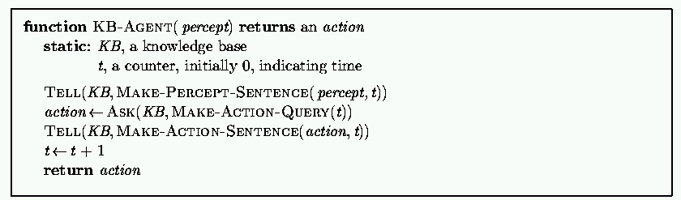
Logical agents for the Wumpus world
Remember: generic knowledge-based agent:
TELL KB what was perceived
Uses a KRL to insert new sentences, representations of facts, into KB
ASK KB what to do.
Uses logical reasoning to examine actions and select best.

Slide 32
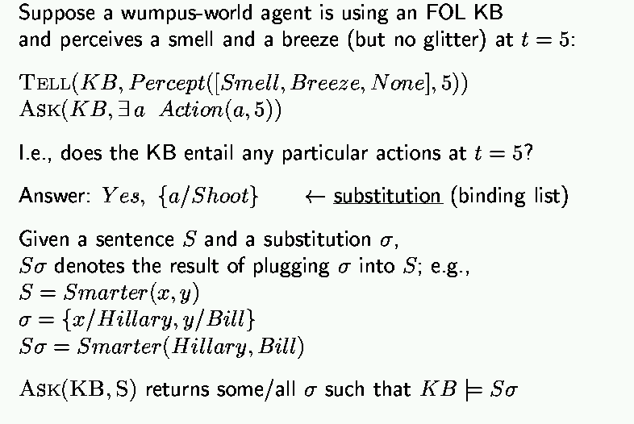
Using the FOL Knowledge Base
Set of solutions
CS 561, Session 12-13

Slide 33
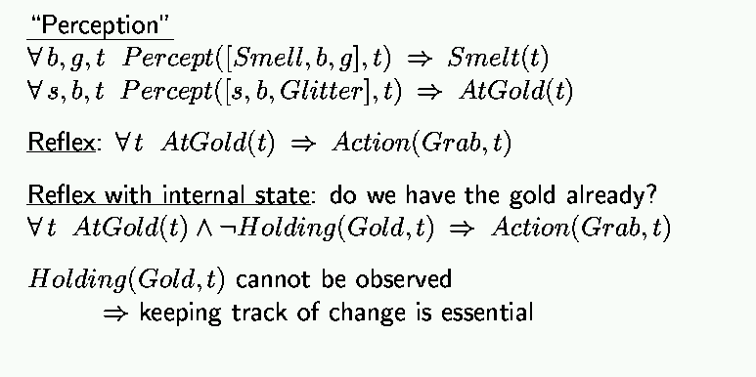
Wumpus world, FOL Knowledge Base
CS 561, Session 12-13

Slide 34
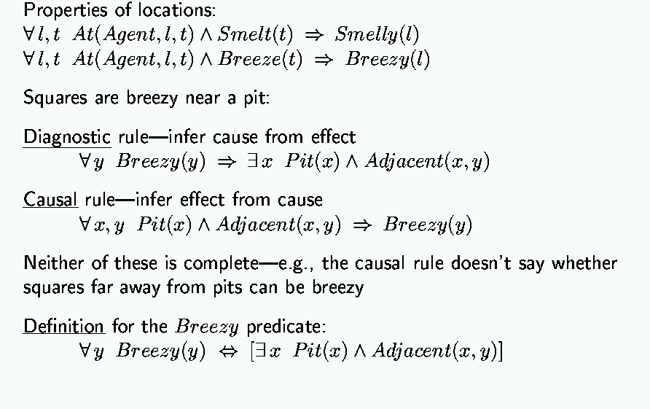
Deducing hidden properties
CS 561, Session 12-13

Slide 35
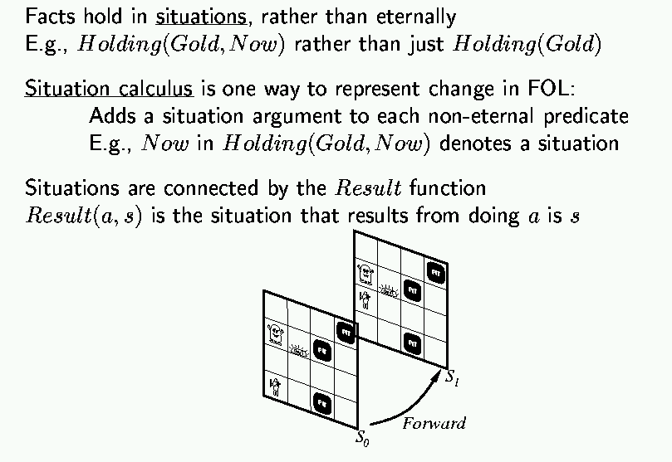
Situation calculus
CS 561, Session 12-13

Slide 36
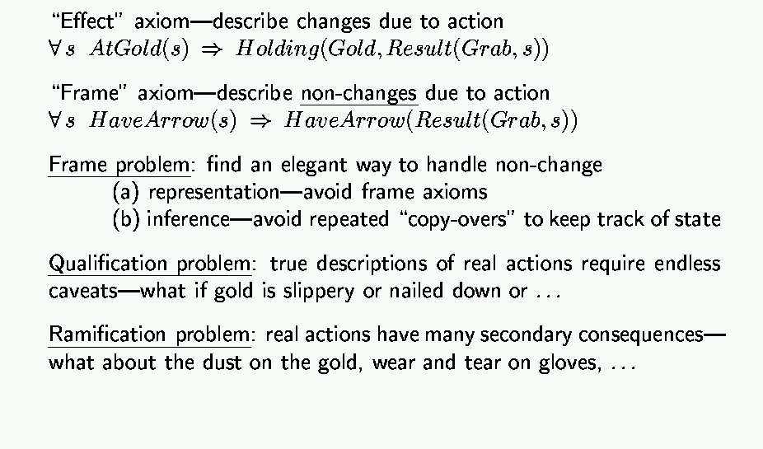
Describing actions
May result in too many frame axioms
CS 561, Session 12-13

Slide 37
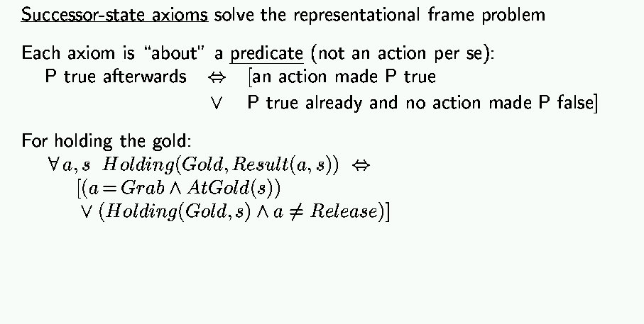
Describing actions (cont’d)

Slide 38
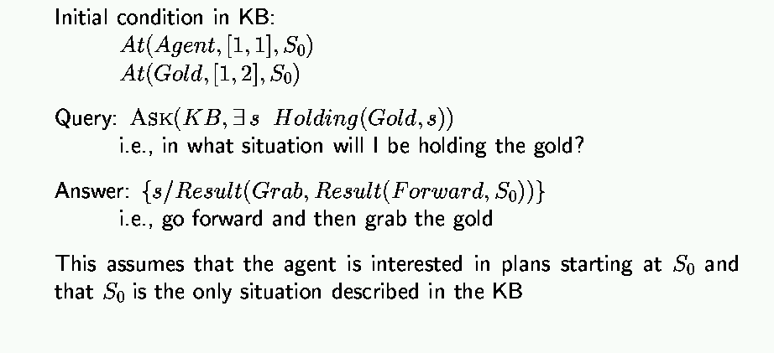
Planning

Slide 39
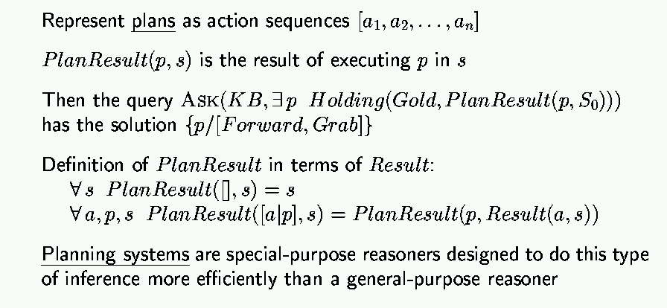
Generating action sequences
[ ] = empty plan
Recursively continue until it gets to empty plan [ ]

Slide 40
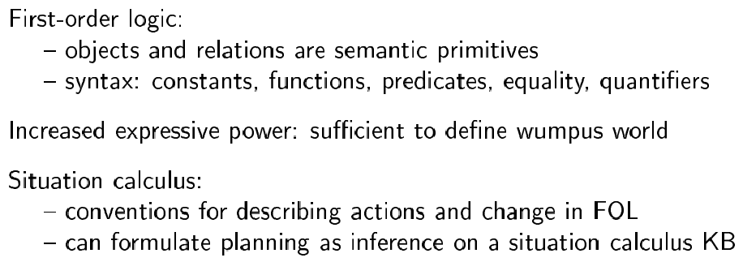
Summary

