Slide 1
Blind (Un-Informed)
and
Heuristic (informed) Strategies

Slide 2
Blind vs. Heuristic Strategies
Blind (or un-informed) strategies have no additional information except available in problem definition
  Distinguish a goal state from a non goal state.
Heuristic (or informed) strategies know whether one non goal state is more promising than others.

Slide 3
Example: 8-puzzle
For a blind strategy, N1
and N2 are just two nodes
(at some depth in the search
tree)
For a heuristic strategy
counting the number of
misplaced tiles, N2 is more
promising than N1
8
2
3
4
7
STATE
N1
5
1
6
1
2
3
1
2
3
4
5
6
4
5
STATE
7
8
N2
7
8
6
Goal state

Slide 4
Blind Strategies
Breadth-first
  Bidirectional
Depth-first
  Depth-limited
  Iterative deepening
Uniform-Cost
Step cost = 1
Step cost = c ≥ ε > 0

Slide 5
Breadth-First Strategy
Expand shallowest unexpanded node.
New nodes are inserted at the end of FRINGE.
1
2
3
FRINGE = (1)
4
5
6
7
FRINGE:
Set of search nodes that have not been expanded yet
The ordering of the nodes in FRINGE defines the search strategy

Slide 6
Breadth-First Strategy
Expand shallowest unexpanded node.
New nodes are inserted at the end of FRINGE.
1
2
3
FRINGE = (2, 3)
4
5
6
7

Slide 7
Breadth-First Strategy
Expand shallowest unexpanded node.
New nodes are inserted at the end of FRINGE.
1
2
3
FRINGE = (3, 4, 5)
4
5
6
7

Slide 8
Breadth-First Strategy
Expand shallowest unexpanded node.
New nodes are inserted at the end of FRINGE.
1
2
3
FRINGE = (4, 5, 6, 7)
4
5
6
7

Slide 9
Bidirectional search
Run two simultaneous searches-one forward from the initial state and the other backward from the goal state.
It is implemented by checking each node before it is expanded to see if it is in the fringe of the other search tree.
Otherwise Stop when two searches meet in the middle.

Slide 10
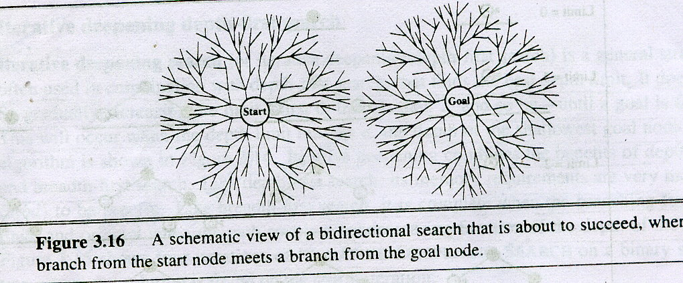
Bidirectional Strategy

Slide 11
Bidirectional Strategy
2 fringe queues: FRINGE1 and FRINGE2
d
d/2
d/2

Slide 12
Depth-First Strategy
Expand deepest unexpanded node
New nodes are inserted at the front of FRINGE
1
2
3
4
5

Slide 13
Depth-First Strategy
Expand deepest unexpanded node
New nodes are inserted at the front of FRINGE
1
2
3
4
5

Slide 14
Depth-First Strategy
Expand deepest unexpanded node
New nodes are inserted at the front of FRINGE
1
2
3
4
5

Slide 15
Depth-First Strategy
Expand deepest unexpanded node
New nodes are inserted at the front of FRINGE
1
2
3
4
5

Slide 16
Depth-First Strategy
Expand deepest unexpanded node
New nodes are inserted at the front of FRINGE
1
2
3
4
5

Slide 17
Depth-First Strategy
Expand deepest unexpanded node
New nodes are inserted at the front of FRINGE
1
2
3
4
5

Slide 18
Depth-First Strategy
Expand deepest unexpanded node
New nodes are inserted at the front of FRINGE
1
2
3
4
5

Slide 19
Depth-First Strategy
Expand deepest unexpanded node
New nodes are inserted at the front of FRINGE
1
2
3
4
5

Slide 20
Depth-First Strategy
Expand deepest unexpanded node
New nodes are inserted at the front of FRINGE
1
2
3
4
5

Slide 21
Depth-First Strategy
Expand deepest unexpanded node
New nodes are inserted at the front of FRINGE
1
2
3
4
5

Slide 22
Depth-First Strategy
Expand deepest unexpanded node
New nodes are inserted at the front of FRINGE
1
2
3
4
5

Slide 23
Problem
If one subtree were of unbounded depth but contained no solution, it would never terminate.
To overcome this depth limited search is used.

Slide 24
Depth-Limited Strategy
Depth-first with depth limit k (maximal depth below which nodes are not expanded)
Three possible outcomes:
  Solution
  Failure (no solution)
  Cutoff (no solution within depth limit)

Slide 25
Iterative deepening search
Iterative deepening search is a state space/graph search strategy in which a depth-limited version of depth-first search is run repeatedly with increasing depth limits until the goal is found.

Slide 26

Iterative deepening search l =0

Slide 27

Iterative deepening search l =1

Slide 28

Iterative deepening search l =2

Slide 29

Iterative deepening search l =3

Slide 30
Uniform-Cost Strategy
Uniform-cost search is an uninformed search algorithm that uses the lowest cumulative cost to find a path from the source to the destination.

Slide 31
Uniform-Cost Strategy
Each step has some cost ≥ ε > 0.
The cost of the path to each fringe node N is
g(N) = Σ costs of all steps.
The goal is to generate a solution path of minimal cost.
The FRINGE is sorted in increasing cost.
A
S
0
1
10
S
5
B
5
G
A
B
C
1
5
15
5
15
C
G
G
11
10

