Slide 1
Two-Player Games
For example, let us consider Tic-Tac-Toe (although it would still be possible to search the complete game tree for this game).
What would be a suitable evaluation function for this game?
We could use the number of lines that are still open for the computer (X) minus the ones that are still open for its opponent (O).
‹#›

Slide 2
Two-Player Games
X
O | X
O | O | X
X | O
X
e(p) = 8 – 8 = 0
e(p) = 6 – 2 = 4
e(p) = 2 – 2 = 0
shows the weak-ness of this e(p)
How about these?
O | O | X
 | X
X
X | X
O | O | O
 | X
e(p) = ∞
e(p) = - ∞
‹#›

Slide 3
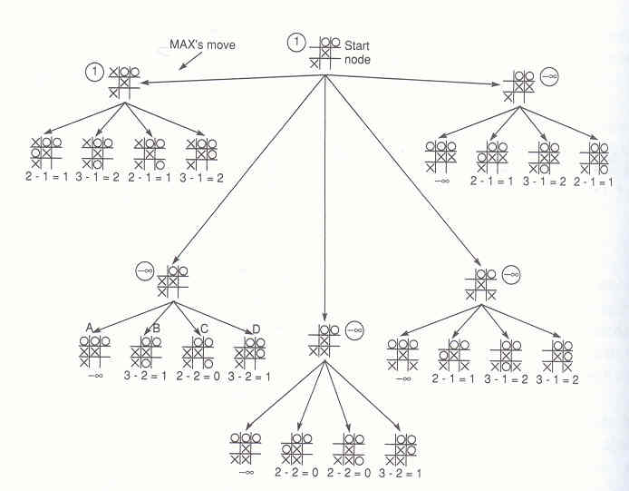
Two-Player Games
‹#›

Slide 4
The Alpha-Beta Procedure
Now let us specify how to prune the Minimax tree in the case of a static evaluation function.
Use two variables alpha (associated with MAX nodes) and beta (associated with MIN nodes).
These variables contain the best (highest or lowest, resp.) e(p) value at a node p that has been found so far.
Notice that alpha can never decrease, and beta can never increase.
‹#›

Slide 5
The Alpha-Beta Procedure
There are two rules for terminating search:
Search can be stopped below any MIN node having a beta value less than or equal to the alpha value of any of its MAX ancestors.
Search can be stopped below any MAX node having an alpha value greater than or equal to the beta value of any of its MIN ancestors.
Alpha-beta pruning thus expresses a relation between nodes at level n and level n+2 under which entire subtrees rooted at level n+1 can be eliminated from consideration.
‹#›

Slide 6
The Alpha-Beta Procedure
Example:
max
min
max
min
‹#›

Slide 7
The Alpha-Beta Procedure
Example:
max
min
max
β = 4
min
4
‹#›

Slide 8
The Alpha-Beta Procedure
Example:
max
min
max
β = 4
min
4
5
‹#›

Slide 9
The Alpha-Beta Procedure
Example:
max
min
α = 3
max
β = 3
min
4
5
3
‹#›

Slide 10
The Alpha-Beta Procedure
Example:
max
min
α = 3
max
β = 3
β = 1
min
4
5
3
1
‹#›

Slide 11
The Alpha-Beta Procedure
Example:
max
β = 3
min
α = 3
max
β = 3
β = 1
β = 8
min
4
5
3
1
8
‹#›

Slide 12
The Alpha-Beta Procedure
Example:
max
β = 3
min
α = 3
max
β = 3
β = 1
β = 6
min
4
5
3
1
8
6
‹#›

Slide 13
The Alpha-Beta Procedure
Example:
max
β = 3
min
α = 3
α = 6
max
β = 3
β = 1
β = 6
min
4
5
3
1
8
6
7
‹#›

Slide 14
The Alpha-Beta Procedure
Example:
α = 3
max
β = 3
min
α = 3
α = 6
max
β = 3
β = 1
β = 6
min
4
5
3
1
8
6
7
‹#›

Slide 15
The Alpha-Beta Procedure
Example:
α = 3
max
β = 3
min
α = 3
α = 6
max
β = 3
β = 1
β = 6
β = 2
min
4
5
3
1
8
6
7
2
‹#›

Slide 16
The Alpha-Beta Procedure
Example:
α = 3
max
β = 3
min
α = 3
α = 6
α = 3
max
β = 3
β = 1
β = 6
β = 2
min
4
5
3
1
8
6
7
2
‹#›

Slide 17
The Alpha-Beta Procedure
Example:
α = 3
max
β = 3
min
α = 3
α = 6
α = 3
max
β = 3
β = 1
β = 6
β = 2
β = 5
min
4
5
3
1
8
6
7
2
5
‹#›

Slide 18
The Alpha-Beta Procedure
Example:
α = 3
max
β = 3
min
α = 3
α = 6
α = 3
max
β = 3
β = 1
β = 6
β = 2
β = 4
min
4
5
3
1
8
6
7
2
5
4
‹#›

Slide 19
The Alpha-Beta Procedure
Example:
α = 3
max
β = 3
β = 4
min
α = 3
α = 6
α = 4
max
β = 3
β = 1
β = 6
β = 2
β = 4
min
4
5
3
1
8
6
7
2
5
4
4
‹#›

Slide 20
The Alpha-Beta Procedure
Example:
α = 3
max
β = 3
β = 4
min
α = 3
α = 6
α = 4
max
β = 3
β = 1
β = 6
β = 2
β = 4
β = 6
min
4
5
3
1
8
6
7
2
5
4
4
6
‹#›

Slide 21
The Alpha-Beta Procedure
Example:
α = 3
max
β = 3
β = 4
min
α = 3
α = 6
α = 4
max
β = 3
β = 1
β = 6
β = 2
β = 4
β = 6
min
4
5
3
1
8
6
7
2
5
4
4
6
7
‹#›

Slide 22
The Alpha-Beta Procedure
Example:
α = 4
max
β = 3
β = 4
min
α = 3
α = 6
α = 4
α = 6
max
β = 3
β = 1
β = 6
β = 2
β = 4
β = 6
min
4
5
3
1
8
6
7
2
5
4
4
6
7
7
‹#›

Slide 23
The Alpha-Beta Procedure
Example:
α = 4
max
Done!
β = 3
β = 4
min
α = 3
α = 6
α = 4
α = 6
max
β = 3
β = 1
β = 6
β = 2
β = 4
β = 6
min
4
5
3
1
8
6
7
2
5
4
4
6
7
7
‹#›

