Slide 1

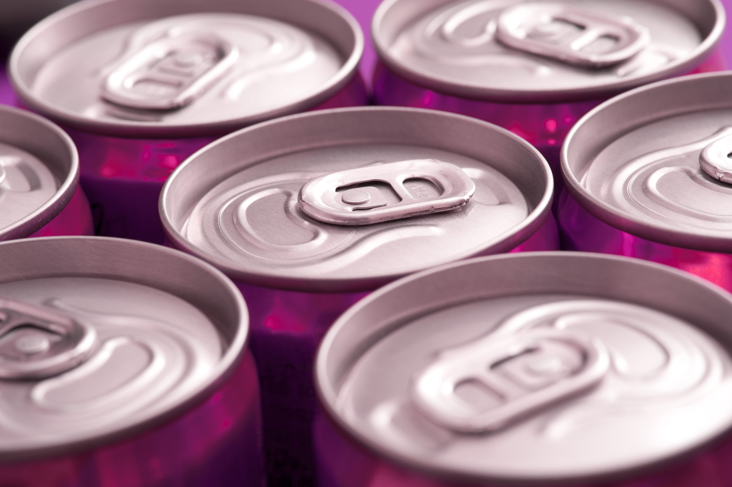

Codex Energy Drink
F&B Industry
Marketing Insights by: Parvez Alam

Slide 2
Outline
About Codex, Energy drink industry & objectives
Data set, problem statements & Tools used
Primary Insights
Secondary Insights
Findings & Recommendations
1
2
3
4
5

Slide 3
About Codex
Codex
German company that operates in Food & Beverage Industry.
Industry
Current market size of energy drinks is 2,400 cr (premium and affordable segments)
Objective
The company wishes to increase brand awareness, market share, and product development.
Recently launched their energy drink in 10 cities in India.
Codex is at 5th position in terms of market capitalization.
It is expected to be 10,000 cr by 2030 growing at a CAGR of 45%
Young Population, Rising disposable income, health consciousness are major driving forces
They conducted a survey in those 10 cities and received results from 10k respondents.

Slide 4
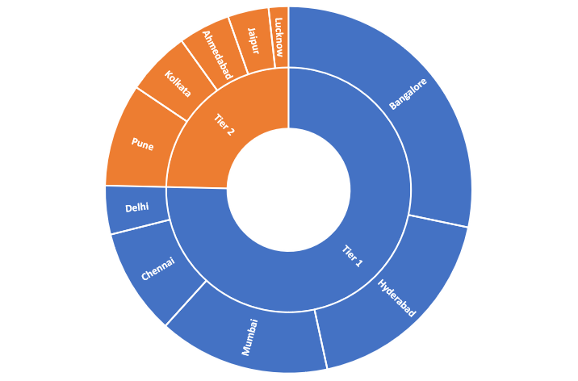
Data Sets, Problem Statement & Tools used
Power Query Power Pivot
Excel Charts
Power Point
DAX
Based on the data collected provide primary insight and Secondary insight to the marketing team

Slide 5
Primary Insights
(Descriptive Data Analytics)

Slide 6
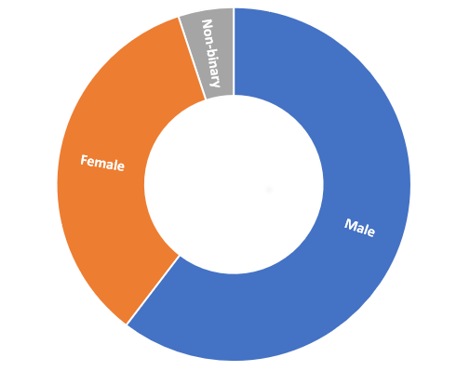
Demographic Insights
Who prefers energy drink more?
60% (6,038) of the respondents are male, 35% (3,455) are female and 5% (507) are Non-binary

Slide 7

Demographic Insights
Which age group prefers energy drinks more?
Youth-adults (15-30) 70% of the total respondents, prefer energy drinks

Slide 8
Demographic Insights
Which type of marketing reaches the most Youth (15-30)?
Online ads reaches 48% of the youth followed by TV commercials 25%

Slide 9
Consumer Preferences
Preferred ingredients of energy drinks
Packaging preferences for energy drinks
Caffeine is the preferred ingredients, followed by vitamins
Compact, portable and innovative bottle is the preferred choice

Slide 10
Competition Analysis
Who are the current market leaders?
Cola-Coka is current market leader with 25% market shares, followed by Bepsi 21%

Slide 11
Competition Analysis
reasons consumers prefer those brands over ours?
Brand reputation, taste-flavor as well as availability are major factors

Slide 12
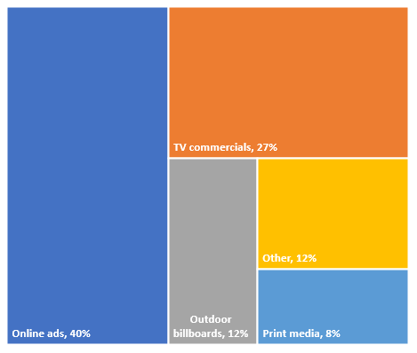
Marketing Channel & Brand Awareness
Marketing channel to reach more customers?
Online Advertising
Event Sponsorship
Social Media Marketing
Influencer Marketing
Online ads attracts most eyeballs 40% followed by TV Commercials 27%

Slide 13
Brand Penetration
Overall rating
Jaipur | 3.4
Kolkata | 3.4
Bangalore | 3.3
Hyderabad | 3.3
Mumbai | 3.3
Pune | 3.3
Chennai | 3.2
Ahmedabad | 3.1
Lucknow | 3.1
Delhi | 3.1
Brand Perception
3.3
3
4,881 respondents tried CODEX before. Average rating is 3.3
2
4
1
5

Slide 14
Brand Penetration
Which cities do we need to focus more on?
Brand awareness is lowest in these 5 cities.
63% of the respondents are not aware about CODEX energy drink in Kolkata.
1

Slide 15
Purchase Behaviour
Purchase location
Consumption Situation
45% of the respondents are purchasing the energy drink from Supermarket and 26% from online retailers
Sports/ exercise & studying/working late is the major reason of consumption
1

Slide 16
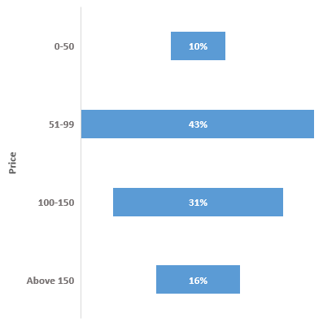
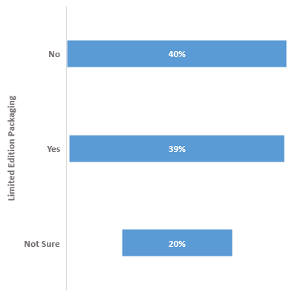
Purchase Behaviour
factors influence respondents' purchase decisions
74% of the respondents are that the price of the product should be between 51-150
Limited edition packaging does not influence the purchasing decisions.
1

Slide 17
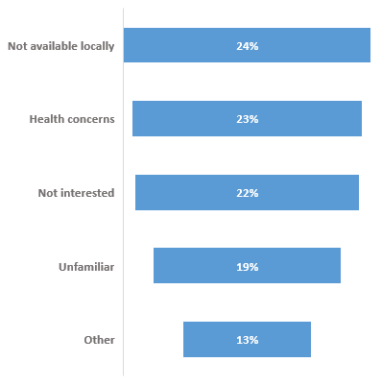
Product Development
Which area of business should we focus more on our product development?
51% of the respondents have not tried the Codex energy drink before
24% of the respondents (Not tried) says that the drink is not available locally
Health concern is another major reason the people not tried Codex energy drink before

Slide 18
Secondary Insights
(Prescriptive Data Analytics)

Slide 19
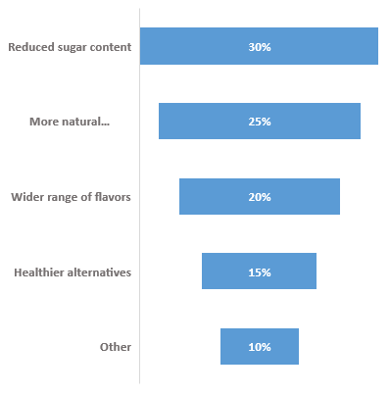
Recommendation: 1
What immediate improvements can we bring to the product?
61% of the respondents are concern about the health impact of energy drink.
The immediate improvement in the product should be to reduce sugar content, more natural ingredients and favors

Slide 20
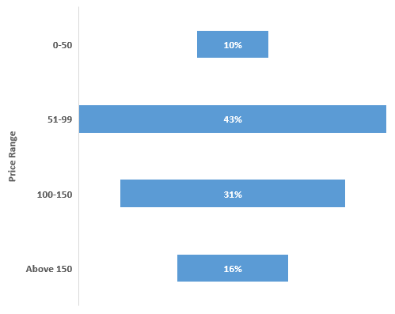
Recommendation: 2
What should be the ideal price of our product?
Pricing is crucial because there are other major players.
The company can adopt Penetration Pricing by offering the product at a price range of (51-99) to quickly gain market share
After that differentiate energy drink with unique features, flavors, or packaging to attract premium-paying consumers. (100-200)

Slide 21
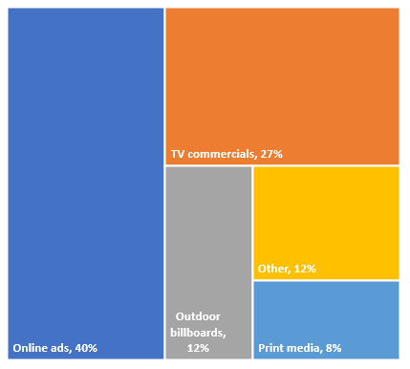
Recommendation: 3
What kind of marketing campaigns, offers, and discounts we can run?
Digital Marketing Campaigns
Influencer Partnerships
Content Marketing
Social Media Contests
Hashtag Contests
Giveaways
Search Engine Optimization
Online Advertising
Social Media Contests
Sponsor local events
concerts, or sports tournaments
Television Commercials
Continue running TV commercials
product placement in TV shows, movies and web series
40% of the respondents get to know about the product through online ads followed by 27% via TV commercials

Slide 22
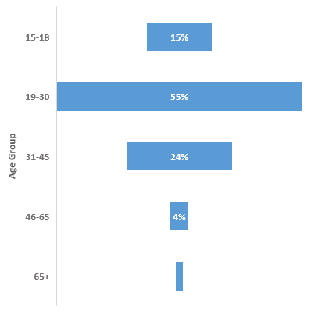
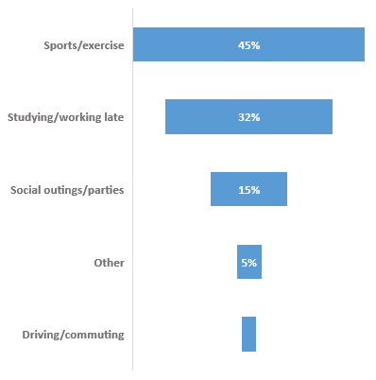
Recommendation: 4
Who can be a brand ambassador, and why?
To decide the brand ambassador we need to understand our target market
Sports Athlete, Fitness Influencer, Social Media Influencer
The brand ambassador should be some one that is appealing to the youth adults
It is crucial to select someone whose persona aligns with the brand's messaging, appeals to the target audience, and can effectively communicate the product's benefits.

Slide 23
Recommendation: 5
Who should be our target audience, and why?
Benefits of Energy drink
Increased Energy and Alertness
Improved Physical Performance
Quick Recovery
Convenience and Portability
Mood Enhancement
Enhanced Focus and Concentration
Active and Fitness Enthusiasts
Young Professionals and Students
Travelers and Adventurers
Gamers and
E-Sports Enthusiasts
Night Shift Workers

Slide 24

Thank You

