Slide 1

AI-Based Network Intrusion Detection System
Name: Vavilathota Parvez Thabarak
AICTE ID :STU65793b747b12c1702443892

Slide 2

PROBLEM STATEMENT
With the rapid increase in internet usage and network-based services, cyber attacks such as DDoS attacks, abnormal traffic behavior, and unauthorized access have become more frequent and complex. Traditional rule-based intrusion detection systems often fail to detect new or unknown attack patterns.
There is a need for an intelligent Network Intrusion Detection System that can automatically analyze network traffic, detect malicious activities using Machine Learning, and provide meaningful explanations to help users understand the detected threats.

Slide 3
Project Description
This project implements an AI-Based Network Intrusion Detection System (NIDS) that uses Machine Learning (Random Forest Algorithm) to classify network traffic as BENIGN or ATTACK.
The system is trained using a real-world network traffic dataset (CIC-IDS2017 – DDoS subset). A Streamlit-based interactive dashboard allows users to train the model, simulate live traffic, and view detection results.
Additionally, Generative AI (Groq LLM) is integrated to provide human-readable explanations for detected network packets, helping users understand why a packet is considered safe or malicious.

Slide 4

WHO ARE THE END USERS?
Network Administrators
Cyber Security Analysts
SOC (Security Operations Center) Teams
Students and Researchers in Cyber Security
Organizations monitoring network traffic

Slide 5

Technology Used
Programming Language: Python
Machine Learning Algorithm: Random Forest Classifier
Web Framework: Streamlit
Libraries: Pandas, NumPy, Scikit-learn
Dataset: CIC-IDS2017 (DDoS traffic subset)
AI Explanation (Optional): Groq LLM API

Slide 6
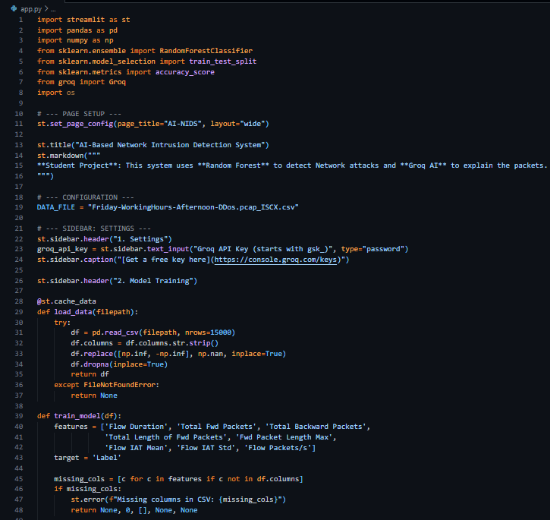
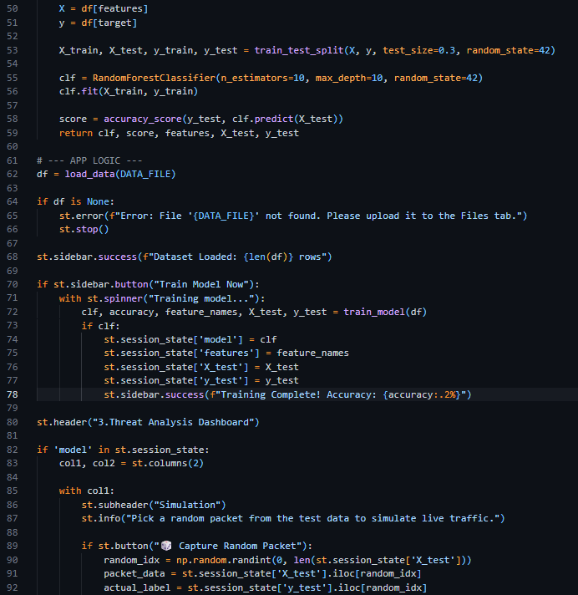
RESULTS

Slide 7
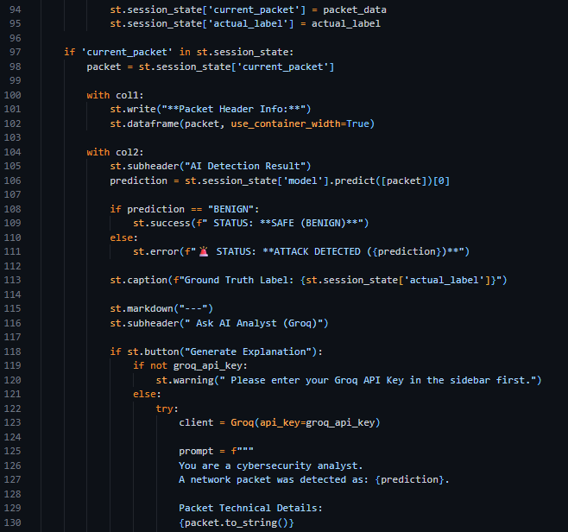
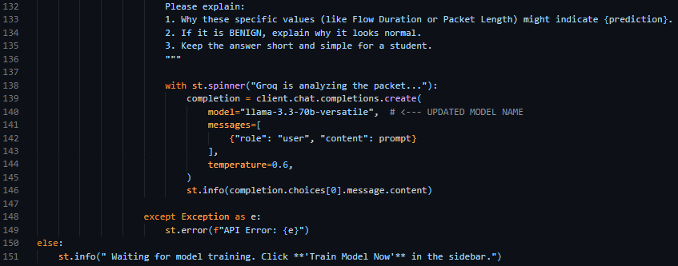
RESULTS

Slide 8
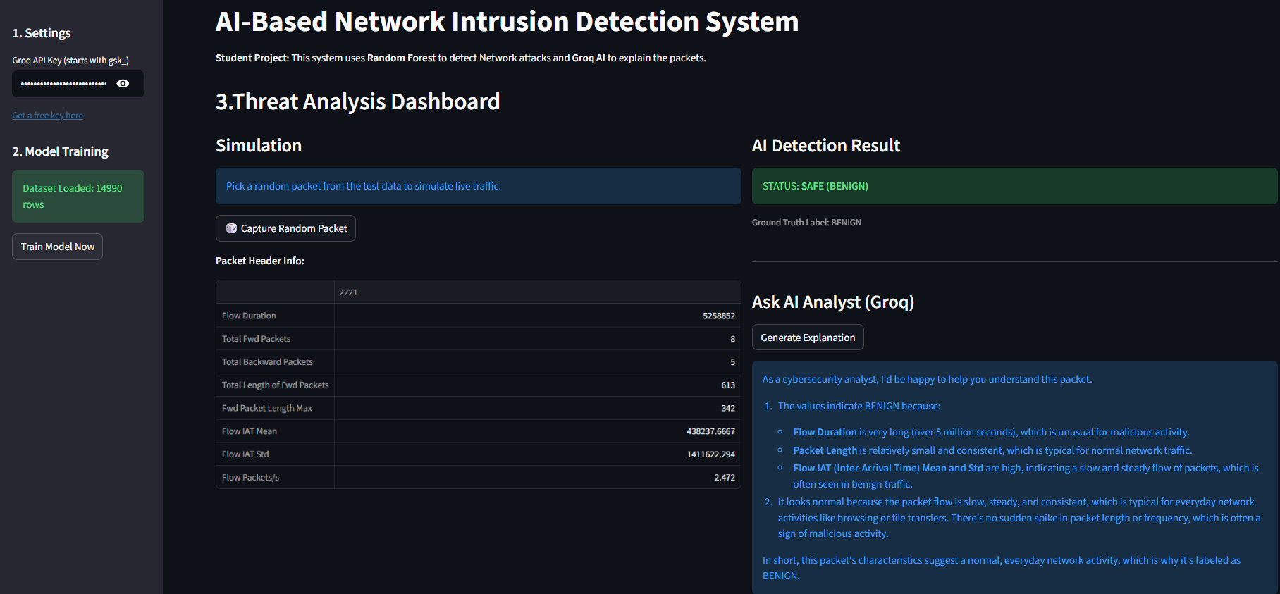
RESULTS

Slide 9
RESULTS
Successfully trained a machine learning model for intrusion detection
Achieved high accuracy in detecting malicious traffic
Correctly classified network packets as BENIGN or ATTACK
Generated AI-based explanations for detected threats
Developed a fully functional interactive dashboard
Demo Link : https://drive.google.com/file/d/1RXWE9F22wkt9CiO7aedQVewmM_31gPyZ/view?usp=drive_link

Slide 10

Certificate - Protection from browser attacks

Slide 11

Certificate - Introduction to System Security

Slide 12

Certificate - Securing Android Devices

Slide 13
GitHub link
AI-Based-Network-Intrusion-Detection-System/app.py at main · ParvezThabarak/AI-Based-Network-Intrusion-Detection-System

Slide 14
Thank you
.
.

