Slide 1
Steganography - Hiding Information in the Image
CAPSTONE PROJECT
Presented By:
Student Name: VAVILATHOTA PARVEZ THABARAK
College Name: SRM INSTITUTE OF SCIENCE AND TECHNOLOGY KTR
Department: CSE – SPECIALIZATION IN CYBER SECURITY
AICTE Internship Student Registration ID : STU65793b747b12c1702443892

Slide 2
OUTLINE
Problem Statement
System Development Approach
Algorithm & Deployment
Result
Conclusion
References

Slide 3
Problem Statement
With increasing cyber threats and surveillance, transmitting secret information securely has become a critical challenge. Traditional cryptography protects the content, but not its existence.
This project addresses the need for covert, secure message transmission by combining cryptography and steganography.
I embed encrypted messages inside images using Least Significant Bit (LSB) manipulation, making the message visually undetectable.
The system ensures confidentiality through AES encryption and usability via a web-based interface.
Our solution provides double-layered protection, ideal for sensitive communication.

Slide 4
System Approach
Technologies Used:
Python
Flask (for web interface)
OpenCV (for image handling)
PyCryptodome (for AES encryption)
HTML/CSS (for frontend UI)
System Requirements:
Python 3.8+
pip packages: flask, numpy, opencv-python, pycryptodome
Libraries Required:
flask, opencv-python, numpy, pycryptodome
werkzeug (for file uploads)

Slide 5
Algorithm & Deployment
Algorithm
User uploads an image and enters a secret message with a password.
Message is encrypted using AES-CBC.
A 256-bit key is derived using PBKDF2 + salt.
Encrypted message is embedded in the image using LSB steganography.
User downloads the encrypted image.
To decrypt, user uploads the image and enters the same key.
System extracts encrypted bits, decrypts them, and displays the original message.
Deployment:
Hosted locally using Flask web server.
Can be containerized or hosted on platforms like Heroku or Render.

Slide 6
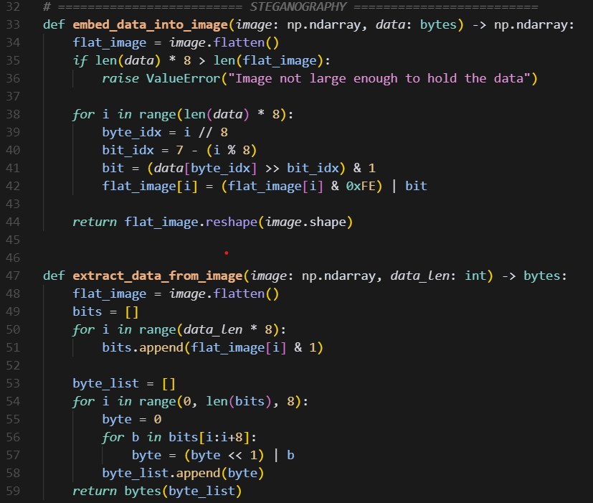
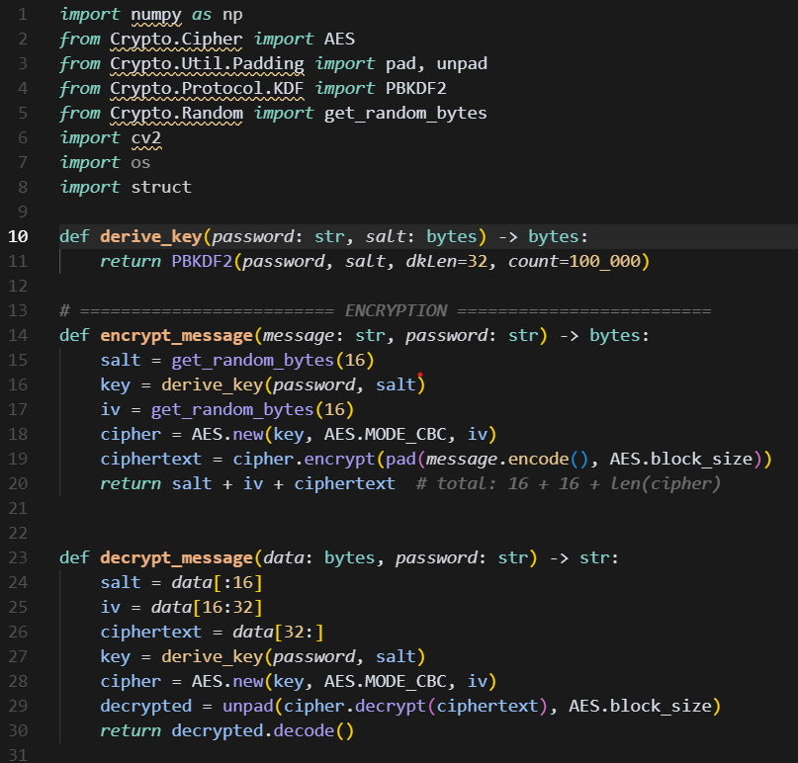
Result

Slide 7
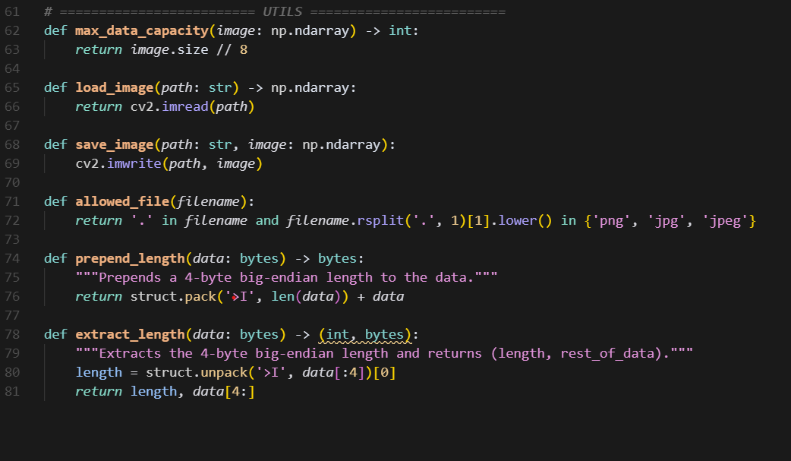

Slide 8
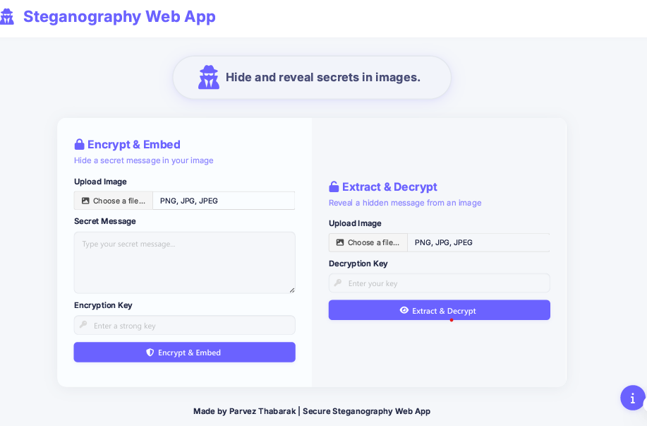

Slide 9
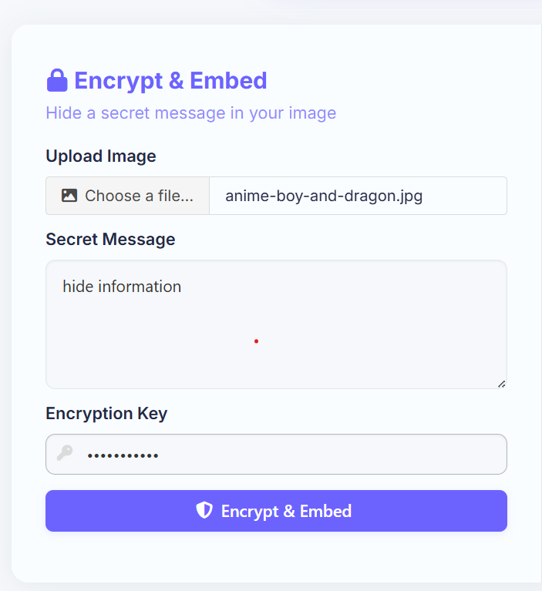
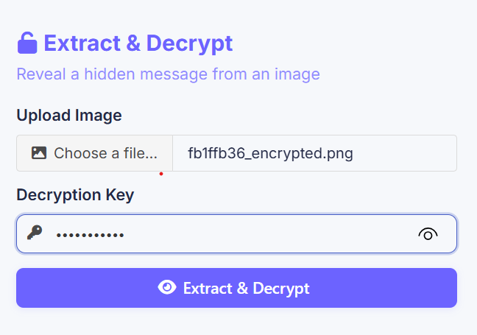
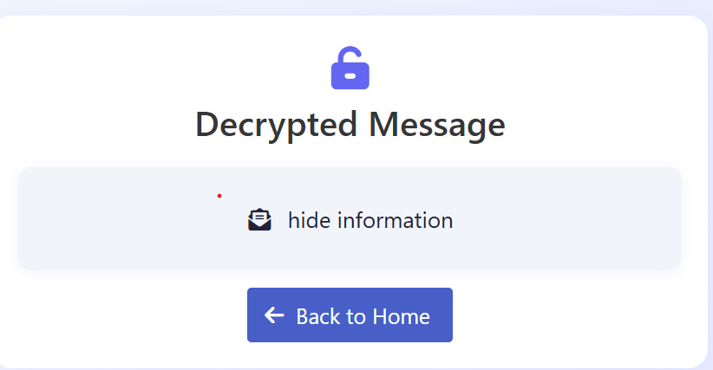
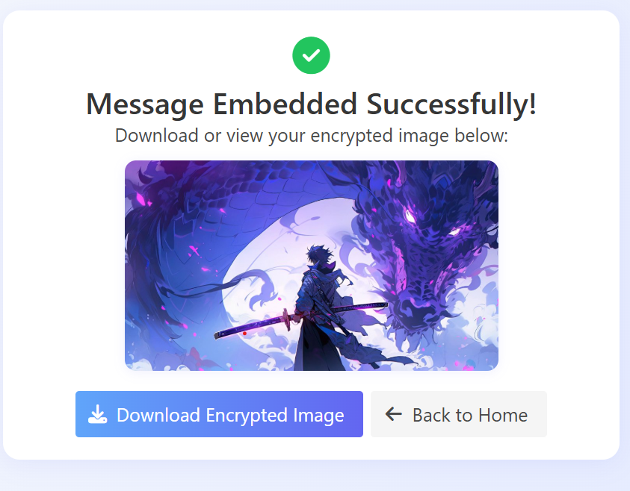

Slide 10
RESULT
GITHUB LINK
ParvezThabarak/Steganography---Hiding-Information-in-the-Image: Config files for my GitHub profile.

Slide 11
Conclusion
The proposed system successfully hides encrypted messages inside images using a secure and invisible method.
By combining AES encryption with LSB steganography, I ensure data confidentiality and stealth.
The Flask web app offers a user-friendly interface to securely send and retrieve hidden messages.
Challenges included handling image size vs. message length, secure key derivation, and ensuring robustness of extraction.
Future improvements can include multi-image support, file hiding, and cloud deployment.

Slide 12
References
https://en.wikipedia.org/wiki/Steganography
https://pycryptodome.readthedocs.io
https://docs.opencv.org
NIST AES Standards
Flask & Werkzeug Official Docs

Slide 13
THANK YOU

