Slide 1
Data Science Workflow
Binary Classification
Parvin Shakibaei

Slide 2
High Lights

Slide 3
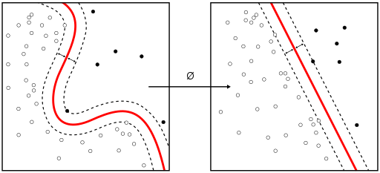
What is a classifier
In machine learning and statistics, classification is the problem of identifying to which of a set of categories (sub-population) a new observation belongs

Slide 4
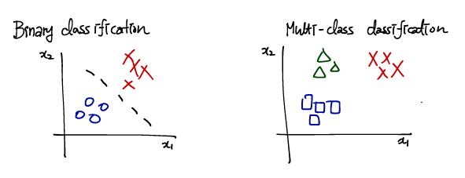

Slide 5
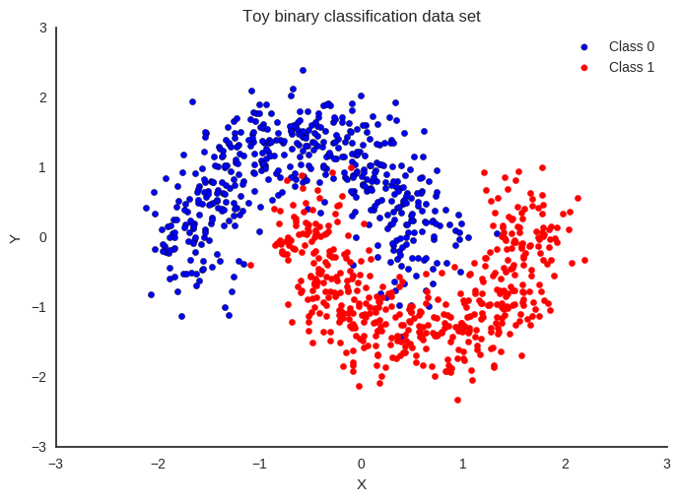
Binary Classifier
Binary or binomial classification is the task of classifying the elements of a given set into two groups (predicting which group each one belongs to) on the basis of a classification rule.

Slide 6
