Slide 1
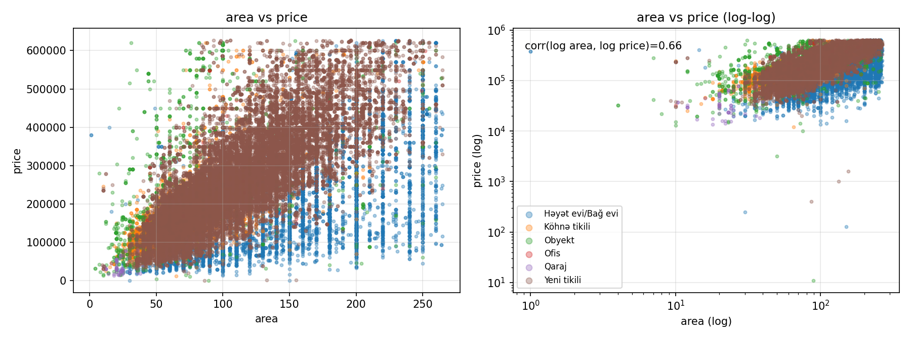
FINAL PROJECT / MACHINE LEARNING
Predicting property prices
in Azerbaijan-Overfitters Team
From-scratch decision trees and Pegasos SVM
on bina.az listings
TASK A / LOG-PRICE REGRESSION
TASK B / PRICE-TIER CLASSIFICATION
93,150 cleaned listings | 28 features
LISTING AREA AND PRICE
Teymur Alasgarov | Tofiq Heydarov | Parvin Salahov
01

Slide 2
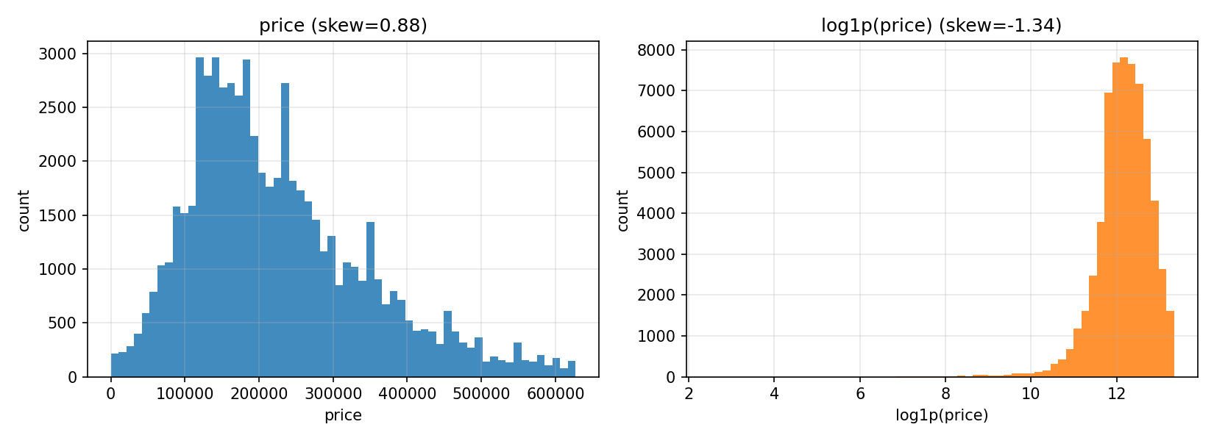
01 / DATA & PREPARATION
Turning listings into model inputs
RAW LISTINGS
ANALYTICAL ROWS
INPUT FEATURES
MEDIAN PRICE
100,775
93,150
28
200,000 AZN
before duplicate handling
after filtering and cleaning
after encoding
training split
WHAT WE DID
Handled duplicate listings; 100,773 rows remained.
Prepared area, land area, floor, rooms, city and category features.
Removed IDs, URLs, scrape-time fields and price-derived columns such as unit_price and total_price.
Price was treated in source units (reported as AZN); no currency-conversion step is documented.
Log(area) vs log(price): 0.658 | Rooms vs log(price): 0.400
The log transform reduces the raw-price skew in the analyzed training data.
02

Slide 3
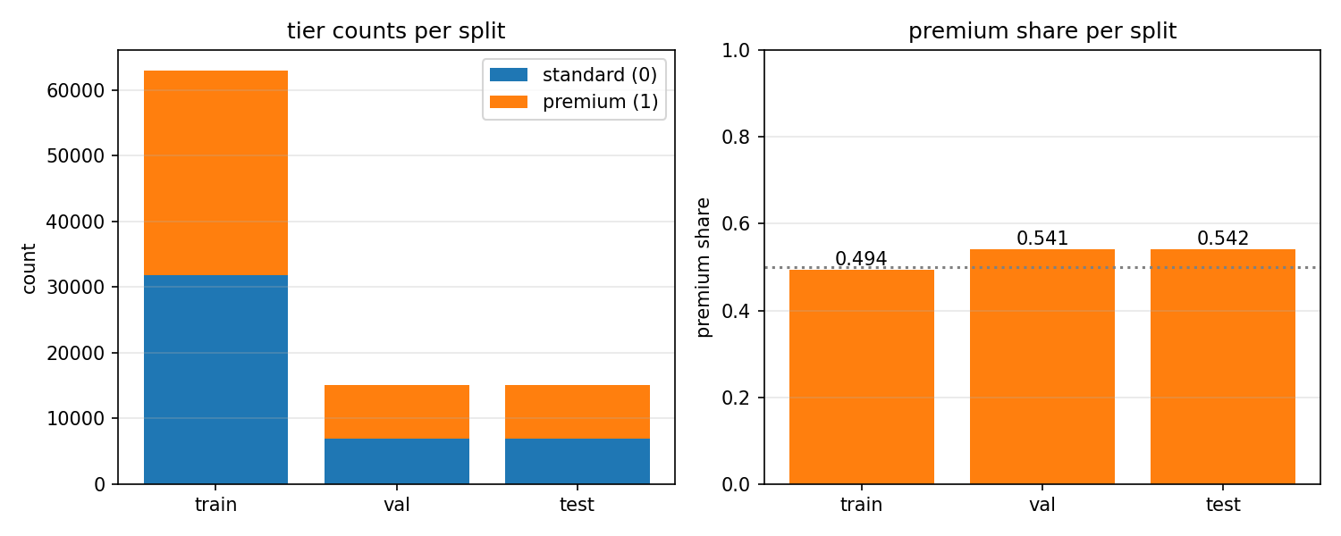
02 / PROBLEM FRAMING
Two tasks, one shared dataset
TASK A / REGRESSION
SPLITS AND TIER BALANCE
Predict log(1 + price)
Train 62,922 Validation 15,114 Test 15,114
Metrics: RMSE | MAE | R-squared
TASK B / CLASSIFICATION
Premium vs standard
Premium = above training-price median
Premium share: 49.4% train | 54.1% validation | 54.2% test
Metrics: precision | recall | F1 | AUC
The split used price quartile bins; it was not stratified directly on the tier label.
03

Slide 4
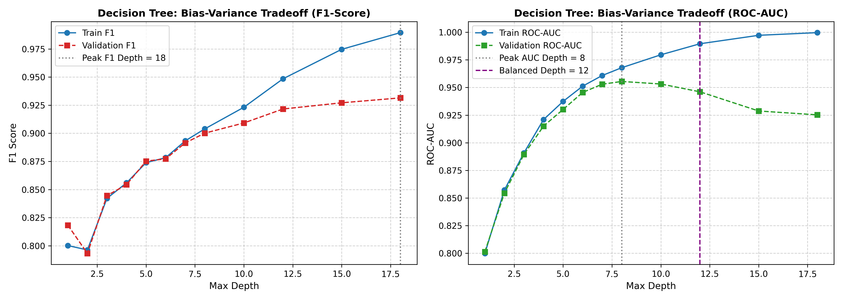
03 / FROM-SCRATCH MODEL
Decision tree: choose splits that reduce impurity
IMPLEMENTATION
Recursive NumPy tree with numeric threshold search.
Regression splits reduce variance / MSE; leaves predict the mean.
Classification splits use Gini or entropy; leaves report class frequencies.
Stopping controls: max depth, minimum split/leaf samples, and minimum impurity decrease.
Tree hyperparameters chosen with validation data.
At deep settings, training AUC approaches 1.00 while validation AUC falls: a clear overfitting signal.
04

Slide 5
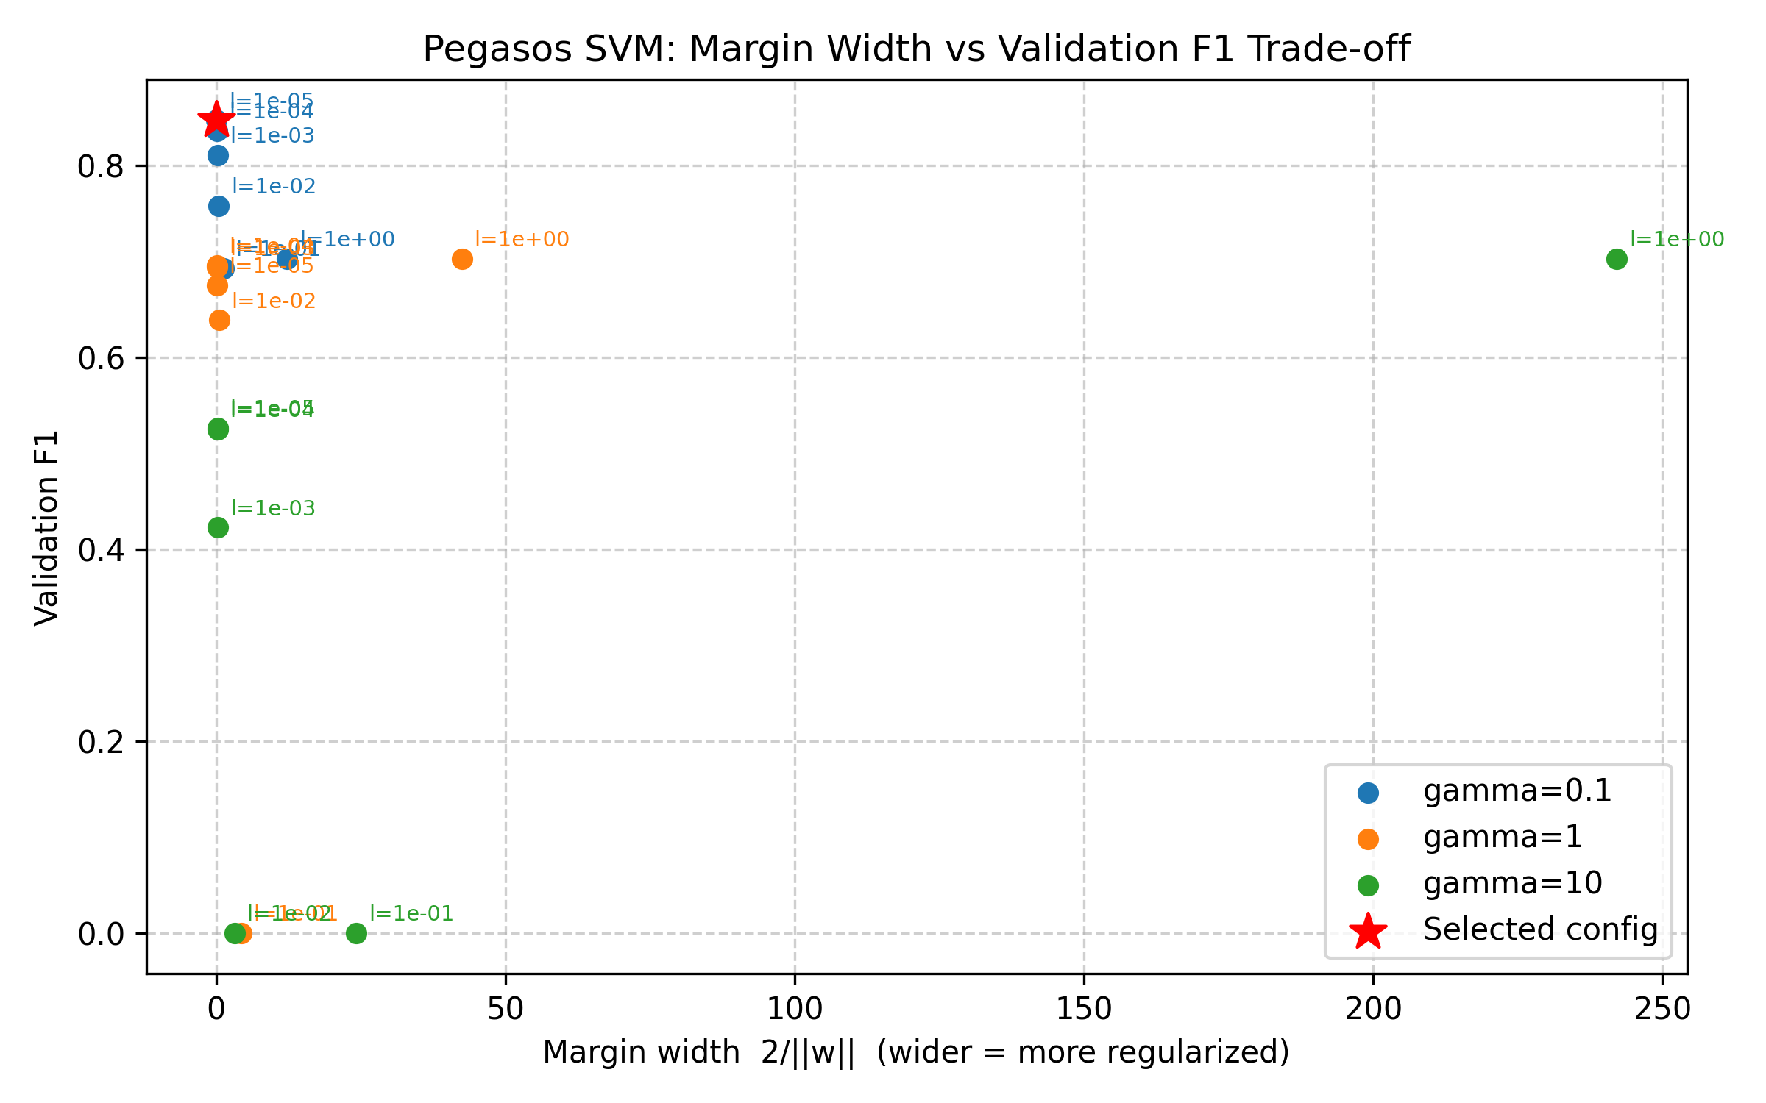
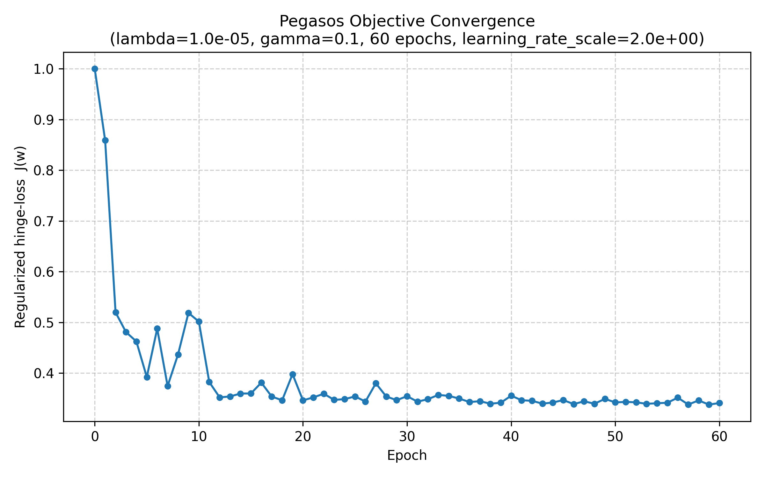
04 / FROM-SCRATCH MODEL
Pegasos SVM: hinge loss plus random features
THE MODEL
J(w,b) = 0.5*lambda*||w||^2 + mean(max(0, 1 - y*f(x)))
Stochastic sub-gradient updates; fixed random seed.
Inputs standardized from training statistics.
256 Random Fourier Features approximate an RBF kernel.
Best validation grid: lambda=1e-5, gamma=0.1 (F1=0.8469; AUC=0.9073). Margin = 2/||w|| in RFF space.
05

Slide 6
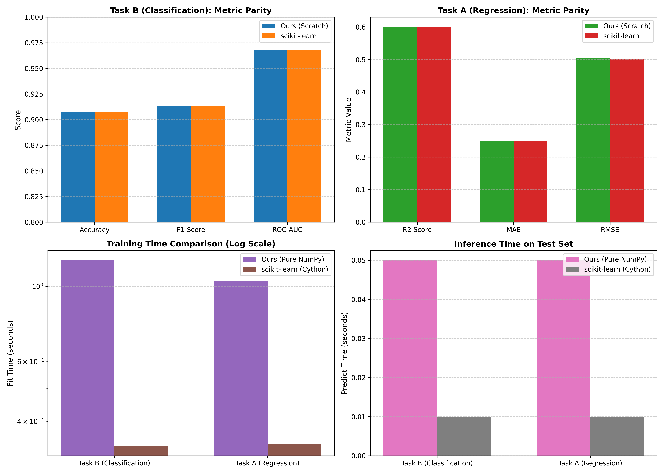
05 / RESULTS
Held-out results: trees are closely matched
Test-set metrics from the full pipeline run (15,114 listings)
Model | Task A RMSE | Task B accuracy | Task B F1 | Task B ROC-AUC
Scratch decision tree | 0.5036 | 0.9079 | 0.9131 | 0.9675
scikit-learn decision tree | 0.5028 | 0.9078 | 0.9131 | 0.9674
Pegasos RFF (main run) | N/A | 0.8511 | 0.8612 | 0.9282
scikit-learn SGD hinge | N/A | 0.8478 | 0.8578 | 0.9198
The scratch tree is within rounding distance of the sklearn tree on this split. Pegasos outperforms the linear SGD baseline on F1/AUC in this main run.
Separate SVM benchmark below uses train + validation for fitting after model selection; its results are reported on Slide 7.
06

Slide 7
06 / COMPARISON & LIMITATIONS
Benchmark context and where errors remain
SVM BENCHMARK / 5-FOLD TASK B F1
PEGASOS TEST CONFUSION MATRIX
Model | F1 mean +/- std | ROC-AUC mean +/- std
Pegasos RFF | 0.8397 +/- 0.0164 | 0.9223 +/- 0.0070
RBF SVC | 0.8874 +/- 0.0052 | 0.9570 +/- 0.0030
SGD hinge | 0.8297 +/- 0.0070 | 0.9022 +/- 0.0063
 | Pred. standard | Pred. premium
Actual standard | 5,989 | 939
Actual premium | 1,545 | 6,641
SVC performed best in this separate benchmark.
Pegasos misses more premium listings than it falsely labels as premium.
LIMITATIONS TO DISCUSS
Land and commercial listings have much higher regression errors than common apartment types.
Sparse categories and regions have fewer examples; their scores are less stable.
RFF approximates, but does not exactly reproduce, the RBF kernel.
07

Slide 8
07 / TEAM & NEXT STEPS
What we learned - and what comes next
TEAM
Main takeaway
Our from-scratch tree performed close to scikit-learn: Task B F1 was 0.9131; Task A RMSE was 0.5036 versus 0.5026.
Pegasos with Random Fourier Features outperformed the linear SGD baseline, while the exact RBF SVC achieved higher scores.
What comes next
Explore whether more Random Fourier Features improve the SVM’s accuracy.
Add more data or location features to better handle rare property types and districts.
Thank you — Questions?
Teymur Alasgarov ~ 40 %
Tofiq Heydarov ~ 27%
Parvin Salahov ~ 33 %
08

