Slide 1
BuLLM BAM Workbench
Updated UI screens: Login → Data Ingestion → RAG → FDE Workbench → Sandbox
16 screens + login in 22 views · captured from the running app (localhost:5174), light theme, 1440×900 · updated 14 Oct 2026

Slide 2
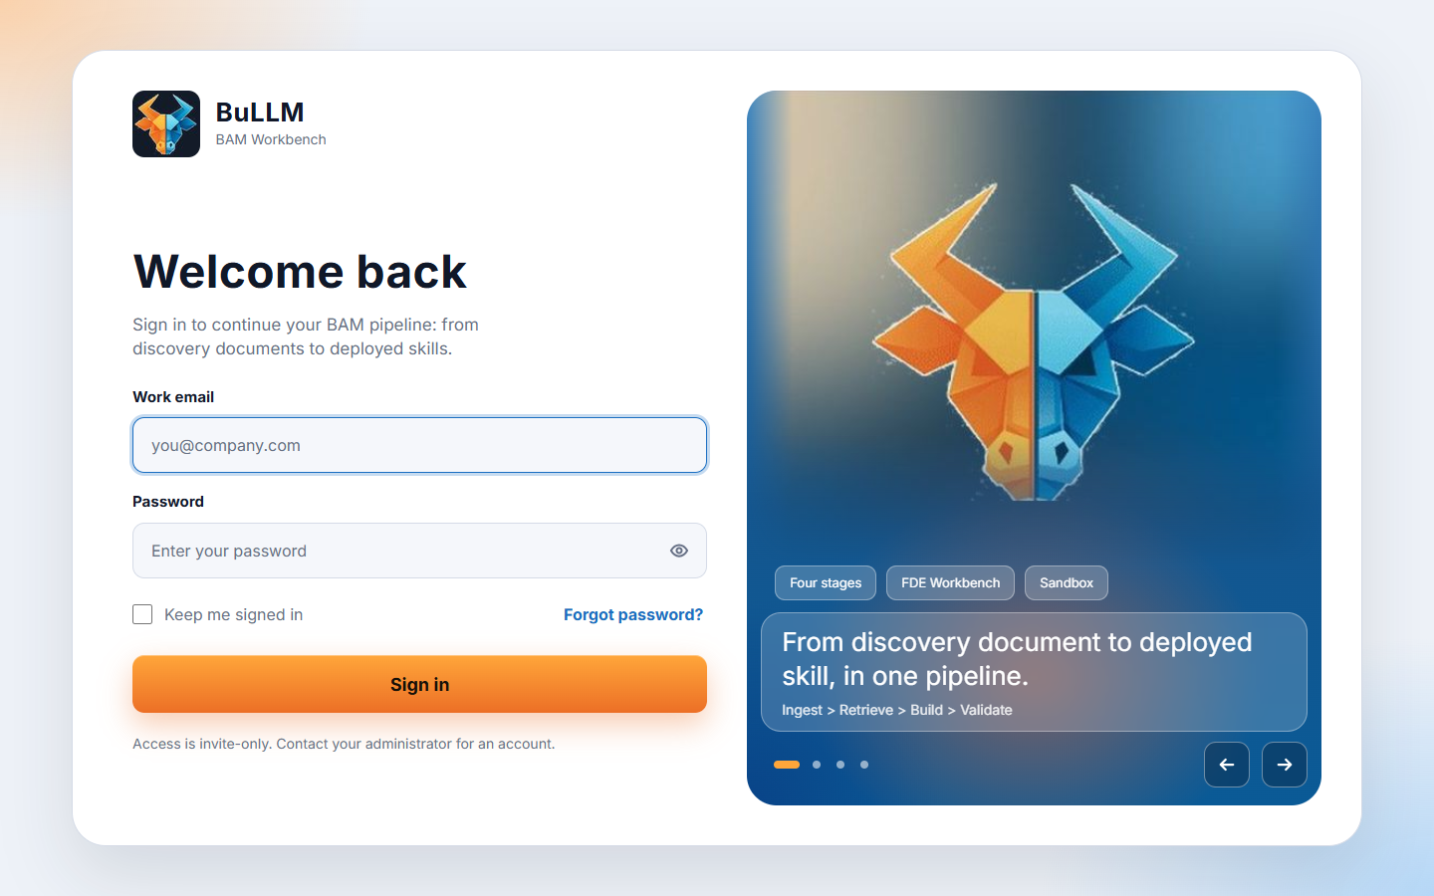
SIGN IN
01 / 22
Login
Public /login: work email + password, "Keep me signed in", quote carousel. Every other route redirects here without a session.

Slide 3
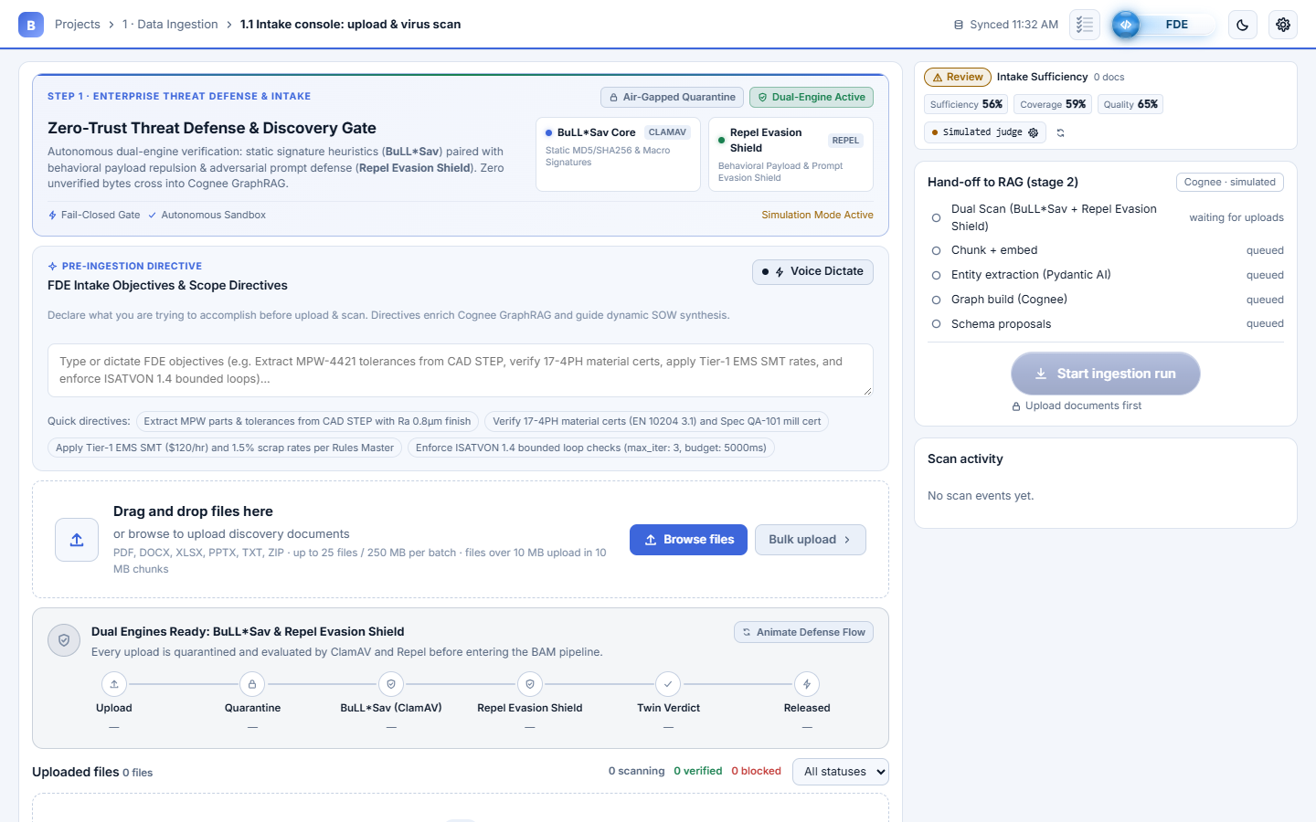
1 · DATA INGESTION
02 / 22
1.1 Intake console: upload & virus scan
Zero-Trust Threat Defense gate: FDE intake directives (voice dictation), drag and drop or Bulk upload, Intake Sufficiency HUD.

Slide 4
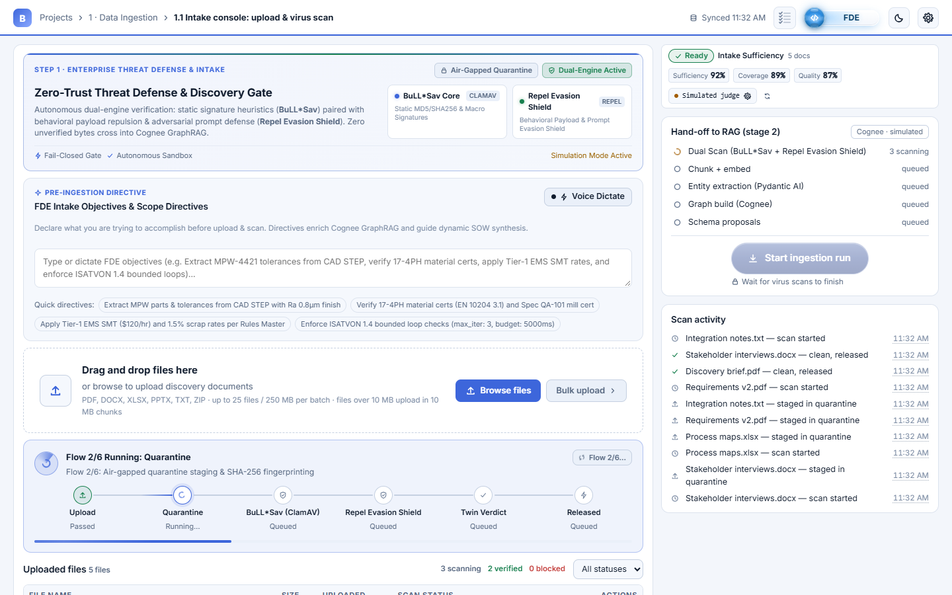
1 · DATA INGESTION
03 / 22
1.1 Live dual-engine scan
Upload → Quarantine → BuLL*Sav → Repel Evasion Shield → Twin Verdict → Released. Start ingestion run waits until every scan finishes.

Slide 5
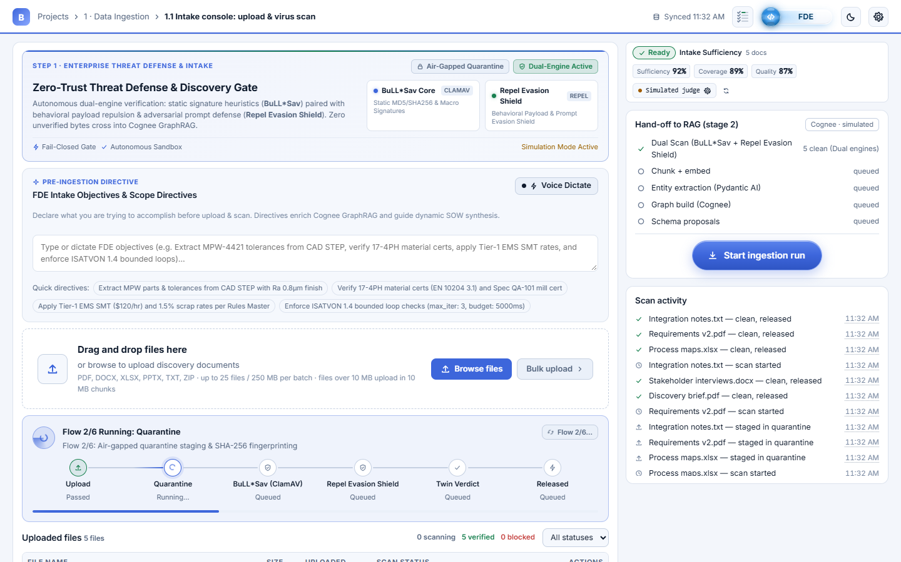
1 · DATA INGESTION
04 / 22
1.1 All files clean: ready for RAG
Every file verified by both engines. Start ingestion run hands only released files to RAG; nothing starts on upload alone.

Slide 6
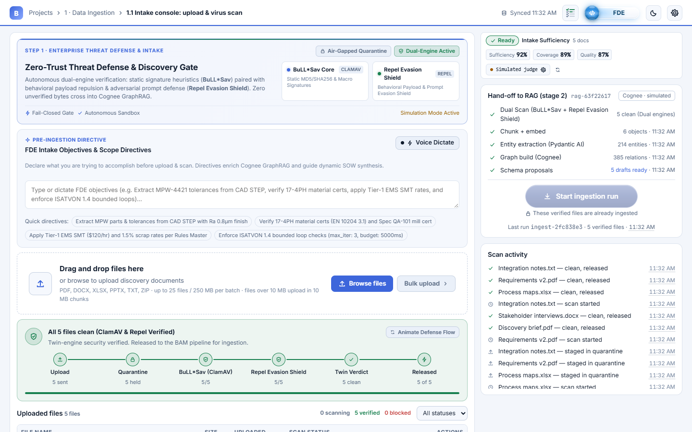
1 · DATA INGESTION
05 / 22
1.1 Batch handed to RAG
After the run starts, the hand-off card shows the run ID and the RAG steps; uploads are locked for this batch.

Slide 7
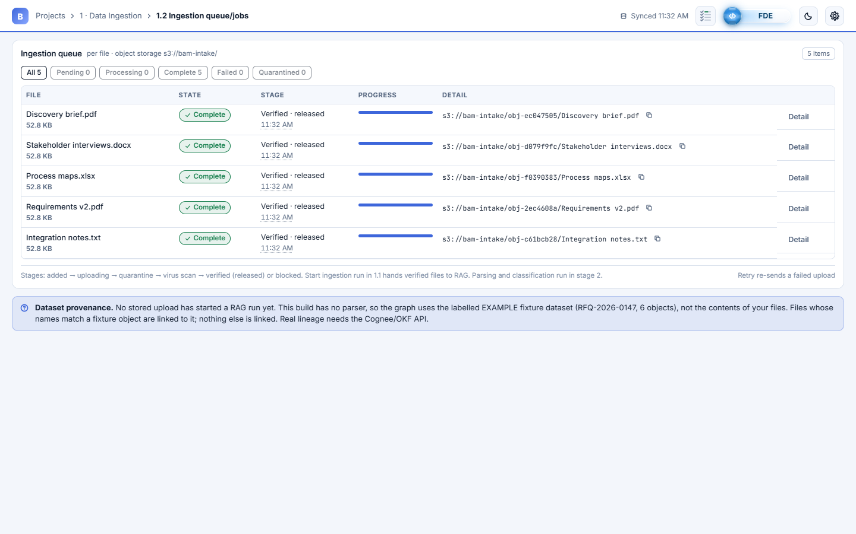
1 · DATA INGESTION
06 / 22
1.2 Ingestion queue/jobs
Per-file state, stage, progress and storage path, filterable by state.

Slide 8
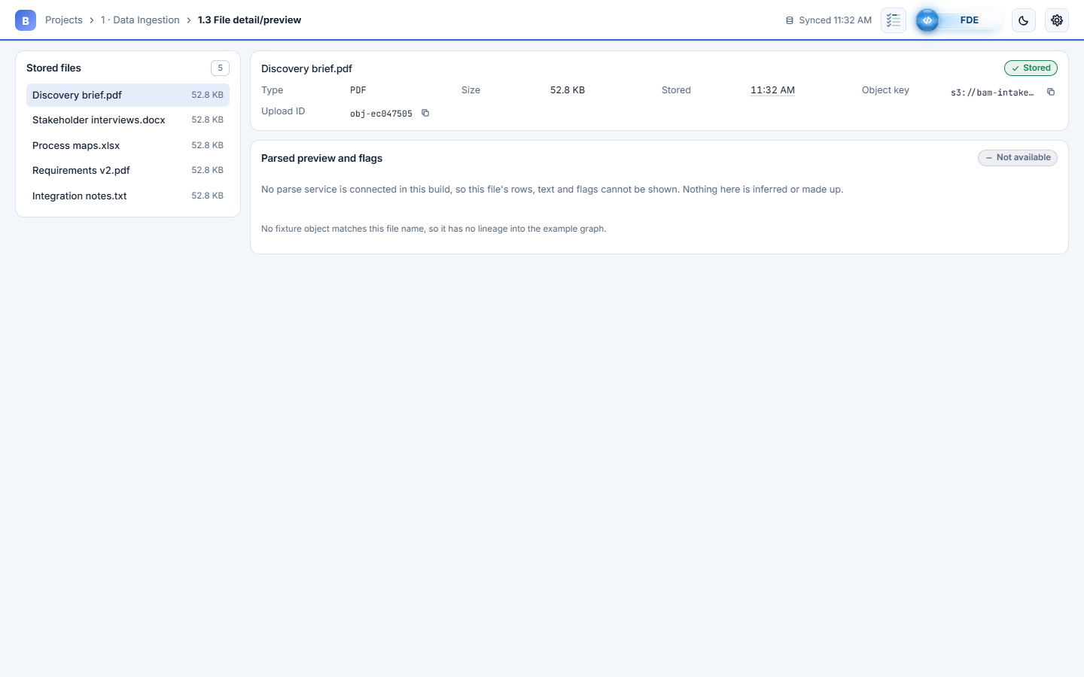
1 · DATA INGESTION
07 / 22
1.3 File detail/preview
Metadata for each stored file. The parse preview says Not available: there is no parser contract yet.

Slide 9
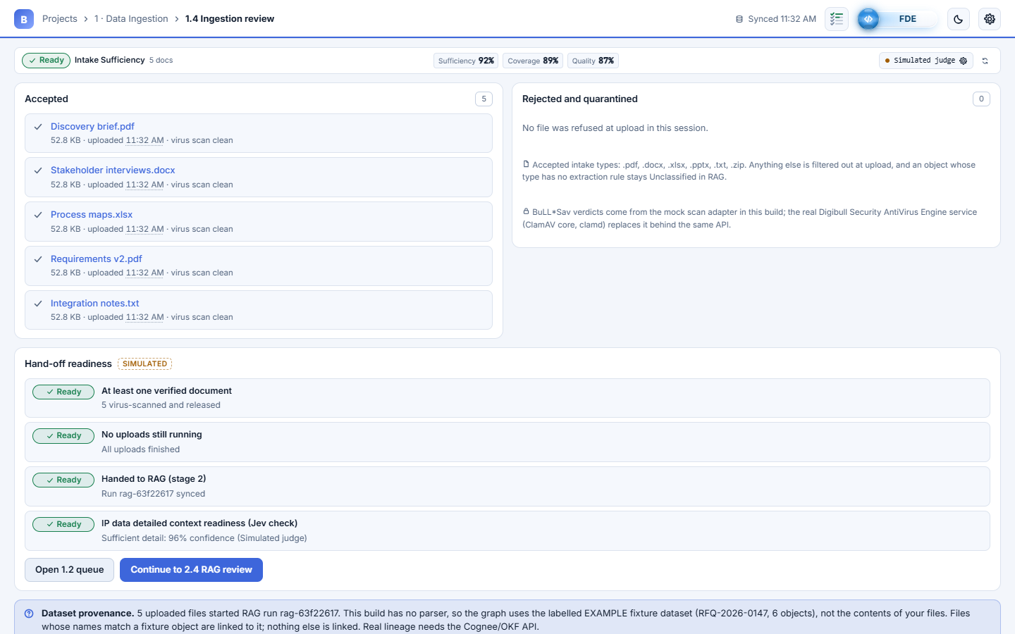
1 · DATA INGESTION
08 / 22
1.4 Ingestion review
Accepted and filtered files with reasons, plus hand-off readiness checks. Stage 1 completes 4/4 once the batch reaches RAG.

Slide 10
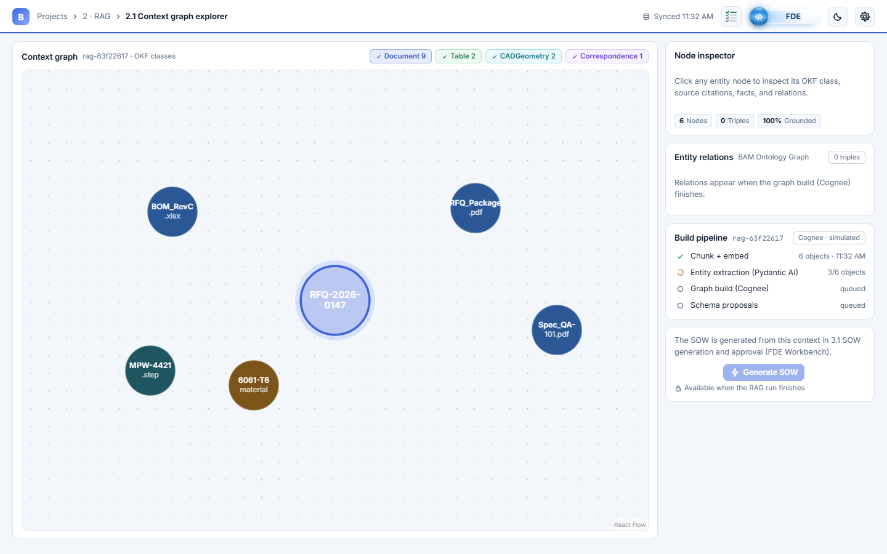
2 · RAG (COGNEE + OKF)
09 / 22
2.1 Context graph: building
Nodes appear during entity extraction; edges only after the Cognee graph build. Fixed, centred canvas.

Slide 11
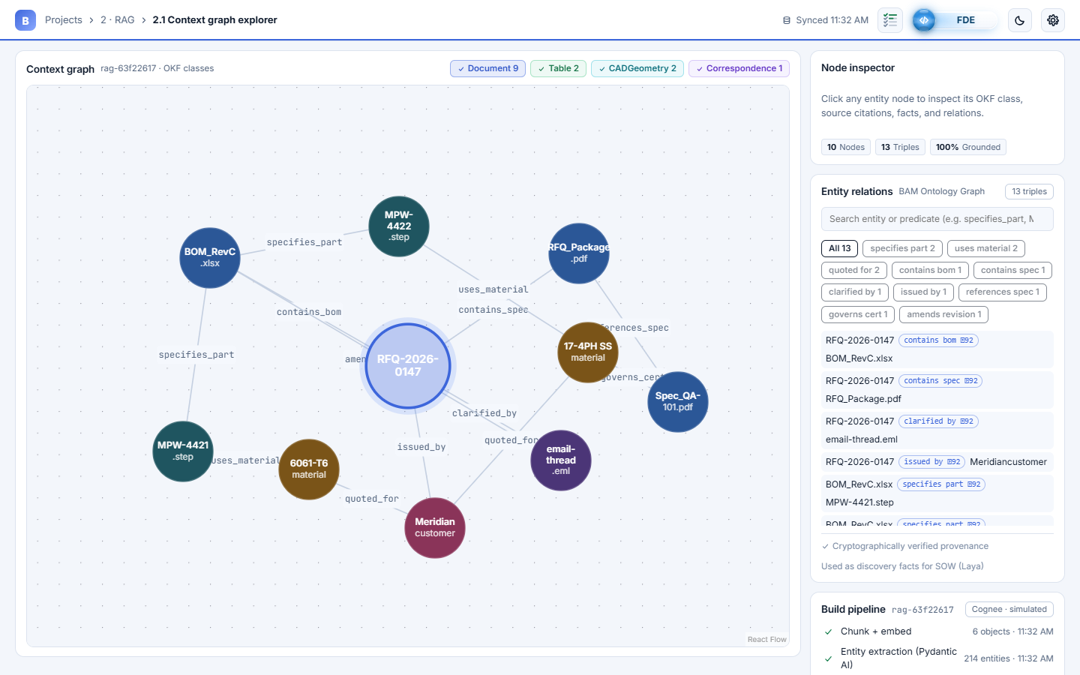
2 · RAG (COGNEE + OKF)
10 / 22
2.1 Context graph explorer
Cognee knowledge graph with labelled relations, node inspector, Entity relations card and Generate SOW.

Slide 12
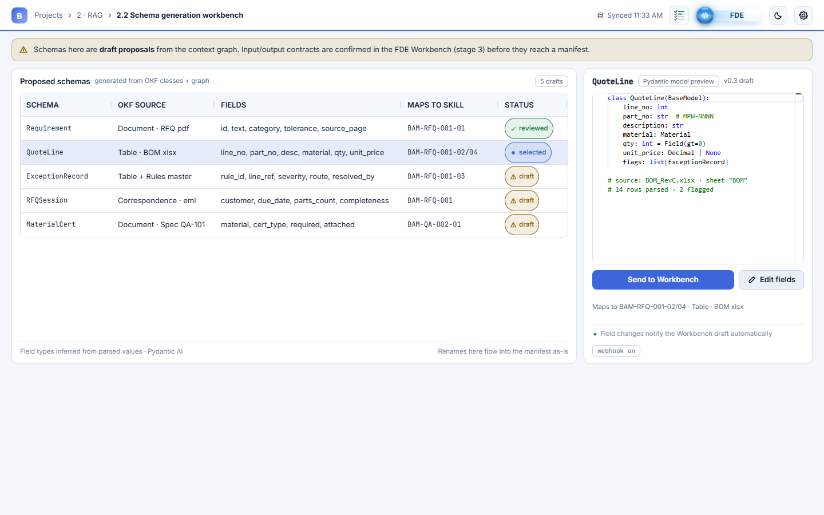
2 · RAG (COGNEE + OKF)
11 / 22
2.2 Schema generation workbench
Draft Pydantic schemas from the OKF classes. Send to Workbench creates a draft hand-off; nothing is approved here.

Slide 13
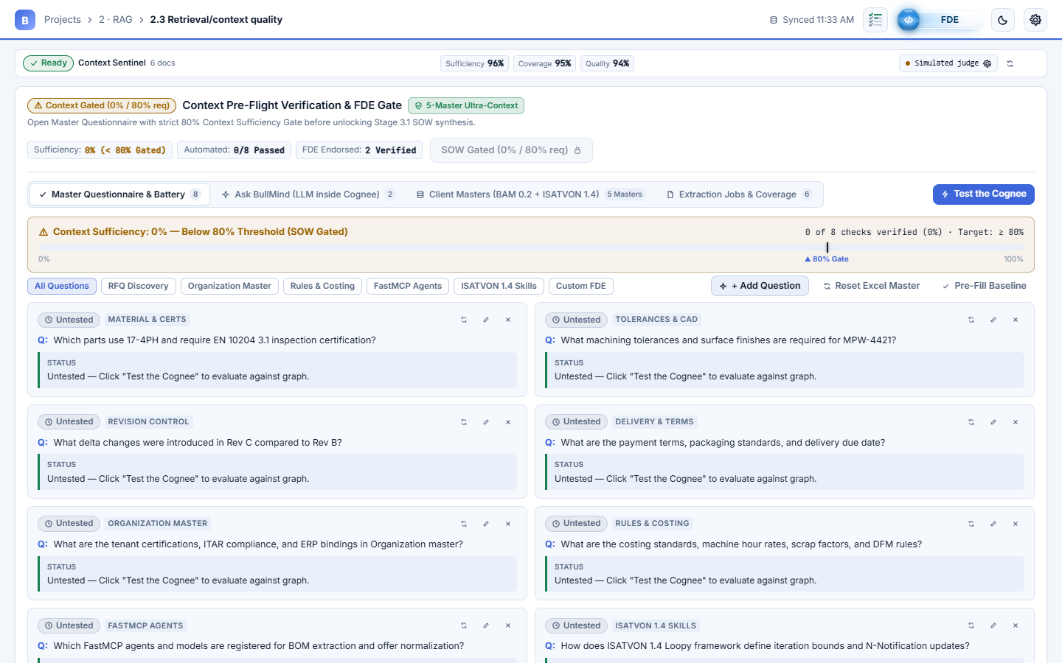
2 · RAG (COGNEE + OKF)
12 / 22
2.3 Cognee pre-flight cockpit
Master questionnaire, 80% context-sufficiency gate and BullMind console before SOW synthesis.

Slide 14
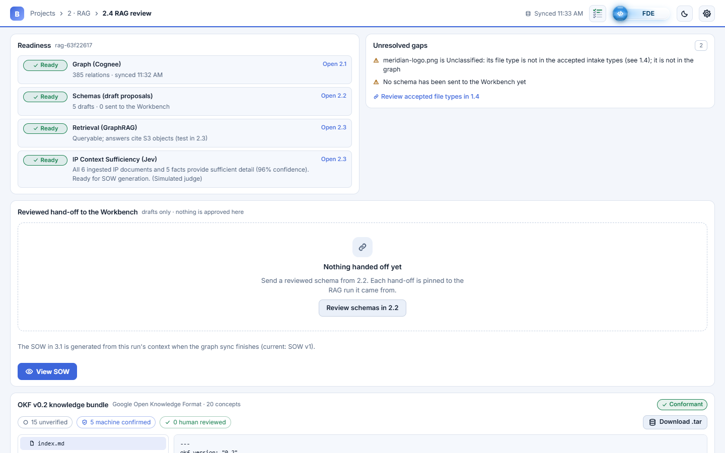
2 · RAG (COGNEE + OKF)
13 / 22
2.4 RAG review: OKF v0.2 bundle
Readiness, unresolved gaps, reviewed hand-off and the Google Open Knowledge Format v0.2 bundle (download as tar).

Slide 15
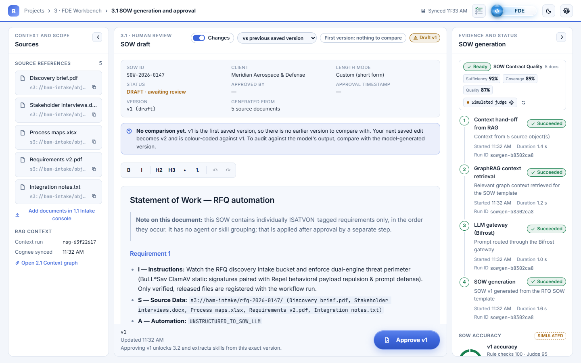
3 · FDE WORKBENCH
14 / 22
3.1 SOW generation and approval
ISATVON SOW in TipTap with live Changes highlighting. SOW accuracy = rule checks + Laya judge. Edit directly, then Approve.

Slide 16
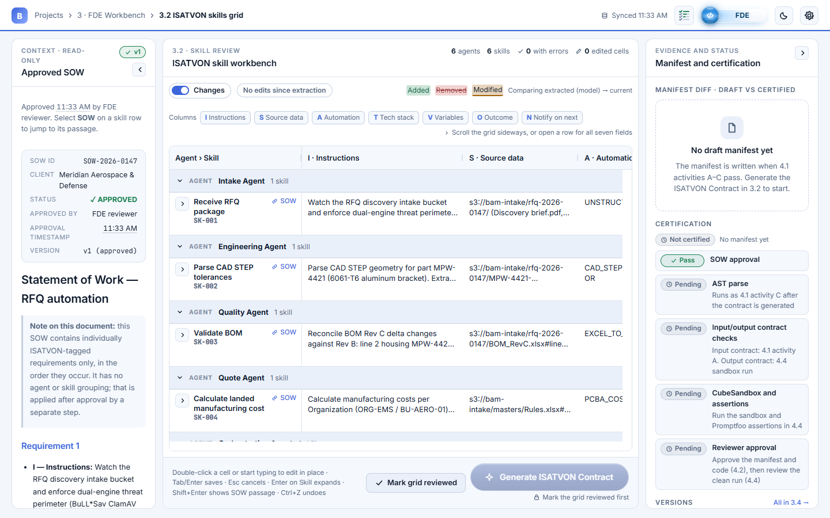
3 · FDE WORKBENCH
15 / 22
3.2 ISATVON skills grid
AG Grid grouped Agent > Skill with inline cell editing and per-cell validation. Mark grid reviewed → Generate ISATVON Contract.

Slide 17
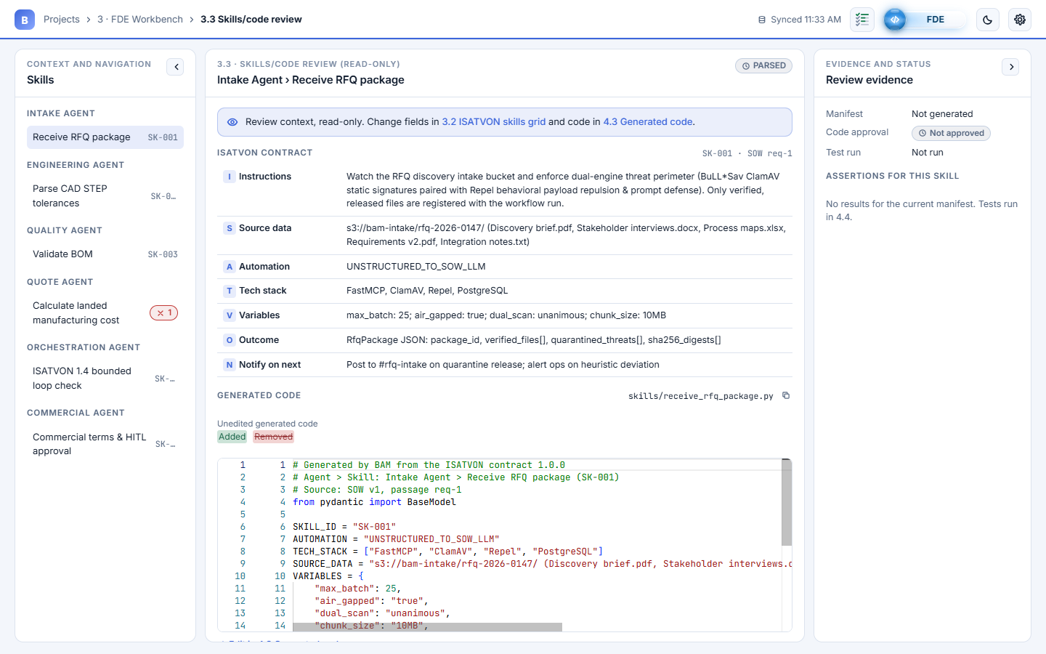
3 · FDE WORKBENCH
16 / 22
3.3 Skills/code review
Read-only view of one skill: its ISATVON contract and the code generated from it.

Slide 18
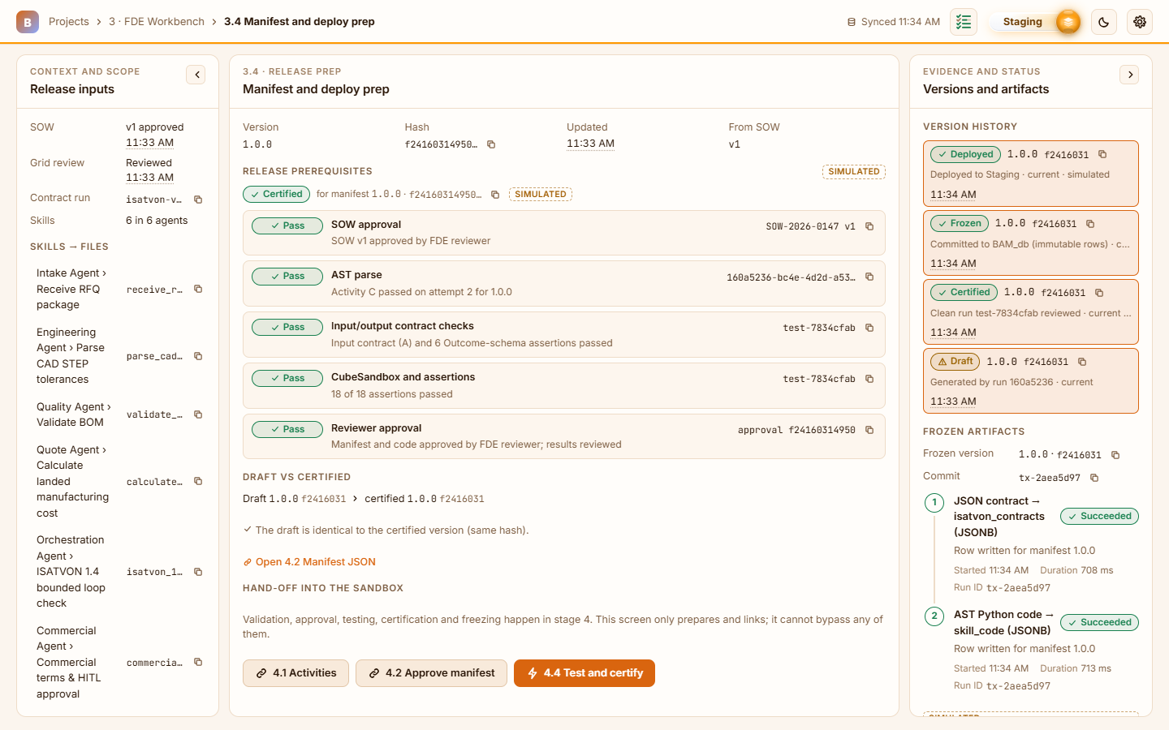
3 · FDE WORKBENCH
17 / 22
3.4 Manifest and deploy prep
Release prerequisites, draft vs certified manifest, version history and frozen artifacts (shown after the deploy, Staging view).

Slide 19
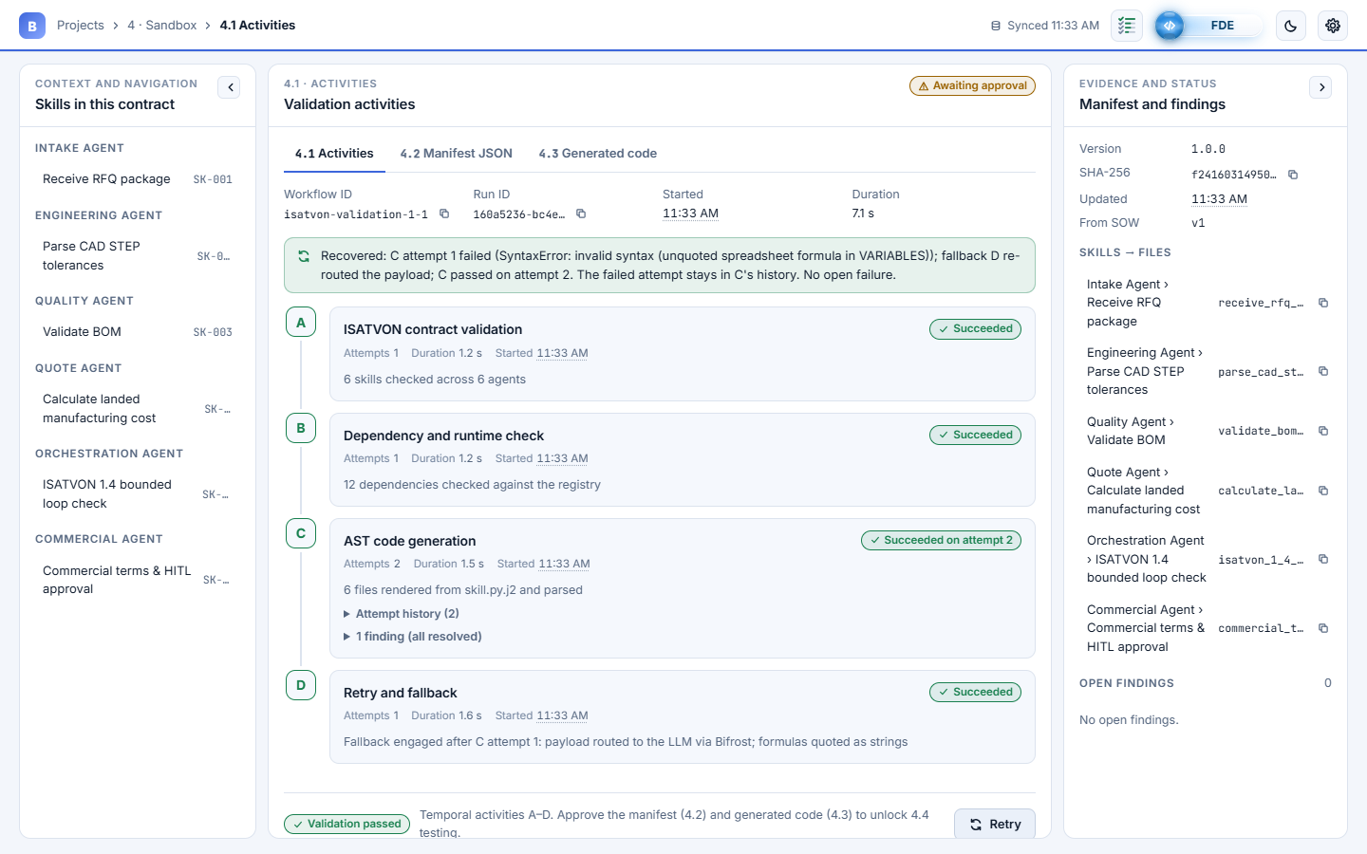
4 · SANDBOX
18 / 22
4.1 Activities
Temporal activities A–D with attempt history (a recovered failure is history). Footer: View manifest.

Slide 20
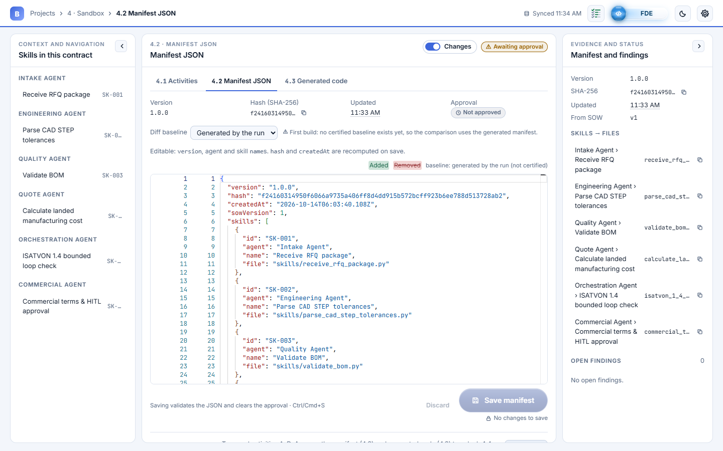
4 · SANDBOX
19 / 22
4.2 Manifest JSON
Editable Monaco diff against the generated (or certified) manifest; saves validate the JSON. Footer: View code.

Slide 21
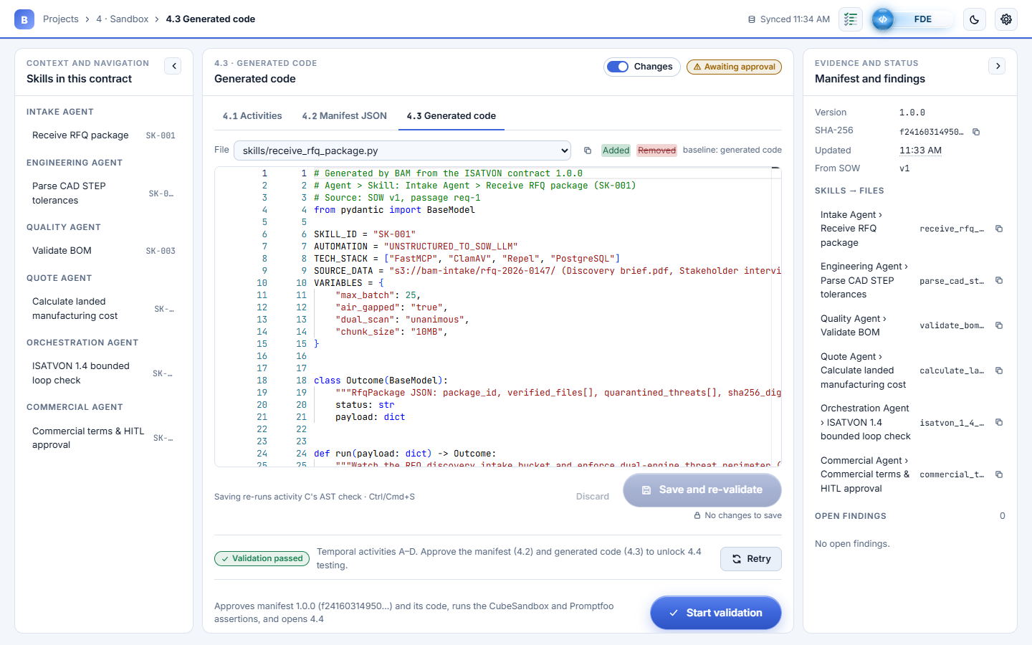
4 · SANDBOX
20 / 22
4.3 Generated code
Editable code diff per skill; saving re-runs the AST check. Start validation approves the manifest hash and opens 4.4.

Slide 22
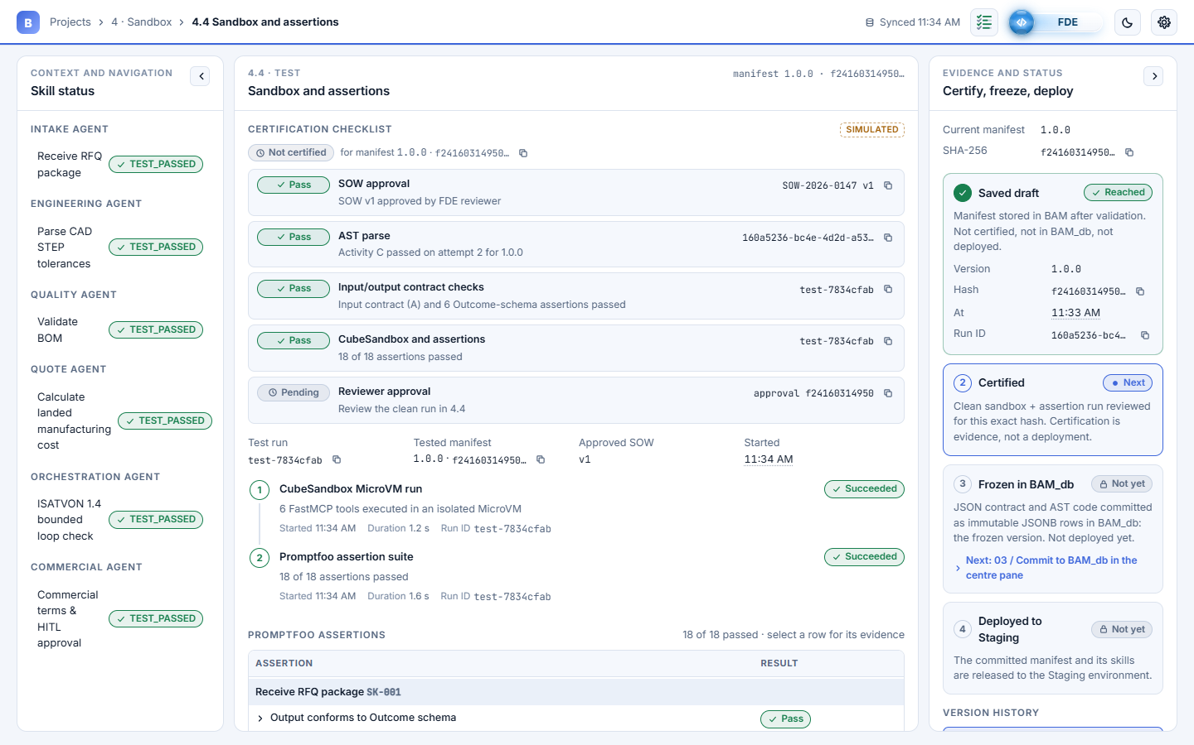
4 · SANDBOX
21 / 22
4.4 Sandbox and assertions
Certification checklist, CubeSandbox run and Promptfoo assertions: Test → Review → Commit to BAM_db → Deploy to Staging.

Slide 23
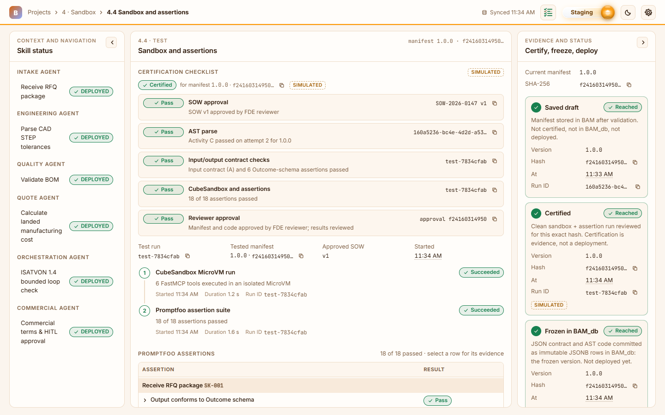
4 · SANDBOX
22 / 22
4.4 Deployed to Staging
Certified, frozen in BAM_db and deployed. The Staging view switches the whole UI to the orange palette (FDE stays blue).

