Slide 1
Upload step & assistant: new screens
BuLLM BAM Workbench · Ingestion › Upload · 29 Oct 2026

Slide 2
What changed on the Upload step
1
Goal capture
2
ISATVON draft
3
Add files gate
Sentence with What / Who / Where dropdowns, Others for your own value, helper cards that highlight their field
Expand goal writes a per-goal draft and its required uploads; Approve unlocks the next step
Locked on every path until the goal is approved, then highlighted as the next step
4
Uploaded files
5
Assistant
6
Verify
Needs attention first with Replace / Retry / Discard; separate Type chip and Confidence bar
One persistent conversation; draft edits from chat; short "Files added."; 1-2 tags that follow the chat
All six sample questions pass; the run result is a message in the thread

Slide 3
Goal capture
Name the agent in one sentence, then expand it into an ISATVON draft

Slide 4
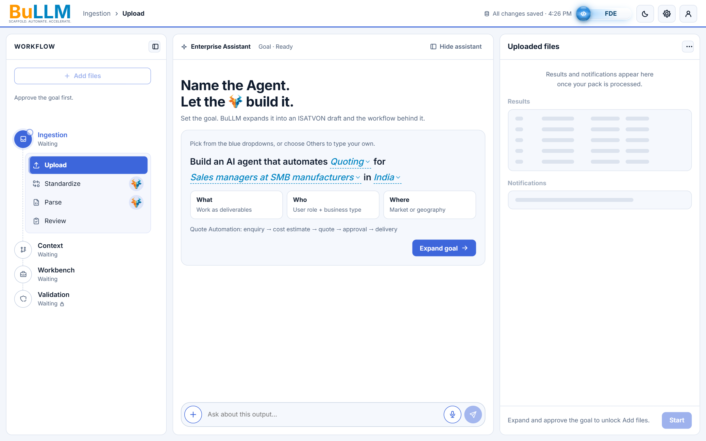
Goal sentence with dropdowns
1
Change 1 · Dropdowns
"Build an AI agent that automates [What] for [Who] in [Where]"; only the three blue fields change.
Defaults: Quoting · Sales managers at SMB manufacturers · India.
Add files stays locked: "Approve the goal first." The right pane footer explains how to unlock it.

Slide 5
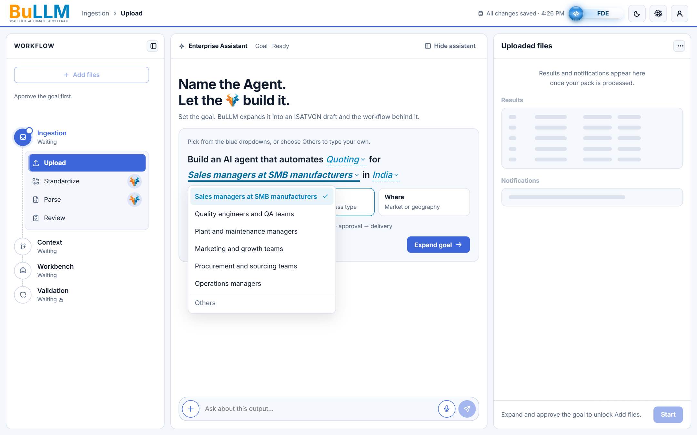
Dropdown menu
2
Goal capture
Opens under its own field, left-aligned, over the cards below; one menu at a time.
Arrow keys, Home / End, Enter or Space; Escape or an outside click closes.
"Others" is last, divided and muted.

Slide 6

Helper cards highlight their field
3
Goal capture
Clicking What, Who or Where highlights only the matching field: stronger blue and a thicker underline.
No box, glow or tint; the menu does not open.
The highlight moves with the next card or field and clears when focus leaves the goal card.

Slide 7

Others: type your own value
4
Goal capture
Choosing Others turns the field into a text input that sizes to what you type.
Fields hug their text, so the sentence keeps normal word spacing.
The flow line regenerates from the custom value ("Invoice Matching: input → processing → review → delivery").

Slide 8
Draft and approval
Expand goal writes the ISATVON draft; Approve opens the upload step

Slide 9
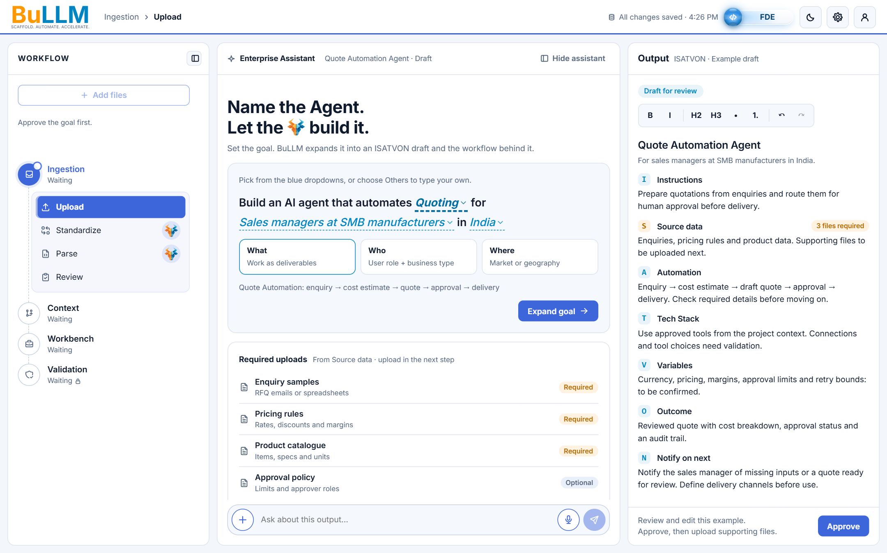
Expanded ISATVON draft
5
Change 1 · Expand goal
Output pane: Quote Automation Agent with all seven ISATVON sections and the formatting toolbar.
Required uploads card lists the supporting files from Source data (Required / Optional).
Each What option has its own profile; Quoting keeps the original example.

Slide 10
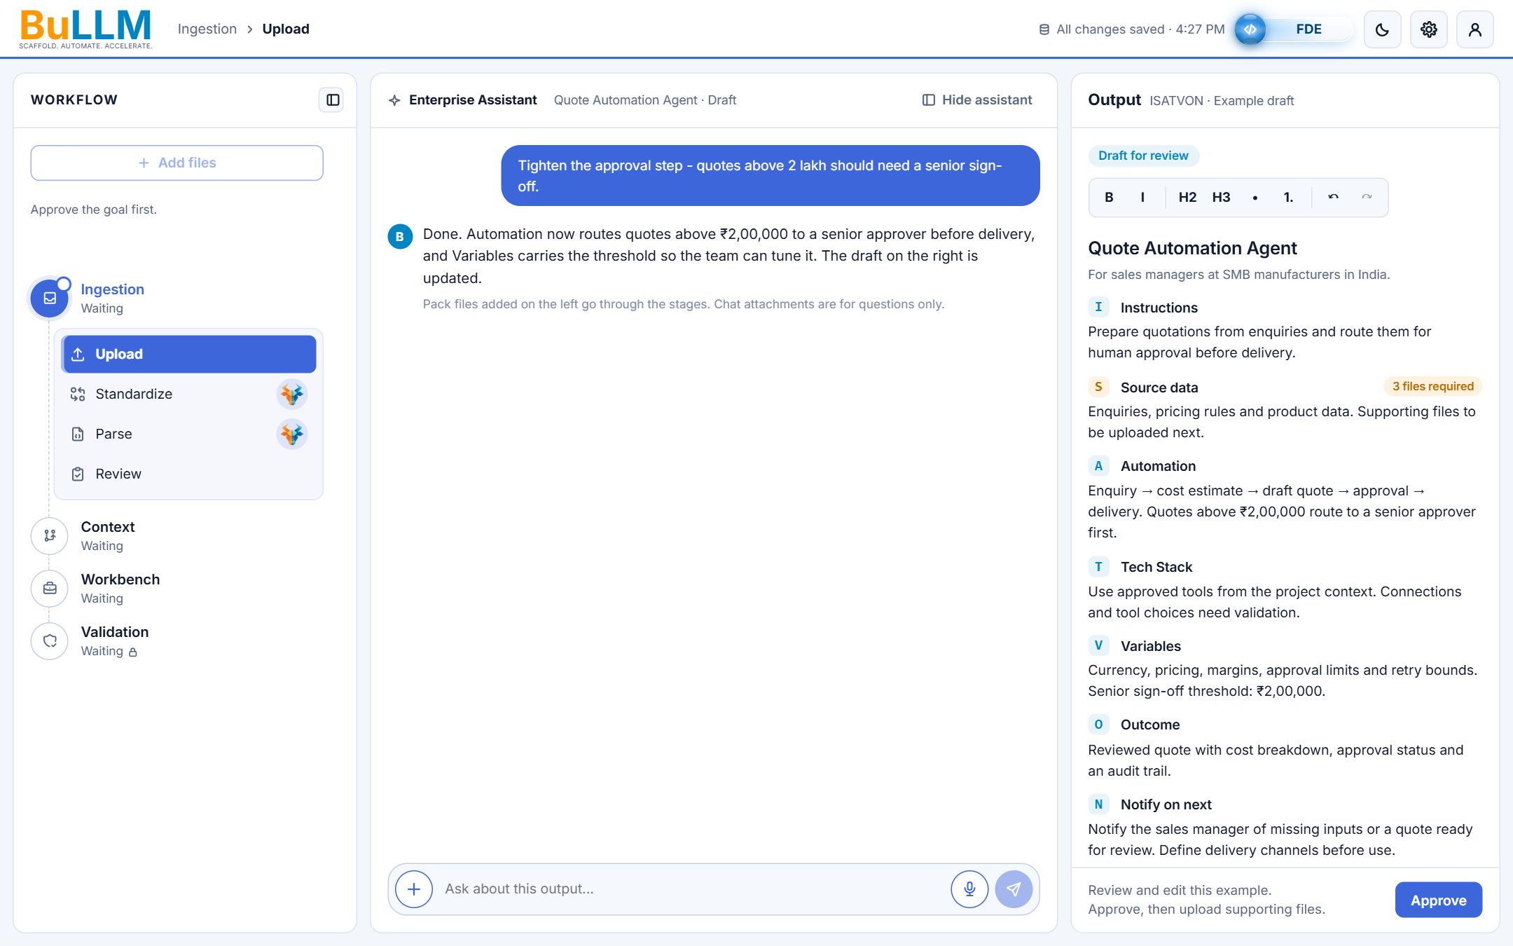
Assistant edits the visible draft
6
Change 4 · Draft edits
"Quotes above 2 lakh should need a senior sign-off" updates Automation and Variables at once.
The reply confirms the change; the draft on the right shows ₹2,00,000.
Margin guardrails, missing files and "what changed" are answered from the same draft.

Slide 11
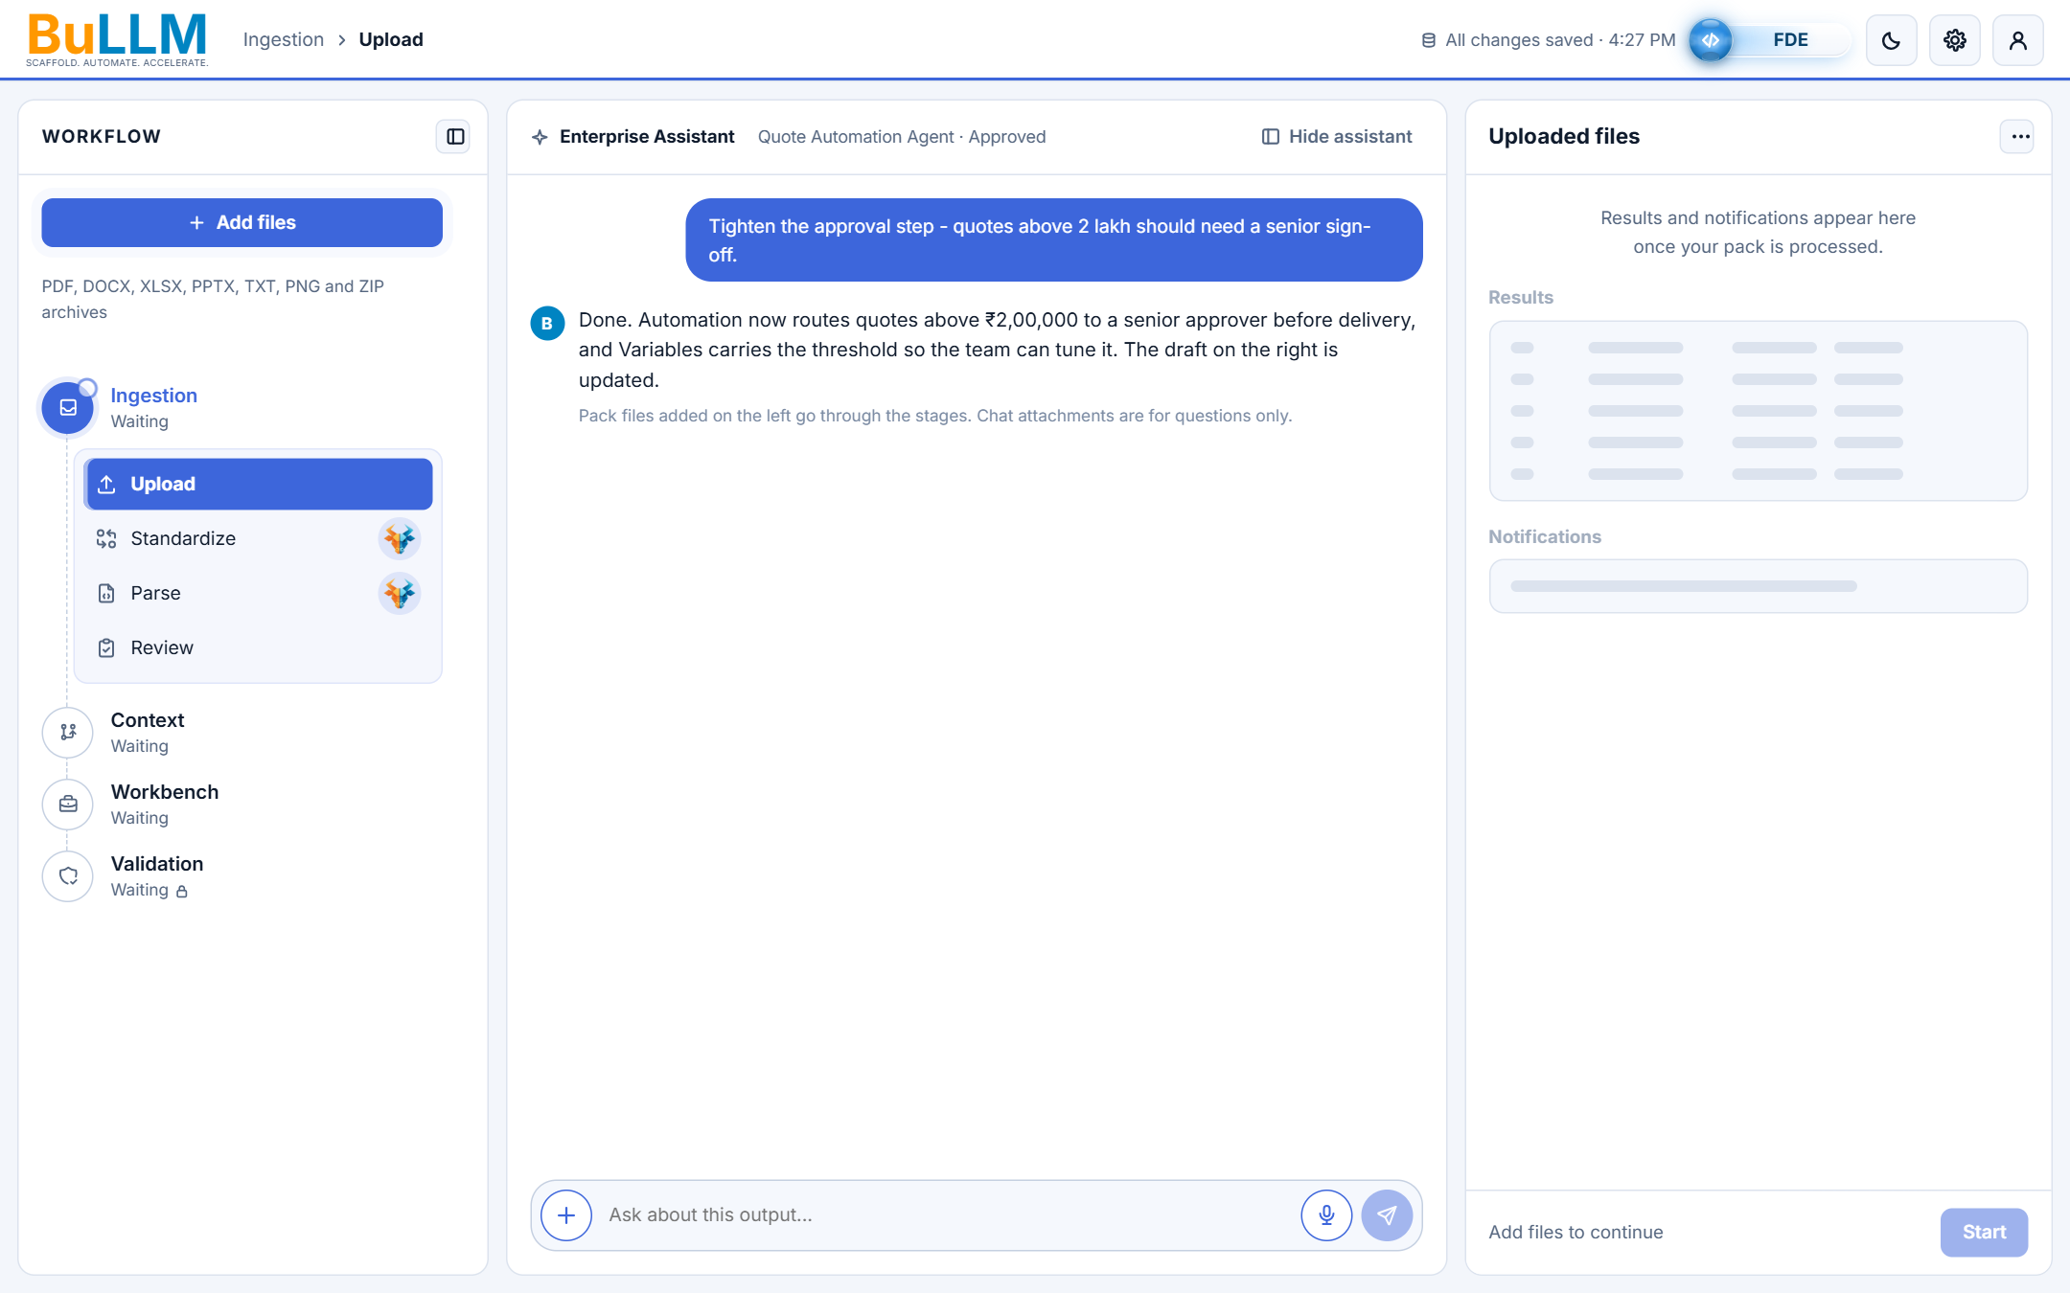
Approval unlocks Add files
7
Approval gate
Approve hands the right pane back to Uploaded files.
Add files turns primary blue with a soft pulse until the first file is added.
Expanding again clears the approval and locks Add files until the new draft is approved.

Slide 12
Uploaded files
Every selected file ends as added or failed, with a reason and a fix

Slide 13
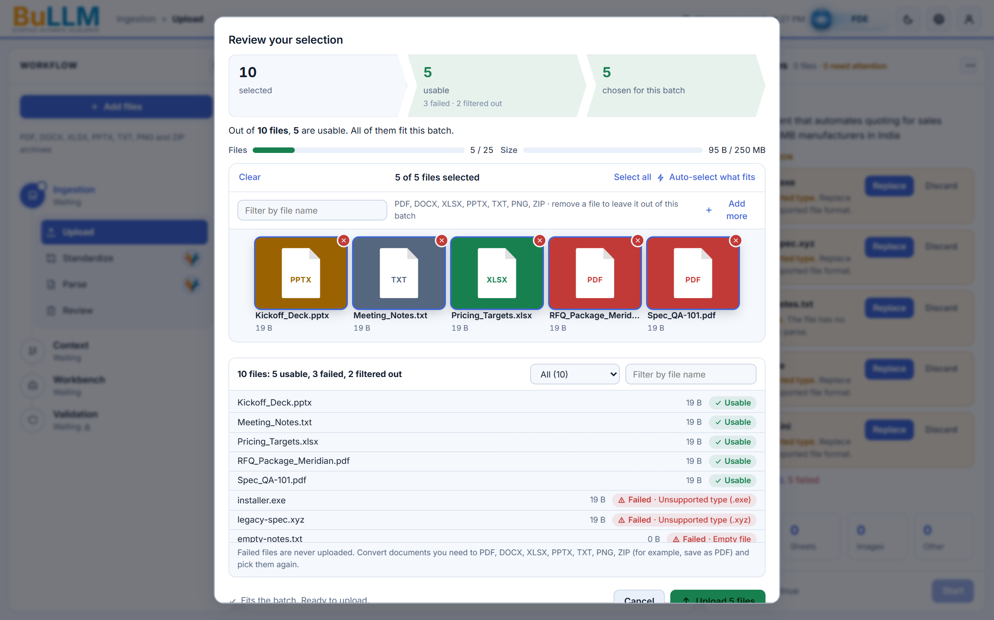
Review your selection
8
Uploaded files
Every picked file is listed: usable, failed with its reason, or filtered out.
The batch fits 25 files / 250 MB before Upload is allowed.
Opens only after the goal is approved; its Add more is guarded by the same lock.

Slide 14
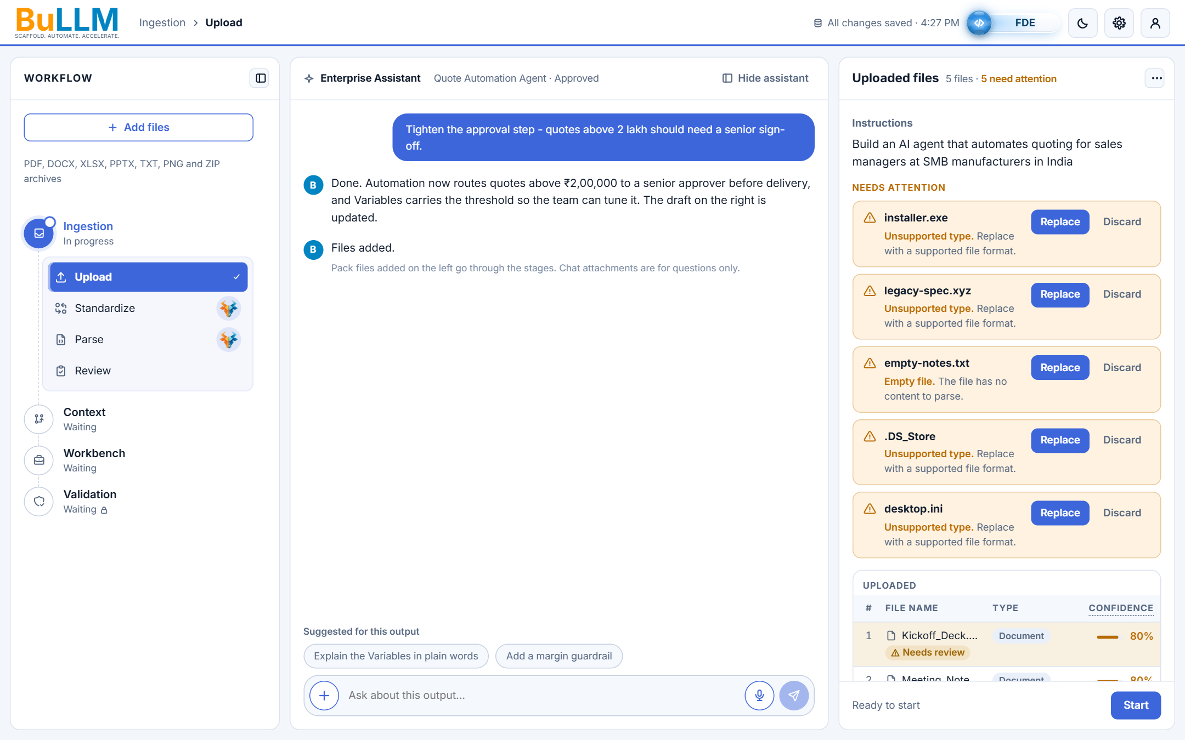
Needs attention with actions
9
Change 3 · Failures
Header count from the live list: "5 files · 5 need attention".
Reason always visible; Replace + Discard for unsupported, empty or system files; Retry + Discard for interrupted uploads.
System files (.DS_Store, desktop.ini) are failures with Replace / Discard, never silently skipped.

Slide 15
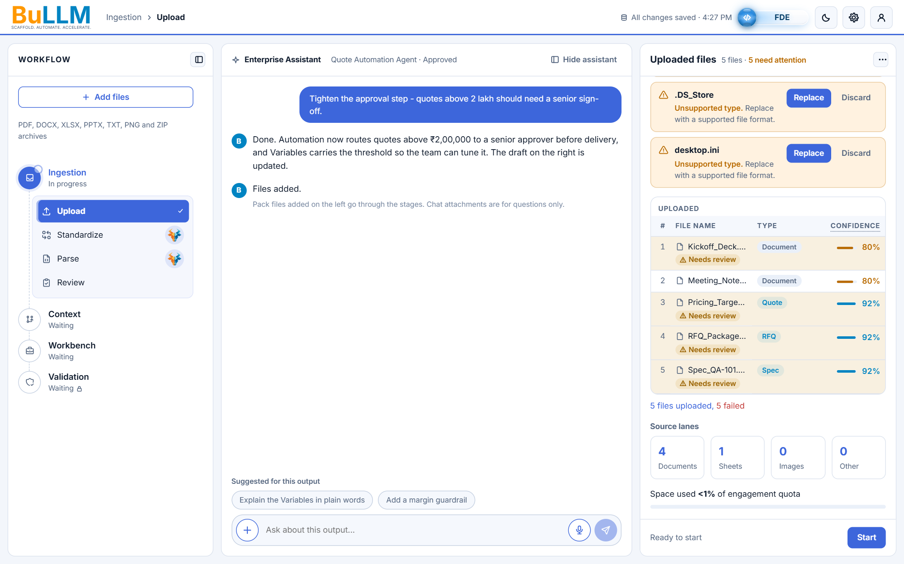
Type and Confidence columns
10
Change 2 · Columns
Header row: #, File name, Type, Confidence.
Type is a tinted chip; Confidence is right-aligned with a thin bar and the percentage.
The bar drops in a narrow pane, so the two columns never run together.

Slide 16
Enterprise Assistant
One conversation that keeps everything and follows the work

Slide 17
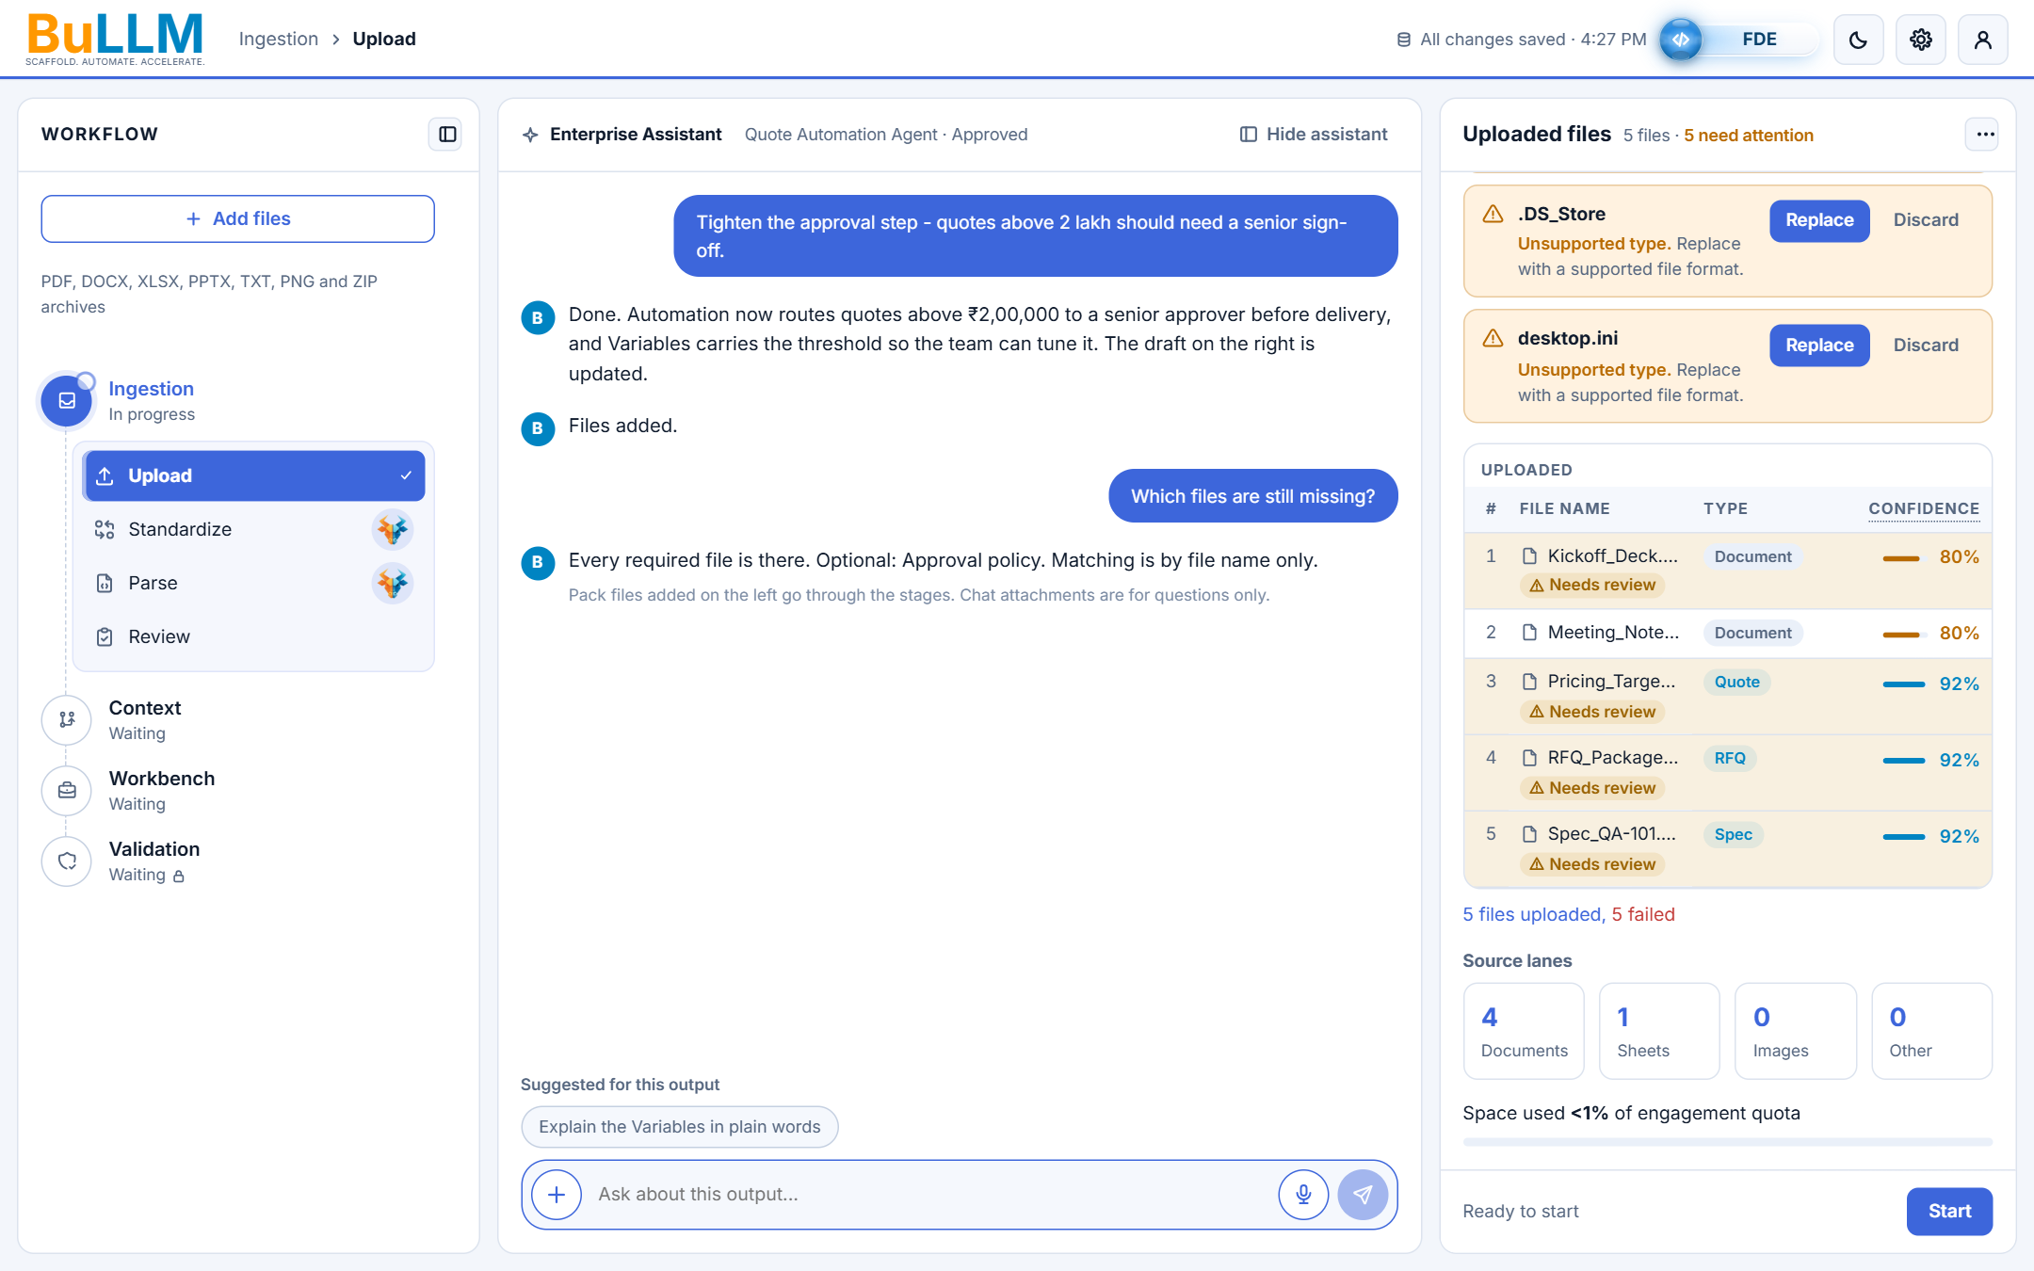
Short acknowledgment and chat-aware tags
11
Change 4 · Tags
One "Files added." per finished batch; counts and reasons stay in the files panel.
Tags above the chatbox appear only after upload, at most two.
Once the chat starts, only follow-ups to the latest message show.

Slide 18
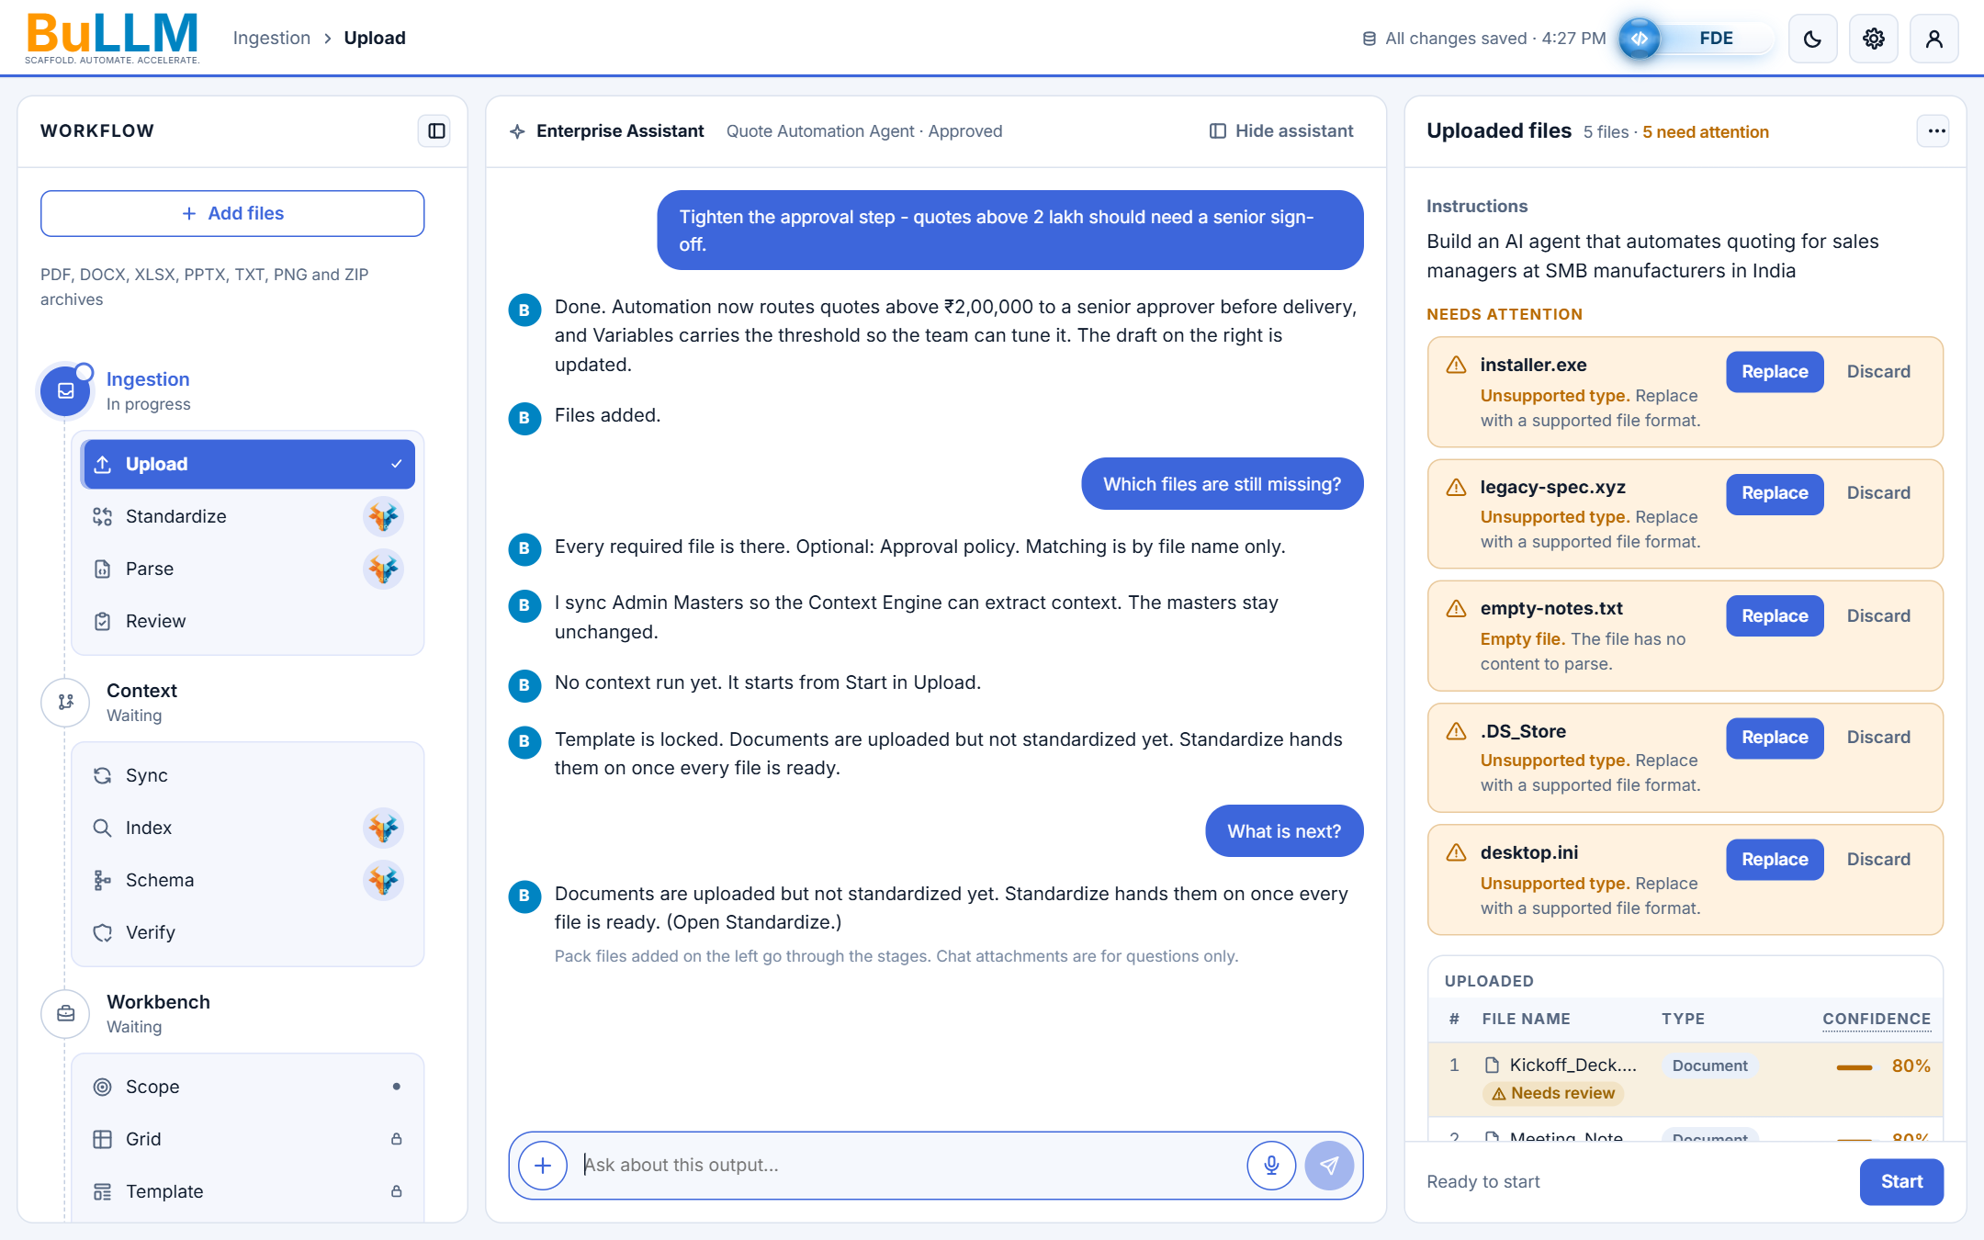
Persistent conversation
12
Keep conversation
Screen updates are posted once as normal messages; nothing is replaced when the stage changes.
New messages push older ones up; scrolled up, "Jump to latest" returns.
Revisits never duplicate a message; history is kept per project.

Slide 19
Verify and themes
Context testing results and dark mode

Slide 20
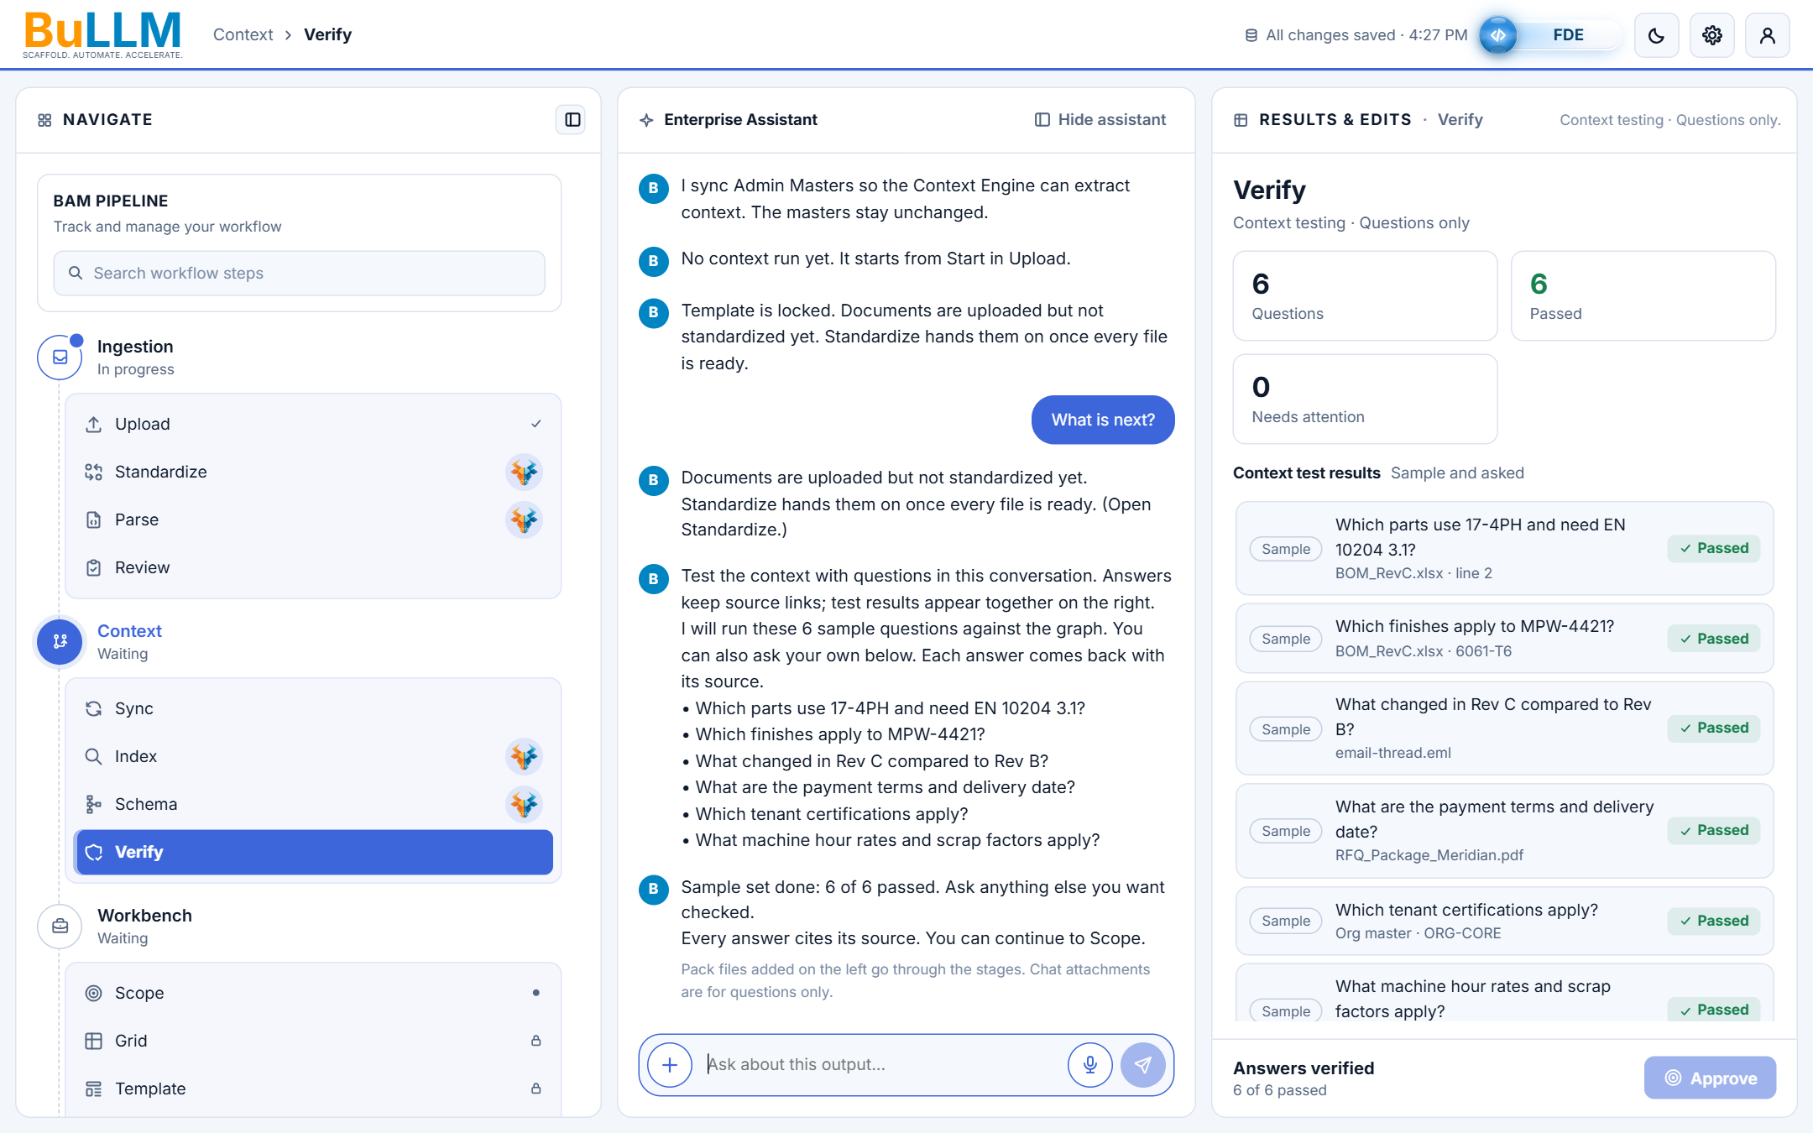
Verify: all sample questions pass
13
Verify and themes
6 questions, 6 passed, 0 need attention.
Machine hour rates and scrap factors are answered from Rules master Rule #1.
The finished run is posted in the thread: "Sample set done: 6 of 6 passed".

Slide 21
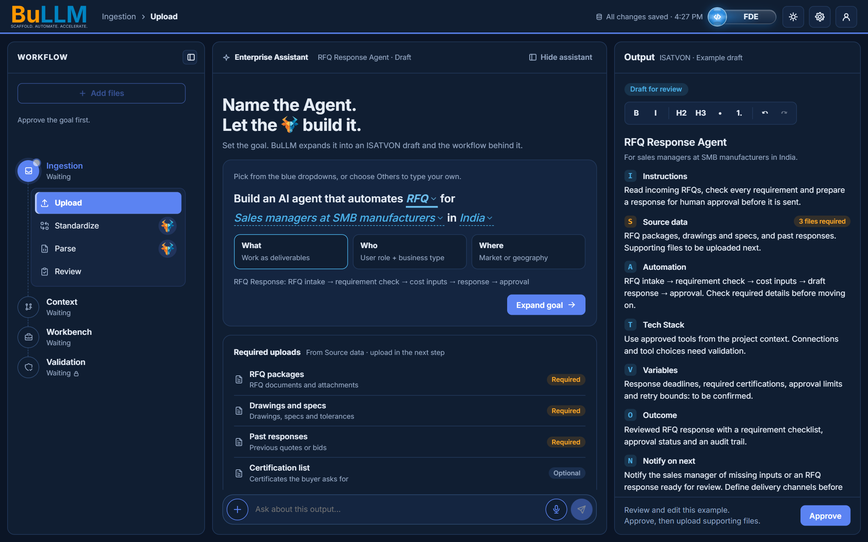
Dark theme: RFQ goal
14
Verify and themes
Every new element follows the dark palette: dropdowns, cards, draft and badges.
RFQ produces its own draft: RFQ Response Agent with RFQ-specific required uploads.
Brand blue #0084C2 and orange #FF9800 throughout.

Slide 22
Status and open points
Verified
Mock today
Next
Type-check, 73 unit tests and the mock backend check pass
Every screen checked in Chrome, light and dark
Every upload path blocked while locked
Draft content and option lists are local constants (marked TODO)
No project id yet: one conversation per session
Chat history lives in memory until reload
Wire option lists and draft generation to the backend
Persist conversations per project
Send this deck with the build for review

