Slide 1
Lending Case Club Study
Goals of data analysis:
The main objective is to be able to identify these risky loan applicants, then such loans can be reduced thereby cutting down the amount of credit loss. Identification of such applicants using EDA is the aim of this case study.
Perform an analysis to understand the driving factors (or driver variables) behind loan default, i.e. The variables which are strong indicators of default. The company can utilize this knowledge for its portfolio and risk assessment.
Submitted By
Arjun Singh
Paryanshu Sourav

Slide 2
Method or techniques used to perform the analysis
Data Sourcing
Data Cleaning
Univariate Analysis
Bivariate analysis
Derived Matrices

Slide 3
Data Sourcing
Following information extracted from data frame using various methods
Convert the excel data into the data frame using python library as pandas
Extract the information of data frame using info and description methods
Identify the columns with null values and null values percentage
Identify the columns with zero values and zero values percentage
Identify the customer behavioural columns
Identified the target columns and other important columns to include in the analysis
Calculated the number of rows present with all NA value
Calculated the shape of data frame
Identified the columns with same value throughout the column.
Updating the null values with most occurrence values in emp_title columns and zero in emp_length

Slide 4
Data Cleaning
Removed all the columns with all values as null
Removed all the columns with all values as Zero
Removed all the columns with the higher percentage of null values(50).
Removed all the columns with the higher percentage of zero values(80).
Removed all the columns with the same value throughout the column
Removed all the rows with loan status as current, it can be default and fully paid so deleting the relates record from analysis process.
Removed all the customer behavioural variables columns.
Removed columns with unnecessary values(URL,desc ..)
Replaced the NAN value with None in emp_title column

Slide 5
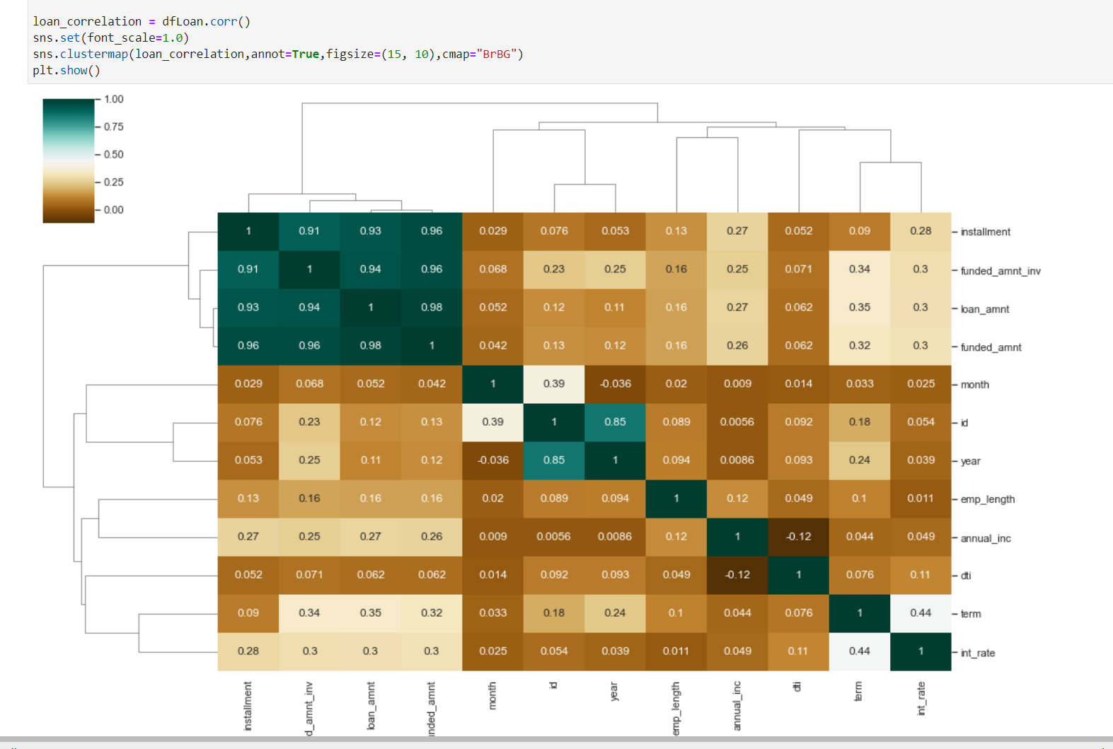
Correlation Matrix - Quantitative Variables
Observation:
Loan amount, investor amount, funding amount are strongly correlated.

Slide 6
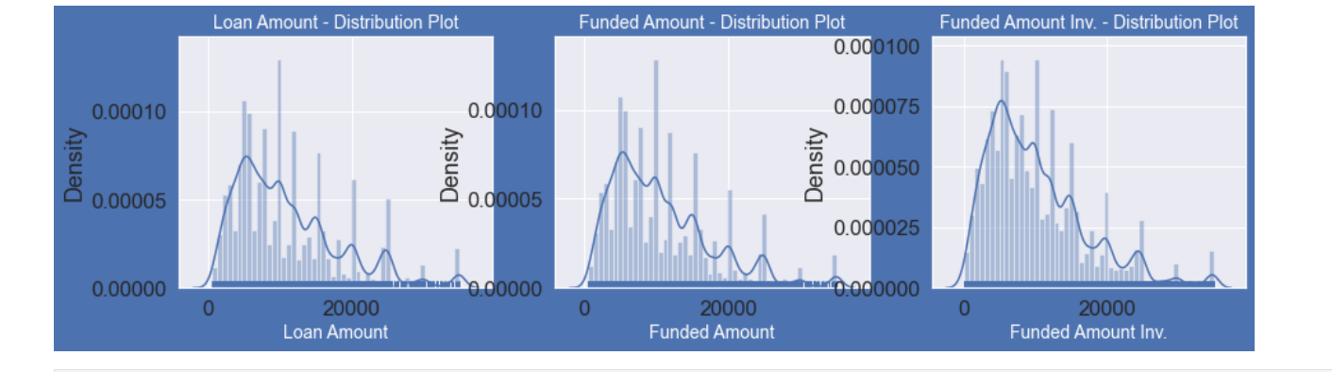
Univariate Analysis
Observation:
Distribution of amounts for all (Loan amount, investor amount, funding amount) these are strongly correlated.

Slide 7
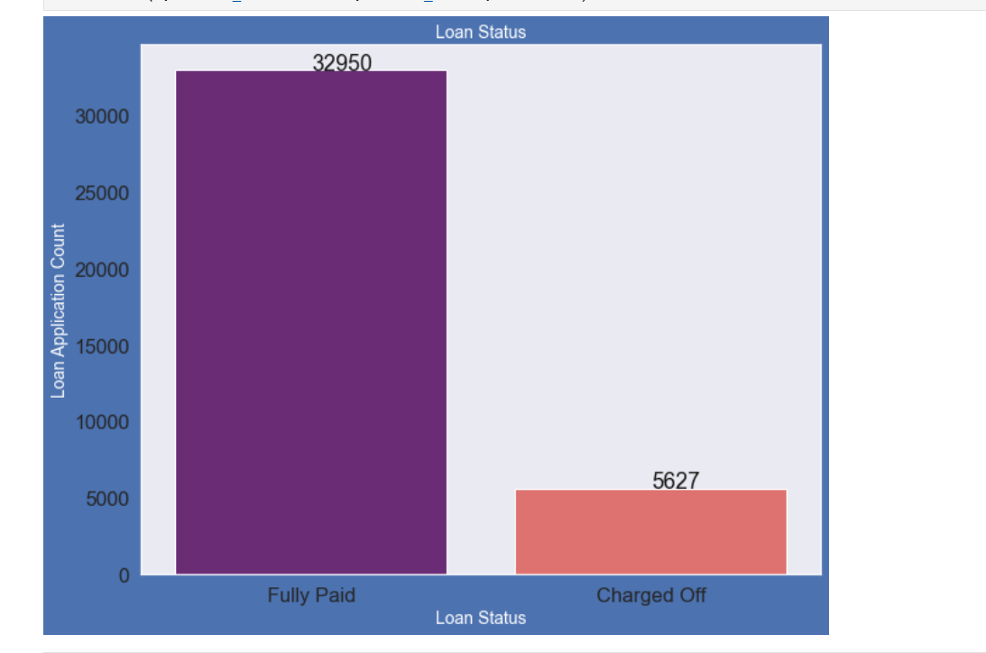
Univariate Analysis - Loan Status
Observation:
Above plot illustrations that close to 14.5% loans were charged off .

Slide 8
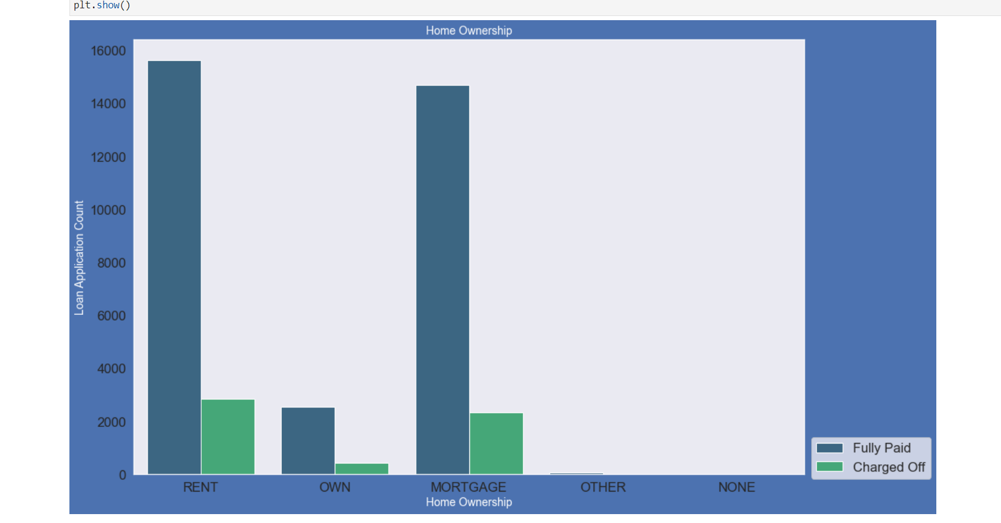
Univariate Analysis - Home Ownership
Observations:
Charged off is high as mentioned categories(Rent, Mortgage).

Slide 9
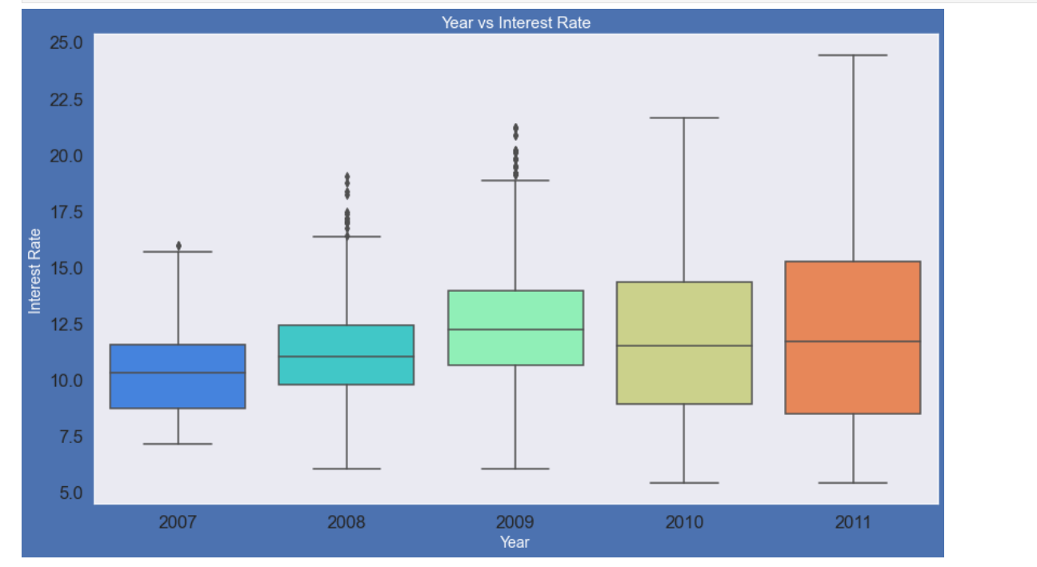
Bivariate Analysis - year vs Interest Rate
Observation:
Interest rate is increasing slowly with increase in year

Slide 10
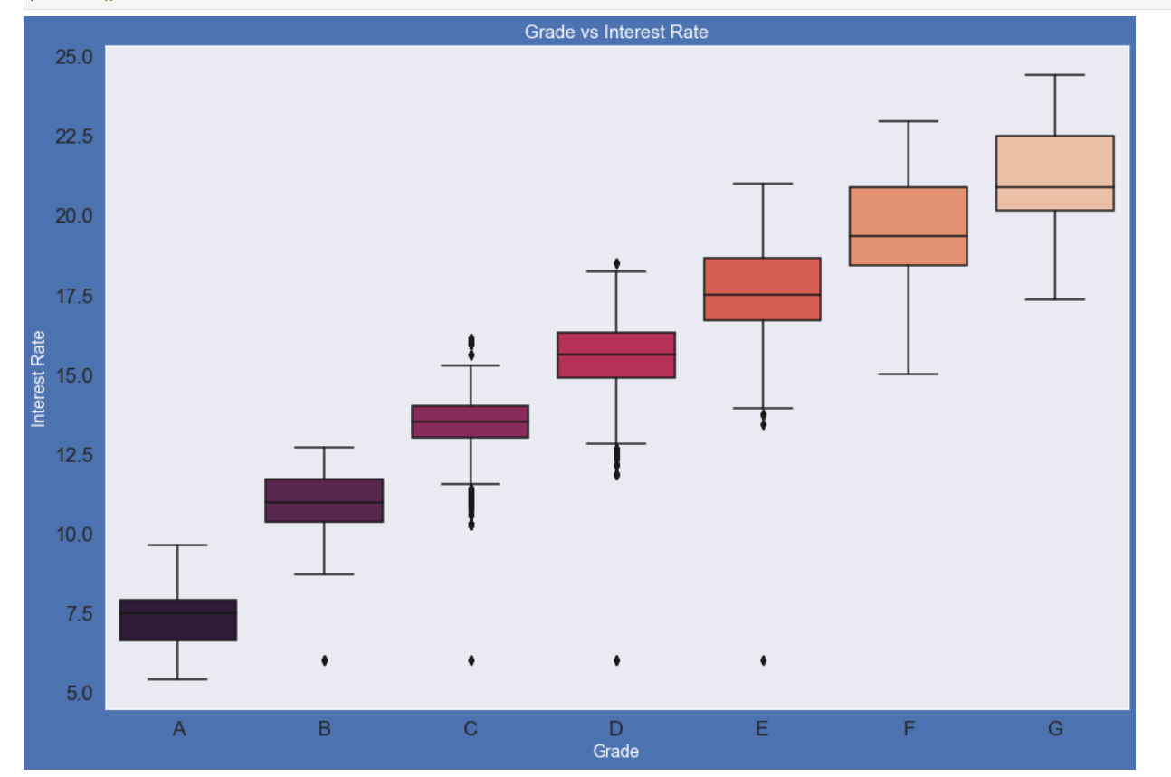
Bivariate Analysis - Grade vs Interest Rate
Observation:
The higher the borrower's credit grade, the lower the interest rate offered to that borrowed loan

Slide 11
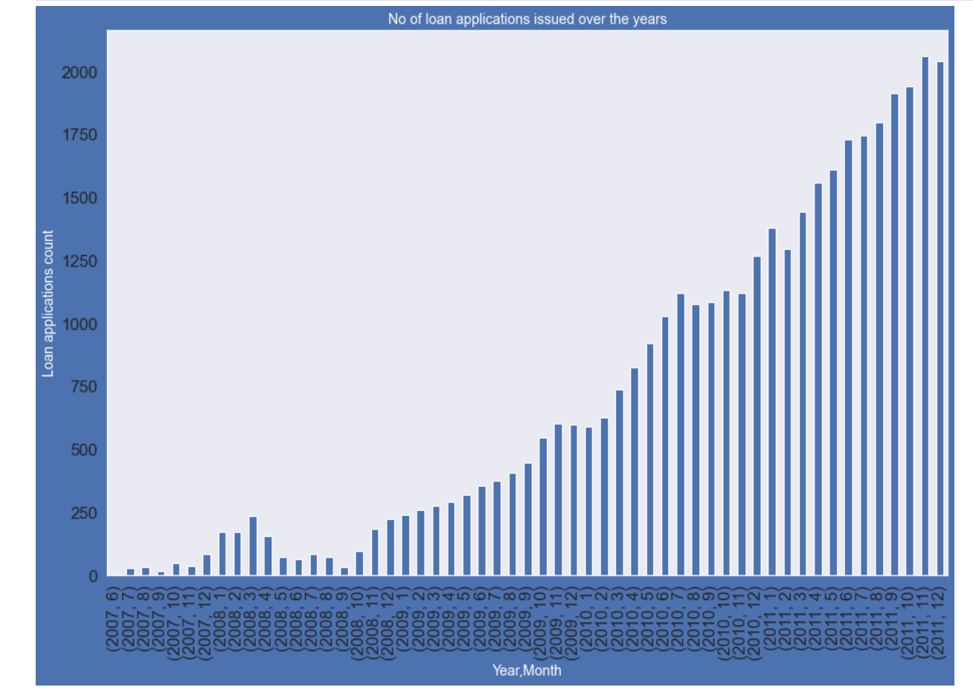
Derived Column - Ordered Categorical Variables
Observation:
As the loan applications increased charged off applications Increased

Slide 12
Recommendation
To identify patterns which indicate if a person is likely to defaulter.
Those who have the own home will be preferred customer to provide the loan

