Slide 1
“Version Control using GIT”
An Overview & Hands-On
Presented by,
Prashanth B S
Asst. Professor, Dept. Of CS&E
M.I.T.E

Slide 2
Lets Develop a Software Project
UI Design
Html/css
Java Coding
Database Design
UI Designer
Java Programmer
Database Admin
UI Code
Java Code
SQL queries
Pen-drive transfer/Upload it cloud!!!
OMG!!!
What if each one of these members do modification to their individual code each hour?!!!!
What if they want to access the previous code which they updated and saved (cloud)?

Slide 3
What is Version Control?
Version control systems are a category of software tools that help a software team manage changes to source code over time
Version control software keeps track of every modification to the code in a special kind of database
Version control protects source code from both catastrophe and the casual degradation of human error and unintended consequences.
VCS is also called as Revision Control Systems(RCS) or Source Code Management Tools(SCM)

Slide 4
Benifits of VCS
A complete long-term change history of every file
Traceability. Being able to trace each change made to the software and connect it to project management and bug tracking software
Branching and merging
  Creating a "branch" in VCS tools keeps multiple streams of work independent from each other while also providing the facility to merge that work back together

Slide 5
What is git?
Git is a mature, actively maintained open source project originally developed in 2005 by Linus Torvalds for version control
Git has been designed with performance, security and flexibility in mind
Git is a Distributed VCS, a category known as DVCS
Revision History is distributed instead of being stored at a single place

Slide 6
Git Architecture

Slide 7
Installation of git in Linux(Debian/ubuntu)
From your bash shell type the command
$ sudo apt-get update
$ sudo apt-get install git
Verify the installation by typing
$ git --version
Configure your Git username and email using the following commands
$ git config --global user.name “prashanth”
$ git config –global user.email “prashanth@xyz.com”

Slide 8
Installation of git in Windows
Download the git windows installer from the official webpage https://git-for-windows.github.io/
Double click on the installer and install it to defaults
One GUI git windows along with git command terminal shortcut will be created on Desktop
Click on the terminal window and type the following commands to set the properties
$ git config --global user.name “prashanth”
$ git config –global user.email “prashanth@xyz.com”

Slide 9
Setting up a Repository
To create a new git repository we use “git init”command from within the Directory
From the working directory issue $ git init
Executing git init creates a .git subdirectory in the project root, which contains all of the necessary metadata for the repo
To copy a working repository into local directory can be done by “git clone” command
From the working directory issue $ git clone <Repo_name>

Slide 10
Configuring the Working Directory
The git config command lets you configure your Git installation (or an individual repository) from the command line.
$ git config --global user.name “prashanth”
$ git config –global user.email “prashanth@xyz.com”
To see the parameters that is set by config command issue
$ git config --list
To get help on git commands issue the command
$ git help command_name

Slide 11
Saving changes to the Local Repo
The git add command adds a change in the working directory to the staging area
$ git add <file>/<directory>
The git status command shows the status of the files that needs to be updated in to the repository
$ git status
The git commit command commits the staged snapshot to the project history (saves into the repository)
$ git commit

Slide 12
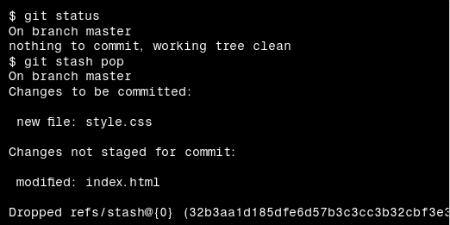
Continued ..
Re-applying your stashed changes

Slide 13
Inspecting the Repository
The git status command displays the state of the working directory and the staging area. It lets you see which changes have been staged, which haven’t, and which files aren’t being tracked by Git
$ git status
The git log command displays committed snapshots. It lets you list the project history, filter it, and search for specific changes
$ git log –author=“name”

Slide 14
Synching the Local Repo with Remote Repo(Git Hub)
The git remote command lets you create, view, and delete connections to other repositories.
$ git remote add <name> <url>
Remove the connection to the remote repository called <name>
$ git remove <name>
To rename the remote repository issue the command
$ git remote rename <old-name> <new-name>
To push the local repository into remote repository
$ git push -u my_local_repo master

Slide 15
Git Advanced
The git fetch command imports commits from a remote repository into your local repo
Fetch all of the branches from the repository
$ git fetch <remote>
A branch represents an independent line of development.The git branch command lets you create, list, rename, and delete branches
$ git branch -d <branch>
The git merge command lets you take the independent lines of development created by git branch and integrate them into a single branch.
$ git merge <branch>

Slide 16
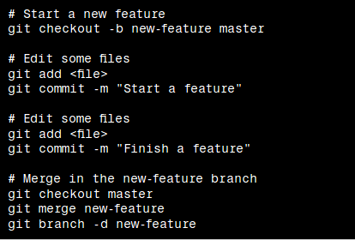

Slide 17
Reference: https://www.atlassian.com/git/tutorials
Thank you!!!

