Slide 1

Ley bot An end to end service to help people with legal support. <
D21IT176 – Ishan Kansara
D21IT183 – Smit Anam
Guided by – Prof. Arkesha Shah

Slide 2
Introduction
“A big problem with the justice system is that it doesn’t matter how much protection the law gives you, if you’re not aware of it. Unless, you studied law in college or are lucky enough to have friends working in the legal profession”.
Cybercrime takes many forms, and it is therefore difficult to fight.
Nowadays, all digital devices (including computers, tablets, and smartphones) are connected to the internet. In theory, cyber criminals could bring a large part of the country to a halt. The government rightly takes cybercrime very seriously, and we are working hard to fight it.

Slide 3
Bot Features.
Offering:
Access anywhere and Quality legal help.
Monetization:
Free of cost for the user end.
Sustainability:
Growth of quality proportional to growth of the platform.

Slide 4
Common forms of cybercrime
Common forms of cybercrime include:
phishing: using fake email messages to get personal information from internet users;
misusing personal information (identity theft);
Hacking: shutting down or misusing websites or computer networks;
distributing child pornography;
grooming: making sexual advances to minors.

Slide 5
This chatbot will help people to know about Cyber Attacks and will guide people to protect themselves if it takes place. It will included in the informative website which guides and help users to surf and get information about the Cyber Attack. The bot will respond accordingly and further the bot will respond according to that Keyword.

Slide 6
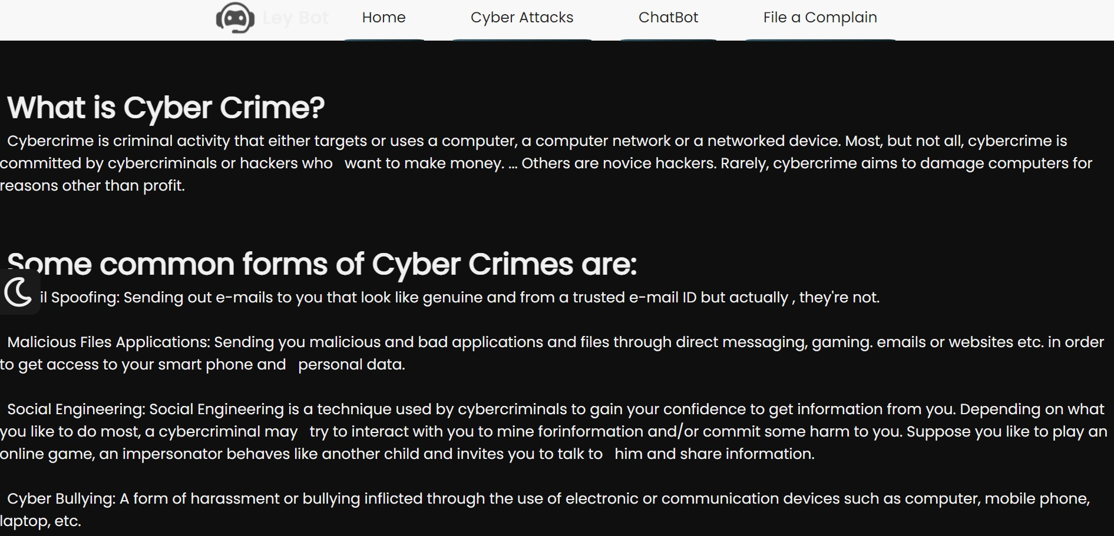
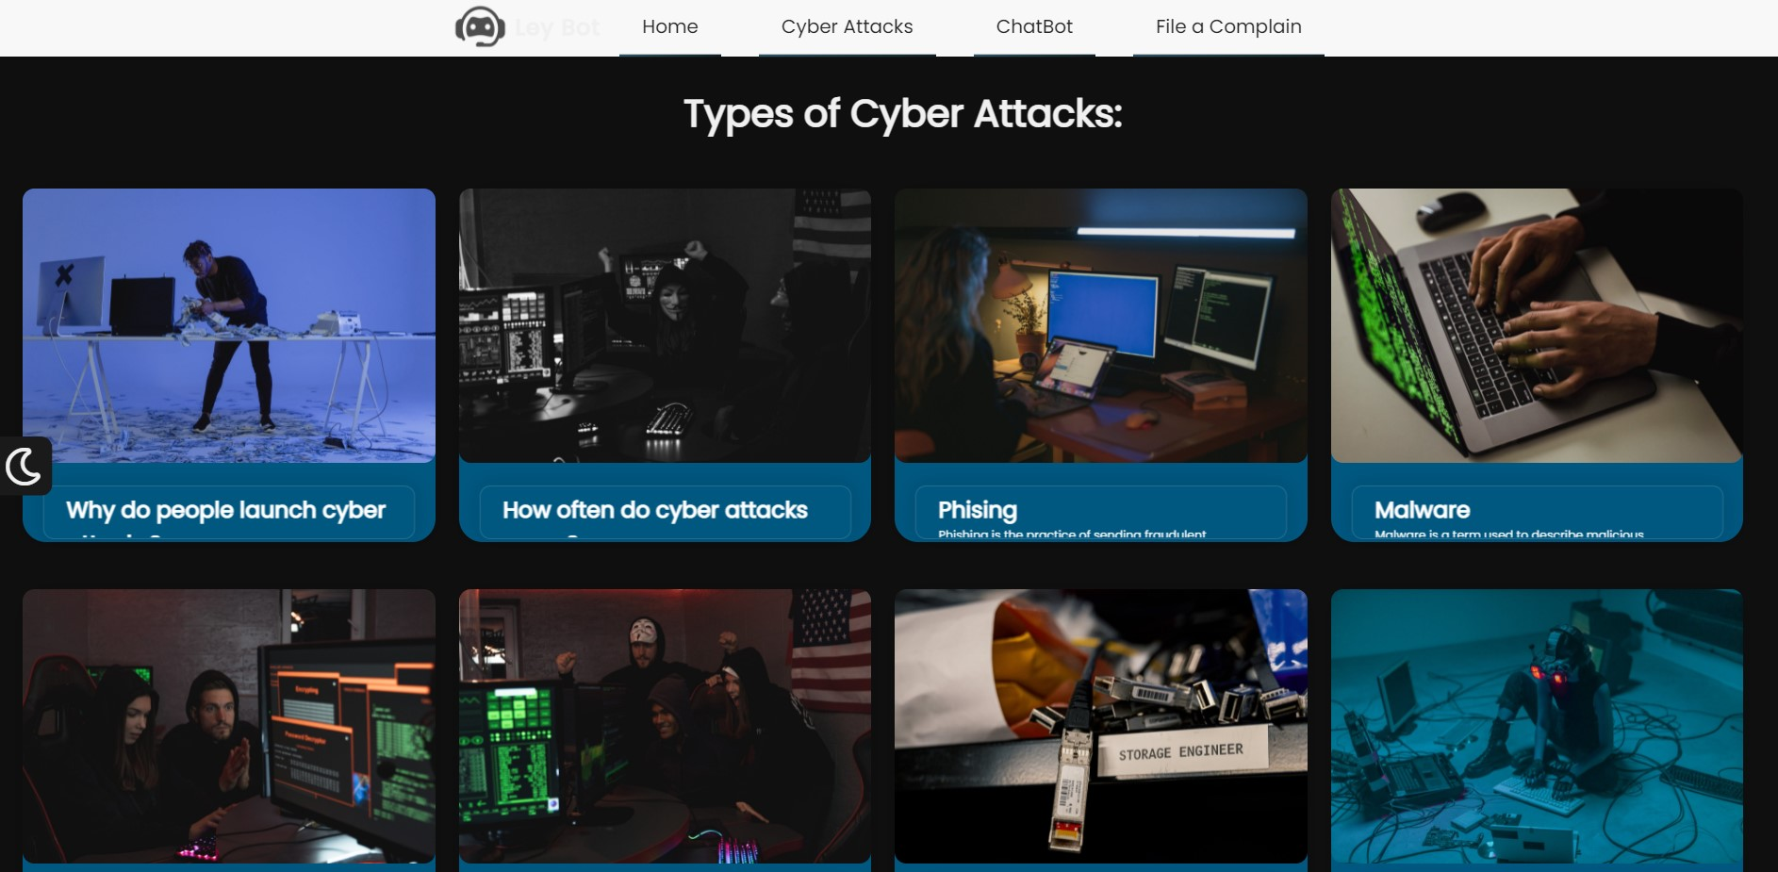
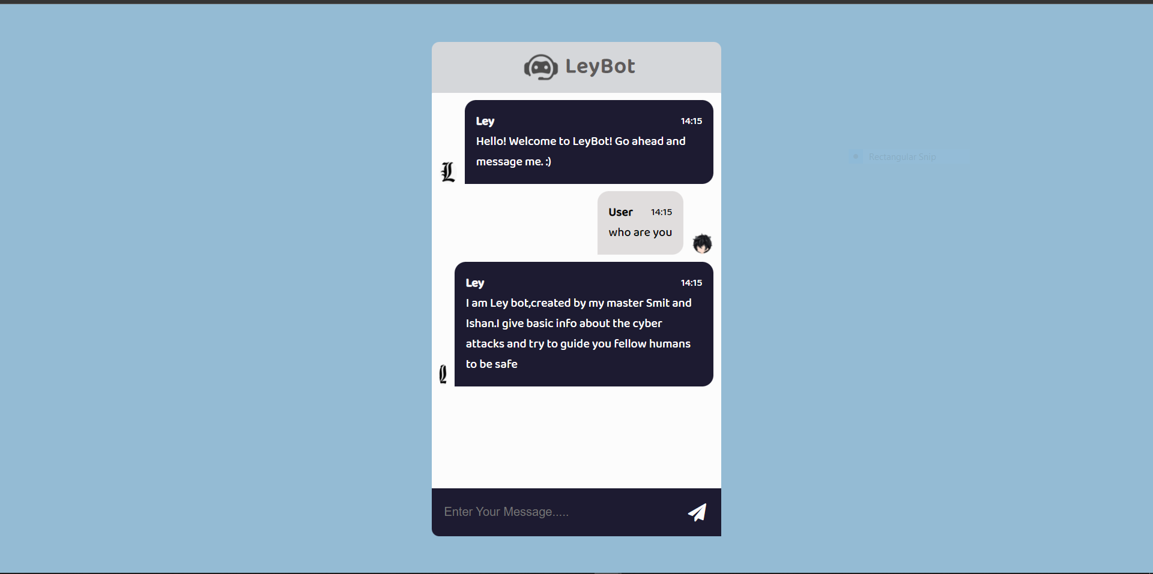
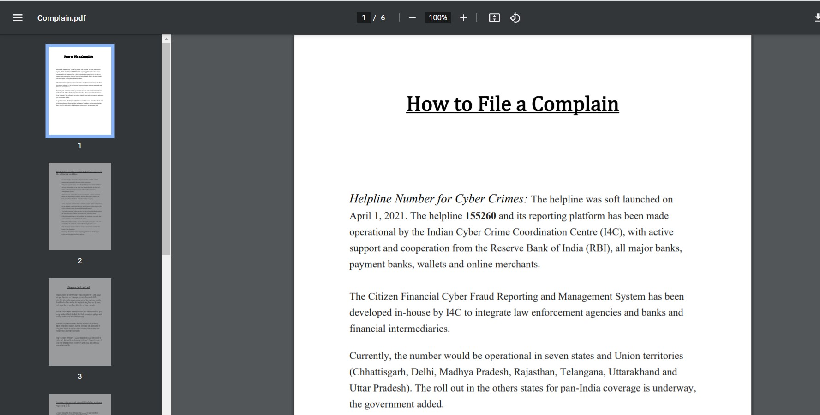
Project Outcome

Slide 7
Technology Stack
Languages we will be using to develop the chatbot:
HTML, CSS, Java script

Slide 8
THANK YOU

