Slide 1
UI and Unit Tests
• Exploring the fundamentals of testing
• Learning the basics of testing your Compose UI
• Covering the basics of unit-testing your core logic
Exploring types of tests
To better understand how to write tests, we must first decide what exactly can be tested in our apps. From this perspective, let's cover the most important types of tests:
• Functional tests: Is the app doing what is expected? We already touched upon functional tests and their benefits in the Understanding the benefits of testing section.
• Compatibility tests: Is the app working correctly on all devices and Android API levels? The Android ecosystem makes this particularly difficult if you consider the variety of devices and manufacturers.
• Performance tests: Is the app fast or efficient enough? Sometimes, apps can suffer from bottlenecks and UI stutters that can be identified via performance benchmarks.
• Accessibility tests: Is the app working well with accessibility services? Such services are used to assist users with disabilities in using our Android application.

Slide 2
UI and Unit Tests
Now, apart from deciding what has to be tested, we must also think about the scope or size of the tests.
The scope indicates the size of the app's portion we're testing. From the perspective of the scope of the tests, we have the following:
• Unit tests: Often referred to as small tests, these test the functional behavior of methods, classes, or groups of classes in an isolated environment. Usually, unit tests target small portions of the app without interacting with the real-world environment; hence, they are more reliable than tests that depend on external input.
• Integration tests: Often referred to as medium tests, these test whether multiple units interact and function correctly together.
• End-to-end tests: Often referred to as big tests, these test large portions of the application, from multiple screens to entire user flows.
Depending on the size of the tests, each type has a degree of isolation. The degree of isolation is tightly related to the scope of the tests, as it measures how dependent the component we're testing is on other components. As the size of the test increases, from small to big, the isolation level of the tests decreases.

Slide 3
UI and Unit Tests
Lastly, we must also classify tests based on the system they will be running on:
• Local tests: Run on your workstation or development system (used in practices such as Continuous Integration (CI)) without the need of an Android device or emulator. They are usually small and fast, isolating the component under test from the rest of the application. Most of the time, unit tests are local tests.
• Instrumented tests: Run on an Android device, be it a physical device or emulator. Most of the time, UI tests are considered instrumented tests, since they allow the automated testing of an application on an Android device.

Slide 4
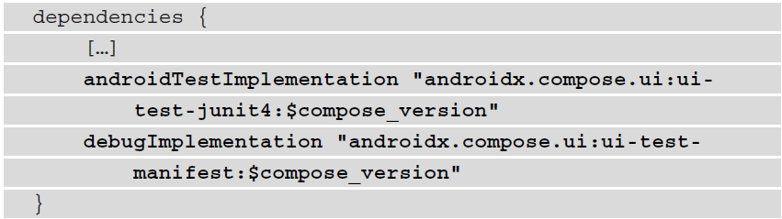
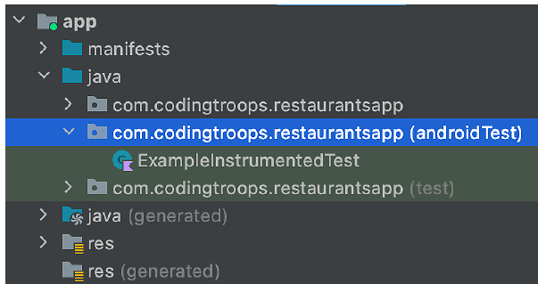
Testing Compose UI
We need to test the first screen of our application, represented by the RestaurantsScreen() composable. Let's begin!
Before creating a test class, locate the androidTest package that is suited for instrumented tests:

Slide 5
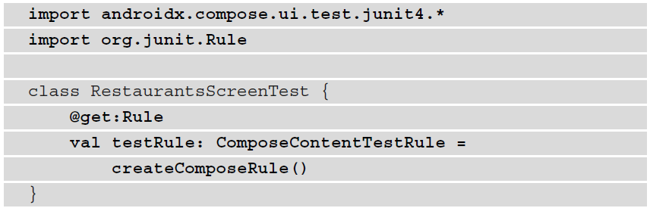
Testing Compose UI
Create an empty Kotlin class named RestaurantsScreenTest inside the androidTest package.
Test rules allow us to add functionality to all the tests within a test class.
ComposeContentTestRule will not only allow us to set the Compose UI under test but also host tests on an Android device, while also giving us the ability to interact with the composables under test or perform UI assertions.

Slide 6
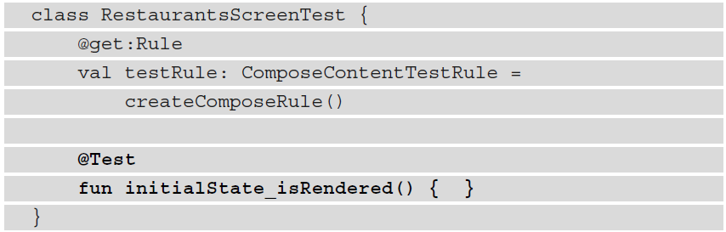
Testing Compose UI
We can say that our screen should have three possible states:
Initial loading state: At this point, we're waiting for restaurants, thus rendering a loading status.
State with content: The restaurants have arrived, so we reset the loading status and render them.
Error state: Something went wrong when the app tried to fetch its content – that is, restaurants. You can see how this state is created inside the block of code exposed by CoroutineExceptionHandler where the isLoading
parameter is set to false to reset the loading status, while also passing the message of Exception to the error parameter.

Slide 7
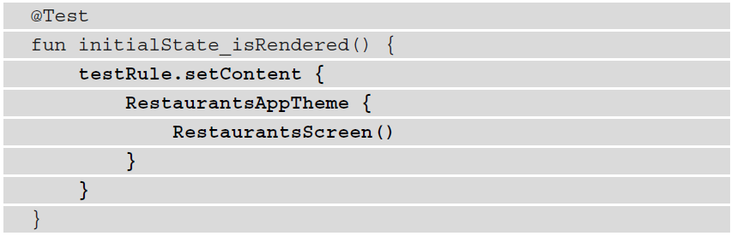
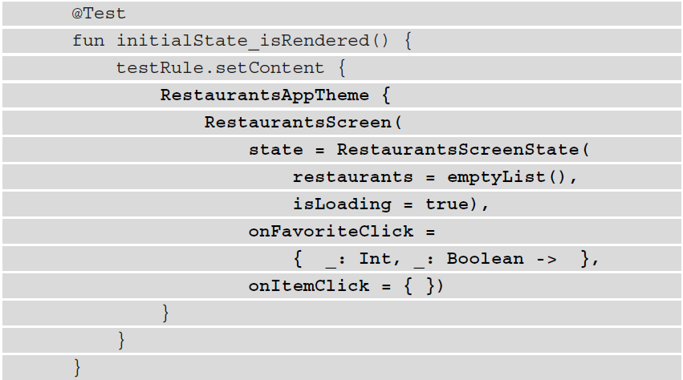
Testing Compose UI

Slide 8
Testing Compose UI
Compose надає нам кілька API для тестування, які допомагають нам знаходити елементи, перевіряти їх атрибути та навіть виконувати дії користувача.
Для тестів UI з Compose ми розглядаємо частини UI як вузли, які можна ідентифікувати за допомогою семантики. Семантика надає значення елементу інтерфейсу, а для цілої ієрархії компонованих елементів генерується дерево семантики, щоб описати його.
Іншими словами, ми повинні мати можливість ідентифікувати будь-що, що описано на екрані за допомогою його відкритої семантики.
Для прикладу, composable елемент Text, який відображає об'єкт String, такий як "Привіт", стане вузлом у дереві семантики, який ми можемо ідентифікувати за значенням його властивості тексту – "Привіт".
Так само composable елементи, такі як Image, вимагають обов'язковий параметр contentDescription, значення якого дозволить нам ідентифікувати відповідний вузол у дереві семантики у наших тестах.

Slide 9

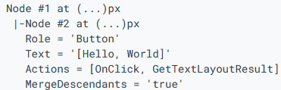
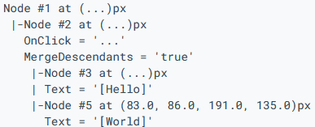
Testing Compose UI
Some nodes merge the semantics information of their children. For example, a button with two text elements merges the text element labels:
composeTestRule.onRoot().printToLog("TAG")
composeTestRule.onRoot(useUnmergedTree = true).printToLog("TAG")

Slide 10
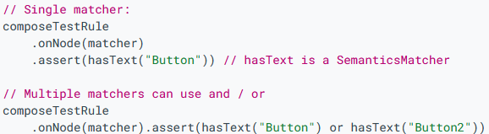
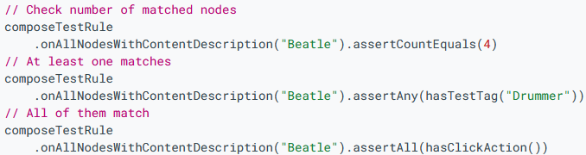

Testing Compose UI
https://medium.com/deemaze-software/testing-in-jetpack-compose-90674052b48c
https://developer.android.com/develop/ui/compose/testing

Slide 11
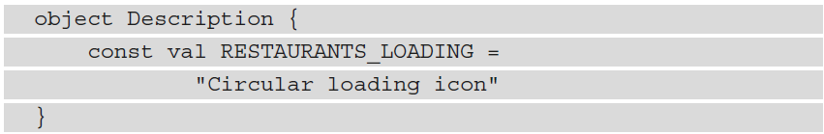
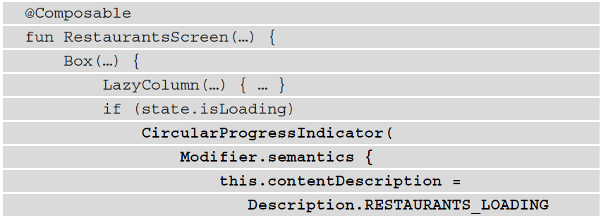
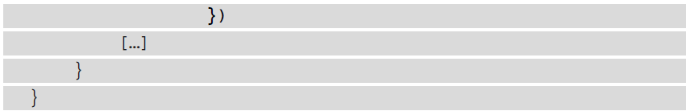
Testing Compose UI

Slide 12
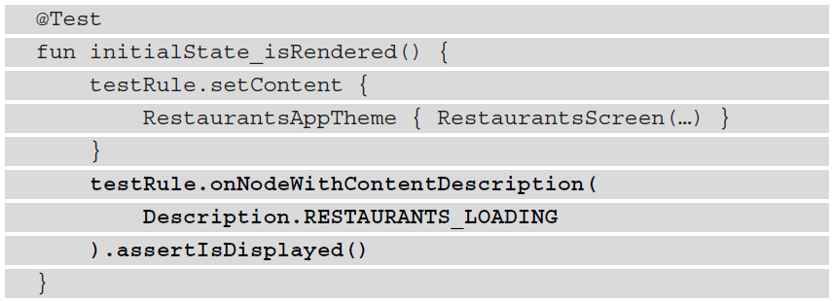
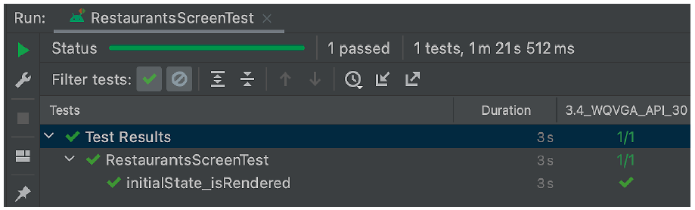
Testing Compose UI

Slide 13
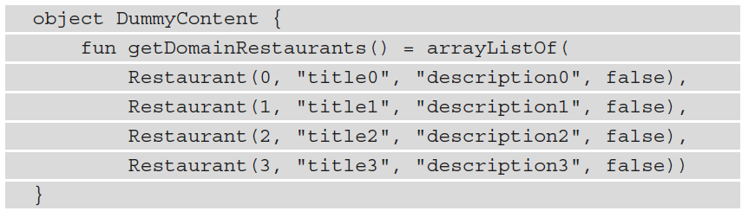
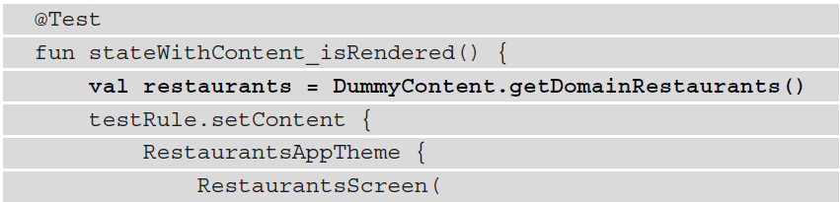

Testing Compose UI
Now, it's time to test whether the RestaurantsScreen() composable is rendering state with content.

Slide 14
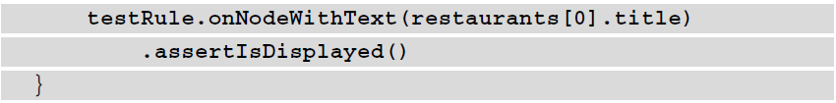
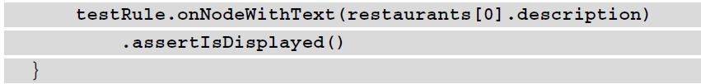

Testing Compose UI
Now, it's time to test whether the RestaurantsScreen() composable is rendering state with content.

Slide 15
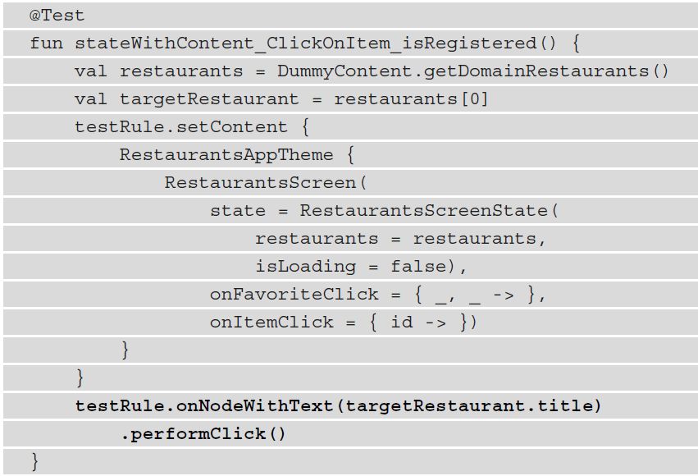

Testing Compose UI
Now, it's time to test whether the RestaurantsScreen() composable is rendering state with content.
Then, identify the node that contains the title text of targetRestaurant and then simulate a user click on this node by calling the performClick() method:

Slide 16
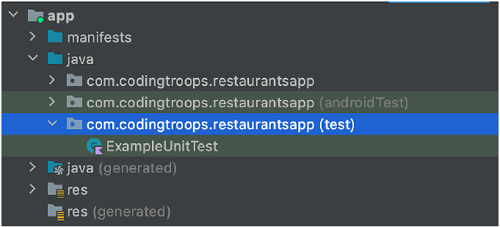
Unit Testing of core logic
We will be writing unit tests for the RestaurantsViewModel class.
Since this component doesn't interact directly with the UI, its unit tests will run directly on your local workstation's Java Virtual Machine (JVM), rather than running on an Android device, as our UI tests did.
Testing the functionality of a ViewModel class

Slide 17
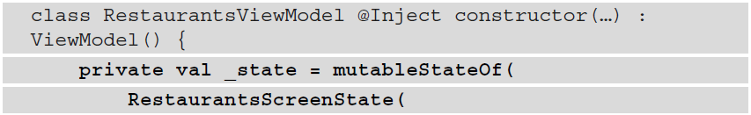
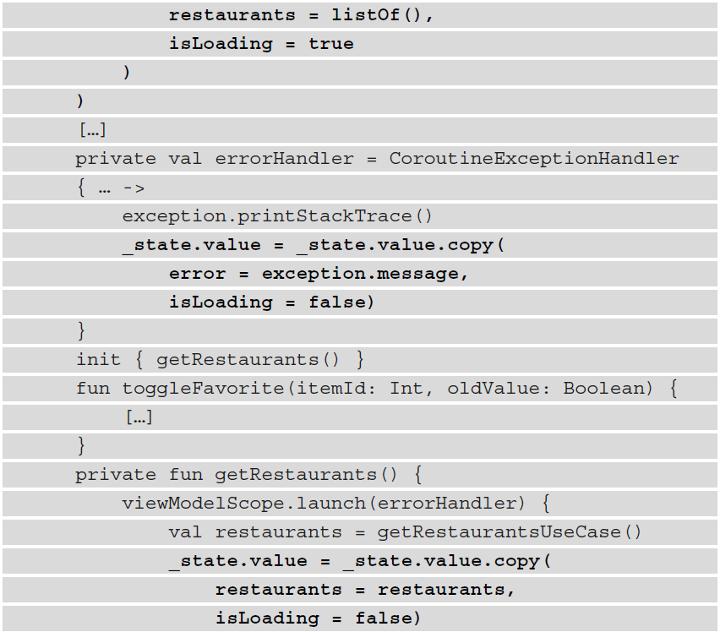
Unit Testing of core logic
Testing the functionality of a ViewModel class

Slide 18
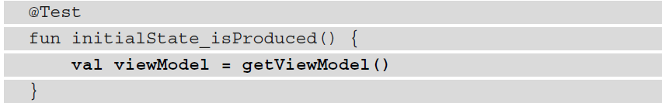
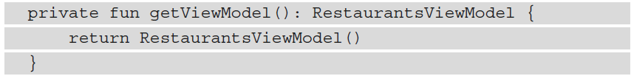
Unit Testing of core logic
Testing the functionality of a ViewModel class
Initial loading state: At this point, we're waiting for restaurants, thus rendering a loading status.
State with content: The restaurants have arrived. This state is produced inside the coroutine launched in the getRestaurants() method, where we mutated the initial state and set the isLoading parameter to false while also passing the list of restaurants to the restaurants parameter.
Error state: Something went wrong when the app tried to fetch its content. You can see how this state is created inside CoroutineExceptionHandler, where the isLoading parameter is set to false to reset the loading status while also passing the message of Exception to the error parameter.

Slide 19
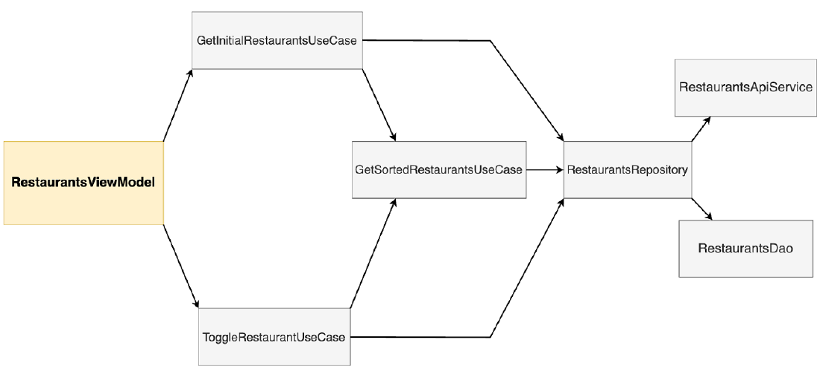
Unit Testing of core logic
Testing the functionality of a ViewModel class
Observing the direct and transitive dependencies of RestaurantsViewModel

Slide 20
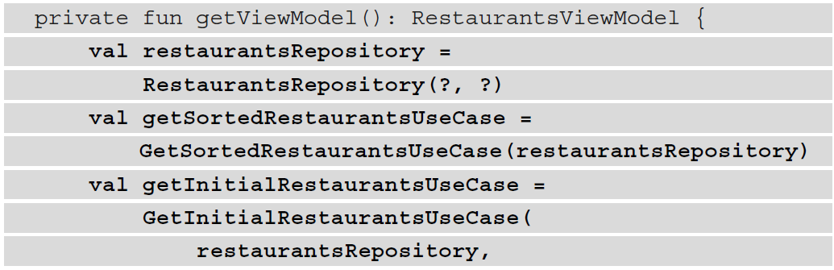
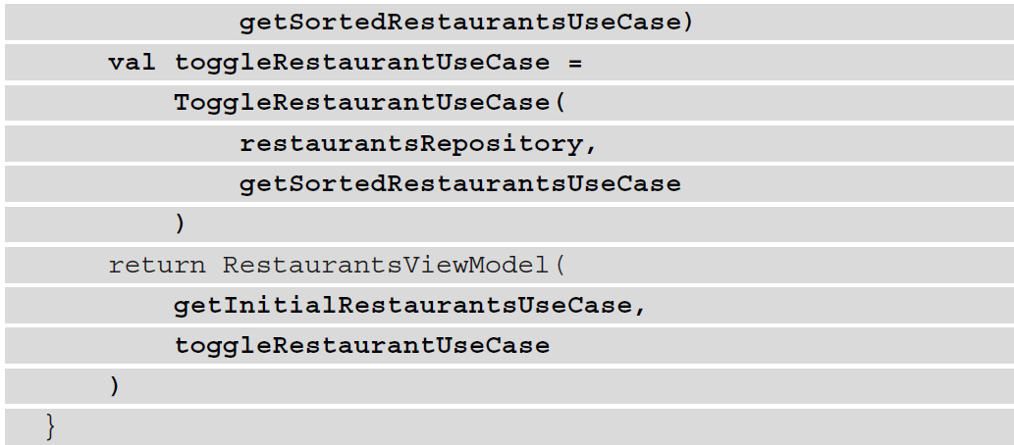
Unit Testing of core logic
Testing the functionality of a ViewModel class

Slide 21
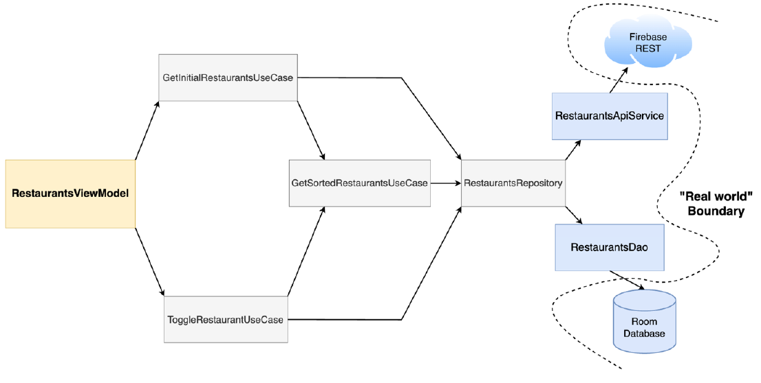
Unit Testing of core logic
Testing the functionality of a ViewModel class
Observing the real-world boundary crossed by the transitive dependencies of RestaurantsViewModel

Slide 22
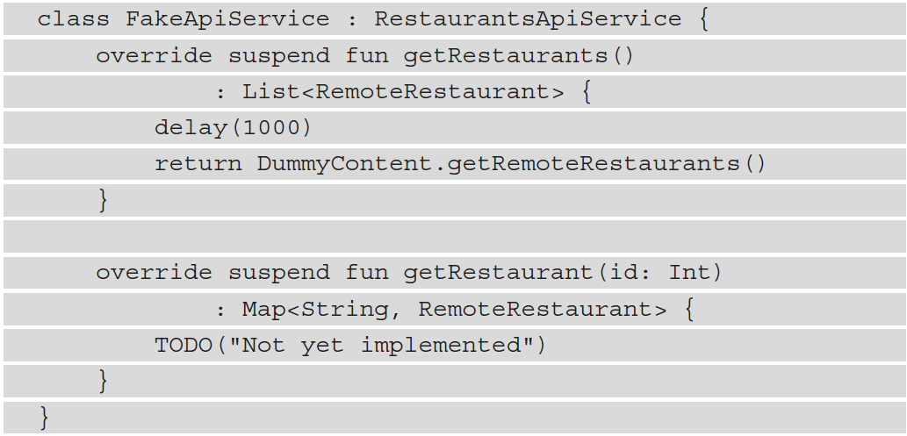
Unit Testing of core logic
Testing the functionality of a ViewModel class
We will define dummy implementations for these interfaces that won't communicate with the real world.
These dummy implementations are often called fakes.
Fakes are simplified implementations of the interfaces that we're looking to interact with in our tests.
Mocks are objects that also simulate the behavior of a real object; however, you can configure their output on the fly without any additional classes.

Slide 23
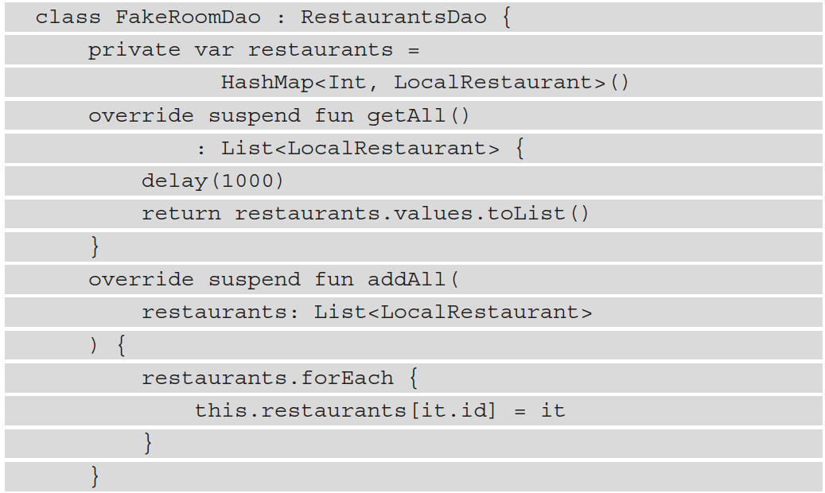
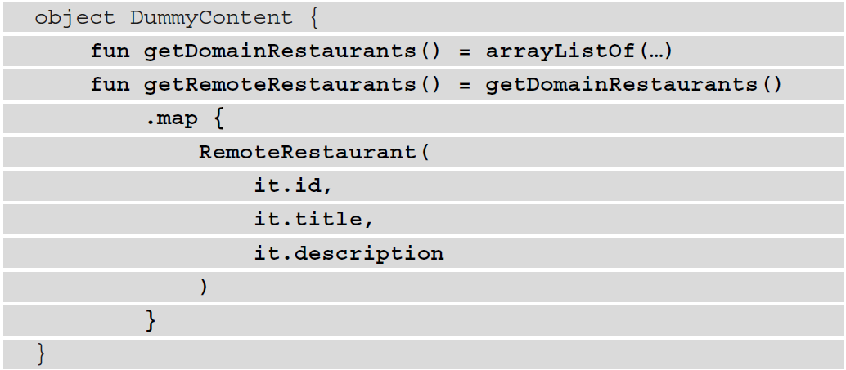
Unit Testing of core logic
Testing the functionality of a ViewModel class

Slide 24
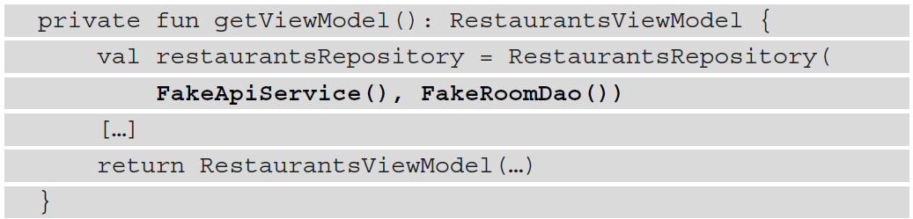
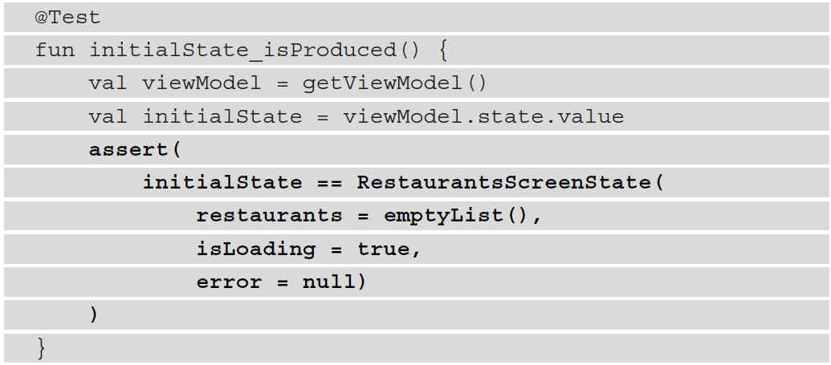
Unit Testing of core logic
Testing the functionality of a ViewModel class

Slide 25
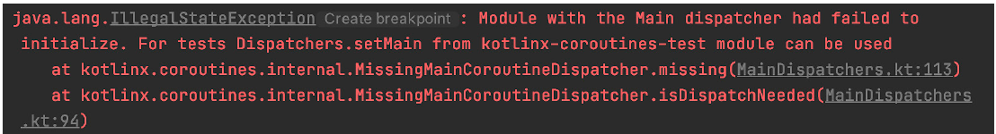
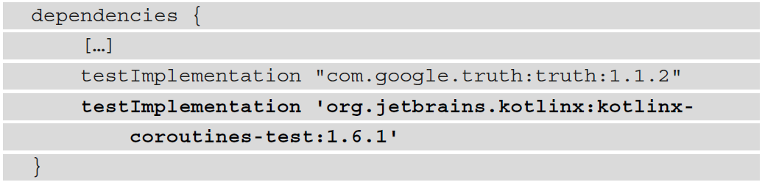
Unit Testing of core logic
Testing the functionality of a ViewModel class
This exception is thrown because our Restaurants app handles asynchronous work with the help of coroutines, and our test code doesn't know how to interact with them.

Slide 26
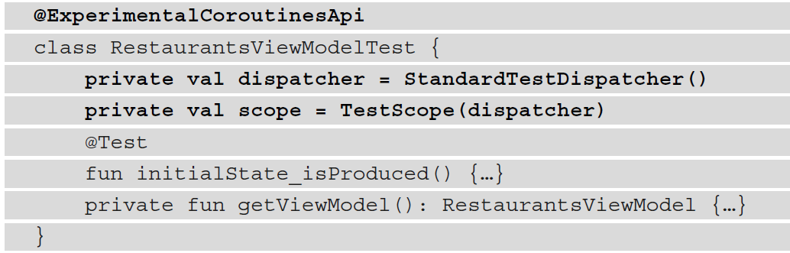
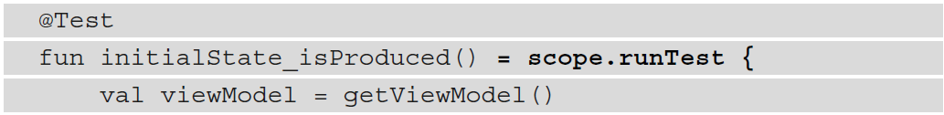
Unit Testing of core logic
Testing the functionality of a ViewModel class
In our test, all coroutines that are launched should use StandardTestDispatcher defined in our test class. So, how can we pass a test dispatcher to the coroutines launched in our RestaurantsViewModel?

Slide 27
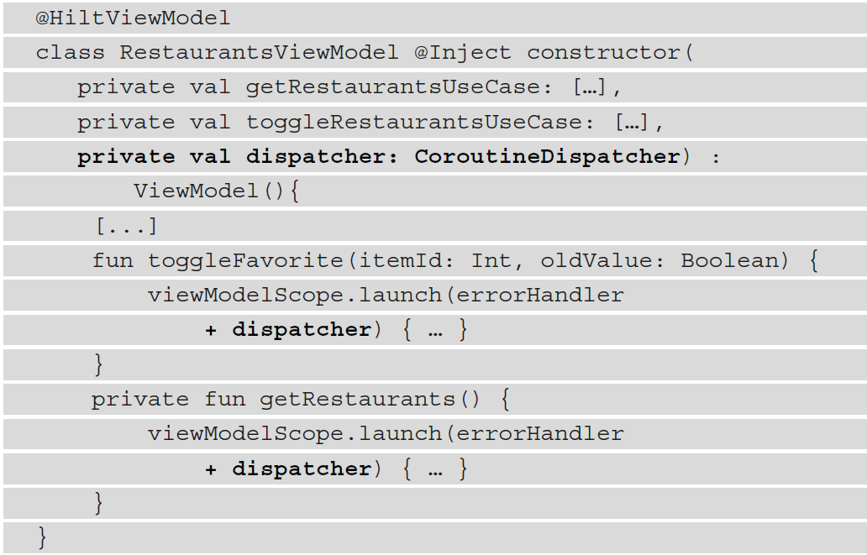
Unit Testing of core logic
Testing the functionality of a ViewModel class
We can inject the dispatcher inside the RestaurantsViewModel class by using its constructor and making it accept a CoroutineDispatcher object, which will be passed to all the coroutines that are launched.
This way, in our production code, RestaurantsViewModel will receive and use the Dispatchers.Main dispatcher, and inside our test code, it will receive and use the StandardTestDispatcher dispatcher.

Slide 28
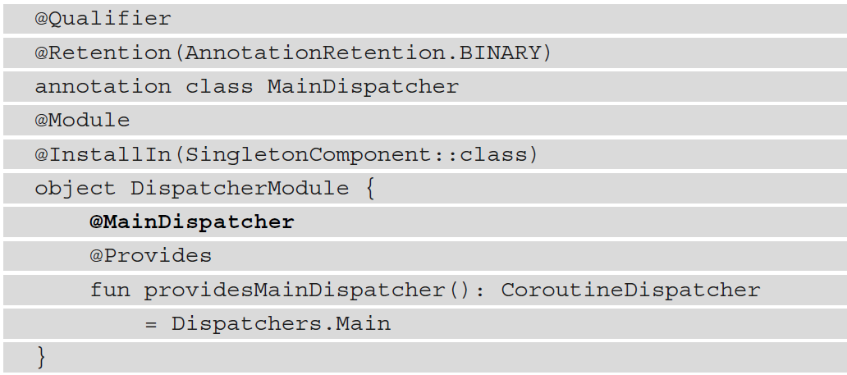
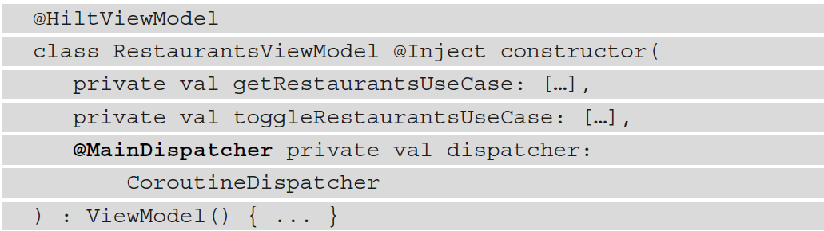
Unit Testing of core logic
Testing the functionality of a ViewModel class

Slide 29
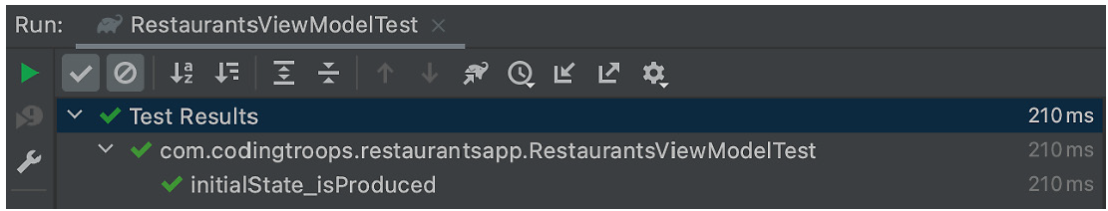
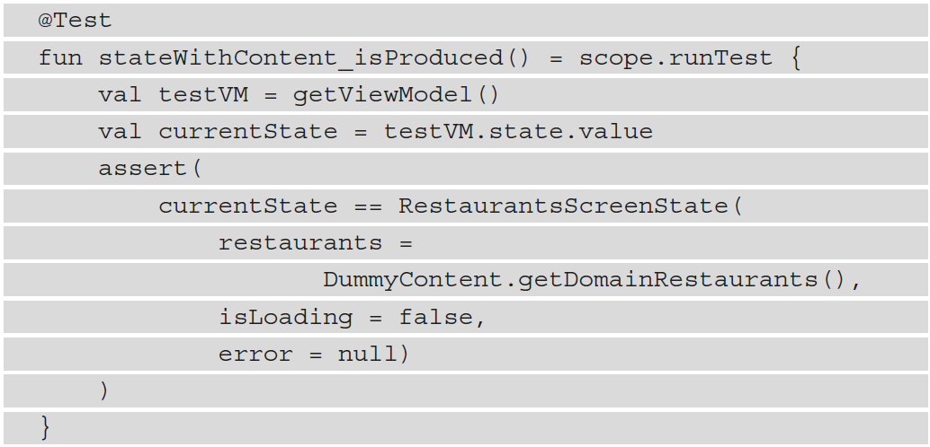
Unit Testing of core logic
Testing the functionality of a ViewModel class

Slide 30
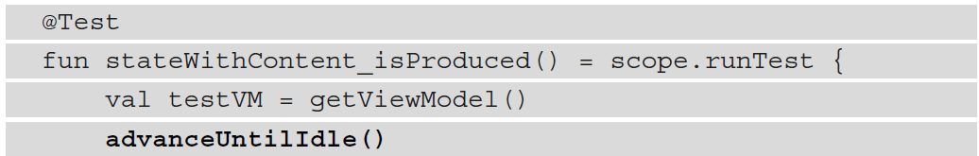
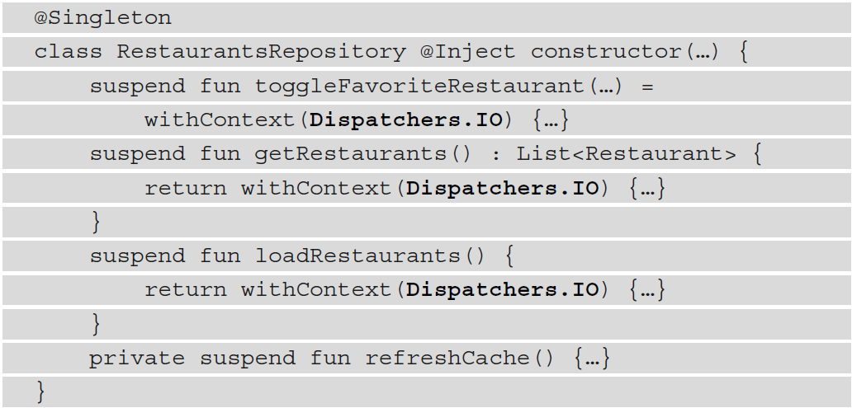
Unit Testing of core logic
Testing the functionality of a ViewModel class

Slide 31
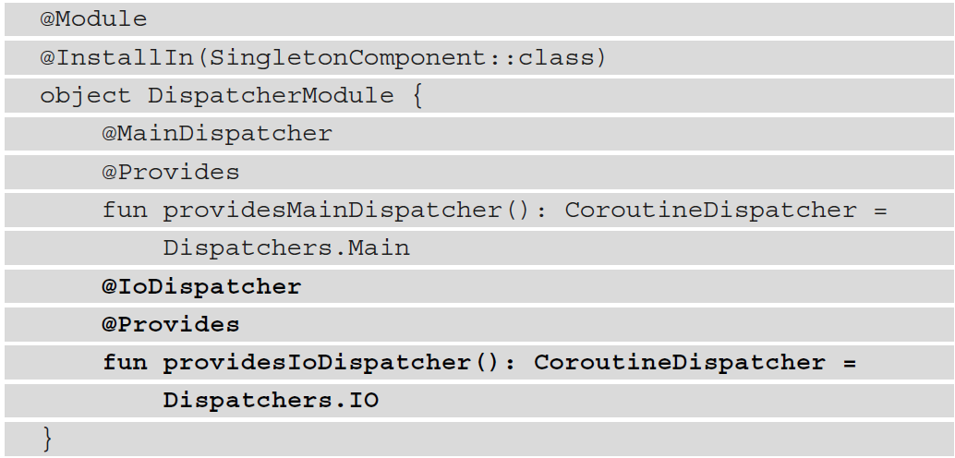
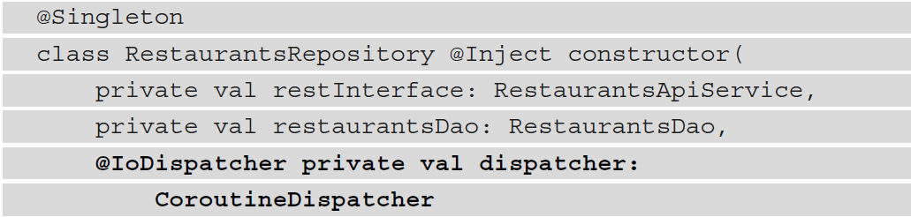
Unit Testing of core logic
Testing the functionality of a ViewModel class

