Slide 1

Course: Java programming i
Mr. Chenda Sovisal

Slide 2
Chapter III
Conditional and Operators in Java

Slide 3

Agenda
Conditional if-else
Relation Operators
Logical Operators
Bitwise Operators
Assignment Operators
Miscellaneous Operators

Slide 4
Conditional if-else in Java

Slide 5
I. Conditional if-else in Java
Conditional if-else or if statement is used to test the condition. It returns true or false. There are various types of if statement in java.
if statement
if-else statement
nested if statement
if-else-if ladder

Slide 6
I. Conditional if-else in Java (con.)
if statement tests the condition. It executes the if statement if condition is true.
Syntax:
if(condition){
//code to be executes
}

Slide 7
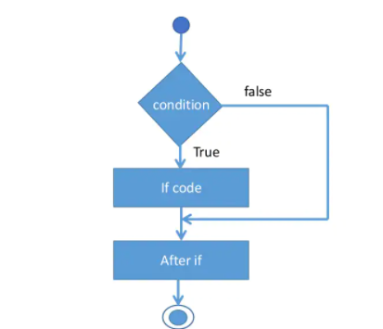
I. Conditional if-else in Java (con.)
Flow chart of if statement

Slide 8
I. Conditional if-else in Java (con.)
Example real life:
If (bank balance is close to zero)
=> borrow friend’s money
If(room is dark)
=> turn on the light
If(student’s mark is 60)
=> student is pass

Slide 9
I. Conditional if-else in Java (con.)
If-else statement also tests the condition. It executes the if block if condition is true otherwise execute the else block.
Syntax:
if(condition){
//code in if block to be executes
}
else{
//code in else block to be executes
}

Slide 10
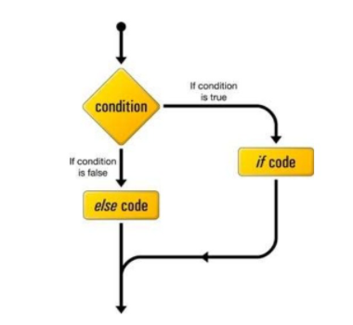
I. Conditional if-else in Java (con.)
Flow chart of if-else statement

Slide 11
I. Conditional if-else in Java (con.)
Example real life:
If today is Thursday, I have Java class else I have other class.
If you finish test early, you can go home early else you need to stay until you finish the test.

Slide 12
I. Conditional if-else in Java (con.)
nested if statement also tests the condition. It is an if statement or if-else statement inside another conditional statement.
Syntax:
if(condition1){
//code to be executes
if(condition2){
//code to be executes
{
}

Slide 13
I. Conditional if-else in Java (con.)
Example real life:
If I have a car and If I have driving license, I will go to Kompot today.
If I have a car but I don’t have driving license, I will ask my sister to drive me to Kompot today.

Slide 14
I. Conditional if-else in Java (con.)
If-else ladder statement or switch statement allows a variable to be tested for equality against a list of values. Each value is called a case, and the variable being switched on is checked for each case.
Syntax:
switch(expression){
case value1:
//code to be executes
break;
case value2:
//code to be executes
break;
default:
//code to be executes
}

Slide 15
I. Conditional if-else in Java (con.)
The variable used in a switch statement can only be int, convertable integer(byte, short, char), string and enums.
You can have any number of case statements within a switch. Each case is followed by the value to be compared to and a colon(:).
The value for a case must be the same data type as the variable in the switch.
When a break statement is reached, the switch terminated.
A swtich statement can have an optional default case, which must appear at the end of the switch. The default case can be used for performing a task when none of the cases is true. No break is needed in the default case.

Slide 16
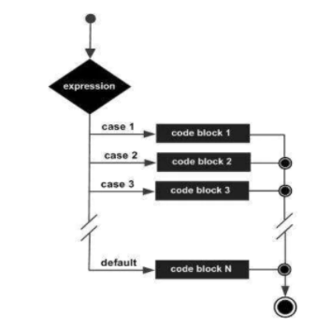
I. Conditional if-else in Java (con.)
Flow chart of switch statement

Slide 17
Relation Operators in Java

Slide 18
II. Relation Operators in Java
These are all relation operators supported by Java:
Operator | Description
== | Check if two variables are equal
!= | Check if tow variables are not equal
> | Check if variable on the left is absolutely greater than variable on the right
< | Check if variable on the left is absolutely smaller than variable on the right
>= | Check if variable on the left is absolutely greater than or equal to variable on the right
<= | Check if variable on the left is absolutely small than or equal to variable on the right

Slide 19
II. Relation Operators in Java (con.)
Example: int A = 10; int B = 20;
Operator | Operating | Result
== | (A==B) | false
!= | (A!=B) | true
> | (A>B) | false
< | (A<B) | true
>= | (A>=B) | false
<= | (A<=B) | true

Slide 20
Logical Operators in Java

Slide 21
III. Logical Operators in Java
These are all logical operators supported by Java:
Operator | Description
&& | Called logical AND operator. If both the two variables are both true, then the condition becomes true.
|| | Called logical OR operator. If any of the two variables are true, then the condition becomes true.
! | Called logical NOT operator. Use to reverses the logical states of its operator. If a condition is true then Logical NOT operator will make false.

Slide 22
III. Logical Operators in Java (con.)
Example: boolean A = true; boolean B = false;
Operator | Operating | Result
&& | (A&&B) | false
|| | (A||B) | true
! | (!A) | false

Slide 23
III. Logical Operators in Java (con.)
Example: int A = 10; int B = 20;
Operator | Operating | Result
&& | (A<B&&B>A) | ???
|| | (A>B||A<B) | ???
! | (!A) | ???

Slide 24
Bitwise Operators in Java

Slide 25
IV. Bitwise Operators in Java
These are all Bitwise operators supported by Java. Java defines several bitwise operators that can be applied to char and the integer types long, int, short, and byte:
Operator | Description
& | Bitwise AND operator
| | Bitwise OR operator
^ | Bitwise exclusive OR operator
<< | Left shift
>> | Right Shift

Slide 26
IV. Bitwise Operators in Java (con.)
Example: int A = 1; int B = 0; //binary A = 1, B = 0
Operator | Operating | Result
& | (A&B) | A = 1 B = 0 R = 0
| | (A| B) | A = 1 B = 0 R = 1
^ | (A^B) | A = 1 B = 0 R = 1
<< | (A<<1) | A = 1 R = 10
>> | (A>>1) | A = 1 R = 0

Slide 27
Assignment Operators in Java

Slide 28
V. Assignment Operators in Java
These are all Assignment operators supported by Java:
Operator | Description
= | Assign values from right side variables to left side variables
+= | Adds right variables to the left variables and assign the result to left variables
-= | subtracts right variables to the left variables and assign the result to left variables
*= | Multiply right variables to the left variables and assign the result to left variables
/= | Divides right variables to the left variables and assign the result to left variables
%= | Calculate modulus right variables to the left variables and assign the result to left variables

Slide 29
V. Assignment Operators in Java
Example: int A = 10; int B = 3;
Operator | Operating | Result
= | A = B | A = 3
+= | A+=B or A = A+B | A = 13
-= | A-=B or A = A-B | A = 7
*= | A*=B or A = A*B | A = 30
/= | A/=B or A = A/B | A = 3
%= | A%=B or A = A%B | A = 1

Slide 30
Miscellaneous Operators in Java

Slide 31
VI. Miscellaneous Operators in Java
Conditional Operator (? :) : is also know as the ternary operator. This operator consists of three variables and is used to evaluate Boolean expressions. The goal of the operator is to decide, which value should be assigned to the variable. The operator is written as:
Syntax:
variable(x) = (expression) ? value <if true> : value <if false>;

Slide 32
VI. Miscellaneous Operators in Java
Example:
int a, b;
a = 10;
b = (a==1) ? 20: 30;
Output
b = 30

Slide 33
The End of Chapter III
Thank you

