Slide 1

Course: Java programming i
Mr. Chenda Sovisal

Slide 2
Chapter IV
Iteration statements and Jump statements

Slide 3

Agenda
Iteration statements
while loop
do loop
for loop
Jump statements

Slide 4
Iteration statements

Slide 5
I. Iteration statements
Iteration or Repetition statements allow us to execute a statement multiple times. Often for programmers, we refer it as loop.
Like condition statements, loop is controlled by Boolean expression.
In java, there are three kind of loops such as:
while loop
do loop
for loop

Slide 6
Iteration statements while loop statement

Slide 7
I. Iteration statements (con.)
The while statement continually executes a block of statements while a particular condition is true. Its syntax can be expressed as:
while (expression) {
//statement(s)
}

Slide 8
I. Iteration statements (con.)
The while statement evaluates expression, which must return a boolean value.
If the expression evaluation is true, the while statement executes the statement(s) in the while block.
The while statement continues testing the expression and executing its block until the expression evaluation is false.

Slide 9
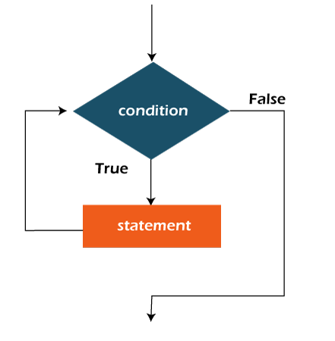
I. Iteration statements (con.)
Logic of a while loop

Slide 10
I. Iteration statements (con.)
Example:
int count = 1;
while (count < 11) {
System.out.println("Count is: " + count);
count++;
}
Output
Count is 1
…
Count is ???

Slide 11
I. Iteration statements (con.)
One thing that u need to be careful when using while loop is infinite loop.
The body of a while loop eventually must make the condition false.
If not, it is called an infinite loop, which will execute until the user interrupts the program.

Slide 12
I. Iteration statements (con.)
Example:
while (true) {
System.out.println("This code is never done!!!");
}
Output
This code is never done!!!
This code is never done!!!
…

Slide 13
I. Iteration statements (con.)
Similar to nested if statements, loop can be nested as well.
That is, the body of a loop can contain another loop.
For each iteration of the outer loop, the inner loop iterates completely.

Slide 14
I. Iteration statements (con.)
Example:
int count1, count2, num;
num = 0;
count1 = 1;
while (count1 <= 10) {
count2 = 1;
while (count2 <= 20) {
System.out.println(num);
num++;
count2++;
}
count1++;
}

Slide 15
I. Iteration statements (con.)
The do-while statement or do loop syntax can be expressed as:
do {
//statement(s)
} while (expression) ;

Slide 16
I. Iteration statements (con.)
The statement is executed once initially, and then condition is evaluated.
The statement is executed repeatedly until the condition become false.

Slide 17
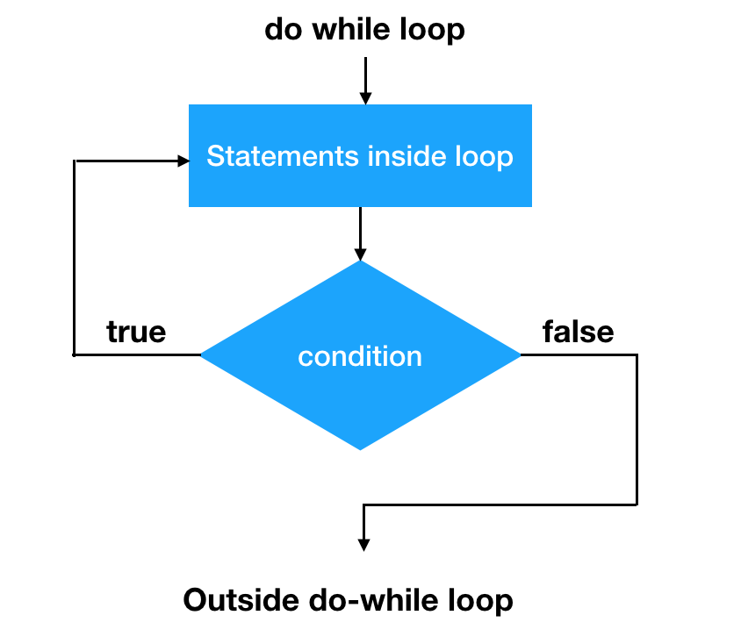
I. Iteration statements (con.)
Logic of a do-while loop

Slide 18
I. Iteration statements (con.)
Example:
int count = 0;
do {
count++;
System.out.println(count);
} while (count < 5);
Output
???

Slide 19
I. Iteration statements (con.)
The for loop syntax can be expressed as:
for(initializing statement; testing condition; increment/decrement) { //code to be iterated }

Slide 20
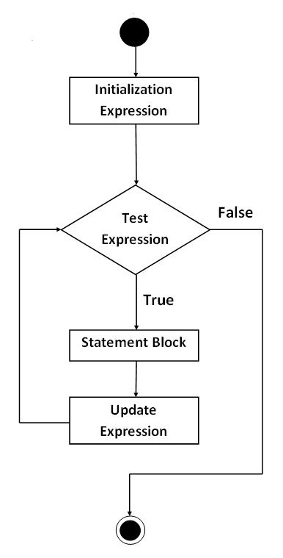
I. Iteration statements (con.)
Logic of a for loop

Slide 21
I. Iteration statements (con.)
Example:
for (int count = 1; count <= 5; count++) {
System.out.println(count);
}
Output
1
2
…
5

Slide 22
I. Iteration statements (con.)
A for loop is functionally like the following while loop structure.
initialization;
while (expression) {
//statement(s)
increment;
}

Slide 23
So when do we use while and for???

Slide 24
I. Iteration statements (con.)
Note 1:
You should use a for loop when you know how many times the loop should run.
If you want the loop to break based on a condition other than the number of times it runs, you should use a while loop.

Slide 25
I. Iteration statements (con.)
Note 2:
Each expression in the header of a for loop is optional.
If the initialization is left out, so no initialization is performed.
If the conditional is left out, it always considered to be true. Therefore, it will become infinitive loop.
If the increment is left out, no increment operation is preformed.

Slide 26
I. Iteration statements (con.)
There is one more way to use for loop and we call it as enhanced for loop. It used to iterate over the elements of a collection without knowing the index of each element. You also need not know the size of the collection. The syntax can be expressed as:
for(<datatype> <variable_name>:<collection_name>) { //code to be iterated }

Slide 27
I. Iteration statements (con.)
Note:
However, there are some limitations to this enhanced for loop. This loop object is immutable which means the values which are retrieved during the execution of the loop are read only. You cannot change the values in the collection while using this loop which is easily done by other loops.

Slide 28
I. Iteration statements (con.)
Example:
String array[] = {
“Java",
“Database",
“Network"
};
for (String a: array) {
System.out.println(a);
}
Output
Java
Database
Network

Slide 29
Jump statements

Slide 30
II. Jump statements
The Java jumping statements are the control statements which transfer the program execution control to a specific statement. In java, there are a few jump statements such as:
break
continue

Slide 31
II. Jump statements (con.)
We can use break statement in the following cases.
Inside the switch case to come out of the switch block.
Within the loops to break the loop execution based on some condition.
Note: The break cannot be used outside the loops and switch statement.

Slide 32
I. Jump statements (con.)
Example:
for (int count = 0; count < 10; count++) {
if ( count == 3 ) {
break;
{
System.out.println(count);
}
System.out.println("break executed");
Output
0
1
2
Break executed

Slide 33
II. Jump statements (con.)
Continue statement is used only within looping statements.
When the continue statement is encountered, then it skip the current iteration and the next iteration starts.
The remaining statements in the loop are skipped. The execution starts from the top of loop again.
We can use continue statement to skip current iteration and continue the next iteration inside loops.

Slide 34
I. Jump statements (con.)
Example:
for (int count = 0; count < 10; count++) {
if ( count % 2 == 0 ) {
continue;
{
System.out.println(count);
}
Output
???

Slide 35
The End of Chapter IV

