Slide 1



C{}DE-A-TH{}N - 2022
Assignment 2

Slide 2
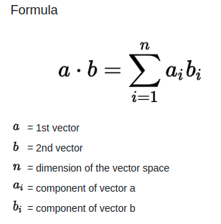
Q. 1. Write a sequential program to perform vector dot product.
Q.2. Write a CUDA program to perform vector dot product.
What is dot product?

Slide 3
Dot product assignment
Consider the arrays’ size sufficiently large eg. 1000000 of type double.
Measure the performance of of sequential version and optimized parallel version
Calculate the speedup observed
You may execute sequential programs on your local machine
However all parallel codes must be executed on server
Parallel versions considered for evaluations only if both sequential and parallel codes gives same output

Slide 4
Submission
Explain in brief your parallelization strategy like data splitting, thread/block creation, and allocation etc.
Ans: Initially we started by defining threads per block is 256 and blocks per grid as 32.
Then we defined a global void function where in we ran the computational process of calculating the dot product through the GPU
Then using standard parallelization method we loaded the data the data on CPU, copied it on GPU then computed it on the GPU and copied back to CPU.\
We also used the “time.h” header file to compute the running time for CPUand GPU
Finally we printed the outputs obtained on CPU and GPU along with the computational time.

Slide 5
Submission
Insert your findings into the below table
Ans:
 | Sequential Time | Parallel version 1 time | Speedup wrt parallel version 1
Dot product | 0.298ms | 0.0691ms | 4.31992
Note:- In case if needed you can add more columns if you have implemented multiple parallel
versions

Slide 6
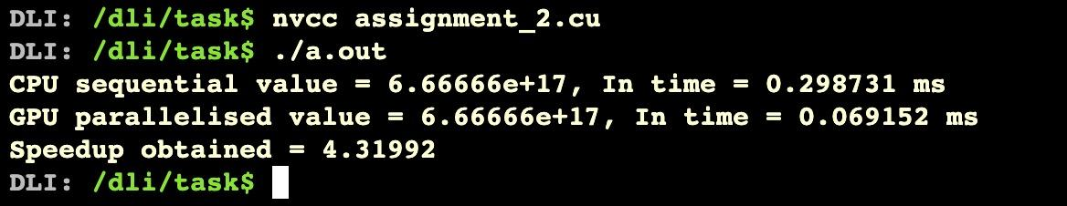
OUTPUT GENERATED:

Slide 7
Submission
Comment on your observations such as limitations of proposed solution, etc.
Ans:
As the complexity of the algorithm increases the complexity of the code also increases.
With increasing the number of blocks and threads the efficiency and speedup increases exponentially.

