Slide 1



C{}DE-A-TH{}N - 2022
Assignment 3

Slide 2
Q. 1 A. Write a C/C++ or Python program to perform 3D convolution
B. Deploy the above code on GPU using CUDA C++/ CUDA Python
Consider the matrix size sufficiently large eg. 512 x 512 x 512 of type double.
Consider mask size as 9 x 9 x 9
Measure the performance of of sequential version and optimized parallel version
Calculate the speedup observed
You may execute sequential programs on your local machine
However all parallel codes must be executed on server
Parallel versions considered for evaluations only if both sequential and parallel codes gives same output

Slide 3
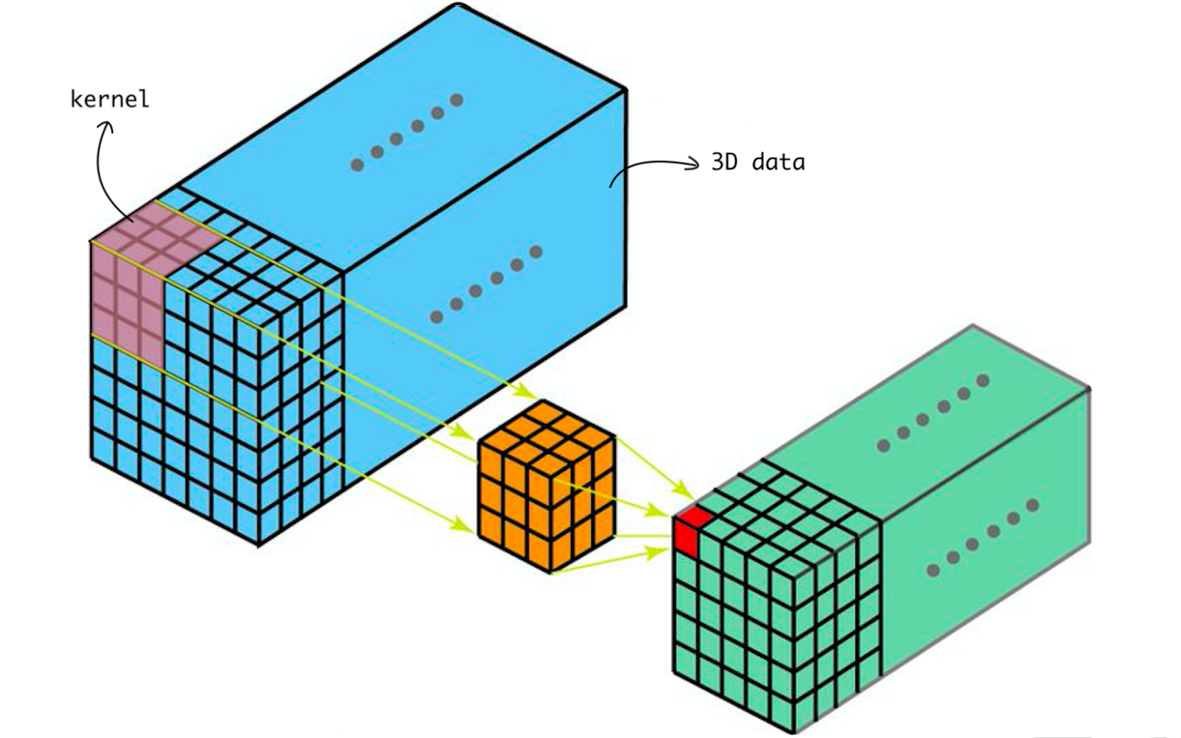
What is 3D Convolution?

Slide 4
Submission
Explain in brief your parallelization strategy like data splitting, thread/block creation, and allocation etc.
Ans:
We defined a global void function where in we ran the computational process of calculating the dot product through the GPU
Then using standard parallelization method we loaded the data the data on CPU, copied it on GPU then computed it on the GPU and copied back to CPU.\
We also used the “time.h” header file to compute the running time for CPU and GPU
Finally we printed the outputs obtained on CPU and GPU along with the computational time.

Slide 5
Submission
Insert your findings into the below table
Ans:
 | Sequential Time | Parallel version 1 time | Parallel version 2 time | Speedup wrt parallel version 1 | Speedup wrt parallel version 1
Matrix matrix addition
Note:- In case if needed you can add more columns if you have implemented multiple parallel
versions

Slide 6
Submission
Comment on your observations such as limitations of proposed solution, etc.
Ans: As the complexity of the algorithm increases the complexity of the code also increases.
With increasing the number of blocks and threads the efficiency and speedup increases exponentially.

