Slide 1



C{}DE-A-TH{}N - 2022
Assignment 5

Slide 2
Q. Sorting on GPU
Q.1 Write a sequential program using C/C++/Python for sorting an integer array of size 100000 in ascending order
Q.2 Deploy the above code on GPU using CUDA C++/ CUDA Python

Slide 3
Submission
Explain in brief your parallelization strategy like data splitting, thread/block creation, and allocation etc.
Initially we started by defining threads per block and blocks per grid as 1024.
Then we defined a global sort function where in we ran the computational process of sorting the array through the GPU
Next we used the random function to generate a random array from 0-100.
Then using standard parallelization method we loaded the data the data on CPU, copied it on GPU then computed it on the GPU and copied back to CPU.
Finally we printed the sorted list.

Slide 4
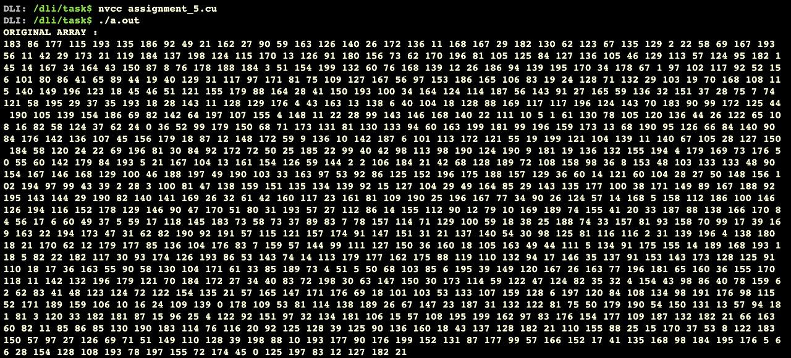
OUTPUT GENERATED:

Slide 5
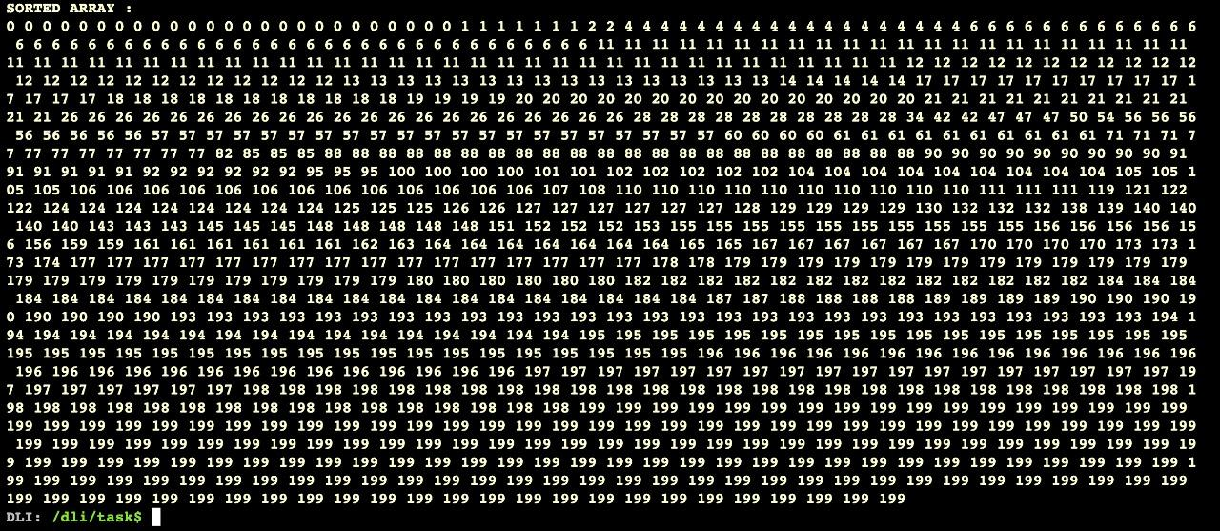
OUTPUT GENERATED:

Slide 6
Submission
Comment on your observations such as limitations of proposed solution, etc.
Ans: The size of array cannot be too large since there is hardware limitations of the threads of the GPU.
As the complexity of the algorithm increases the complexity of the code also increases.

