Slide 1

Project Title - Seasonal Agriculture Performance Analysis
[Student Name-Akshat Gupta] [College Name-JSS Academy of Technical Education]
AICTE STU ID : [STU6a672d23d05381785146659]
VOIS AICTE Batch 1 2026–2027

Slide 2

PROBLEM STATEMENT
Agricultural performance is shaped by the interaction of seasonal environmental conditions, farming practices, resource availability, and market conditions. Factors like temperature, rainfall, irrigation, and input access vary across seasons and directly affect crop yield and productivity.
However, raw agricultural data is often fragmented and inconsistent, making it difficult to clearly see how and why performance changes across seasons. Important patterns and relationships remain hidden without structured analysis.
This project analyzes seasonal agricultural data to uncover meaningful patterns, trends, relationships, and variations in performance, and to identify the key factors driving seasonal differences.
Key Question: How does agricultural performance vary across seasons, and what factors are associated with these differences?

Slide 3
Project Description
This project performs an end-to-end data analytics study of agricultural activities, exploring how seasons, crops, regions, environmental conditions, farming practices, resource usage, and economic outcomes together shape agricultural performance and productivity outcomes across diverse farming contexts.
Dataset: 4,000 farm records • 28 variables • 3 seasons • 8 states • 8 crops • 4 irrigation methods.
Workflow: Dataset Exploration → Cleaning → Feature Engineering → EDA → Seasonal Analysis → Resource & Economic Analysis → Statistical Analysis → Insights & Recommendations

Slide 4

WHO ARE THE END USERS?
Farmers
Seasonal crop, irrigation and resource planning
Agricultural Planners
Regional and seasonal comparison
Resource Managers
Water usage and irrigation efficiency
Researchers
Environmental and agricultural relationships
Policy Stakeholders
Evidence-based agricultural planning

Slide 5

Technology Used
Google Colab – Cloud-based notebook environment used for writing, executing, and documenting the entire analysis in an interactive and shareable format.
Python – Primary programming language used to implement the full analytical workflow, from data processing to statistical evaluation
Pandas – Core library for data loading, cleaning, transformation, and aggregation, enabling efficient handling of large, structured datasets
NumPy – Used for numerical operations, array handling, and mathematical computations underlying the analysis
Matplotlib – Foundational library for creating static data visualizations to explore trends and patterns
Seaborn – Built on Matplotlib, used for advanced analytical and statistical visualizations, enabling clearer representation of relationships between variables
SciPy – Applied for hypothesis testing and statistical analysis to validate observed patterns and relationships in the data
CSV – Source format of the agricultural dataset, used for structured storage and easy integration with Python-based tools

Slide 6
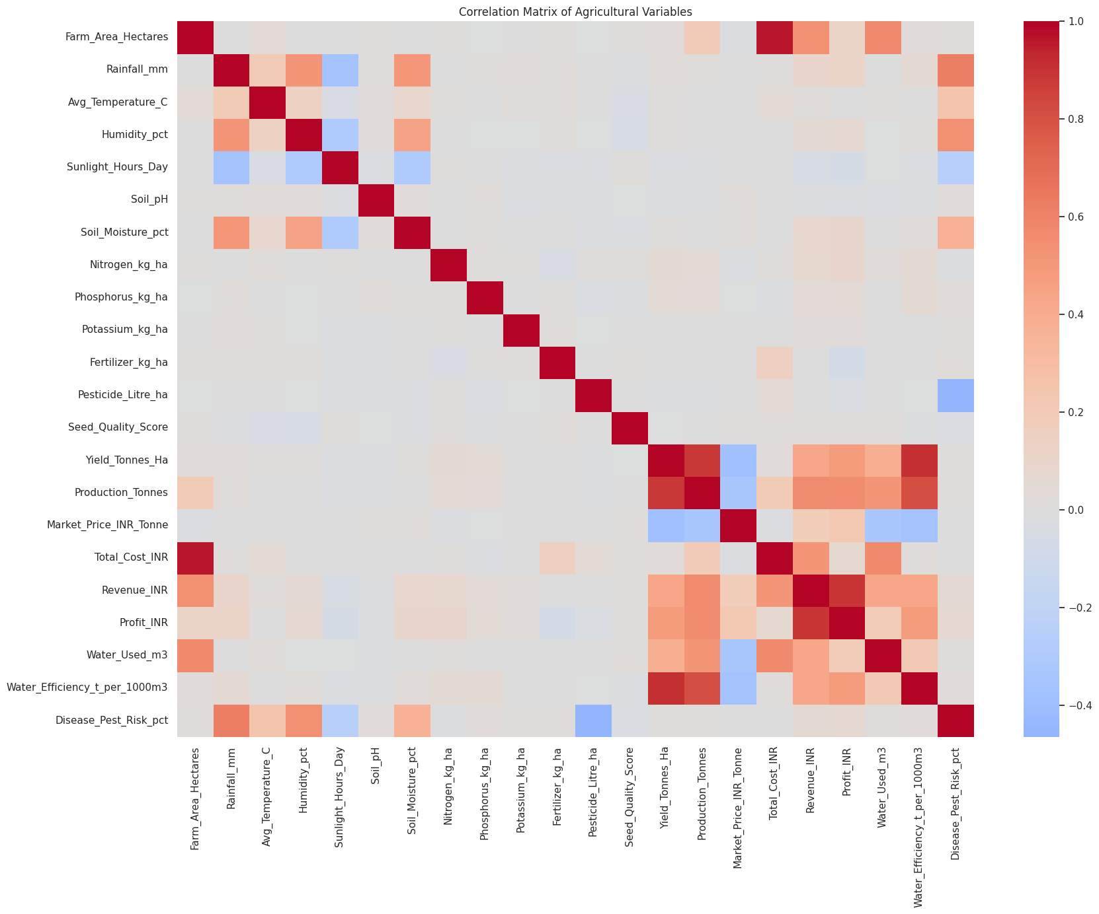
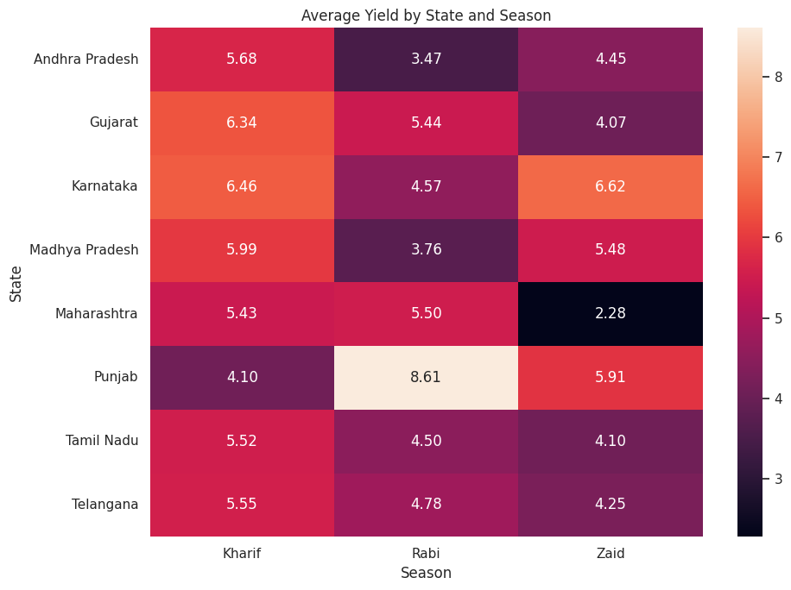
RESULTS – DATASET & KPI OVERVIEW
4,000
Farm records
28
Variables
3
Seasons
8
States
8
Crops
4
Irrigation methods
Season distribution
Data quality
Duplicate records: 0
Missing values handled using median imputation for rainfall, soil moisture and yield
Outliers identified using the IQR method
Outliers retained unless shown to be data errors

Slide 7
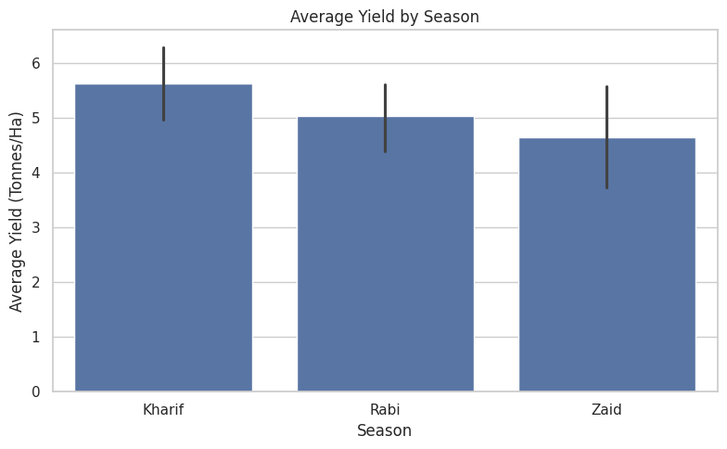
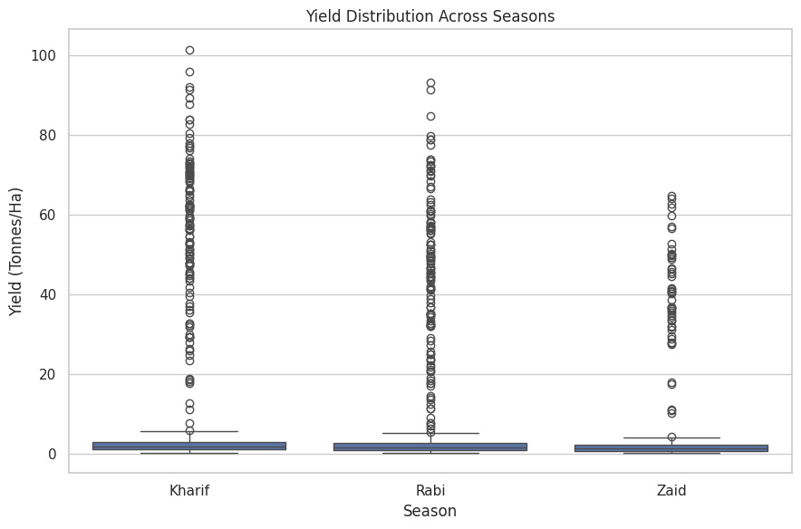
RESULTS – SEASONAL PERFORMANCE
Kharif records the highest observed average yield (5.63 t/ha) and highest average profit (INR 178,915).
However, the one-way ANOVA result is F = 1.544, p = 0.214, so the mean-yield difference across seasons is not statistically significant at the 5% level.

Slide 8
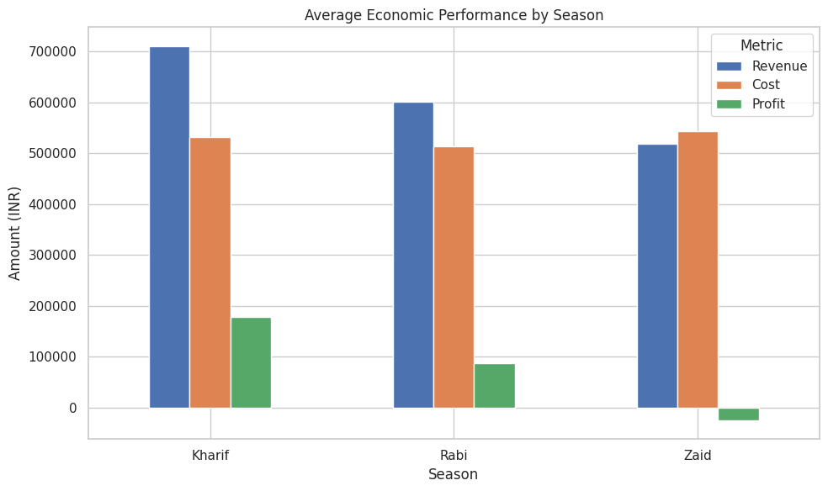
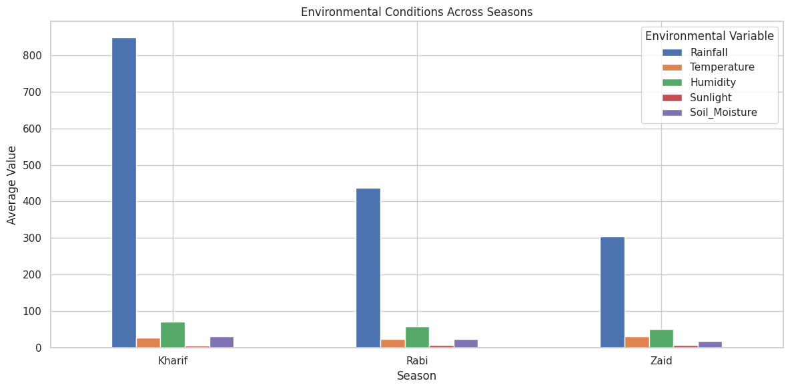
RESULTS – ENVIRONMENT & CROP ANALYSIS
Kharif has the highest average rainfall (849 mm) and soil moisture (31.2%), while Zaid has the highest average temperature (31.0°C). Crop performance varies by season; Sugarcane has the highest overall average yield (46.94 t/ha).

Slide 9
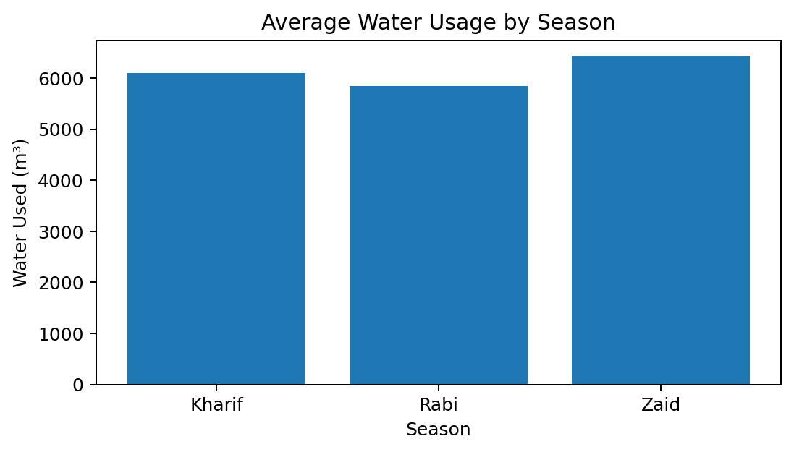
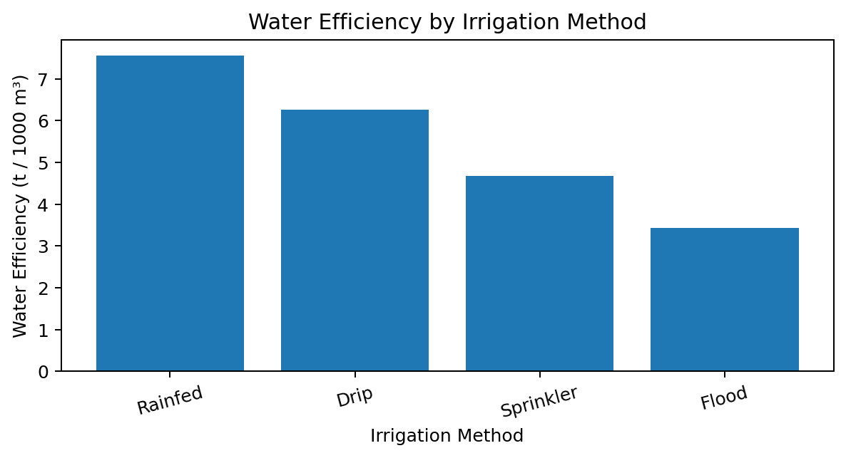
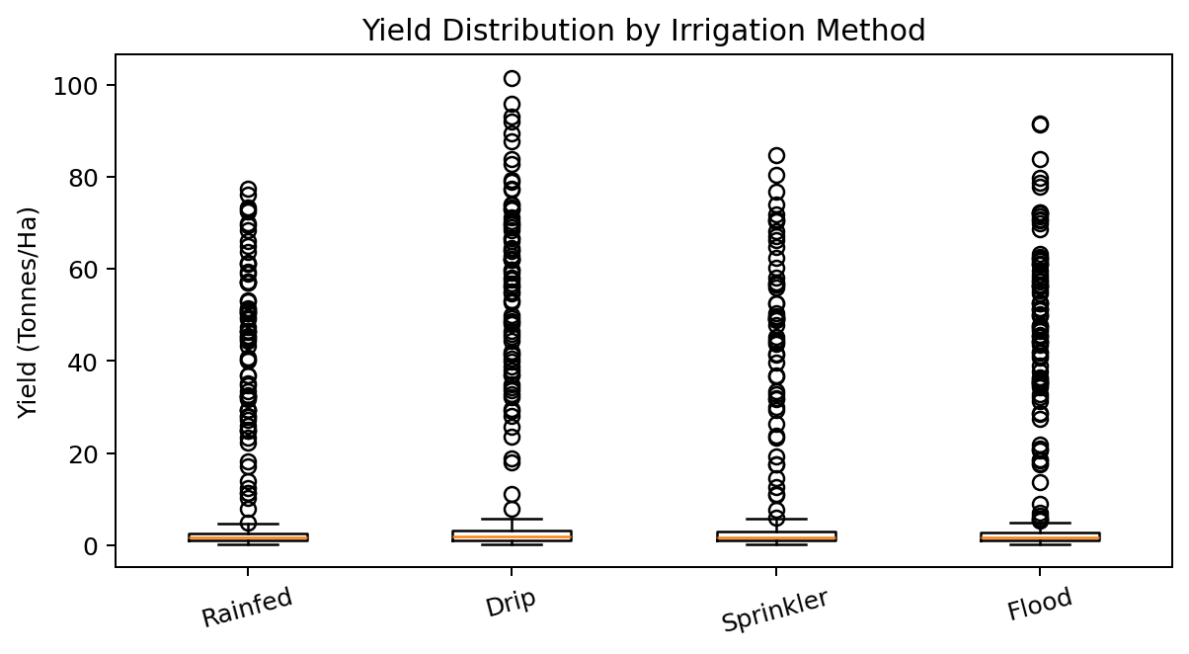
RESULTS – RESOURCES & IRRIGATION
Rainfed has the highest observed water-efficiency value (7.56 t/1000 m³), while Drip has the highest average profit among irrigation methods (INR 219,626).
Water efficiency is derived from yield and water use, so its strong correlation with yield should not be interpreted as an independent causal effect.

Slide 10
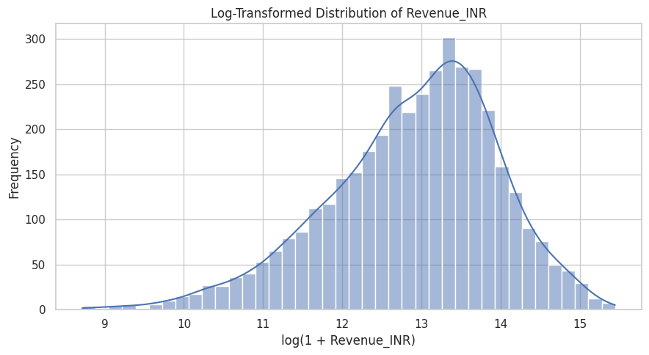
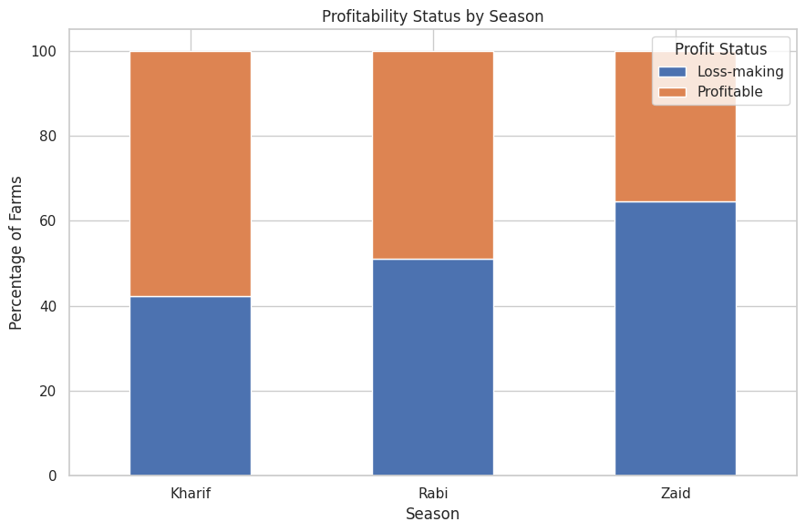
RESULTS – ECONOMIC & STATISTICAL ANALYSIS
Average profit: Kharif INR 178,915 | Rabi INR 87,689 | Zaid INR -24,805 Profitability: 2,034 profitable farms vs 1,966 loss-making farms. ANOVA: F = 1.544, p = 0.214 → no statistically significant difference in mean yield across seasons at α = 0.05. Among the independent variables tested, Water_Used_m3 has the strongest positive correlation with yield (r = 0.386). Soil_pH has the strongest negative correlation (r = -0.021). Correlation indicates association, not causation.

Slide 11
Future Scope
Predictive Yield Modeling – Developing machine learning models that leverage environmental and farming variables (such as rainfall, temperature, soil type, and irrigation method) to accurately forecast crop yield before harvest
Crop Recommendation System – Building a recommendation engine that suggests the most suitable crops for a given region and season, based on historical performance, climatic conditions, and resource availability
Future Yield Forecasting – Utilizing multi-year historical data and time-series techniques to project future agricultural output, helping anticipate production trends and potential shortfalls
Geospatial Analysis – Conducting state- and district-level spatial analysis to visualize regional agricultural performance, identify high- and low-productivity zones, and support location-specific planning
Interactive Dashboard Development – Creating dynamic dashboards using Power BI, Tableau, or Streamlit to enable real-time exploration of agricultural trends, seasonal comparisons, and key performance metrics by stakeholders
Real-Time Data Integration – Incorporating live weather, soil health, and market-price data feeds to enhance model accuracy and enable timely, data-driven decision-making for farmers and policymakers

Slide 12
GitHub Repository
[Github Link]
Repository should contain: • Google Colab/Jupyter notebook • Dataset or dataset reference • Analysis code • Documentation / README

Slide 13

VOIS Course Completion Certificate Course: Data Visualization

Slide 14
Thank You
Seasonal Agriculture Performance Analysis
Questions & Discussion
Thank you for your time and attention.
This project undertook a comprehensive, end-to-end data analytics study of agricultural activities — integrating seasonal, environmental, operational, and economic dimensions across 4,000 farm
records to build a holistic understanding of what drives agricultural productivity and profitability.
I welcome your questions and feedback, particularly on the analytical workflow, key insights, and how these findings could be extended or applied in real-world agricultural decision-making.
.
.
[Akshat Gupta] • [JSS Academy of Technical Education]

