Slide 1

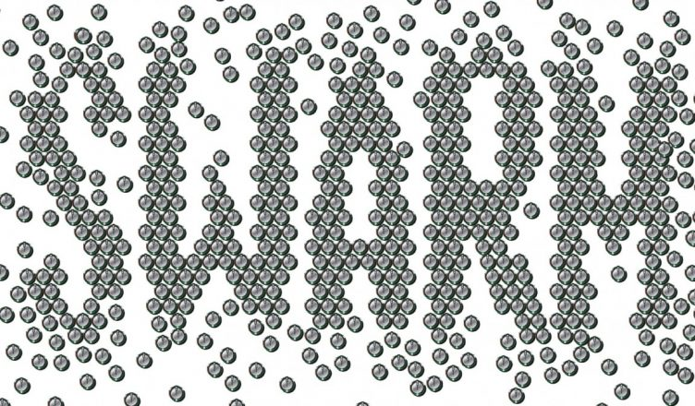
Robotics
Members
Paritosh Sanadhya
Prathmesh Bhaktan
Samiksha Jain
Sarthak Malik
Vidhi Mittal
Mentors
Annu shree
Shubhanshu Agarwal

