Slide 1

Your On-demand Social Media Delivery App

Slide 2
PROBLEM
Price is an important concern for customers ordering online.
Bogus Buyer is now a major concern in the Philippines delivery company.
High Commission it gives restaurant owners a hard time to earn profits.

Slide 3
SOLUTION
Save money on low delivery fee and discount Vouchers
Make sure sure your dealing with Validated Customers by checking their rating and badges.
Lowest commission rate in the market.

Slide 4
VIDEO DEMO
DEMO HERE

Slide 5


MARKET VALIDATION
3,756,007
Total population
301,629
Food Delivery App User

Slide 6
OVERALL MARKET SIZE
PHP 12.35B
Total Available Market Revenue in 2020
PHP 423.6M
Serviceable Available Market Revenue
* Top 2 Players combine 70% Revenue *

Slide 7



LOOKING FORWARD : POTENTIAL OUTCOME
Worst case Scenario
PHP 2,118,000
Gets 0.5% of Serviceable Market
If we don’t spend on marketing and do not consistently find new partners.
Realistic Scenario
PHP 21,180,000
Gets 5% of Serviceable Market
Generates revenue per year
Best Case Scenario
PHP 216,036,000
51% of Serviceable Market
Becomes the market Leader

Slide 8
BUSINESS MODEL
We take 20%-25% on each partner’s food delivery transaction and 10%-15% on all normal delivery transaction.
Featured ads of our partners.
paid ads for those who wants promote their products.

Slide 9
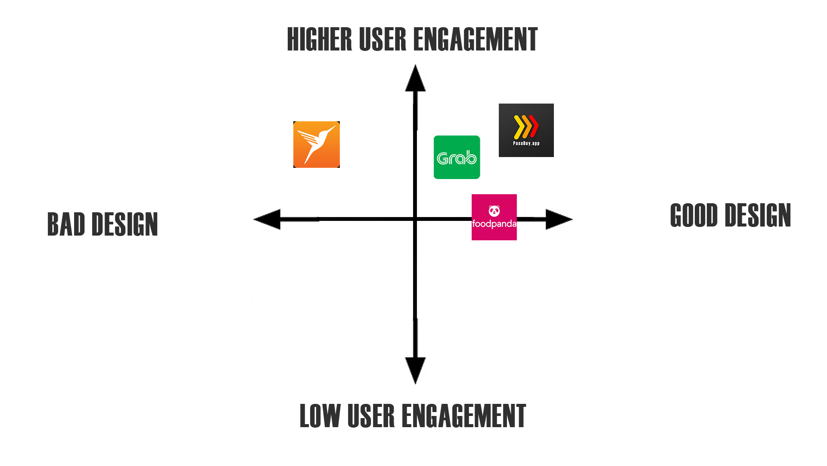
COMPETITION

Slide 10
COMPETITIVE ADVANTAGE
First in the Market – for being social media on-demand app
All in one app – Movers & Shops owners doesn’t need to download different aps.
Ease to use – go to news feed and order.
Safest to transact – Get vouch by others and get validated by us.
Secured Virtual Wallet - using Blockchain Technology.

Slide 11
GO-TO MARKET
Referral System – User refers the app to another user to get Discounts/Vouchers
Social Media – Partnerships with Influencers, Page Groups, Facebook and Google Ads.
Partners Page – Creating a deal with our Partner to make us their Cover Photo.
Posters & Sticker – on Tricycles and Partners Shops

Slide 12
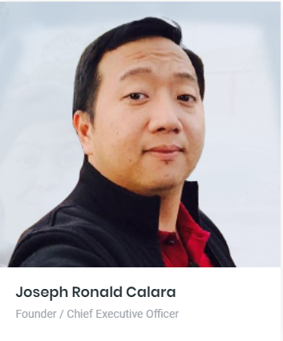


MEET OUR TEAM
Joseph Ronald Calara
Founder / Chief Executive Officer
Michael Ian Belaguin
Co-Founder / Chief Operation Officer
Caezar De Castro II
Co-Founder / Chief Technical Officer

Slide 13
TRACTION
Pasabuy.app website up
Trade License secured
Office Location Rented
30 Food Shops signed as Partner
Established Online Presence
Social Media Partnership @ Tiga South ka ba
App research and development 40% Completed
Marketing assets / tools or Items acquired.

Slide 14
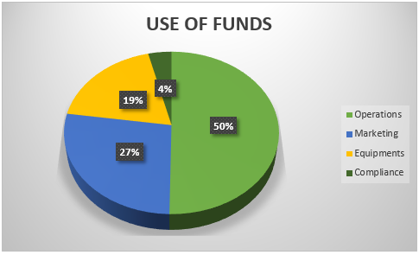
FUNDRAISING INFORMATION
Raising Php 6,000,000.00 to accelerate growth.

