Slide 1


“Your On-demand Social Media
Delivery App”

Slide 2



PROBLEM
PRICE
an important concern for customers ordering online.
BOGUS BUYER
now a major concern in the Philippines delivery companies.
HIGH COMMISSION
gives restaurant owners a hard time to earn profits.

Slide 3



SOLUTION
Save money on low delivery
fee and discount Vouchers
Make sure your dealing with
Validated Customers by checking
their rating and badges.
Lowest commission rate
in the market.

Slide 4

VIDEO DEMO

Slide 5


MARKET VALIDATION
3,756,007
Total population
301,629
Food Delivery App User

Slide 6
OVERALL MARKET SIZE
PHP 12.35B
Total Available Market Revenue in 2020
PHP 423.6M
Serviceable Available Market Revenue
* Top 2 Players combine 70% Revenue *

Slide 7



LOOKING FORWARD : POTENTIAL OUTCOME
Worst case Scenario
PHP 2,118,000
Gets 0.5% of Serviceable Market
Realistic Scenario
PHP 21,180,000
Gets 5% of Serviceable Market
Best Case Scenario
PHP 216,036,000
51% of Serviceable Market

Slide 8

BUSINESS MODEL
We take 20%-25% on each Partner’s food delivery transaction and 10%-15% on all normal delivery transaction.
Featured ads of our partners.
paid ads for those who wants promote their products.

Slide 9
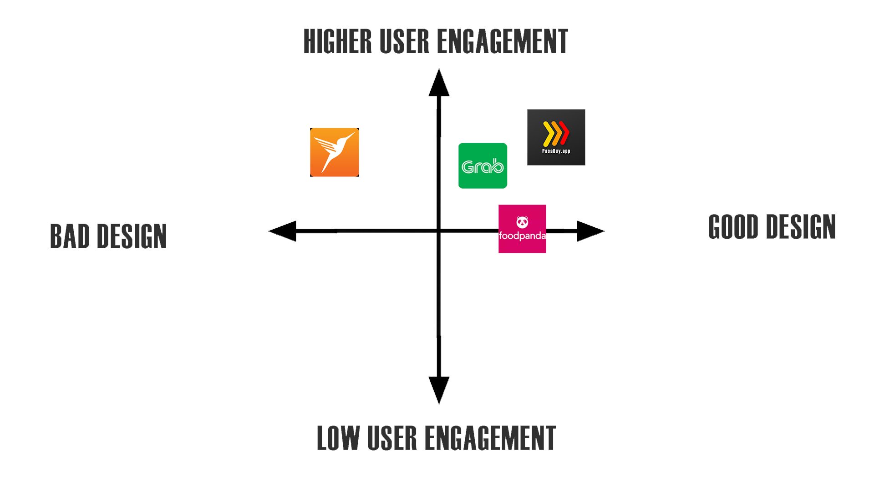
COMPETITION

Slide 10
COMPETITIVE ADVANTAGE
First in the Market – for being social media on-demand app
All in one app – Movers & Shops owners doesn’t need to download different apps.
Ease to use – go to news feed and order.
Safest to transact – Get vouch by others and get validated by us.
Secured Virtual Wallet - using Blockchain Technology.

Slide 11
GO-TO MARKET
Referral System – User refers the app to another user to get Discounts/Vouchers
Social Media – Partnerships with Influencers, Page Groups, Facebook and Google Ads.
Partners Page – Creating a deal with our Partner to make us their Cover Photo.
Posters & Sticker – on Tricycles and Partners Shops

Slide 12
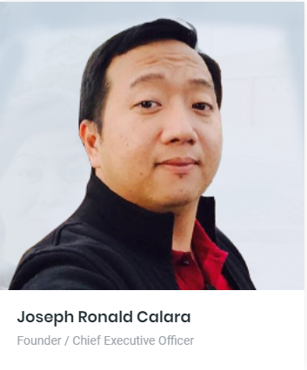
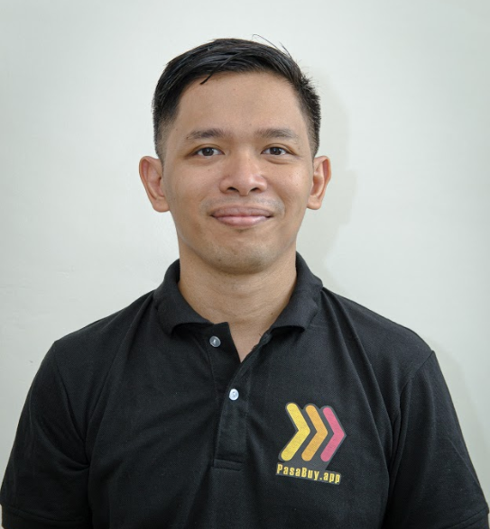
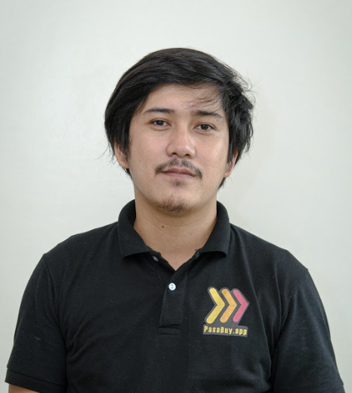
MEET OUR TEAM
Joseph Ronald Calara
Founder / Chief Executive Officer
- Registered Electrical Engineer
- Registered Master Electrician
- 11 yrs Experience on
Project Management.
Completed Project Management Professional Course at Cambridge University.
Michael Ian Belaguin
Co-Founder / Chief Operation Officer
- Electronics and Communication Engineer.
- 14 yrs Experience as
Process Engineer.
- Project Operation Manager
at AMKOR Tech Phil.
Caezar De Castro II
Co-Founder / Chief Technical Officer
- 6 yrs Experience as
Software Developer.
Published dozens of Company website as Freelance.
- Integrate Network Firewall in a BPO Company.

Slide 13

TRACTION
PasaBuy.App website up
Trade License secured
Office Location Rented
30 Food Shops signed as Partner
82 Interested Food shops
Established Online Presence
Social Media Partnership @ Tiga South ka ba
App research and development 40% Completed
Marketing assets / tools or Items acquired.

Slide 14
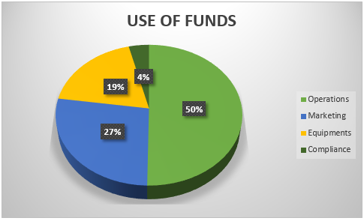
FUNDRAISING INFORMATION
Raising Php 6,000,000.00 to accelerate growth.

Slide 15


