Slide 1


“Your On-demand Social Media Delivery App”

Slide 2



PROBLEM
PRICE
an important concern for customers ordering online.
BOGUS BUYER
now a major concern in Philippine delivery companies.
HIGH COMMISSION
gives restaurant owners a hard time to earn profits.

Slide 3



SOLUTION
Save money on low delivery
fee and discount vouchers.
Make sure your dealing with
Validated Customers by checking
their rating and badges.
Lowest commission rate
in the market.

Slide 4

VIDEO DEMO

Slide 5


MARKET VALIDATION
3,756,007
Total population
301,629
Food Delivery App User
Put source

Slide 6
OVERALL MARKET SIZE
PHP 12.35B
Total Available Market Revenue in 2020
PHP 423.6M
Serviceable Available Market Revenue
* Top 2 Players combine 70% Revenue *
Put source

Slide 7



LOOKING FORWARD : POTENTIAL OUTCOME
Worst case Scenario
PHP 2,118,000
Gets 0.5% of Serviceable Market
Realistic Scenario
PHP 21,180,000
Gets 5% of Serviceable Market
Best Case Scenario
PHP 216,036,000
51% of Serviceable Market

Slide 8

BUSINESS MODEL
We take 20%-25% on each Partner’s food delivery transaction and 10%-15% on all normal delivery transaction.
Featured ads of our partners.
Paid ads for those who want to promote their products.

Slide 9
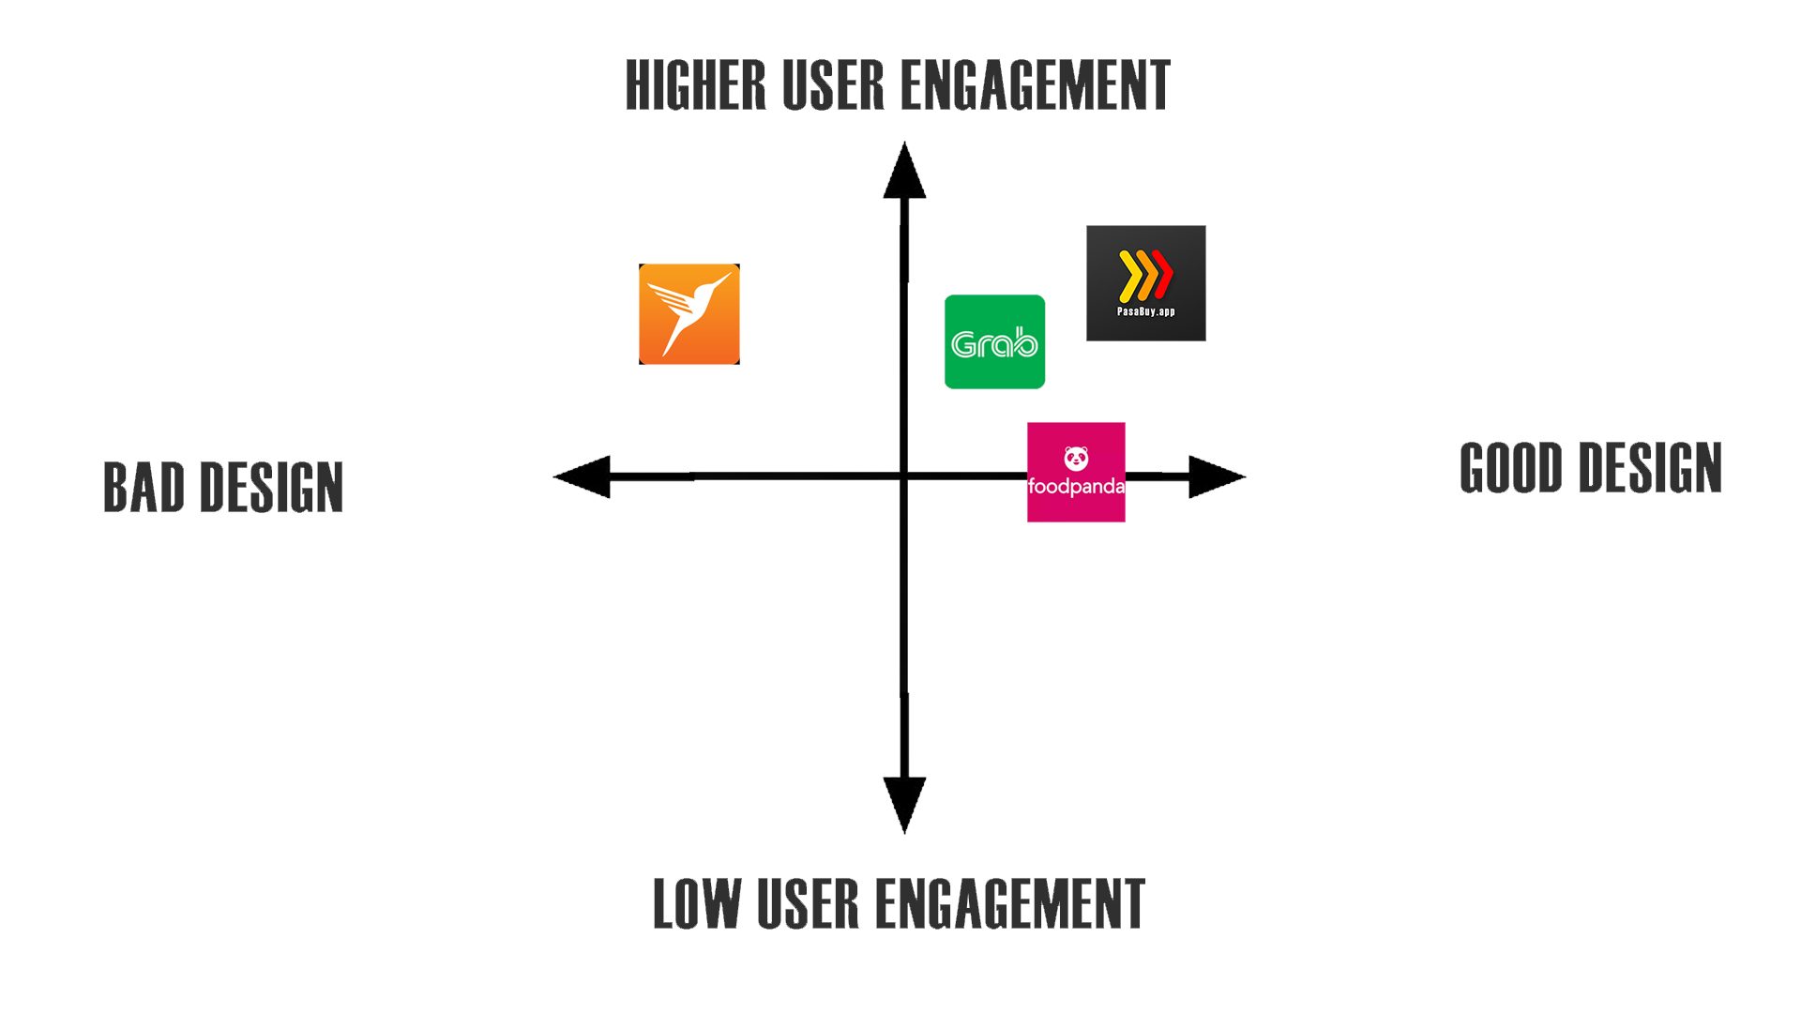
COMPETITION

Slide 10
COMPETITIVE ADVANTAGE
First in the Market – For being the social media on-demand app.
All in one app – Movers & Shops owners don’t need to download different apps.
Ease to use – Go to news feed and order.
Safest to transact – Get vouched by others and get validated by us.
Secured Virtual Wallet - Using Blockchain Technology.

Slide 11
GO-TO MARKET
Referral System – User refers the app to another user to get Discounts/Vouchers.
Social Media – Partnerships with Influencers, Page Groups and Facebook.
Partners Page – Creating a deal with our Partner to make us their Cover Photo.
Posters & Sticker – on Tricycles and Partners Shops
Digital Marketing – Search Engine Optimization and Pay-Per-Click (Google Ads)

Slide 12
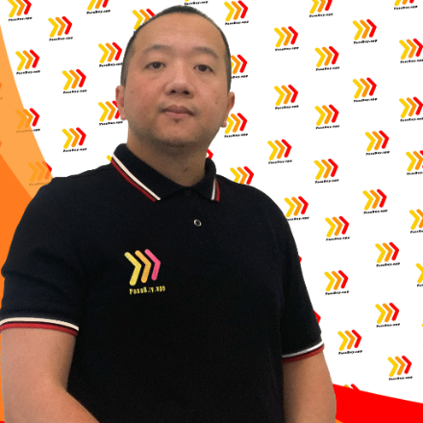
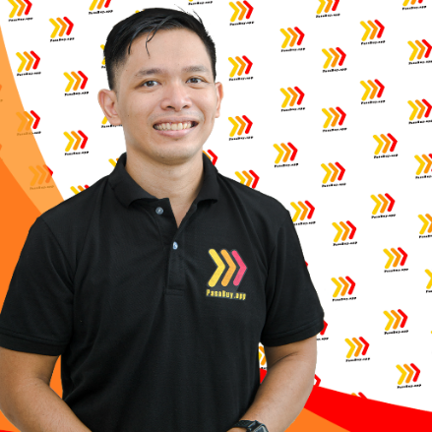

MEET OUR TEAM
Joseph Ronald Calara
Founder / Chief Executive Officer
Michael Ian Belaguin
Co-Founder / Chief Operation Officer
Caezar De Castro II
Co-Founder / Chief Technical Officer
Registered Electrical Engineer
Registered Master Electrician
11 yrs Experience on Project Management
Completed Project Management Professional Course at Cambridge University
Electronics and Communication Engineer
14 yrs Experience as Process Engineer
Project Operation Lead at AMKOR Tech Philippines.
6 yrs Experience in Software Engineering
Published dozens of Company website and applications.
Integrate Network Security in a Business Process Outsourcing.

Slide 13

TRACTION
PasaBuy.app Website Up
Trade License Secured
Office Location Rented
30 Food Shops Signed as Partner
82 Interested Food Shops
Established Online Presence
Social Media Partnership @ Tiga South ka ba
App Research and Development 40% Completed
Marketing Assets / Tools or Items Acquired.

Slide 14
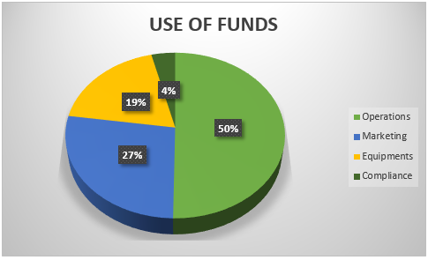
FUNDRAISING INFORMATION
Raising Php 6,000,000.00 to accelerate growth.

Slide 15


