Slide 1
Best Place to Set up café/juice bar - Toronto

Slide 2
Background
Find best place to set up a café/juice bar in Toronto
The location should be focused on a neighborhood
Competition should be a minimum to succeed the business
The business should sustain relative customer base to succeed

Slide 3
Data Sources
Neighborhood data with Postal Codes; From Wikipage "https://en.wikipedia.org/wiki/List_of_postal_codes_of_Canada:_M"
Venues data; Foursquare
Longitudes & Latitudes of Toronto Neighborhoods; CSV file provided by Coursera 'http://cocl.us/Geospatial_data'
Longitudes & Latitudes of Toronto; from geopy package

Slide 4
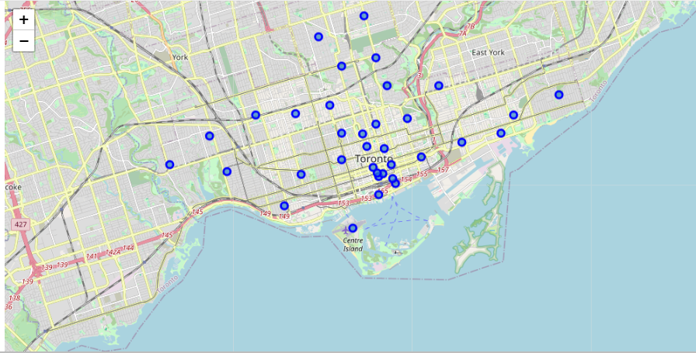
Torronto Neighborhoods in Map

Slide 5
Model Development
Identify all the venues in neighborhoods using Foursquare data
We can identify the common venues in neighborhood.
Common factor for a venue in a neighborhood can be identified on a rank given based on the proportion of a given venue category among all venue categories in the neighborhood
When the proportion of an eatery is high the competition is high to setup an eatery in that neighborhood.

Slide 6
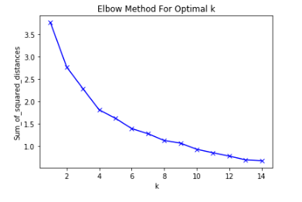
Model Development
Clustering approach is the best method for analyzing this dataset
K-Means clustering approach was selected to cluster data set based on common venue categories in a neighborhood
K-Means is used due to its simplicity & ability to generate quick insights
The best K value (Number of clusters) is identified as 8 based on elbow model, according to below graph;

Slide 7
Assumptions Made
This model has been derived based on some major assumptions;
The exact area & population within a neighborhood is not considered.
The insight is based on the venues but not on any review or current status data regarding the venue.
I have assumed all venues available in the dataset are actively used & an average amount of people use
All venue details in a neighborhood have been captured by the foursquare dataset
People residing/ or using any facility in a certain neighborhood will prefer to dine/eat/drink in that neighborhood

Slide 8
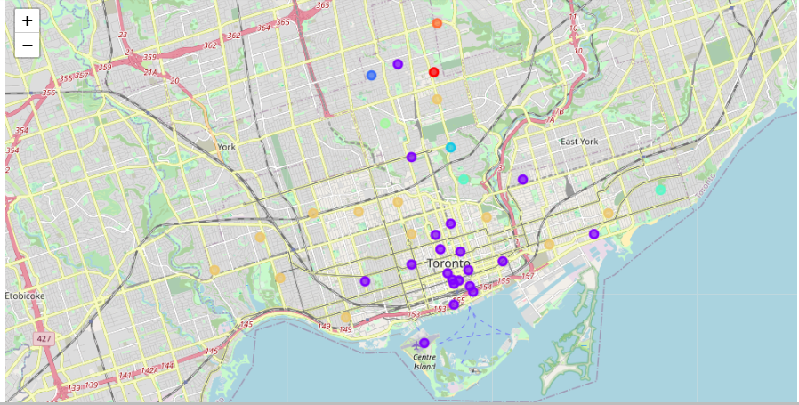
Visualization after clustering

Slide 9
Result From data analysis
The 8 clusters are clearly visualized in the previous slide.
The 2 major clusters identified was found to have a lot of eateries and directly concluded as unsuitable for a new business setup;
Out of the 6 remaining clusters it is seen that only 3 clusters do not have eateries.
The 3 remaining clusters have 3 neighborhoods which were left out for selection
Moore Park, Summerhill East
Lawrence Park
Roselawn
Moore Park, Summerhill East |  | Lawrence Park |  | Roselawn
Venue | Proportion among venues in neighborhood | Venue | Proportion among venues in neighborhood | Venue | Proportion among venues in neighborhood
Gym | 0.5 | Swim School | 0.33 | Garden | 1
Play Ground | 0.5 | Park | 0.33
 |  | Bus Line | 0.33

Slide 10
Result From data analysis
Lawson park has a young age population for which a park & swim school has been established. Adult population is not outgoing here, so they might visit the city centers in the bus if required (For dining, movies, grocers etc.)
Moore Park, Summerhill East has a population much towards teens & young adults. They intend to be fit, do exercise & play. Thus we have a Gym & Playground based here. Here also adult & young populations will visit other neighborhoods for dining, movies, grocers etc.
Roselawn has only data for 1 venue. This indicates that the population might be lesser here. The people are most likely to come outside only for essential tasks & are required to go to other neighborhoods for dining, movies, grocers etc.

Slide 11
Conclusion
The best neighborhoods for setting up a business are concluded as;
Moore Park, Summerhill East
Lawrence Park
Roselawn
This decision is clearly arrived at because of lesser competition & higher potential customers in the Moore Park, Summerhill East neighborhood.
The client is strongly advised to setup the business in Moore Park, Summerhill East.

