Slide 1

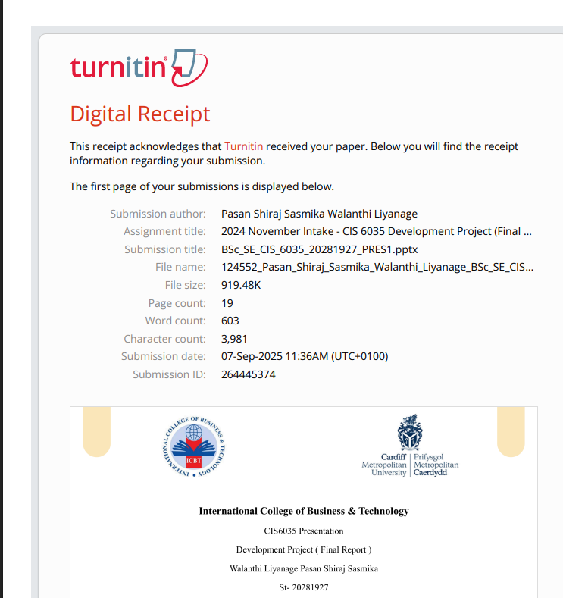

Slide 2
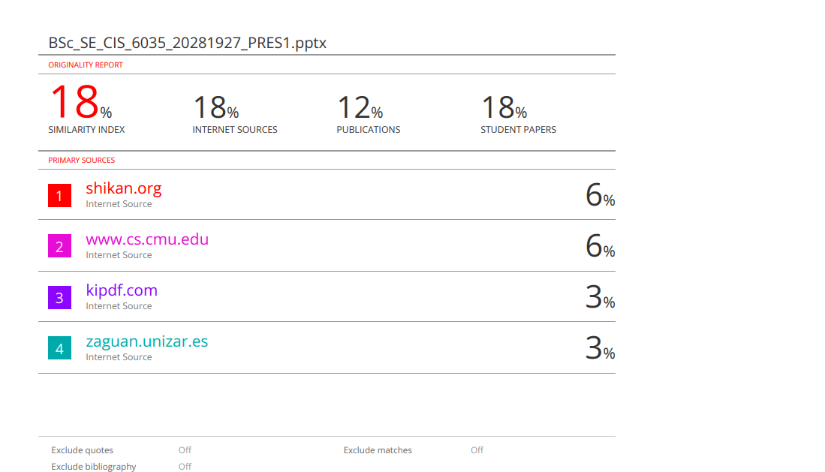

Slide 3
International College of Business & Technology
CIS6035 Presentation
Development Project ( Final Report )
Walanthi Liyanage Pasan Shiraj Sasmika
St- 20281927
GL/BSCSD/07/21
1 Page

Slide 4

A Mobile App for Discovering Local Services in Sri Lanka
2 Page

Slide 5

OVERVIEW
Introduction
04
Sequence Diagram
12
Project Background
05
System Architecture Diagram
13
Problem Statement
06
Proposed Solution
07
Time Plan
14
Literature Review
08
Challenges and Limitations
15
System Requirements - Functional
09
Conclusion - Achieved Objectives
16
System Requirements - Non-Functional
10
Future Recommendations
17
Tools, Technologies, Methodology, Frameworks
11
3 Page

Slide 6
INTRODUCTION
Focus: Mobile app development for local service discovery
Organization: Cardiff School of Technology, ICBT Campus
Addresses digital transformation in Sri Lanka’s service sector
Enhances accessibility for consumers and providers
4 Page

Slide 7
PROJECT BACKGROUND
Sri Lanka’s digital growth: High smartphone penetration
Gap in local service discovery: Reliance on word-of-mouth
SMEs lack digital visibility, limiting market reach
Locato: A solution for efficient, trustworthy service access
5 page

Slide 8
PROBLEM STATEMENT
Inefficient service discovery: Time-consuming, unreliable methods
Lack of digital presence for small businesses
Information asymmetry: No verified service information
Hinders economic growth and consumer trust
6 page

Slide 9




PROPOSED SOLUTION
Locato: Cross-platform mobile app for service discovery
Features: Search, filter, map view, reviews, admin verification
Built with MERN stack, React Native, OpenStreetMap
Empowers users and providers, promotes digital inclusion
7 page

Slide 10
LITERATURE REVIEW
Location-Based Services (LBS): Improve efficiency (Dey, 2010).
Filtering & Search: Boosts relevance (Yan, 2017).
Reviews & Ratings: Build trust (Gupta, 2020).
Research Gap: Few hyper-local apps in developing countries.
8 page

Slide 11
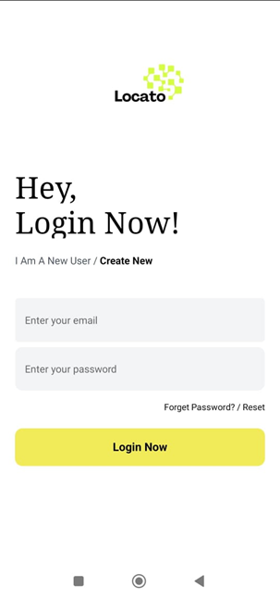
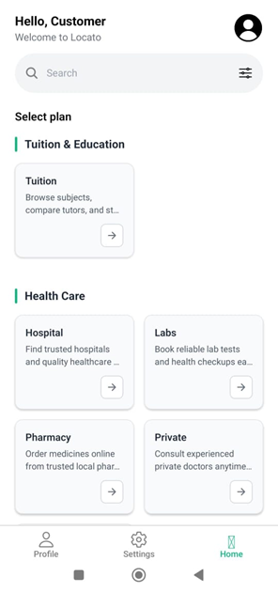
SYSTEM REQUIREMENTS - FUNCTIONAL
User Management: Register, login, role-based access
Service Listing: Create, update, delete by providers
Search & Filter: By category, location, ratings
Reviews: User-driven star ratings, comments
Admin: Approve providers, manage listings
9 page

Slide 12
SYSTEM REQUIREMENTS - NON-FUNCTIONAL
Performance: Load services in <3 seconds (4G)
Usability: Intuitive UI, minimal learning curve
Security: JWT authentication, HTTPS encryption
Scalability: Handle 1,000 concurrent users
Compatibility: Android 6.0+, iOS 12+
10 page

Slide 13

TOOLS, TECHNOLOGIES, METHODOLOGY, FRAMEWORKS
Tools: VS Code, Git, Postman, Figma
Technologies: React Native, Node.js, MongoDB, OSM
Methodology: Agile (Scrum-inspired) for iterative development
Frameworks: Express.js, React Navigation, Zustand
11 page

Slide 14
SEQUENCE DIAGRAM
Illustrates time-ordered interactions: Service Owner, User, Admin, System, Database
Covers registration, login, service requests, approvals/rejections
Highlights conditional flows (search, filter, approval)
Ensures accurate execution of system processes
12 page

Slide 15
SYSTEM ARCHITECTURE DIAGRAM
Client-Server Model: React Native (client), Node.js (server)
Database: MongoDB for flexible, scalable storage
API: RESTful for stateless communication
Mapping: OpenStreetMap for cost-effective geolocation
13 page

Slide 16
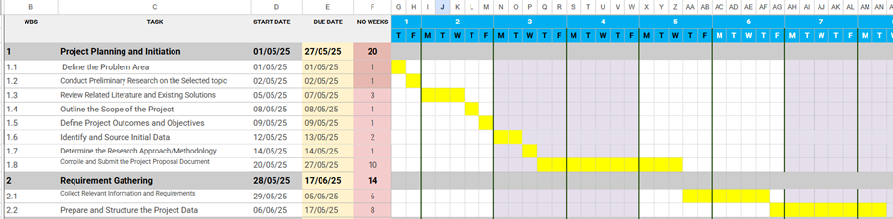
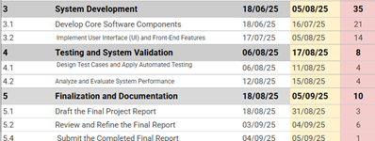

TIME PLAN
14 page

Slide 17
CHALLENGES AND LIMITATIONS
Cold Start: Sparse initial service listings
Manual Admin Approval: Scalability bottleneck
Internet Dependency: Degraded experience in low connectivity
No AI: Lacks personalized recommendation engine
15 page

Slide 18
CONCLUSION - ACHIEVED OBJECTIVES
Centralized directory with advanced search, filtering
Location-aware mapping with OpenStreetMap integration
Secure, role-based system for users, providers, admins
Functional review system and admin dashboard
15 page

Slide 19
FUTURE RECOMMENDATIONS
AI Recommendations: Personalized service suggestions
In-App Booking/Payments: Enhanced user journey
Real-Time Chat: Direct provider-customer communication
Localization: Support Sinhala, Tamil languages
17 page

Slide 20
References
Agre, P. E., 2001. Changing places: Contexts of awareness in computing. Human-Computer Interaction, 16(2-4), pp. 177-192.
Alsharif, M. &. N. M., 2019. Mobile applications in developing countries: Opportunities and challenges. Journal of Information Technology in Developing Economies, 12(3), pp. 45-60.
Bank, W., 2023. Digital economy for South Asia: Sri Lanka country diagnostic, Washington, DC: World Bank Group.
Dey, A. K. A. G. D. &. S. D., 2010. A conceptual framework and a toolkit for supporting the rapid prototyping of context-aware applications. Human-Computer Interaction, 16(2-4), pp. 97-106.
Dey, A. K. A. G. D. &. S. D., 2010. A conceptual framework and a toolkit for supporting the rapid prototyping of context-aware applications. Human-Computer Interaction, 16(2-4), pp. 97-166.
18 page

Slide 21
THANK YOU
18 page

