Slide 1
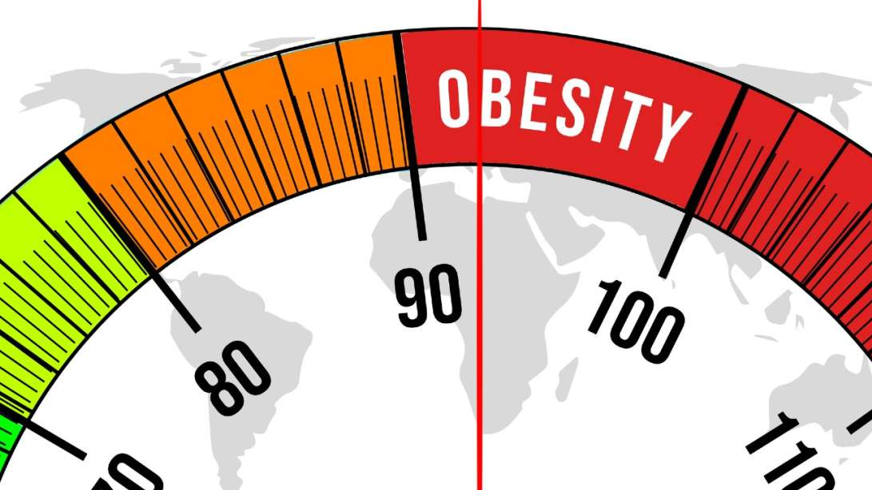
Obesity Prediction Using Random Forest Algorithm
A Machine Learning Approach to Health Risk Assessment

Slide 2

Introduction
Growing prevalence of obesity and associated health risks.
The complexity of obesity involving behavioral, environmental, genetic, and economic factors.
Project Aim: To utilize machine learning, specifically the Random Forest algorithm, to predict obesity categories based on demographic, physical, and lifestyle data.

Slide 3

Objectives
Primary Objective:
Develop an accurate model for classifying individuals into various obesity categories.
Secondary Objectives:
Conduct exploratory data analysis (EDA) to identify patterns.
Generate actionable insights to inform public health policies.

Slide 4
Dataset Overview
Source: Kaggle - Health Research Institutions Dataset.
Parameters Included: Age, Gender, Height, Weight, BMI, Physical Activity Level.
Goal: Predict obesity categories based on these factors.

Slide 5

Methodology
Algorithms Considered:
Possibilistic C-Means (PCM)
Support Vector Machine (SVM)
K-Nearest Neighbors (KNN)
Random Forest (Chosen Model)
Feature Scaling: StandardScaler used for uniform contribution.

Slide 6

Data Preprocessing
Steps Involved:
Handling missing values.
Feature scaling using StandardScaler.
Splitting data into training (80%) and testing (20%) sets.

Slide 7

Model Training
Algorithm Used:
Random Forest
Training Details:
Implemented using the scikit-learn library in Python.
Key hyperparameters tuned for optimization.

Slide 8
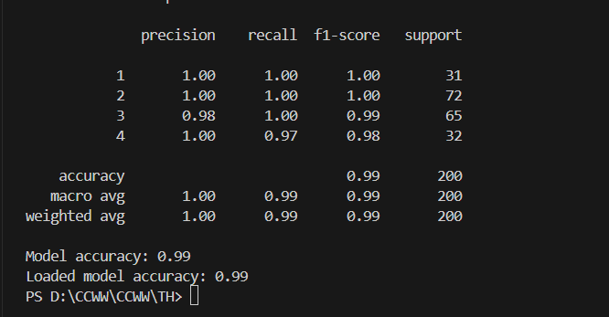
Model Evaluation
Results:
Accuracy of the model on the test set: 99%

Slide 9
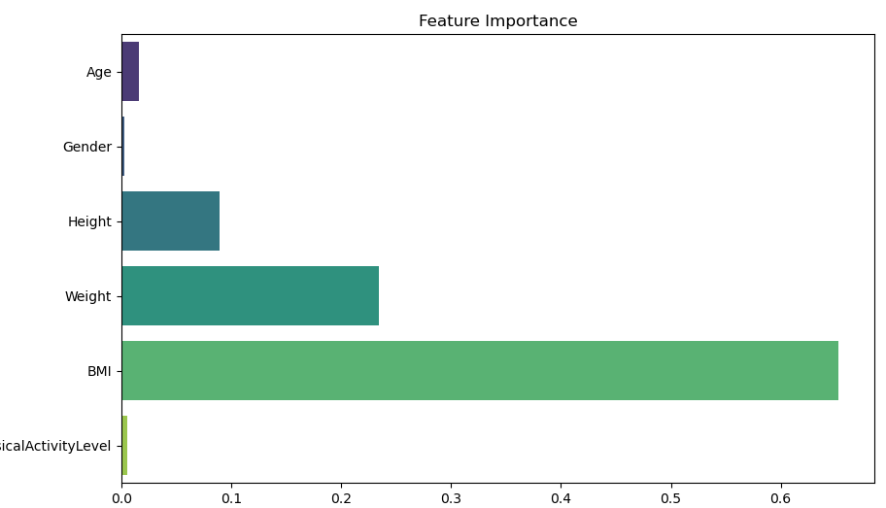
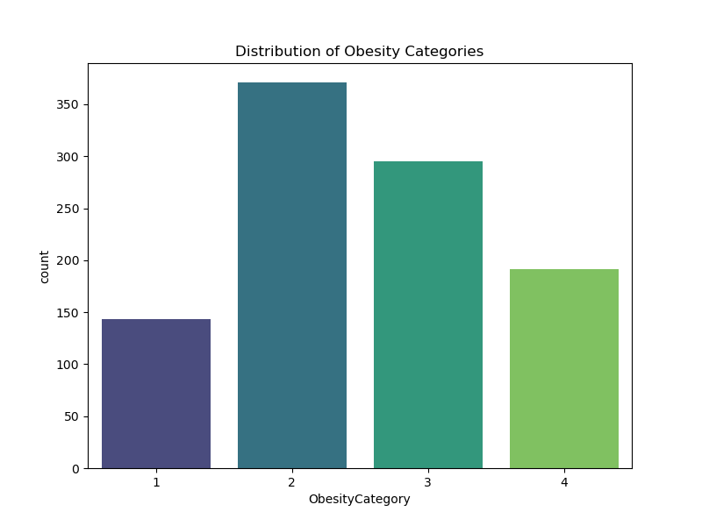
Results and Discussion
Feature Importance Graph: BMI and Weight are the most critical predictors of obesity, with BMI being the dominant factor.
Distribution of Obesity Categories Graph: Most individuals are classified as normal weight or overweight, which influences the model's predictions.

Slide 10
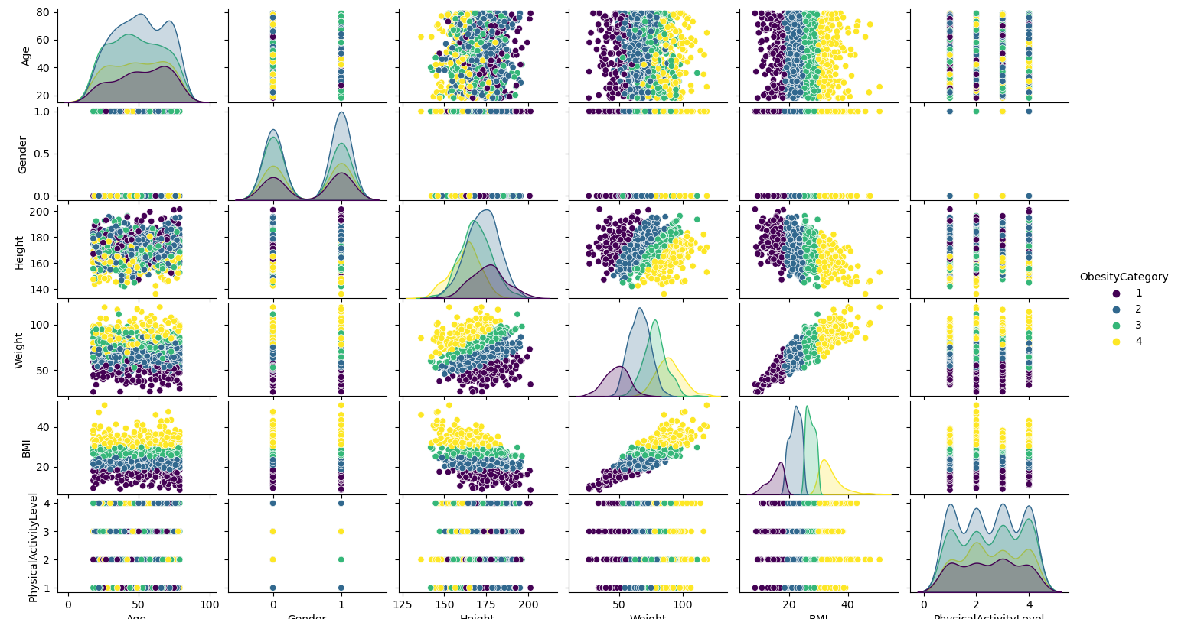
Results and Discussion
This pair plot reveals correlations between health metrics and obesity categories, highlighting how age, BMI, and physical activity contribute to obesity classification

Slide 11
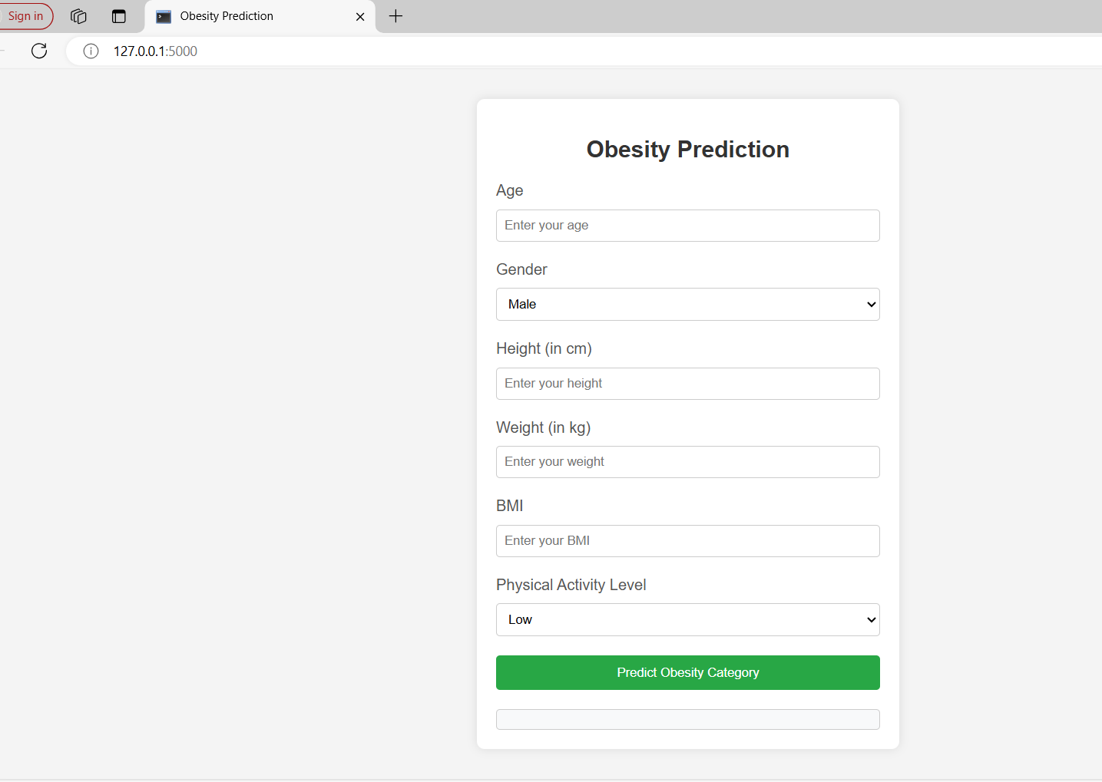
Web Application Development
Overview: User-friendly interface built using Flask.
Input parameters: Age, BMI, Physical Activity Level.
Prediction output: Obesity category based on user inputs.

Slide 12
Deployment and Testing
Process: Web application deployed on a local server.
Multiple test cases conducted to ensure accuracy and usability.
Outcome: Final adjustments made based on feedback.

Slide 13

Conclusion
Summary: Random Forest model effectively predicts obesity categories.
Web application provides an accessible tool for users.
Future Work: Potential improvements with more data and further model tuning.

Slide 14

Thank You!

