Slide 1

BloodBridge — Connecting Blood. Saving Lives.
AI-powered emergency blood request network that instantly links donors, hospitals and communities. Designed for speed, security and scale.

Slide 2

The Problem
Thousands struggle to find compatible blood in critical moments.
Donors, hospitals and patients remain fragmented—manual calls and WhatsApp chains slow responses.
Hospitals rely on ad-hoc networks; verification and availability are uncertain.
Every minute matters when someone needs blood.

Slide 3






Our Solution
BloodBridge is a lightweight digital platform that instantly connects verified donors to emergency recipients using location-aware search, secure verification and real-time notifications.
Register
Search
Request
Notify
Donate
Save Life

Slide 4
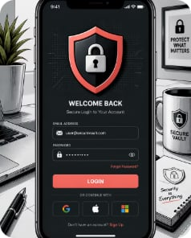


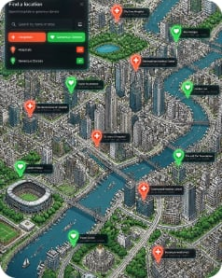
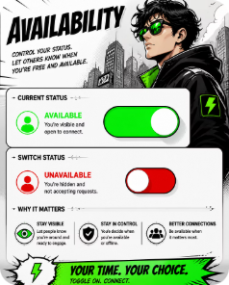


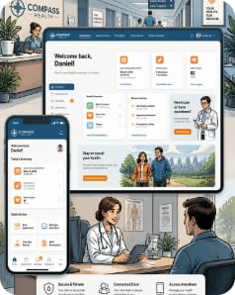
Key Features
Secure Authentication
Donor Registration
Emergency Requests
Group & Location Search
Quick profile capture: blood type, donation history, eligibility and certificates.
One-tap request with required blood group, urgency level and hospital pickup details.
Multi-factor sign-in, JWT-based sessions, role-based access for hospitals and volunteers.
Geo-filtered matching by blood group and proximity for faster discovery.
Availability Status
User Dashboard
Notifications
Mobile Responsive Interface
Push, SMS and in-app alerts with priority escalation for critical requests.
Donors set availability; hospitals view real-time inventory and donor status.
Unified view for hospitals, coordinators and donors: requests, history and confirmations.
Accessible on low-bandwidth connections; progressive web app and native-ready UI.

Slide 5

System Workflow
Emergency Request
Find Donors
Notify Donors
Confirm & Complete
This workflow shortens time-to-match and adds verification at each step to ensure safety and traceability.

Slide 6





Technology Stack
Frontend
React · Tailwind CSS · Axios — fast, responsive interfaces
Backend
Spring Boot · Spring Security · JWT · REST APIs — secure, scalable services
Database
MySQL — reliable relational storage for records and audit logs
Designed for low-latency lookups and secure, authenticated communication between client and hospital systems. API-first approach enables easy hospital integrations and mobile clients.
Tools
Maven · GitHub — CI-ready and version controlled

Slide 7
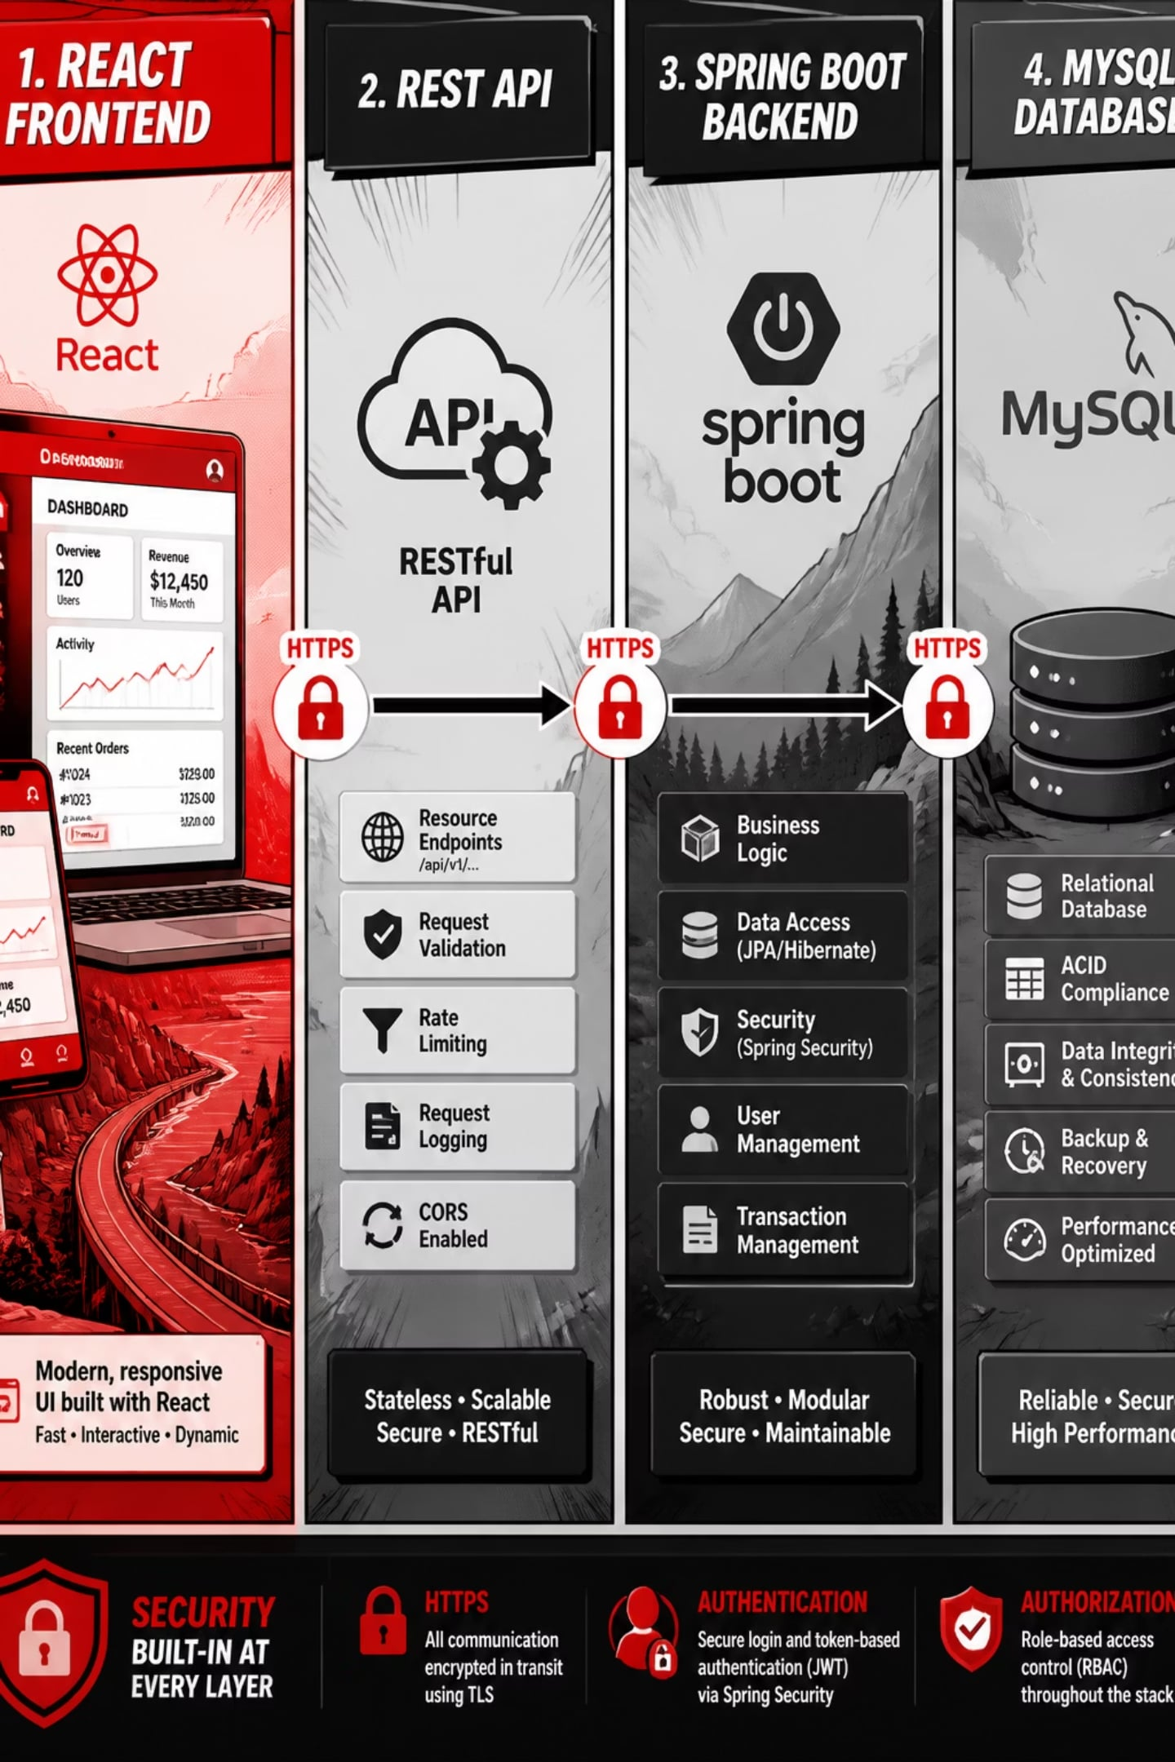
Architecture
Layered design: client-side UI ↔ authenticated REST API ↔ business logic & verification ↔ persistent storage. All API traffic uses TLS; JWT ensures role-based access and short-lived tokens for emergency sessions.

Slide 8
Why BloodBridge Is Different
Fast Donor Discovery
Geo-aware, blood-group filtering to cut match time dramatically.
Real-time Availability
Live donor status and hospital inventory visibility reduces uncertainty.
Secure Authentication
Verified identities and encrypted communication for patient safety.
Easy UX
Designed for clinicians, coordinators and first-time donors — minimal steps under duress.
Community-driven
Volunteer networks, blood-banks and hospitals collaborate on one platform.
Scalable Backend
Microservice-ready architecture to support city, regional and national rollouts.

Slide 9
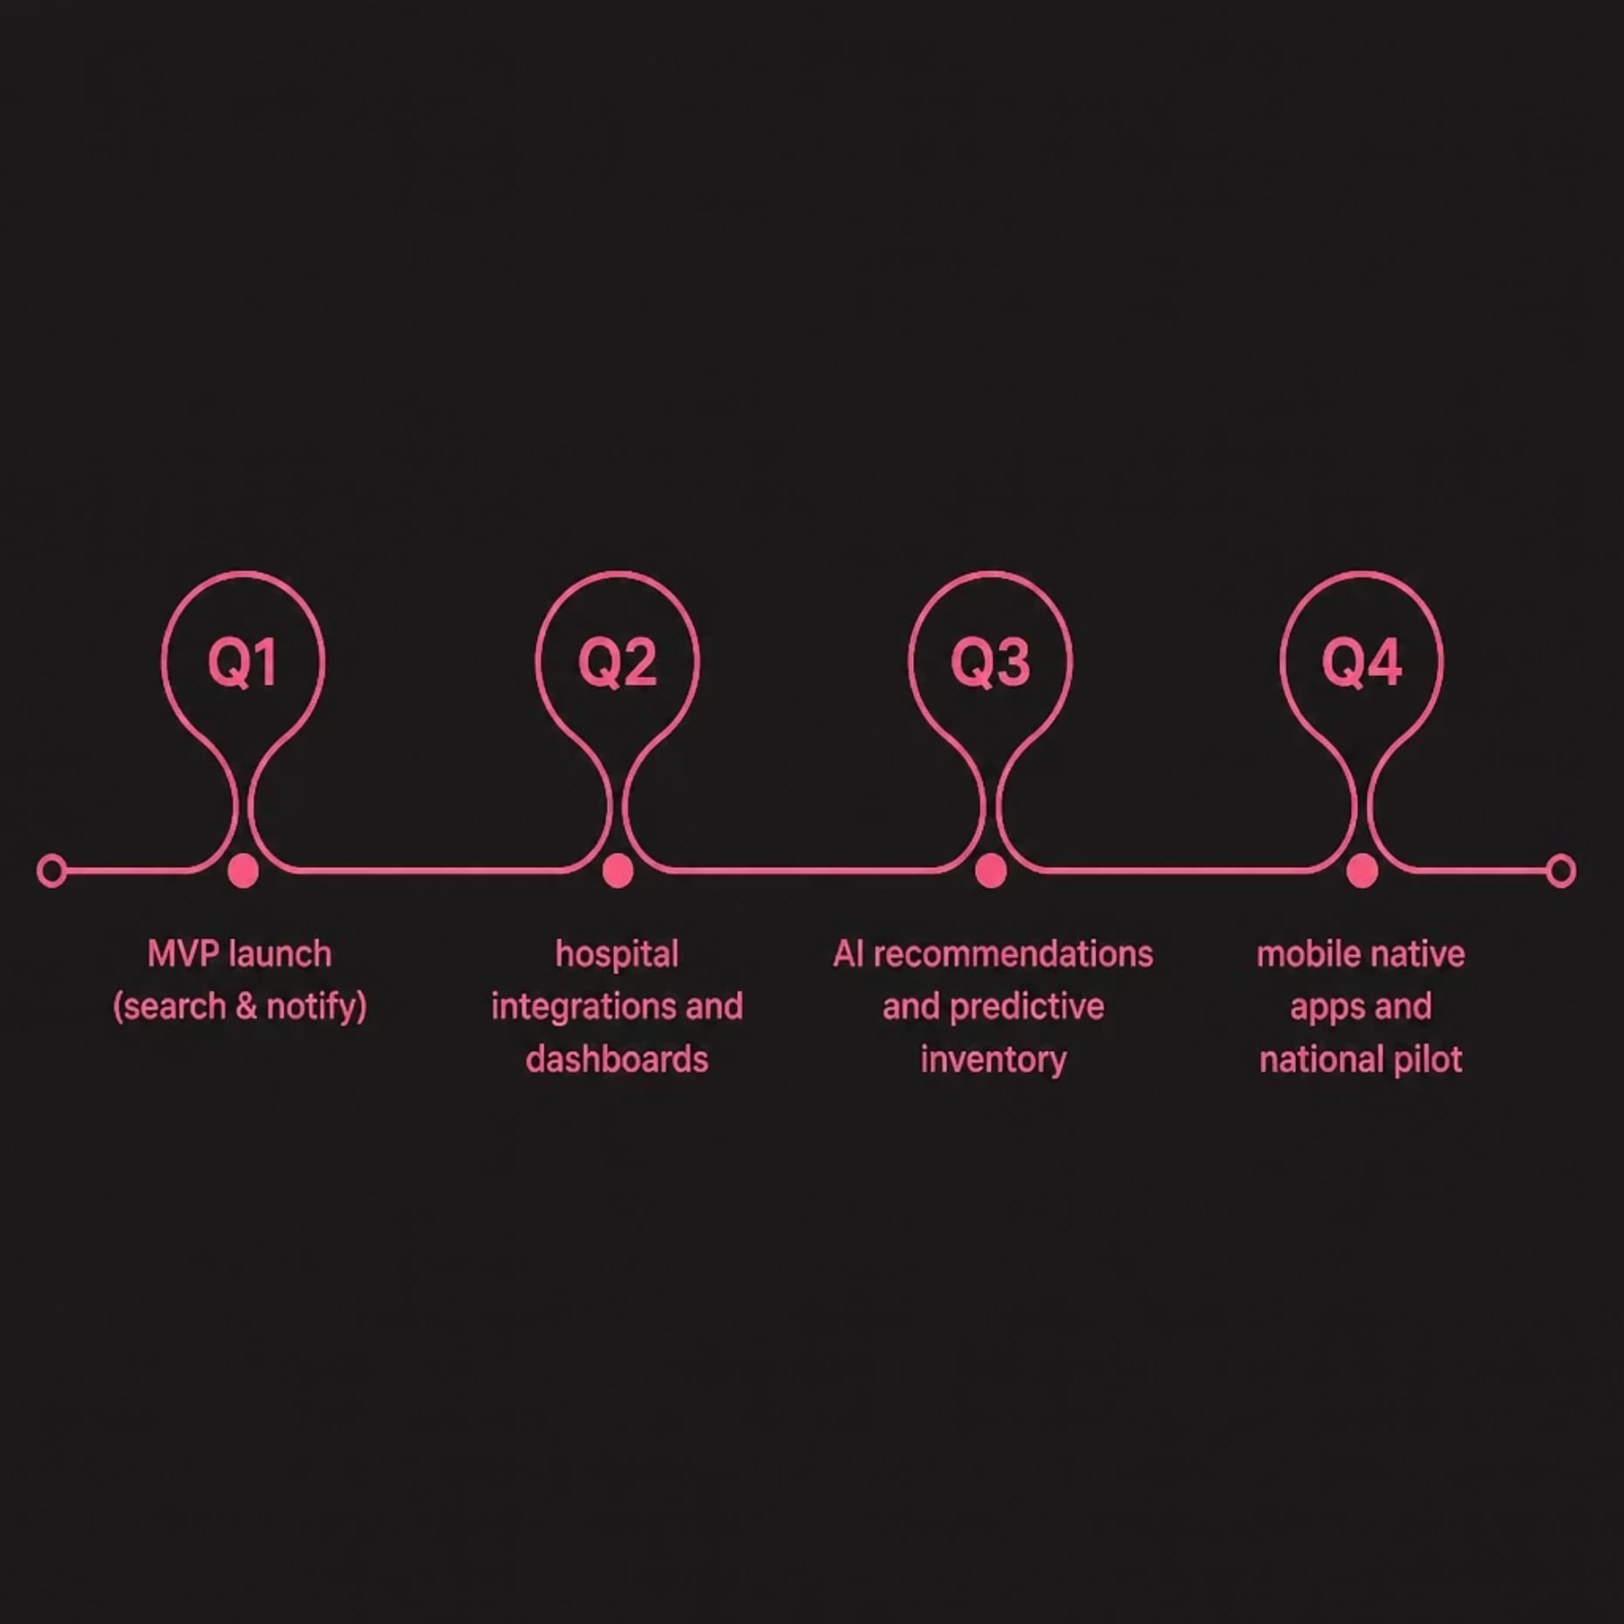
Roadmap & Future Enhancements
AI donor recommendations & eligibility scoring
Live GPS tracking for donor routing
Hospital EMR and blood-bank integrations
Predictive blood inventory (ML forecasting)
Advanced analytics dashboard for health administrators
Native mobile apps with offline-first support

Slide 10





Social Impact
Faster Emergency Response
Reduce time-to-match, increasing survival chance in critical transfusions.
Increased Donor Participation
Simplified workflows and reminders convert availability into action.
Reduced Shortages
Better visibility and predictive forecasting stabilises local blood supply.
Community Collaboration
Hospitals, NGOs and volunteers coordinate on one verified platform.
Impact snapshot: faster matches, more donors, fewer critical shortages — measurable health outcomes at community scale.

