Slide 1

Stochastic Simulation of an Epidemic outbreak in a large network
Lecture with Computer Exercises:
Modelling and Simulating Social Systems with MATLAB

Slide 2
Introduction / aim of the project
Realization of our own ideas for a stochastic simulation of an epidemic outbreak in a large network.
Analyze the differences between different realizations of a disease outbreak
What influences do random variations have?
Is the disease outbreak predictable?
How do the start conditions influence the disease spreading?

Slide 3
Simulation overview
Network generation (10000 cities, 93 mil. people)
Cities with inhabitants
Connections
Travelling parameters
Disease spreading through infections
Disease spreading through traffic
Data output
Analysis

Slide 4

Network generation
Use Barabási-Albert Model to form a scale free network
a
Storing the network as node and edge lists
Why a scale free network?
generation of hubs was desired
good modell for air traffic [1]
Why loops?
No dead ends
More realistic appearance
Use Zipf‘s Law to generate the city population

Slide 5
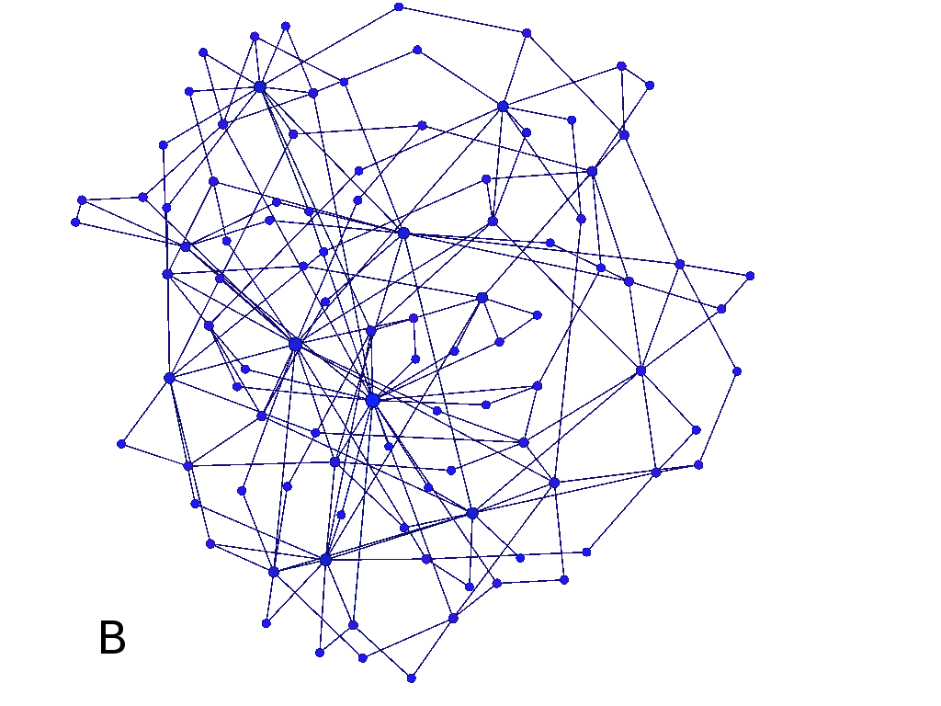
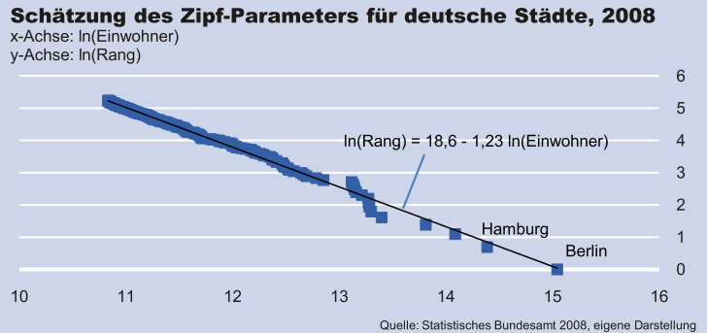
Network generation
Fig. 1: 100 node scale free network plotted using Gephi 0.81 beta
Fig. 2: Estimation of the Zipf-Parameter for german cities, 2008 [2]

Slide 6
Disease spreading - Infection
SI – model (non lethal / no resistance)
ODE:
Stochastic model: Normal distributed numbers of meetings for each infected. Depending on Δt
For each meeting:
Parameters were estimated with a disease outbreak of a flu. Very rough approximation.

Slide 7

Disease spreading - Traffic
For every edge in the network the number of travelers per time step were calculated based on the population of the smaller city (to avoid transport ˃ population).
Scale transport according the degrees of connected cities (e.g. airports, train stations).
Number of infected travelers is hyper geometrically distributed.
Fig. 3: Sketch of two cities x and y. Edges are indicated as double arrows.

Slide 8
Approximations
Large number of calculations
Infections approximations:
With binomial distributed random variable (multiple infections of the same susceptible possible)
In a later stage (above 10,000 infected) no random component anymore
Traffic approximations:
Same number of travelers in both direction of an edge
Un-weighted edges -> no distances considered
Use of parfor for simultaneous simulations. (One run, 80 days simulated approx. 30 min on a standard laptop).

Slide 9
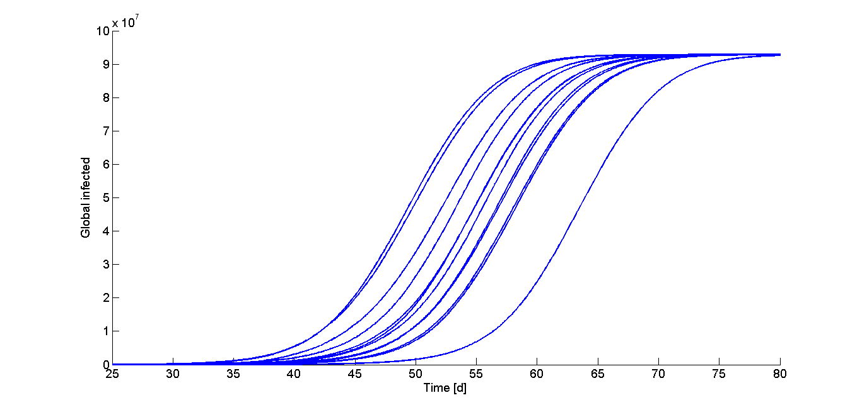
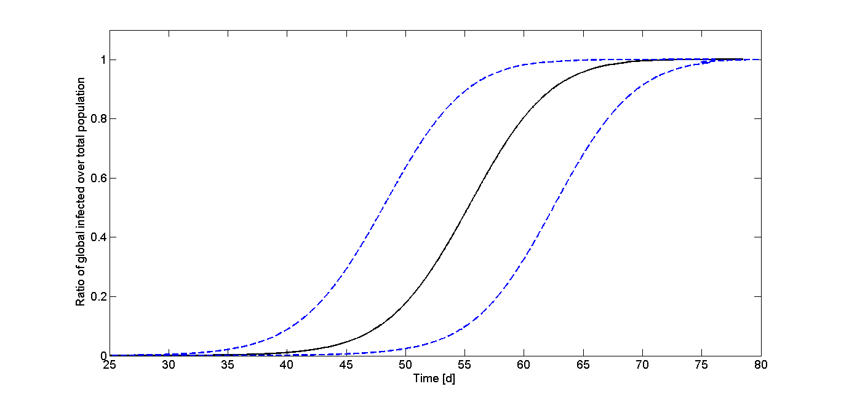
Results
Time until 1000 people are infected:
Fig. 4: Example simulations
Fig. 5: Mean and expectation range. n= 147

Slide 10
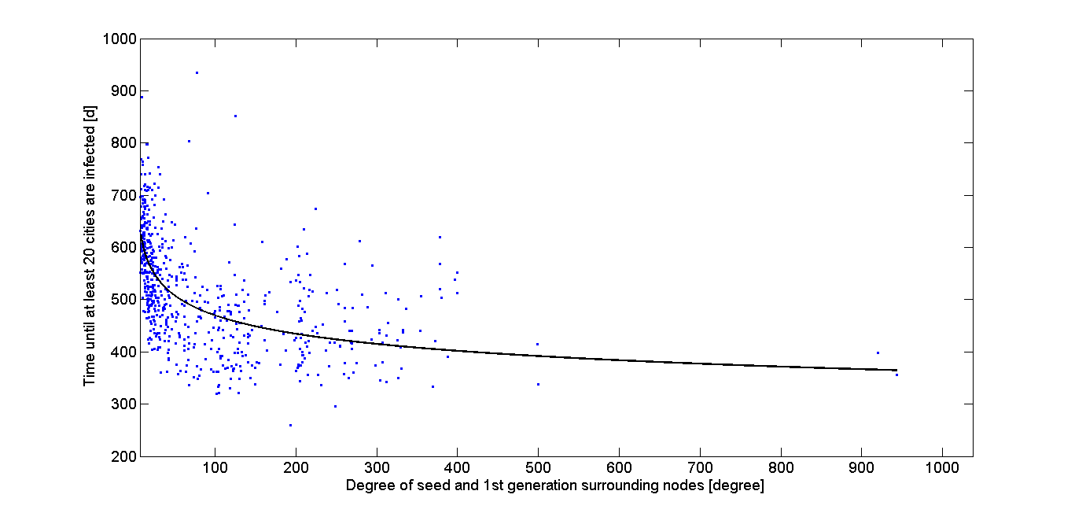
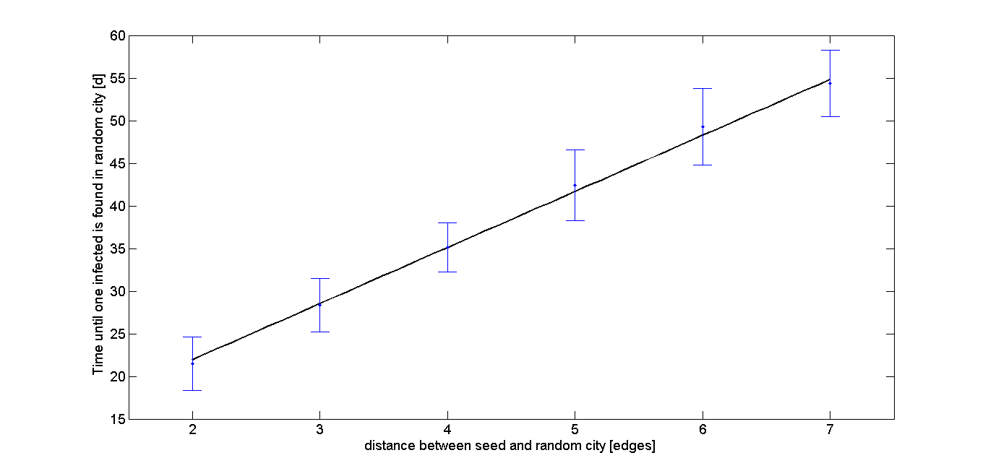
Results
Weak correlation of degree and disease spreading
Linear correlation of distance and disease spreading
Fig. 6: Degree versus time until 20 cities are infected
Fig. 7: Distance between two nodes versus time until second node is infected

Slide 11
Discussion
Big time variations for the infections caused by the stochasticity of the model and the centrallity of the source of the infection
Results are not applicable to the real world, because parameters were chosen at random
Program performance is good, due to approximations
-> larger networks would be possible

Slide 12
References
[1]:Berliant M. and Watanabe H, "A Scale-Free Network Structure Explains the City-Size Distribution." mimeo 1-11, 2008.
[2]:Just T and Stephan P, "Die seltsam stabile Größenstruktur deutscher Städte: Das Zipfsche Gesetz und seine Implikationen für urbane Regionen." Deutsche Bank Research, No 31, 2009;

Slide 13
Movie of the disease spreading
Infection of a 500 city network
The colour scale is not linear, small infected numbers are shown stronger

