Slide 1
Stochastic Simulation of an Epidemic outbreak in a large network
Lecture with Computer Exercises:
Modelling and Simulating Social Systems with MATLAB

Slide 2
Introduction / aim of the project
Realization of our own ideas for a stochastic simulation of an epidemic outbreak in a large network.
Analyze the differences between different realizations of a disease outbreak
What influences do random variations have?
Is the disease outbreak predictable?
How do the start conditions influence the disease spreading?

Slide 3
Simulation overview
Network generation (10000 cities, 93 mil. people)
Cities with inhabitants
Connections
Travelling parameters
Disease spreading through infections
Disease spreading through traffic
Data output
Analysis

Slide 4

Network generation
Use Barabási-Albert Model to form a scale free network
a
Storing the network as node and edge lists
Why a scale free network?
generation of hubs was desired
good modell for air traffic [1]
Why loops?
No dead ends
More realistic appearance
Use Zipf‘s Law to generate the city population

Slide 5
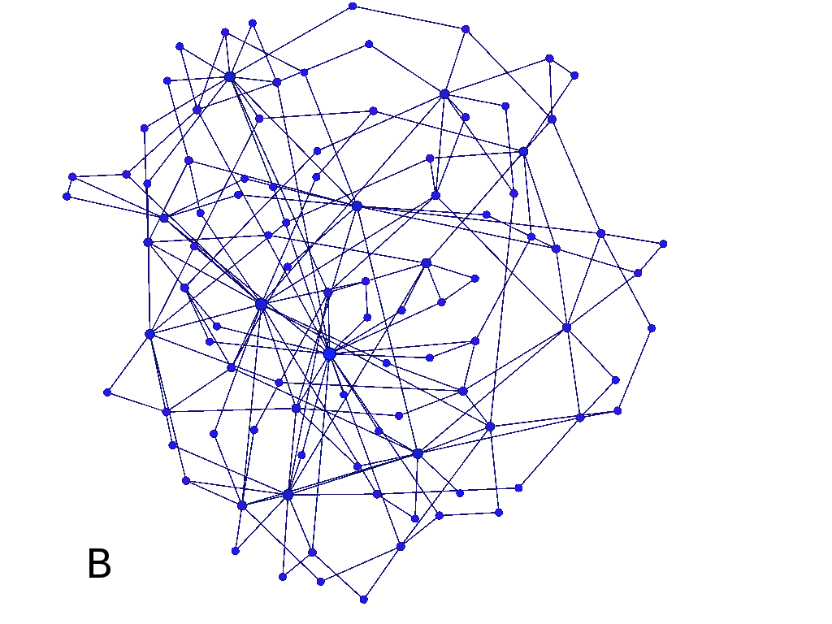
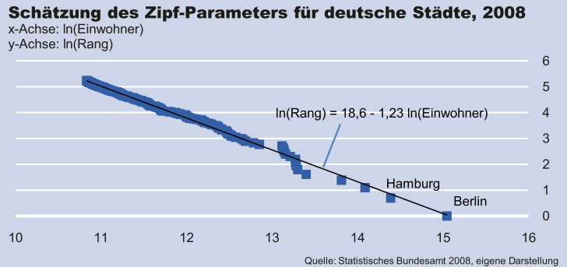
Network generation
Fig. 1: 100 node scale free network plotted using Gephi 0.81 beta
Fig. 2: Estimation of the Zipf-Parameter for german cities, 2008 [2]

Slide 6
Disease spreading - Infection
SI – model (non lethal / no resistance)
ODE:
Stochastic model: Normal distributed numbers of meetings for each infected. Depending on Δt
For each meeting:
Parameters were estimated with a disease outbreak of a flu. Very rough approximation.

Slide 7

Disease spreading - Traffic
For every edge in the network the number of travelers per time step were calculated based on the population of the smaller city (to avoid transport ˃ population).
Scale transport according the degrees of connected cities (e.g. airports, train stations).
Number of infected travelers is hyper geometrically distributed.
Fig. 3: Sketch of two cities x and y. Edges are indicated as double arrows.

Slide 8
Approximations
Large number of calculations
Infections approximations:
With binomial distributed random variable (multiple infections of the same susceptible possible)
In a later stage (above 10,000 infected) no random component anymore
Traffic approximations:
Same number of travelers in both direction of an edge
Un-weighted edges -> no distances considered
Use of parfor for simultaneous simulations. (One run, 80 days simulated approx. 30 min on a standard laptop).

Slide 9
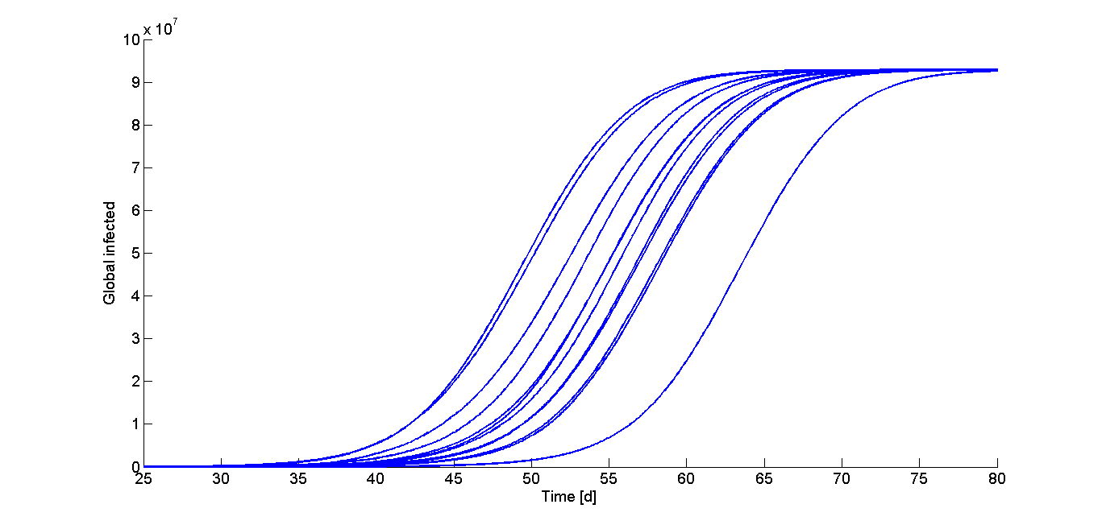
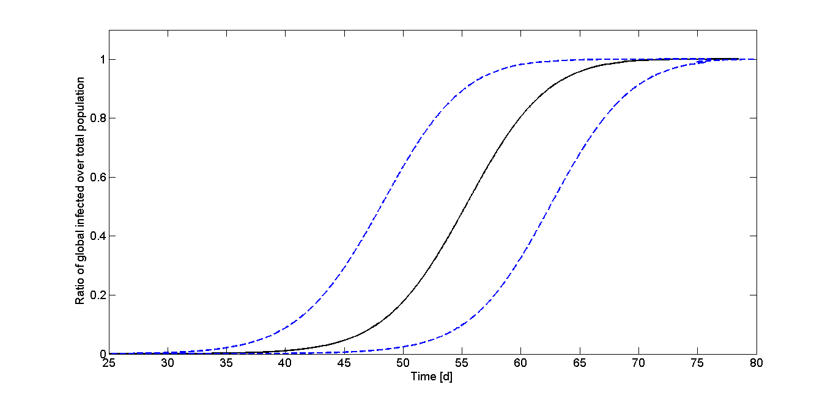
Results
Time until 1000 people are infected:
Fig. 4: Example simulations
Fig. 5: Mean and expectation range. n= 147

Slide 10
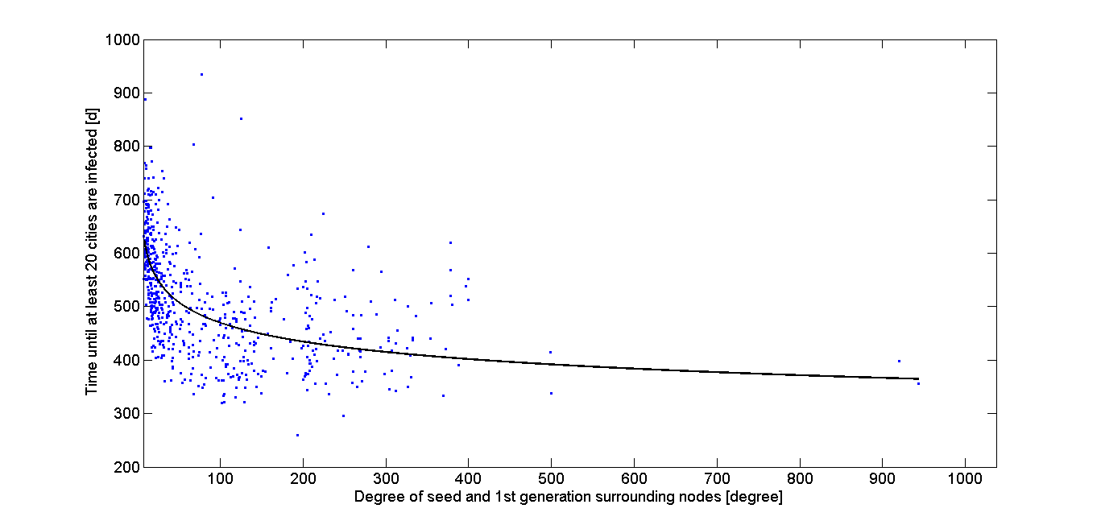
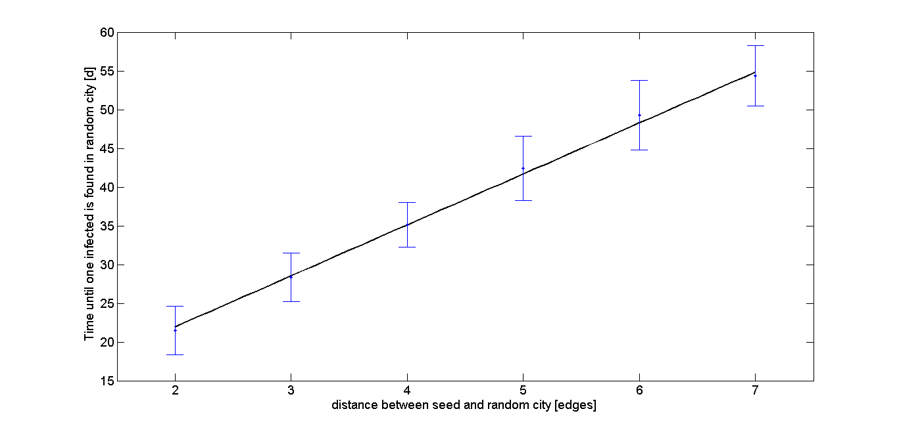
Results
Weak correlation of degree and disease spreading
Linear correlation of distance and disease spreading
Fig. 6: Degree versus time until 20 cities are infected
Fig. 7: Distance between two nodes versus time until second node is infected

Slide 11
Movie of the disease spreading
Infection of a 500 city network
The colour scale is not linear, small infected numbers are shown stronger

Slide 12
Discussion

Slide 13
References
[1]:Berliant M. and Watanabe H, "A Scale-Free Network Structure Explains the City-Size Distribution." mimeo 1-11, 2008.
[2]:Just T and Stephan P, "Die seltsam stabile Größenstruktur deutscher Städte: Das Zipfsche Gesetz und seine Implikationen für urbane Regionen." Deutsche Bank Research, No 31, 2009;

