Slide 1
Lab Course
Group 2 – Pascal Stücheli, Christian Jordi

Slide 2
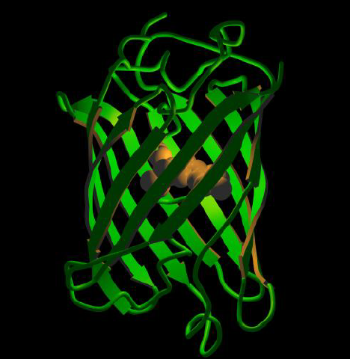
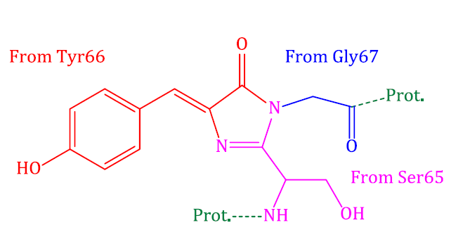
Introduction
GFP very extensively used in science
Fluorophore absorbes light and emits on a different wavelength
Practical Course in
Molecular Biology & Microbiology, 2012

Slide 3
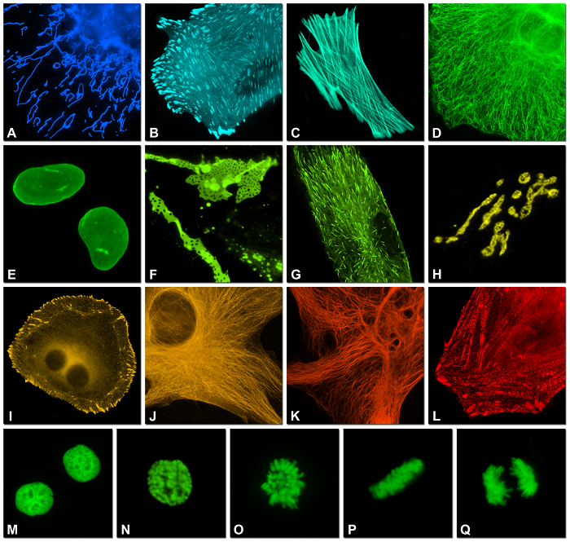
Introduction
State of the art:
Different absorptions
Different emissions
Different stabilities
…
Goal of this experiment was it to produce a library of site – directed random mutations and screen for a red shifted excitation
Shaner, et al. Journal of Cell Science, 2007

Slide 4
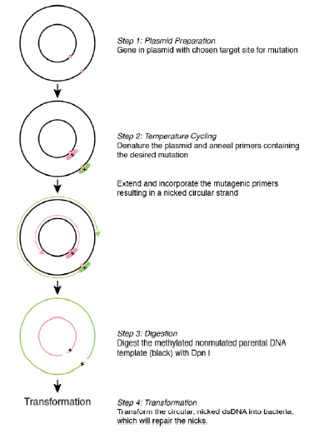
Strategy
1. Create a library of mutants
(F64, S65, S72), GFPuv on a plasmid with Ampicillin resistance, site directed mutagenesis in PCR
2. Transform plasmid in E.coli
Rubidium induced competent strain Top10
3. Screen for better excitation
Red shifted excitation
4. In silico analysis of the mutant
5. Transform plasmid in production strand of E. coli, run test-fermentation, process of product

Slide 5
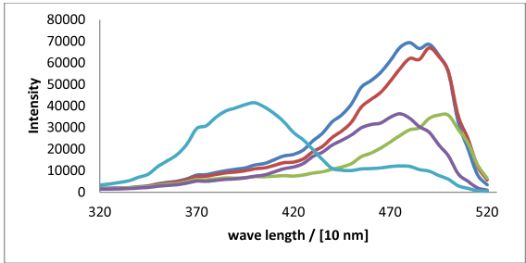
Characterization of mutants: UV-VIS
Combined excitation spectra (550nm) of all mutants and the wild type. Variant 2, variant 3, variant 4, variant 5, wild type.

Slide 6
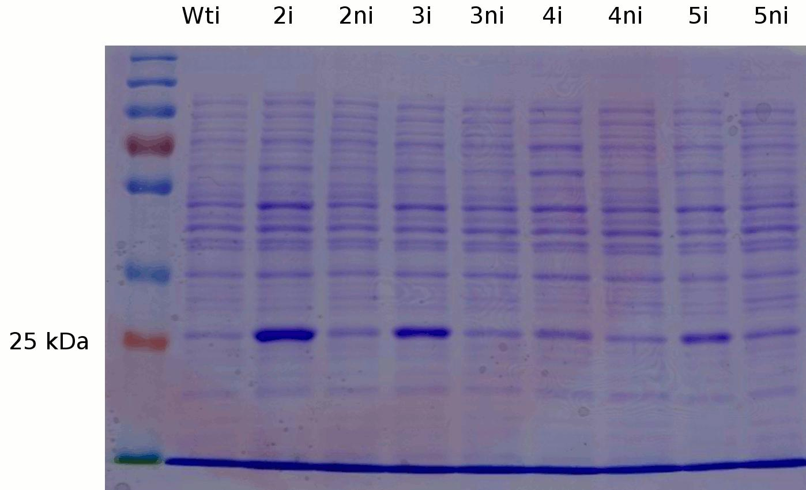
Characterization of mutants: SDS PAGE
SDS-PAGE gel of the proteins present in the chosen mutants and the wildtype.

Slide 7


Characterization of mutants: Sequencing
Variant 5 was a double mutant and therefore discarded
Tab.: DNA- and AA-sequences of the mutant plasmid and their ancestor.
Mutated sites are indicated in bold

Slide 8
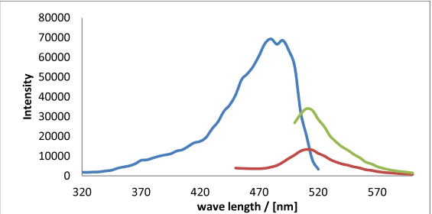
UV-VIS Spectra of Variant 2
Fig. Spectral properties of the chosen mutant: Variant 2. Excitation (550 nm), Emission (395 nm), Emission (470 nm)

Slide 9
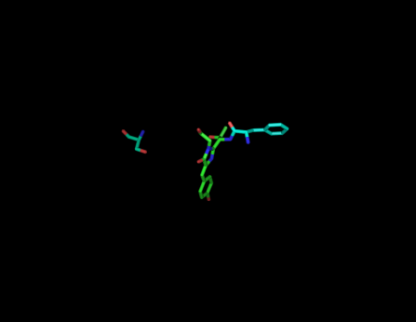
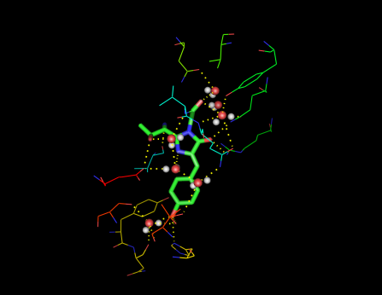
Invetigating the structure of GFP
PyMOL pictures of the chromophore, showing it together with the mutated sites (left) and all interacting residues (right)

Slide 10
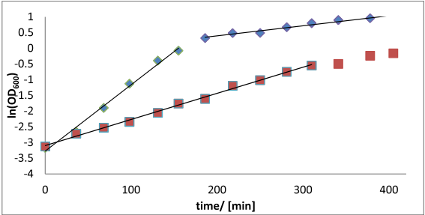
Bacterial Growth Curve
ln(X) = ln(X₀) + μt
Calculated μ :
LB (initial): 1.272 h⁻¹
LB (later): 0.192 h⁻¹
M9: 0.498 h⁻¹
The natural logarithm of the optical densities of the cultures versus the growth time. A linear regression of the exponential growth phases was done to get the growth rates on different media. LB, M9

Slide 11
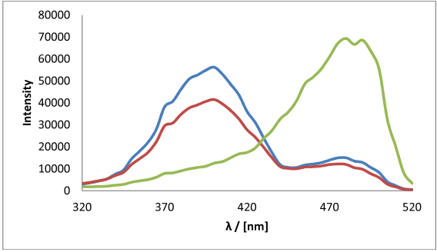
Product Analysis
Excitation (395 nm) spectra of the product compared to the desired variant 2 and the wild type. Product, variant 2, wild type

Slide 12


Purification
Total protein concentration determined using a Bradford assay
Purification factor | 3.3 ± 1
GFP fraction | 19.5% ± 4%
GFP concentration / [mg/mL] | 6.78 ± 4.2

Slide 13
Summary and Discussion
Good fluorescing mutants were produced
Around one fifth of the mutants had red shift
Almost all were fluorescing, at least slightly, under UV light
Red shift could have been seen well (≈80 nm)
Growth was in an estimated range (t₂ = 1.39 h)
Protein expression with IPTG was good
The produced GFP was from the wild type. Somehow not the correct one was chosen. Many possible sources for this contamination possible. Growth experiments were done with the wild type which could lead to a contamination
In future other AA’s could be investigated for their effect on fluorescence

Slide 14
Summary
Mutation worked quite well
Red shift as expected and in a high quantity
Fermentation worked well with the wild type
In silico analysis showed many positions with a contact to the fluorophore which could be tested for the effect on fluorescence

