Slide 1
Lab Course
Group 2 – Pascal Stücheli, Christian Jordi

Slide 2
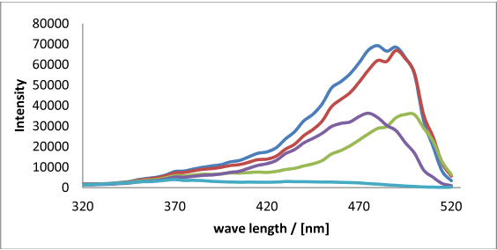
UV-VIS Spectra of Mutants
Fig. Combined excitation spectra (550nm) of all mutants and the wild type. Variant 2, variant 3, variant 4, variant 5, wild type.

Slide 3
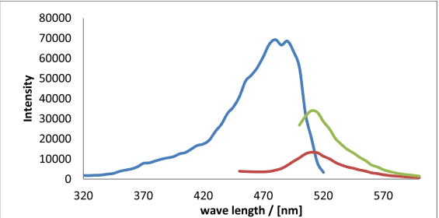
UV-VIS Spectra of Variant 2
Fig. Spectral properties of the chosen mutant: Variant 2. Excitation (550 nm), Emission (395 nm), Emission (470 nm)

Slide 4


Sequencing of mutants
Variant 5 was a double mutant and therefore discarded
Tab.: DNA- and AA-sequences of the mutant plasmid and their ancestor.
Mutated sites are indicated in bold

Slide 5
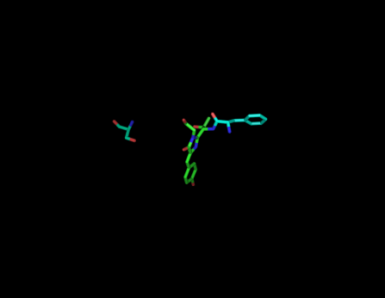
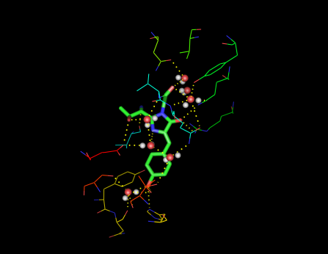
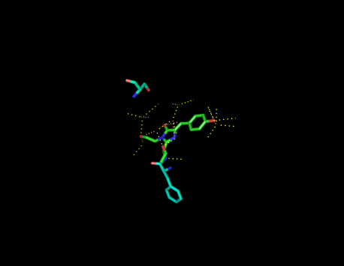
GFP

Slide 6
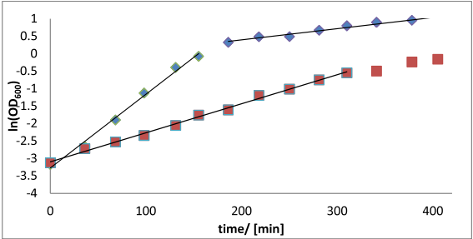
Bacterial Growth Curve
ln(X) = ln(X₀) + μt
Calculated μ :
LB (initial): 1.272 h⁻¹
LB (later): 0.192 h⁻¹
M9: 0.498 h⁻¹
Fig.: The natural logarithm of the optical densities of the cultures versus the growth time. A linear regression of the exponential growth phases was done to get the growth rates on different media. LB, M9

Slide 7
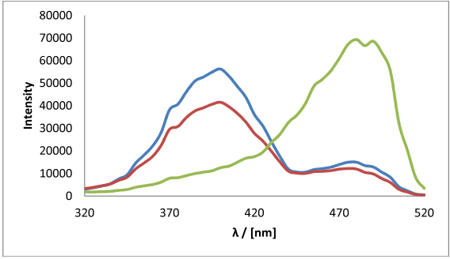
Product Analysis
Fig.: Excitation (395 nm) spectra of the product compared to the desired variant 2 and the wild type. Product, variant 2, wild type

Slide 8
Troubleshooting

Slide 9

Purification
Total protein concentration determined using Bradforts method
2nd formula and values…

