Slide 1
HEALTH INFORMATION SYSTEM
A Basic Client & Program Management Platform
Presented By: Pascal Ndubi
Date: 24/04/2025

Slide 2
CHALLENGE UNDERSTANDING
Build a secure health system where doctors can:
Sign up and log in as admins
Create health programs (TB, HIV, Malaria, etc.)
Register clients
Enroll clients in programs
Search clients in a registered client list
View client profiles
Interact via both API & Web UI

Slide 3
TECHNOLOGY USED
Backend: FastAPI + SQLAlchemy + JWT
Frontend: React
Database: PostgreSQL(Supabase) for production MySQL for development
Auth: Password hashing + JWT
API: RESTful with token-based access

Slide 4
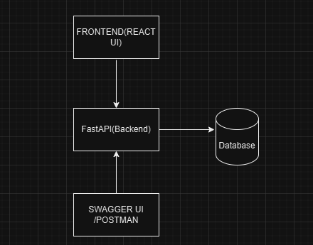
SYSTEM ARCHITECTURE DESIGN

Slide 5
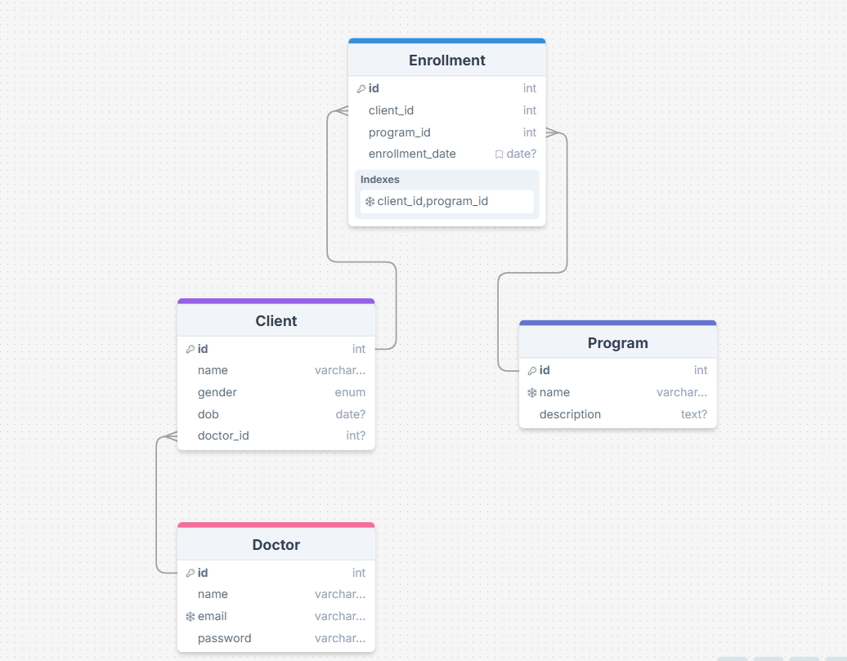
DATABASE DESIGN

