Slide 1
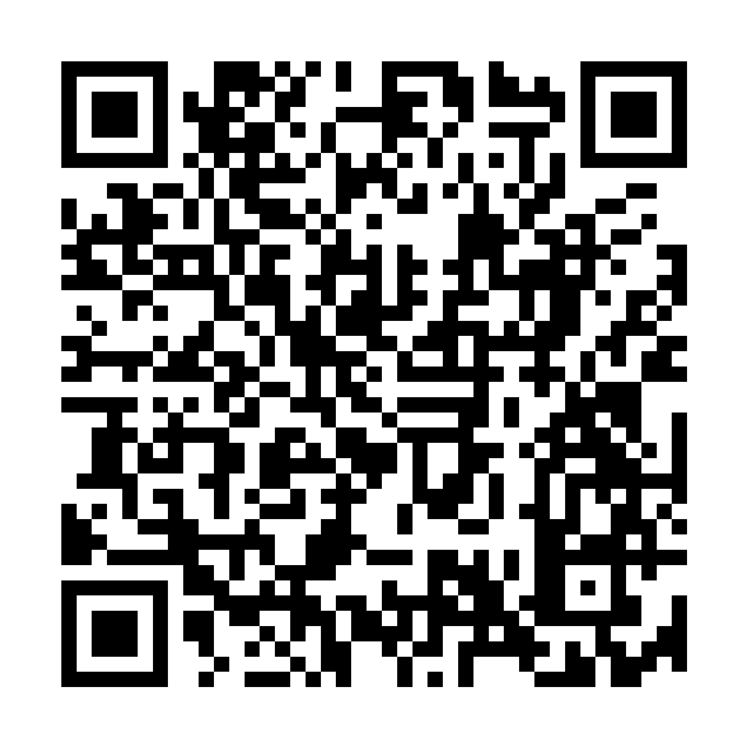
Rejista
Nine in ten Nigerian businesses have no papers
We register them with the Corporate Affairs Commission, in the language they actually speak, for a flat fee they can see before they pay.
Nigeria · pilot: Balogun market, Lagos
Scan it now
It opens the real registration form — the same one a trader in Balogun market would use.
Demonstration build — no payment is taken and nothing is filed with the government yet.
Pascal, Omar, Bello, Olu and Shamin · e-Governance Practicum (ICT4D) · 1 August 2026
Rejista · investor deck · Pascal, Omar, Bello, Olu and Shamin
1
Notes:
QR encodes https://rejista-ten.vercel.app/register?src=booth-01 — error-correction H with a full quiet zone, so it survives projection and print. Vector versions live in public/print/. Demonstration build: no payment is taken and nothing is filed with the government yet.

Slide 2
THE PROBLEM
Nine in ten Nigerian businesses are invisible to banks and buyers
Registration with the Corporate Affairs Commission (CAC) is what makes a business visible.
~40m
~9 in 10
Invisible to banks, government and big buyers — the register is the door, and they are not on it.
small businesses in Nigeria
of them unregistered
SMEDAN/NBS — to be verified
SMEDAN/NBS — to be verified
The consequence, not a survey figure
Not settled yet. Both figures are open items until they are checked against SMEDAN/NBS. A wrong number on a trust slide costs more than a missing one.
Source: SMEDAN/NBS national MSME survey — both figures to be verified before this deck is shown to anyone.
Rejista · investor deck · Pascal, Omar, Bello, Olu and Shamin
2
Notes:
Do not present these as settled. Verifying them against SMEDAN/NBS is an open item. A wrong number on a trust slide costs more than a missing one.

Slide 3
ROOT CAUSE
Registration is not mainly a cost problem — it is an uncertainty problem
Unknown
What the owner cannot do
The usual way in
Price
You do not know the price up front
what an owner is choosing between today
An agent who charges what they feel like, takes as long as they take, and stops answering the phone.
Progress
You cannot see whether anything is happening
The price is not the barrier. Not knowing is.
Recourse
You have no recourse if it fails
Three unknowns, not a price tag. Owners stay out because they cannot see the price, the progress, or the recourse.
Rejista · investor deck · Pascal, Omar, Bello, Olu and Shamin
3

Slide 4
HOW IT WORKS
Answer, verify, grow — the applicant's part takes about ten minutes
1
Answer the questions
2
Verify and file it
3
Use what comes back
cheap · on their own phone
the paid job · what we sell
free · the certificate is yours
A few questions in your own language — no paper forms, no office to visit, no agent to chase.
Your ID confirms who you are. We check the business name is free, then file it with the Corporate Affairs Commission.
Your certificate and tax number — enough to open a business account yourself.
About 10 minutes.
₦7,500 service fee.
No further fee.
The government's part takes as long as it takes. We show which stage the case is actually at — that is the part an agent will not give you.
Rejista · investor deck · Pascal, Omar, Bello, Olu and Shamin
4

Slide 5
UNIT ECONOMICS & PRICING
One flat fee the customer can see before they pay
₦17,500
total to the customer,
quoted before anything is paid
Rejista ₦7,500
Government (CAC) ₦10,000
Line
Amount
Who receives it
Rejista service fee
₦7,500
Us — for filing it and standing behind it
Government (CAC) fee
₦10,000
Paid to CAC, not to us
Total to the customer
₦17,500
Flat, quoted before they pay
An agent charges a comparable all-in. We do not compete on price. We compete on knowing the price up front, checking your own case, and getting your fee back if we fail.
Fees as of July 2026. The CAC figure is the government's own charge and moves independently of ours.
Rejista · investor deck · Pascal, Omar, Bello, Olu and Shamin
5
Notes:
Deliberate and important: an earlier version of the pitch claimed agents charge 2-4x. Once the government's own fee is added to both sides, the totals overlap. Do not reinstate the price claim.

Slide 6
BUSINESS IDEA
Registration is the wedge, not the business
A registered trader then needs an account, a card machine, working capital and cover.
1
Money in
2
Money to grow
how the trader gets paid
how the trader buys stock
Card & transfer payments, POS terminal, supply to corporates.
Working-capital loan, equipment finance, market-association savings.
3
Protection
4
Staying right
what keeps a bad month from ending it
what keeps the papers valid
Shop & stock insurance, health cover, legal help.
Annual CAC returns, tax filing, simple bookkeeping.
We take a share when they take one up — never a cut of their sales. The registration buys the relationship; the relationship is the business.
Out of scope for now: 6 of the 12 services on the roadmap need a partner we have not signed yet.
Rejista · investor deck · Pascal, Omar, Bello, Olu and Shamin
6

Slide 7
THE FIRST PILOT
Eight weeks in one market — against thresholds set before we start
Metric
Threshold
What we run
“Fake the back end, make the front end real.”
Complete the form
≥ 40%
Where
Balogun market, Lagos
Then pay
≥ 50%
How many
100–200 registrations
CAC approves
≥ 90%
How long
8 weeks
Certificate delivered
≤ 3 days
Who files
A human operator
Would refer a friend
≥ 70%
Miss these and we do not raise. We will have learned it for a few thousand dollars instead of several hundred thousand.
Thresholds are pre-registered: they are written here so they cannot be revised downward after the numbers land.
Rejista · investor deck · Pascal, Omar, Bello, Olu and Shamin
7

Slide 8
THE RISK WE LEAD WITH
Two questions could end this — neither is answered yet
1
Can we file on someone's behalf at all?
2
Does being registered actually help?
the one that stops everything
the one that decides whether it was worth it
No public CAC filing API exists. Third parties resell lookup of businesses that already exist, not filing. The route is an accredited channel.
The whole case assumes a registered trader can then reach credit and contracts. Research on formalisation is mixed.
Week one — before another line of code. If the answer is no, this stops.
We ask every applicant at 60 days whether it got them anything real — and we publish the answer either way.
Both answers are dated, not deferred. The CAC route is confirmed in week one; the benefit question is measured at 60 days and published either way.
Rejista · investor deck · Pascal, Omar, Bello, Olu and Shamin
8
Notes:
Keep this slide. Investors have seen a hundred decks that hide the killer risk. Leading with it is the differentiator, and it is also just true.

Slide 9
THE TEAM
Every risk that can kill this has one named owner
Pascal, Omar, Bello, Olu and Shamin — e-Governance Practicum (ICT4D)
Owner
Area
What they are on the hook for
Pascal
Partnerships (CAC path), go / no-go
The week-one answer
Omar
Product & tech build
The live form
Olu
Operations, field agent, filing
Every filing in the pilot
Bello
Budget & unit economics
The ₦7,500 holding up
Shamin
Compliance (NDPA, DPIA, consent)
Data handled lawfully
We are not the government. Rejista is a filing agent — the certificate is issued by the Corporate Affairs Commission. You could file it yourself; what you pay us for is not having to.
Rejista · investor deck · Pascal, Omar, Bello, Olu and Shamin
9

Slide 10
THE ASK
What is built, what it costs, and what we want from this room
“We do not compete on price. We compete on knowing the price up front, checking your own case, and getting your fee back if we fail.”
1
2
3
A route into CAC
The pilot
A hard read
the week-one question
8 weeks, one market
before we raise
An introduction to an accredited filing channel. If the answer is no, this stops.
Enough to file 100–200 registrations by hand in Balogun and measure them against the five thresholds.
Tell us which threshold you would not accept. We publish the 60-day answer either way.
rejista-ten.vercel.app/register
Scan before you leave — no payment taken
Built: the form. Cost to the customer: ₦17,500 flat. Wanted: the CAC route confirmed in week one.
Yaba, Lagos, Nigeria · rejista-ten.vercel.app/start
Placeholder contact details — to be replaced before launch.
Rejista · investor deck · Pascal, Omar, Bello, Olu and Shamin
10

