Slide 1
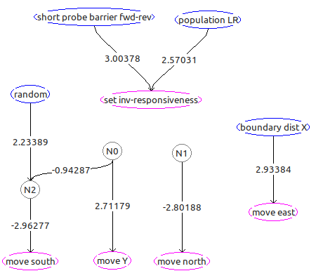
Biosim FPC translation
a story in two parts
21.01.2023, by Uwe Schächterle

Slide 2
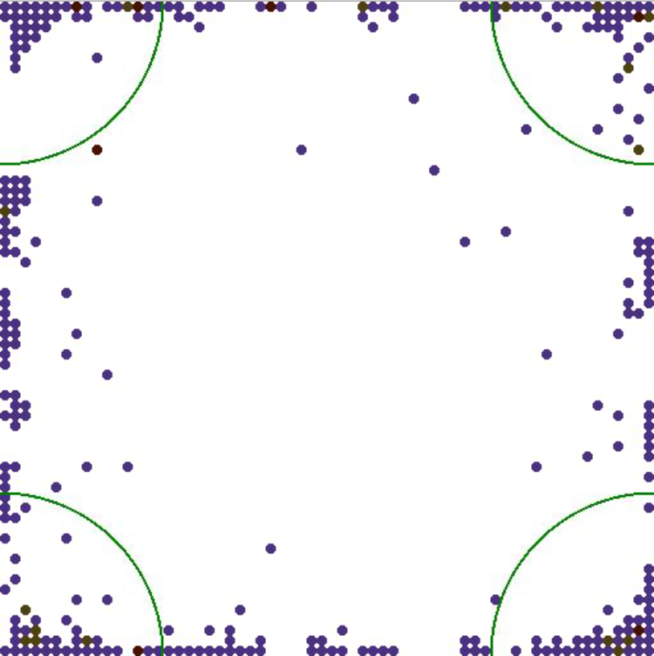
Introduction
Prequel
What Biosim is ..
Part 1: Technical aspects
Statistics
Libraries
Language specifics
Part 2: Validation and interpretation
How the code was validated
Running simulations and interpret results
Improvements compared to the original

Slide 3
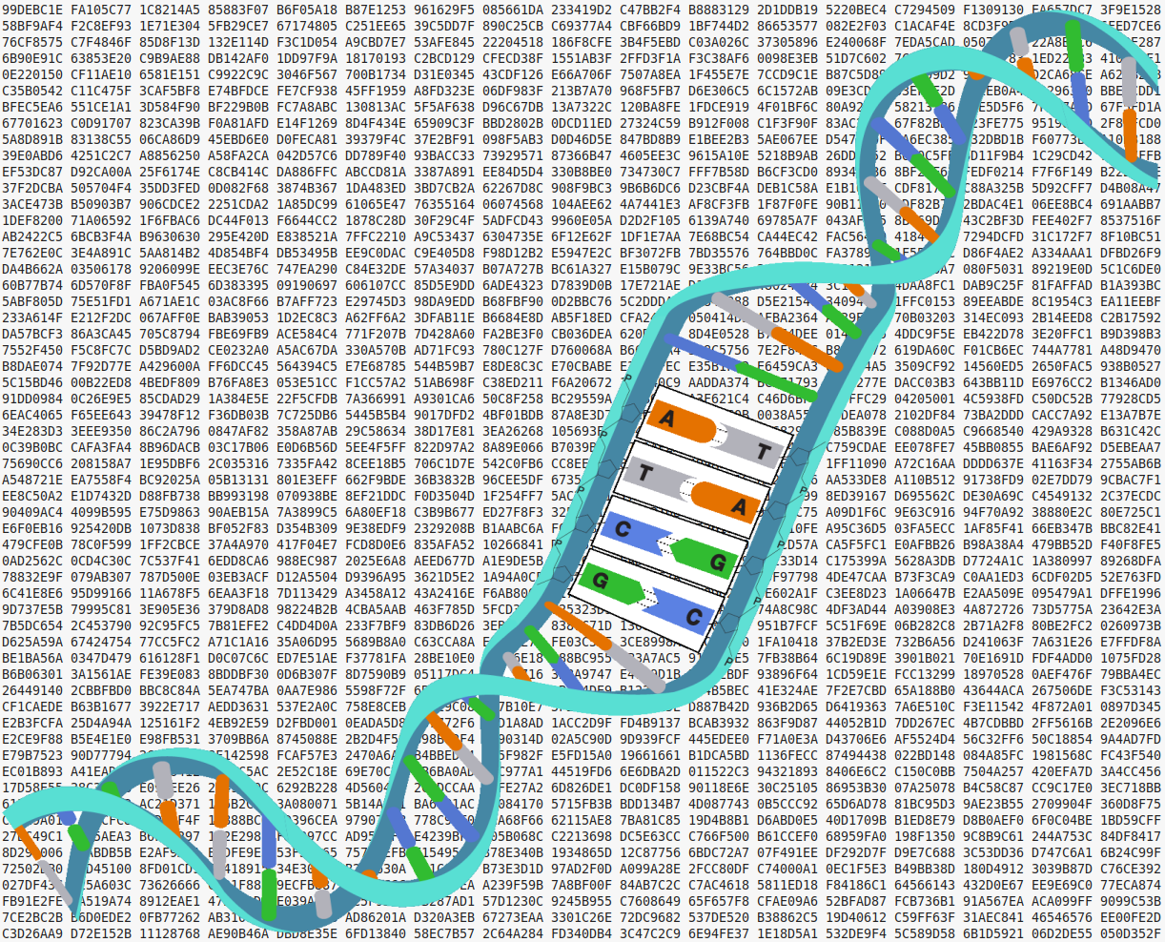
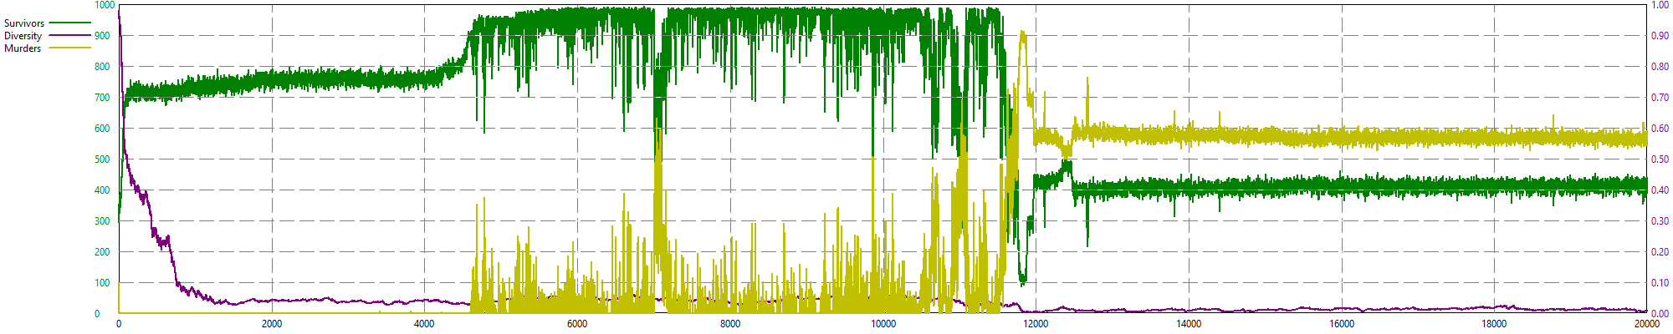
What Biosim is ..
Random
Configurable
Real
Notes:
Die Simulation von Evolution
1. Würfeln von Zufälligen Genen
2. Ableiten von Gehirnen aus diesen Genen
3. Erzeugen einer Population mit Individuen
4. Simulation von Zeit
5. Darvin, “Survival of the fittest”
6. Fortpflanzung, Natürlich und Mutation
7. 1000ende von Generationen

Slide 4
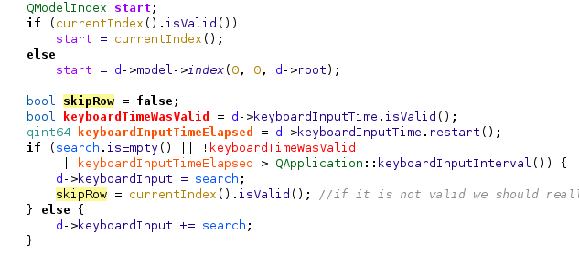
Statistics
35 C++ Files
3277 Lines of Code
Porting took approx 6 weeks (debugging another 6)
Notes:
- Code aus FPC Sicht unsinnig Strukturiert (1.h auf mehrere .c Files)
-

Slide 5
Libraries
OMP (Multithread Lib)
cimg_library (AVI Lib)
std::map (TFPGMap)
std::list (Array of)
Gnuplot

Slide 6
Language specifics
Anonymos functions
Bitwise unions
Multidimensional arrays
Structs with methods
Integer enums
Pointer over pointers
Custom random number generator
Notes:
Anonymos functions → Threadsafe kriegen ?
Bitwise unions → Gibt es so nicht, auch unsinnig
Multidimensional arrays → In C++ extrem merkwürdig in der Declaration
Structs with methods → TObject
Integer enums → mag FPC nicht, aber geht
Pointer over pointers → schlechte Lesbarkeit
Custom random number generator → gut

Slide 7
How the code was validated
1. Simple reproduce the results of the youtube video
→ Challange 6 failed
2.Modifiy the orig code to be traceable
200k tracepoints taken and compared against FPC run
Notes:
1. Ergebnisse in einfachen Dingen Reproduzierbar (trotz Bug)
2. Challange 6 nicht repruzierbar → Kantakt David Miller
* Ettliche div by 0 gefixt
* Unittests implementiert
=> Umschreiben C++ Code auf Pure C++, single Threaded→ schreiben eines Tracers
* float toleranz 0.0015
=> Bug: Sortierrichtung Parents verkehrt
-\
-/ Natur ist krass, weil es dennoch sehr gut funktionierte

Slide 8
Running simulations and interpret results

Slide 9
Improvements compared to the original
Speedup (remove redundant loadings, no exceptions)
Ability to pause / shutdown / restart
Replace Thread pool by (https://wiki.freepascal.org/Parallel_procedures)
GeneEditor
No need of external tools
More sensors (Bloc*, Always1)

