Slide 1

Factors Influencing Residential Property Sales Price Pre and Post Covid
A Machine Learning Approach predicting Residential Property Market Value in 2023
BUAN 5510 – CAPSTONE
Mansi Mahajan, Pascal Ntaganda, Jibok Park

Slide 2

Agenda
Introduction / Problem Statement
Data Sources & Data preprocessing
Statement1/Statement2
PCA
Clustering
Model Evaluation
Feature Selection
Conclusion
Recommendation, Limitation or Future Scope
Q&A

Slide 3

Problem Statement
What are the significant features impacting the Sales Price of Residential Properties pre Covid and post Covid?
2. To build a machine learning model for predicting the Total Market Value in 2023 for Residential Properties built in the last 10 years

Slide 4
Dataset Sources
 | Property Information of Pierce County¹⁾ |  |  |  | External Datasets
 |  |  |  |  | Pierce County²⁾ |  | School Digger³⁾
Problem Statement1 | Sale | Appraisal Account | Improvement | Improvement Builtas | Address Points | Schools | school score
Problem Statement2 | Tax Account ​
Property Information. | Pierce County, WA - Official Website. (n.d.). https://www.piercecountywa.gov/736/Data-Downloads
2) Address points. Pierce County WA Open GeoSpatial Data Portal (v2.1). (n.d.-a). https://gisdata-piercecowa.opendata.arcgis.com/datasets/address-points/explore
3) school score. SchoolDigger. (n.d.). https://www.schooldigger.com/go/WA/schools/0870001496/school.aspx

Slide 5
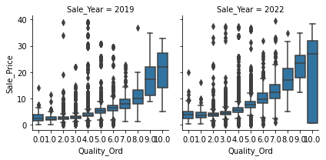
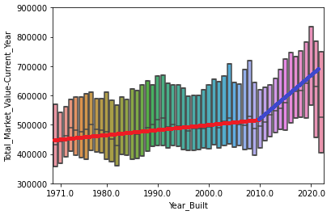
Data Exploration
Keep one attribute if Attributes are highly correlated
Sale Price in 2022 is higher than 2019 with wide range
Sale Price increased exponentially on Quality of Properties
Market Value has the different trend for the houses built recently

Slide 6
Data Preprocessing(1)
NULL Value
General
dsd
Customized
Replace Nulls with Zero
Attic Finished Square Feet, Basement Square Feet, Carport Square Feet, Balcony Square Feet, Porch Square Feet, Attached Garage Square Feet, Detached Garage Square Feet, Fireplaces
Replace Nulls with N/A
Waterfront Type, View Quality
Data Type
Nominal
Drop text such as BuildID
to Dummy: Waterfront Type, HVAC Description, etc
To Date: Appraisal Date, Sale Date, Year_Built, etc
Ordinal to Numeric: Quality, Condition, View Quality
Null Ratio | Treatment
>= 30% | drop
10<= < 30% | replace with 'N/A'
<10% | drop the rows

Slide 7
Data Preprocessing(2)
Filter down
Sales Price Data
Sale Date in 2019 & 2022
Market Value Data
Residential Properties built in 10 years
Total Market Value in 100k to 30M
Merged Datasets
Use Parcel Number for Pierce County data and the radius between school and property for school score to join tables
Sales Price Data: 11,295 observations in 2019 and 10,247 observations in 2022 with 44 attributes
Market Value Data: 17,246 and 24 attributes

Slide 8
Statement1
Sale2019 vs Sale2022

Slide 9
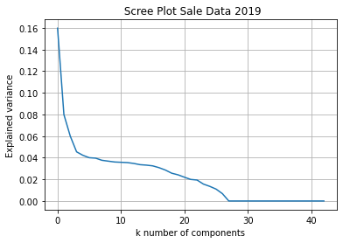
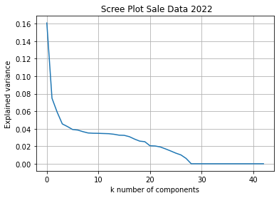
PCA
28
28
Notes:
PCA is used for dimensionality reduction, which transforms the original features into uncorrelated principal components
In Principal Component Analysis , we have used the Scree Plots which is an effective way to understand and decide how many principal components we should retain for our analysis
Principal Component Analysis (PCA) is a technique employed for dimensionality reduction. It transforms original features into uncorrelated principal components, aiding in simplifying complex datasets. To determine the optimal number of principal components for our analysis, we used Scree Plots, a valuable visualization tool.
In our analysis, a Scree Plot (refer to Fig xxx in the appendix) revealed that the variance decreases as we increase the number of components. Notably, after reaching around k=28 components, the variance plateaus. This observation led us to select k=28 as the appropriate number of components for our subsequent analysis.
Addressing our first problem statement, we sought to identify key features influencing Residential property Sales Prices, both pre and post Covid. Feature selection is vital for pinpointing relevant features and their importance values. This process grants insights into changes in feature significance between the Pre-Covid and Post-Covid eras.
A noteworthy point is that higher model accuracy enhances the reliability of feature importance measures and their interpretations. For Sales data in 2019, the Random Forest Regressor identified significant features including 'Land Net Square Feet', 'Quality', 'Porch Square Feet', 'Attached Garage Square Feet', 'Built-As Square Feet', 'Physical Age', 'ZipCode', and 'Average School Score'.
In the case of 2022 Sales data, the important features encompass 'Land Net Square Feet', 'Quality', 'Porch Square Feet', 'Attached Garage Square Feet', 'Fireplaces', 'Built-As Square Feet', 'HVAC Description', 'Bedrooms', 'Physical Age', 'ZipCode', and 'Average School Score'.
By employing PCA and meticulous feature selection, we gain a deeper understanding of the dynamics driving Residential property Sales Prices, enabling us to draw meaningful insights from our analysis.

Slide 10
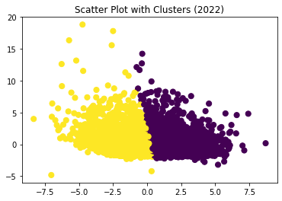
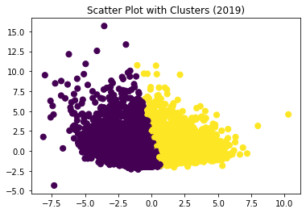
Clustering
K-Means Clustering
Guarantees convergence
Group data with similar characteristics
Silhouette score metric
Range of score: -1 to 1
The closer to 1 the better clustering
K-means Clustering
Data | Silhouette Score | Numbers of Records
 |  | Cluster 1 | Cluster 2
Sales Data 2019 | 0.44 | 5077 | 6108
Sales Data 2022 | 0.45 | 5399 | 4729

Slide 11
2019 Cluster Results
Clustering Results (Feature Importance/PCA): Sales Dataset 2019
Feature Importance: Evaluation Metric: R Squared
Model | Cluster 1 | Cluster 2 | Weighted Average
Random Forest Regressor | 0.93 | 0.78 | 0.88
Gradient Boosting Regressor | 0.87 | 0.75 | 0.82
Principle Component Analysis: Evaluation Metric: R Squared
Random Forest Regressor | 0.75 | 0.82 | 0.78
Gradient Boosting Regressor | 0.74 | 0.78 | 0.76
Neural Network | 0.60 | 0.68 | 0.77
Clustering Results: Sales Dataset 2019
Evaluation Metric: R Squared
Model | Cluster 1 | Cluster 2 | Weighted Average
Random Forest Regressor | 0.87 | 0.91 | 0.89
Gradient Boosting Regressor | 0.93 | 0.87 | 0.90
Neural Network | 0.75 | 0.80 | 0.77

Slide 12
2022 Cluster Results
Clustering Results (Feature Importance/PCA): Sales Dataset 2022
Feature Importance: Evaluation Metric: R Squared
Model | Cluster 1 | Cluster 2 | Weighted Average
Random Forest Regressor | 0.76 | 0.70 | 0.72
Gradient Boosting Regressor | 0.70 | 0.65 | 0.67
PCA: Evaluation Metric: R Squared
Random Forest Regressor | 0.72 | 0.77 | 0.75
Gradient Boosting Regressor | 0.75 | 0.73 | 0.72
Neural Network | 0.61 | 0.62 | 0.60
Clustering Results: Sales Dataset 2022
Evaluation Metrics: R Squared
Model | Cluster 1 | Cluster 2 | Weighted Average
Random Forest Regressor | 0.75 | 0.82 | 0.77
Gradient Boosting Regressor | 0.77 | 0.81 | 0.76
Neural Network | 0.70 | 0.81 | 0.75

Slide 13
Unclustered Results
All models relatively did well for both years
PCA application reduced model fit.
2019: RFM stood-out
2022: GBR stood-out
Results for Sales Dataset 2019
Evaluation Metric: R Squared
Model | With All Features | Feature Selection | PCA
Random Forest Regressor | 0.90 | 0.90 | 0.82
Gradient Boosting Regressor | 0.89 | 0.89 | 0.80
Neural Network (With Hyperparameter Tuning) | 0.80 |  | 0.72
Results for Sales Dataset 2022
Evaluation Metric: R Squared
Model | With All Features | Feature Selection | PCA
Random Forest Regressor | 0.87 | 0.88 | 0.80
Gradient Boosting Regressor | 0.88 | 0.89 | 0.83
Neural Network (With Hyperparameter Tuning) | 0.82 |  | 0.70

Slide 14
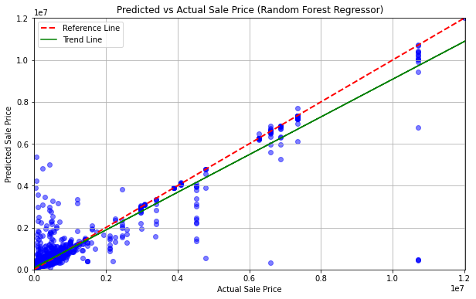
2019 Sales Data Prediction

Slide 15
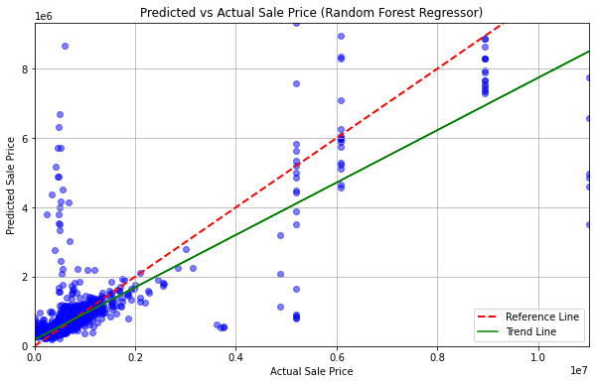
2022 Sales Data Prediction

Slide 16
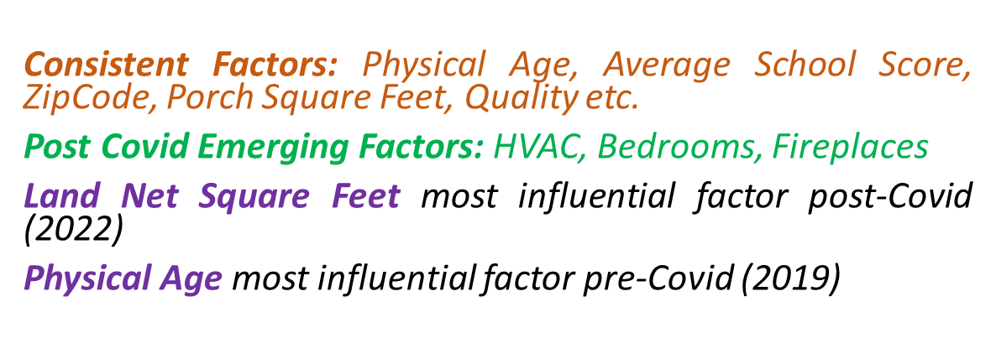
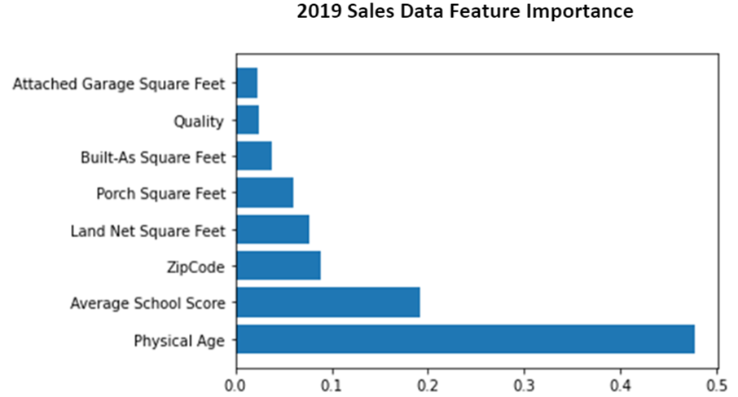
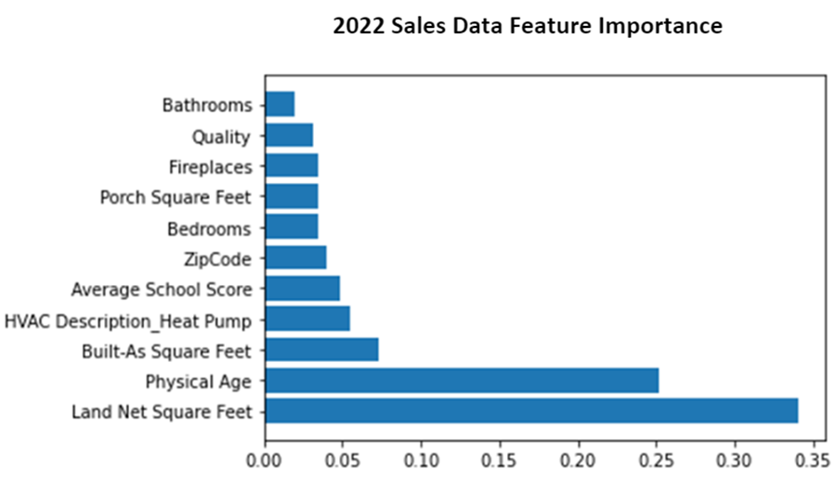
Feature Importance Analysis:

Slide 17

Problem 1 Conclusion:
Analyzing significant factors influencing residential property sales prices pre and post Covid
Random Forest and Gradient Boosting Regressor outperformed other models.
Utilized Feature Importance to understand key factors pre & post-Covid
Consistent Factors: Physical Age, Average School Score, ZipCode, porch square feet, quality etc.
Post Covid Emerging Factors: HVAC, Bedrooms, Fireplaces
Emerging and traditional factors reshape real estate in response to evolving needs.

Slide 18
Statement2
Market Value Prediction

Slide 19
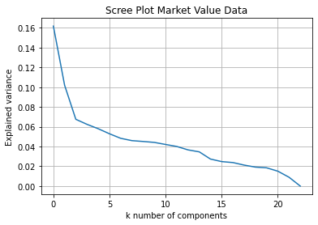
PCA
Notes:
PCA is used for dimensionality reduction, which transforms the original features into uncorrelated principal components
In Principal Component Analysis , we have used the Scree Plots which is an effective way to understand and decide how many principal components we should retain for our analysis
Principal Component Analysis (PCA) is a technique employed for dimensionality reduction. It transforms original features into uncorrelated principal components, aiding in simplifying complex datasets. To determine the optimal number of principal components for our analysis, we used Scree Plots, a valuable visualization tool.
In our analysis, a Scree Plot (refer to Fig xxx in the appendix) revealed that the variance decreases as we increase the number of components. Notably, after reaching around k=28 components, the variance plateaus. This observation led us to select k=28 as the appropriate number of components for our subsequent analysis.
Addressing our first problem statement, we sought to identify key features influencing Residential property Sales Prices, both pre and post Covid. Feature selection is vital for pinpointing relevant features and their importance values. This process grants insights into changes in feature significance between the Pre-Covid and Post-Covid eras.
A noteworthy point is that higher model accuracy enhances the reliability of feature importance measures and their interpretations. For Sales data in 2019, the Random Forest Regressor identified significant features including 'Land Net Square Feet', 'Quality', 'Porch Square Feet', 'Attached Garage Square Feet', 'Built-As Square Feet', 'Physical Age', 'ZipCode', and 'Average School Score'.
In the case of 2022 Sales data, the important features encompass 'Land Net Square Feet', 'Quality', 'Porch Square Feet', 'Attached Garage Square Feet', 'Fireplaces', 'Built-As Square Feet', 'HVAC Description', 'Bedrooms', 'Physical Age', 'ZipCode', and 'Average School Score'.
By employing PCA and meticulous feature selection, we gain a deeper understanding of the dynamics driving Residential property Sales Prices, enabling us to draw meaningful insights from our analysis.

Slide 20
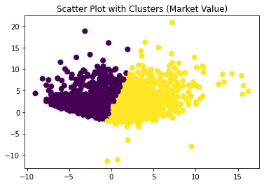
Clustering
K-means Clustering
Data | Silhouette Score | Numbers of Records
 |  | Cluster 1 | Cluster 2
Market Value | 0.48 | 8278 | 9009

Slide 21
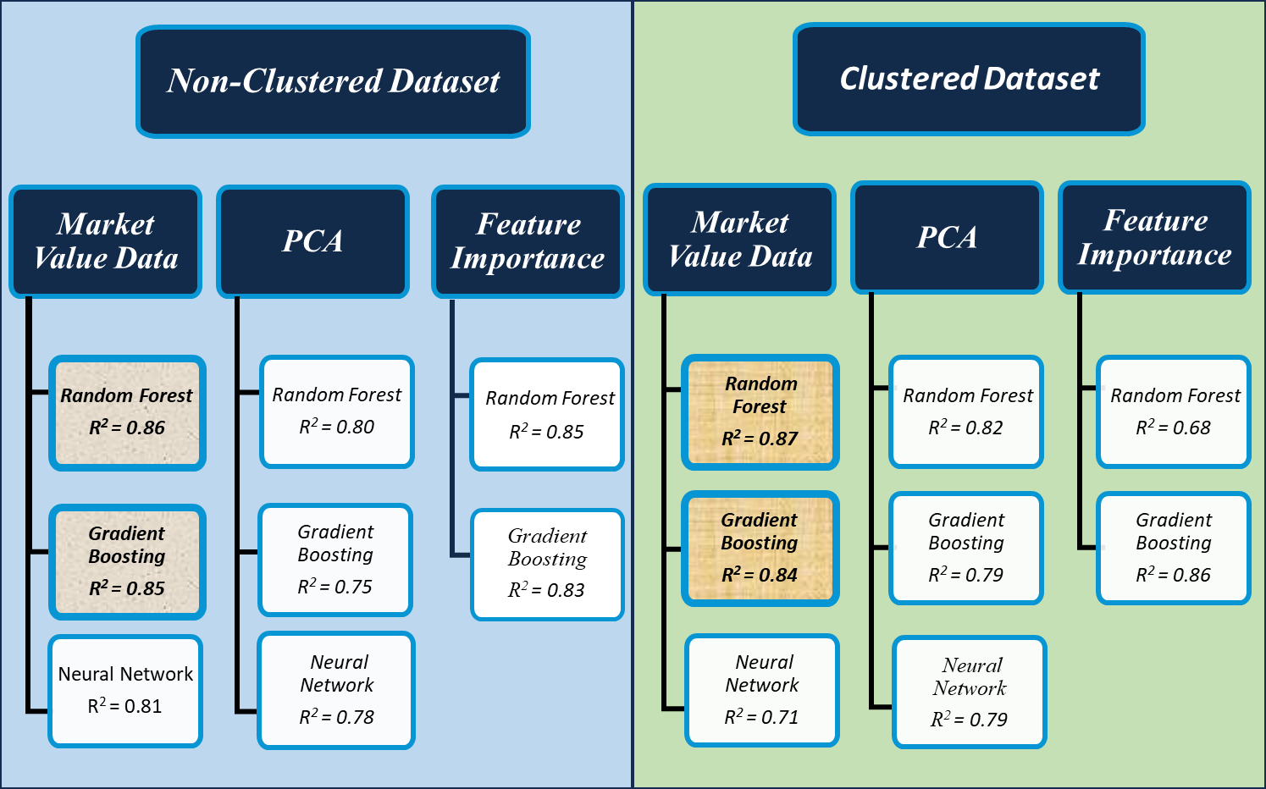
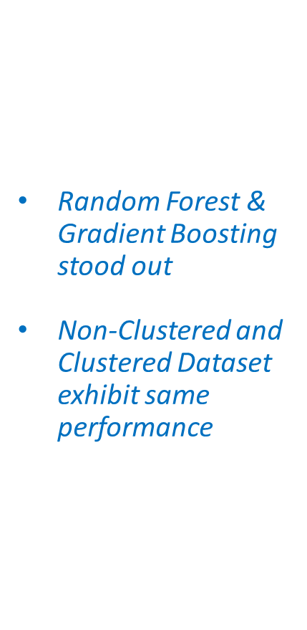
Model Evaluation (Market Value Prediction)

Slide 22
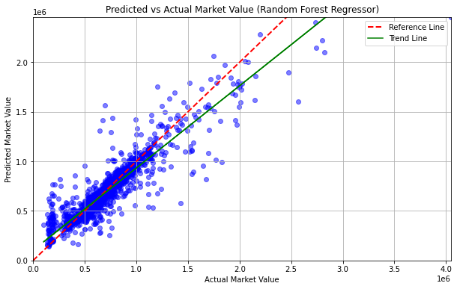
Random Forest Prediction

Slide 23
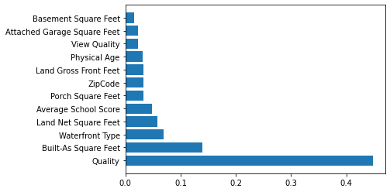
Market Value Feature Importance:
Quality is the most important feature
Average School score holds significant importance

Slide 24
Problem 2 Conclusion:
Random Forest and Gradient Boosting models consistently stood-out.
87% of the variability in Market Value is effectively captured by the model's selected variables.
Model's robust ability to provide accurate predictions
Key feature is property Quality.
School ratings continue to hold significance.
* Considered houses built in last 10 years.

Slide 25

Recommendations and Future Scope
Explore additional community variables from the Pierce County
Incorporate demographic information about homeowners as potential features
Address constraints such as computation power to handle larger dataset sizes and complex machine learning model deployments.
Expand the scope of variables and temporal resolution of the dataset
Investigate advanced techniques for overcoming computation limitations and optimizing model performance.
Collaborate with other research domains to explore interdisciplinary insights and potential applications.

Slide 26

Q & A

