Slide 1


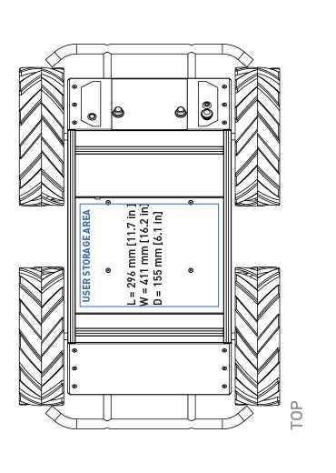
Fixed Audio Source
Search Point
Bounding Box

Slide 2

Dynamic Audio Source
Search Point
Bounding Box

Slide 3
Fixed Audio Source
Search Point
Bounding Box

Slide 4
Fixed Audio Source
Search Point
Bounding Box

