Slide 1

Implementing an Auditory Interface to Reduce Visual Overload For Teleoperation in Virtual Environments
Department of computer science
Comp0132: Robotics and computation project and dissertation
Pascal Weiliam Li Poo Kim
Supervisors:
Dr. Vijay Pawar
Mr. Harvey Stedman

Slide 2










Definition of Teleoperation
Teleoperation is a term used for the remote operation of a robot/machine/system controlled by a human operator.
Human
Operator
Interface
Slave side: Physical or Virtual
Communication
Channel
Command
Signals
Sensor
Information
Master Control

Slide 3
Importance
Extraplanetary Exploration (Mars Rovers), Military Missions (reconnaissance, removing hazardous materials), Search and Rescue Operations (survivors of calamities)
Autonomous systems may face difficult problems in terms of tasks, terrains or situations that need teaming up with humans and that cannot be done alone.
Paramount to design a human-machine interface to maximize information while minimizing cognitive load.
Better situational awareness, greater immersion and reduced confusion.

Slide 4
Challenges
Teleoperation is facing increasingly complicated scenarios and refined tasks.
Latency which can cause degraded visual image/feedback or delayed control command.
Improper user-interface or feedback and thus limited information.
Motion sickness, Cognitive overload.

Slide 5
Background
Project is focused on auditory feedback couped with a visual display in VE for navigation.
Advantages over visual feedback:
Decreases visual workload.
Requires low-bandwidth communication links.
No significant information losses during congested network.
Require less computational power.

Slide 6



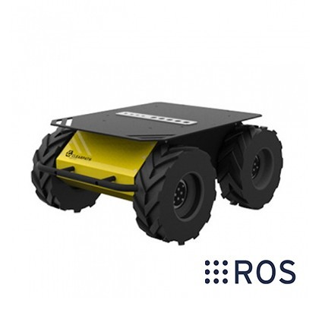
Main Tools
ROS Bridge
“Rosbridge provides a simple, socket-based programmatic access to robot interfaces and algorithms provided by ROS [1]”
Rendering and Interface side
Husky A200 UGV mobile base
Processing sensor information and ground truth environment

Slide 8
Hypothesis and Expectations

Slide 9
References
http://www.isrr-2011.org/ISRR-2011/Program_files/Papers/Jenkins-ISRR-2011.pdf

