Slide 1
Let the Tensors Flow!
An introduction to Google's Deep-Learning Framework
Pascal Pompey
Research Engineer,
Predictive analytics
IBM Dublin Research Laboratory
Pascal.pompey@gmail.com

Slide 2
Menu
Come on! Turn to the deep side of learning!
Why Tensorflow?
Tensorflow's main concepts
  Hello world application
  Standard NN application
BREAK!!! May the beer be with you!
Recap
Recommended architecture of tensor flow projects
SNLI

Slide 3
Menu
Deep learning: A new hope
  Come on! Turn to the deep side of learning!
  Why Tensorflow?
  Tensorflow's main concepts
  Hello world application
  Standard NN application
BIKE ACCIDENT, Wait for episode 2

Slide 4
Come on! Turn to the deep-side of learning
Notes:
Can't make a presentation on a deep-learning framework without justifying deep-learning
Explain some of the fundamental strength of the deep-learning approach

Slide 5
Come on! Turn to the deep-side of learning
Why deep learning?
Historical context
  Machine-learning & Data-mining
    Bits and pieces to solve different problem
  Data-science:
    Solving complex problems
    Many data-sources, unstructured-data
Requirements of data-science
  Integrate heterogeneous data-sources
  Explore and generate complex feature spaces
  Integrate many different techniques together in a single pipeline
  Consolidate methods and workflows

Slide 6
Come on! Turn to the deep-side of learning
Why deep learning?
Historical context
  Machine-learning & Data-mining
    Bits and pieces to solve different problem
  Data-science:
    Solving complex problems
    Many data-sources, unstructured-data
Requirements of data-science
  Integrate heterogeneous data-sources
  Explore and generate complex feature spaces
  Integrate many different techniques together in a single pipeline
  Consolidate methods and workflows

Slide 7
Complex data-science applications
How it used to be done before
Data-flows: Different frameworks
Learning: Different algorithms
Programming: Different libraries / languages
R
Sklearn
DB
R
Hadoop
Map-reduce
Spark
HDFS

Slide 8
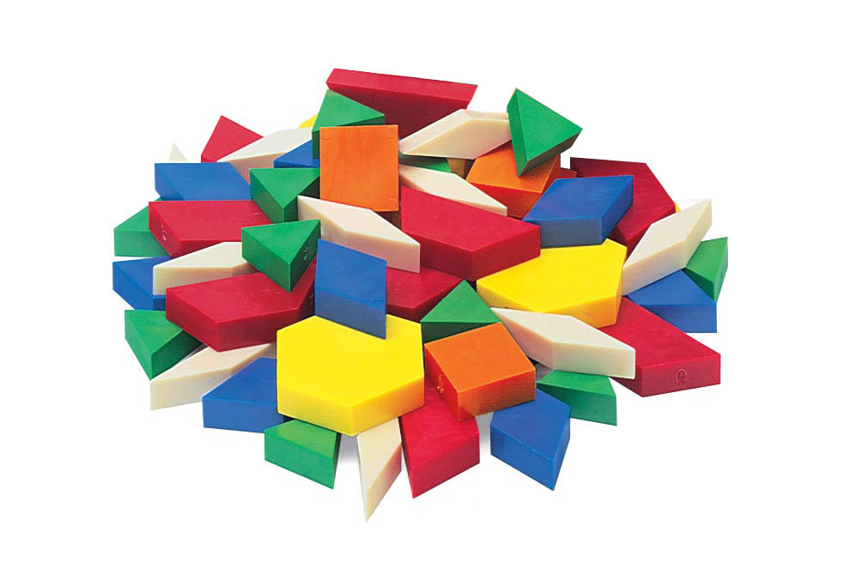
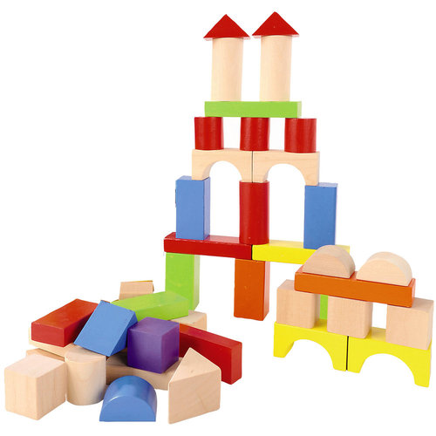
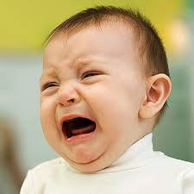
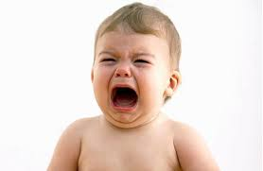
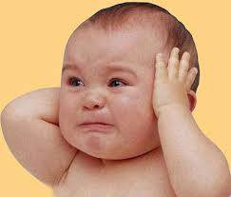
Complex data-science applications
How it used to be done before

Slide 9
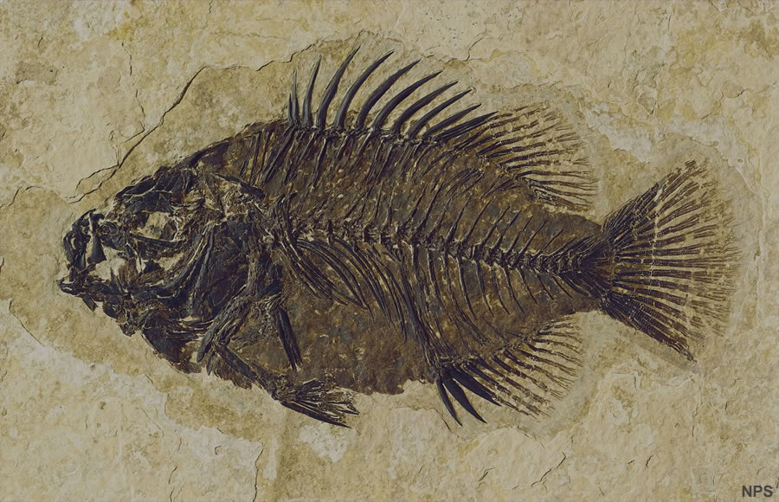

Complex data-science applications
How it used to be done before

Slide 10
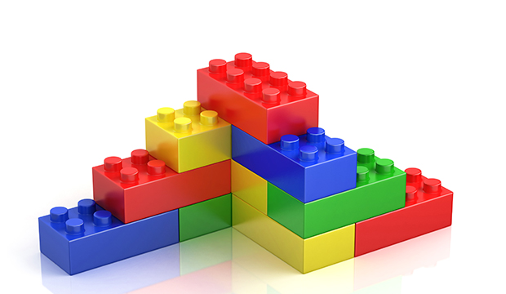
The Lego idea

Slide 11
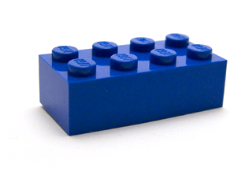
Specification of a data-science lego block
Needs to be able to learn anything
Needs to be able to fit in an encompassing learning problem
Needs to scale horizontally for processing and learning

Slide 12
Deep-Learning and Lego
Neural Network: Universal approximator
Back-propagation: ties it all together

Slide 13
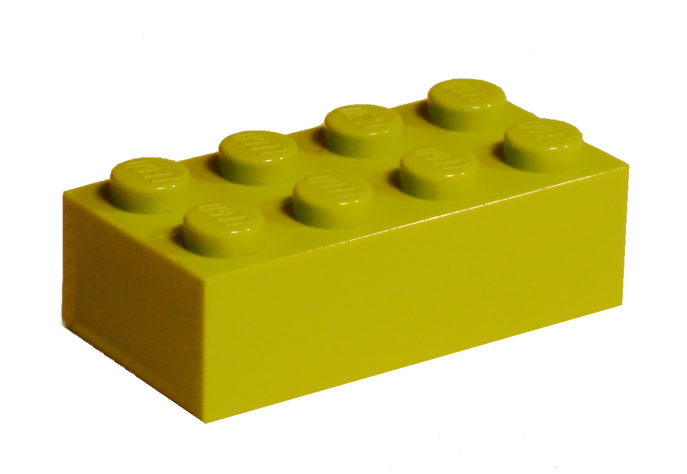
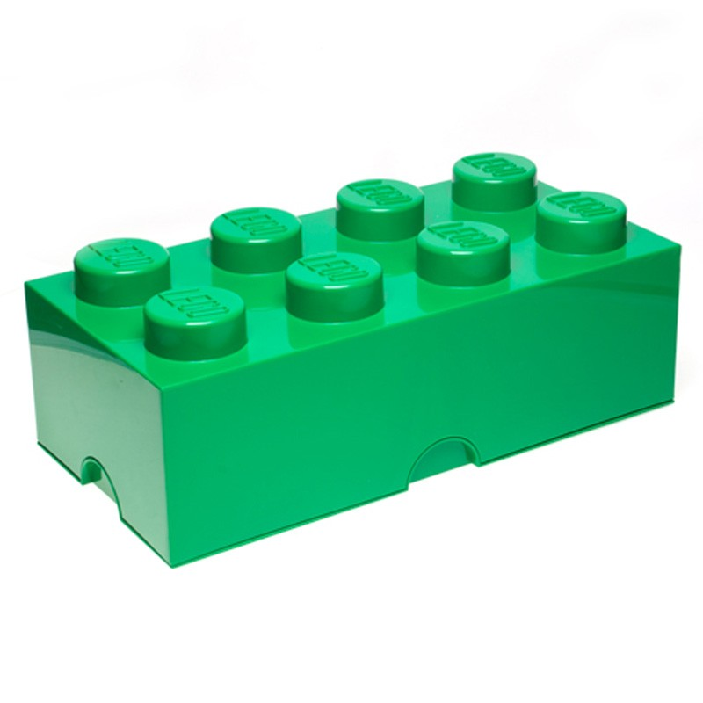
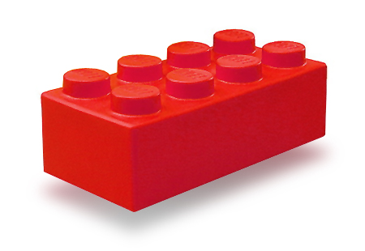
Deep learning and lego
Image descriptor
ConvNet
Language-model
(lstm)
ConvNet
NER
Word- embedding
Auto-encoder

Slide 14
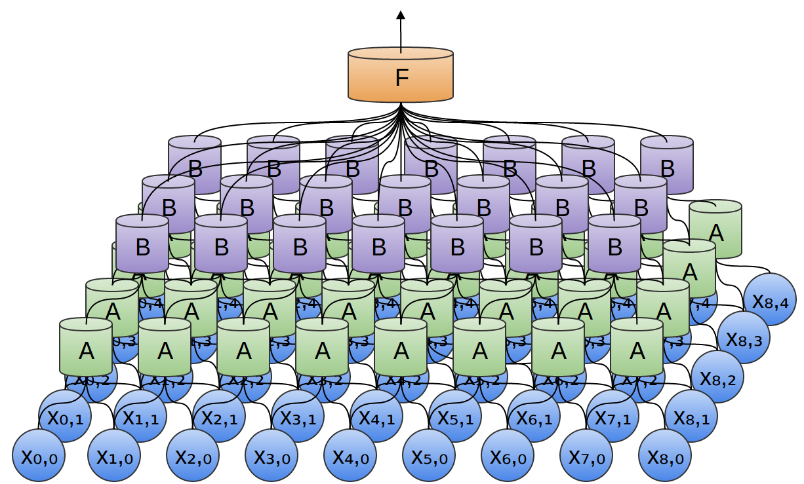
The Lego idea
Deep-learning implements the lego interface

Slide 15
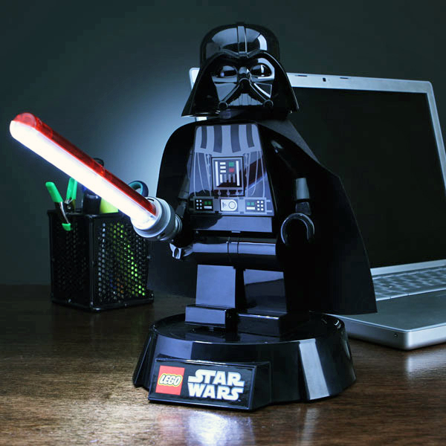
Deep-Learning and Lego
Neural Network: Universal approximator
Back-propagation: ties it all together
Come on!
Turn to the deep side
of learning!

Slide 16
Why Tensor-Flow?

Slide 17
Deep-learning libraries classified
Deep-Learning
Frameworks
Programmatic
Property
Based
Lua
Python
Java
Caffee
Torch
(distributed)
Theano
Tensor Flow
(distributed)

Slide 18
Deep-learning libraries classified
Deep-Learning
Frameworks
Programmatic
Property
Based
Lua
Python
Java
Caffee
Torch
(distributed)
Theano
Tensor Flow
(distributed)

Slide 19
The Tensor-Flow school of deep-learning
Underpinning concepts of tensor-flow

Slide 20
What are tensors?
Double: 3.14159..
Vector: [1.0, 2.0, 3.0, 5.0, 8.0, 13.0, …]
  e.g. time-series
Matrix: [ [1, 2], [1, 4], [1, 8], [1, 16], ... ]
  e.g. images
Tensor: [ [matrix], [matrix], [matrix], [matrix] ]
  e.g. list of images

Slide 21
Why tensors?
What are tensors?
Double: 3.14159..
Vector: [1.0, 2.0, 3.0, 5.0, 8.0, 13.0, …]
  e.g. time-series
Matrix: [ [1, 2], [1, 4], [1, 8], [1, 16], ... ]
  e.g. images
Tensor: [ [matrix], [matrix], [matrix], [matrix] ]
  e.g. list of images
Tensor of rank r, shape [d1, d2, …]
  You get the idea
Tensor of rank 0, shape []
Tensor of rank 1, shape [n]
Tensor of rank 2, shape [n, m]
Tensor of rank 3, shape [n, m,k]
Tensors are defined by a shape and a type
Tensors are the main data-structure holding data in tensor flow
Notes:
Tensors replace the data-frame thinking
Tensor flows puts the emphasis on data flows more than data-frame values

Slide 22
Why tensors?
What are tensors?
Double: 3.14159..
Vector: [1.0, 2.0, 3.0, 5.0, 8.0, 13.0, …]
  e.g. time-series
Matrix: [ [1, 2], [1, 4], [1, 8], [1, 16], ... ]
  e.g. images
Tensor: [ [matrix], [matrix], [matrix], [matrix] ]
  e.g. list of images
Tensor of rank r, shape [d1, d2, …]
  You get the idea
Tensor of rank 0, shape []
Tensor of rank 1, shape [n]
Tensor of rank 2, shape [n, m]
Tensor of rank 3, shape [n, m,k]
Tensors are defined by a shape and a type
Tensors are the main data-structure holding data in tensor flow
Notes:
Tensors replace the data-frame thinking
Tensor flows puts the emphasis on data flows more than data-frame values

Slide 23
Ingredients of data-science applications
Hyper-
parameters
Data
Data-Science
Application
Model
Parameters
Pipeline
Optimization
Problem
Results

Slide 24
Let's do it!
Sessions + data-dictionary + placeholders
“Hello data!” in tensorflow

Slide 25
Defining inputs in tensor flow
Placeholders = source of the flow
Data
Hyper-
parameters
Placeholders
Data-Science
Application
Model
Parameters
Pipeline
Optimization
Problem
Results
application_input = tf.placeholder( name='..', dtype=tf.int32, shape=(..) )

Slide 26
Passing data to applications
Data-dictionary
Data-Dictionary
Data
Hyper-
parameters
Placeholders
Data-Science
Application
Model
Parameters
Pipeline
Optimization
Problem
Results
feed_dict = {placeholder_variable : values}

Slide 27
Outputting data in tensor flow
Session.run() returns target tensors
Session.run()
Session
Data-Dictionary
Data
Hyper-
parameters
Placeholders
Data-Science
Application
Model
Parameters
Pipeline
Optimization
Problem
Results
retrieved_tensor = session.run(tensors_to_retrieve, feed_dict)

Slide 28
Running applications in tensorflow:
Session
Session.run()
Session
Data-Dictionary
Data
Hyper-
parameters
Placeholders
Data-Science
Application
Model
Parameters
Pipeline
Optimization
Problem
Results
A defined application is run in a session object

Slide 29
Let's do it!
Sessions + data-dictionary + placeholders
“Hello data!” in tensorflow

Slide 30
Defining processing pipelines
Session.run()
Session
Data-Dictionary
Data
Hyper-
parameters
Placeholders
Data-Science
Application
Model
Parameters
Variables
Pipeline
Optimization
Problem
Tensors
Tensors operations
Results
The application graph is where intermediary data (tensors) intertwines with model variables

Slide 31
Defining variables in tensorflow
Warnings:
  tensorflow picky about variables types
  Variables are attached to a session
  Variables MUST be initialized before starting using
    init = tf.initialize_all_variables()
    session.run(init)

Slide 32
Let's do it!
Sessions + data-dictionary + placeholders
+
Tensors + variables
Logistic-regression in tensorflow

Slide 33
Actually learning something
Defining loss and optimizer
Session.run()
Session
Data-Dictionary
Data
Hyper-
parameters
Placeholders
Data-Science
Application
Model
Parameters
Variables
Pipeline
Optimization
Problem
Tensors
Tensors operations
Non-linear functions
Training Optimizers
Losses / Reductions
Results
Defining a loss and adding a training operation enables to define an optimization problem

Slide 34
Let's run it!
Sessions + data-dictionary + placeholders
&
Tensors + variables
&
Loss + optimizer
Logistic-regression in tensorflow

Slide 35
Comparison point
Tensorflow & scikit-learn
Tensorflow
Full fledged optimization routine
SGD based
Requires definition of optimization problem
Designed to scale
Scickit-learn
Out-of-box ML library
Dedicated optimizer
Just use the fit() and predict() methods
Designed to be user-friendly

Slide 36
Phases of data-science applications
Definition
Training
Scoring
Hyper-
parameters
Data
Data-Science
Application
Model
Parameters
Pipeline
Optimization
Problem
Results

Slide 37
Shall I use deep-learning / tensorflow?
Application is complex
Data is
  Highly dimensional
  Plenty
Feature space is:
  Complex
  Huge
Application is simple
Data is
  Concise
  Small
Feature space is:
  Intuitive
  Simple
YES!
NO!
Don't use a sledgehammer to kill a fly.

Slide 38
Defining a neural network
Our basic lego block
Session.run()
Session
Data-Dictionary
Data
Hyper-
parameters
Placeholders
Data-Science
Application
Model
Parameters
Variables
Pipeline
Optimization
Problem
Tensors
Tensors operations
Non-linear functions
Results

Slide 39
Let's do it!
Sessions + data-dictionary + placeholders
+
Tensors + variables + NN operations
Mnist in tensorflow

Slide 40
The process of deep-learning
Training
Validation
Test
Split
Your
Data
Define
your network
Define your
loss criterion
&
Optimizer
Run epoch
Accuracy
improved?
Validate /
Track your
accuracy
Test

Slide 41
Hyper-parameters tunning
Session.run()
Session
Data
Dimensionality
Regularization
Dropouts
Data-Dictionary
Hyper-
parameters
Placeholders
Data-Science
Application
Model
Parameters
Variables
Pipeline
Optimization
Problem
Tensors
Tensors operations
Non-linear functions
Training Optimizers
Losses / Reductions
Results
Defining a loss and adding a training operation enables to define an optimization problem

Slide 42

Hyper-parameters tuning
It's a trap!

Slide 43
Recommended structure of a deep-learning application

Slide 44
Ingredients of data-science applications
Dimensionality
Regularization
Dropouts
Hyper-
parameters
Data-Dictionary
Placeholders
Data
Data-Science
Application
Model
Parameters
Variables
Tensors
Tensors operations
Pipeline
Optimization
Problem
Training Optimizers
Losses / Reductions
Results

Slide 45
Outputting data in tensor flow
Session.run() returns target tensors
Session.run()
Session
Data
Dimensionality
Regularization
Dropouts
Data-Dictionary
Hyper-
parameters
Placeholders
Data-Science
Application
Model
Parameters
Variables
Tensors
Tensors operations
Pipeline
Optimization
Problem
Training Optimizers
Losses / Reductions
Results

Slide 46
Why would google open-source TensorFlow?
One Framework to rule them all, One Framework to find them,
One Framework to bring them all and in deep-learning bind them

Slide 47
End of presentation

