Slide 1
Open Source Tools & Scripting at & crontab
Author : Sun Qiang
Student Number: 21804416

Slide 2
What ’at’ & ‘crontab’ for?
at:
Executes a command once on a particular time.
crontab:
Run shell commands periodically on a given schedule

Slide 3
At
Usage:
at [-V] [-q x] [-f file] [-mMlbv] timespec ...
at [-V] [-q x] [-f file] [-mMlbv] -t time
at -c job ...
atq [-V] [-q x]
at [ -rd ] job ...
atrm [-V] job ...
batch

Slide 4
Examples
at –V
at –q x
at -m
at –M
at –l
at -v
at –f file
at –t
at –r
at –d
at –c
at rm
atq
batch
Show the version
Specify the name for the task, valid name from a-zA-Z
Send mail to the user after job finished even if there was no output.
Never send mail, so, never notify the user
Running at -l is the same as running atq; it displays all queued at jobs.
Shows the time the job will be executed before reading the job.
Reads the job from file rather than standard input.
Run the job at time, given in the format [[CC]YY]MMDDhhmm[.ss].
Is the same as running atrm. It removes a job from the at queue.
Is the same as running atrm. It removes a job from the at queue.
cats the jobs listed on the command line to standard output.
Delete jobs
Show the list of jobs
To execute a one-time task when the load average is below 0.8

Slide 5
Single Line & Multi-lines
Single Line
at -f test.sh now + 10 minutes
Multi-lines
at now + 10 minutes
at > echo ‘hello’ > 1.txt
Ctrl + D

Slide 6
Time Format
the expression: | would translate to:
noon | 12:00 PM October 18 2014
midnight | 12:00 AM October 19 2014
teatime | 4:00 PM October 18 2014
tomorrow | 10:00 AM October 19 2014
noon tomorrow | 12:00 PM October 19 2014
next week | 10:00 AM October 25 2014
next monday | 10:00 AM October 24 2014
fri | 10:00 AM October 21 2014
NOV | 10:00 AM November 18 2014

Slide 7
Time Format
9:00 AM | 9:00 AM October 19 2014
2:30 PM | 2:30 PM October 18 2014
1430 | 2:30 PM October 18 2014
2:30 PM tomorrow | 2:30 PM October 19 2014
2:30 PM next month | 2:30 PM November 18 2014
2:30 PM Fri | 2:30 PM October 21 2014
2:30 PM 10/21 | 2:30 PM October 21 2014
2:30 PM Oct 21 | 2:30 PM October 21 2014
2:30 PM 10/21/2014 | 2:30 PM October 21 2014
2:30 PM 21.10.14 | 2:30 PM October 21 2014

Slide 8
Time format
now + 30 minutes | 10:30 AM October 18 2014
now + 1 hour | 11:00 AM October 18 2014
now + 2 days | 10:00 AM October 20 2014
4 PM + 2 days | 4:00 PM October 20 2014
now + 3 weeks | 10:00 AM November 8 2014
now + 4 months | 10:00 AM February 18 2015
now + 5 years | 10:00 AM October 18 2019
Another kind of format
-t [[CC]YY]MMDDhhmm[.ss] -t 201611010303.11

Slide 9
Crontab
The crontab is a list of commands that you want to run on a regular schedule, and also the name of the command used to manage that list.
usage:
crontab [-u user] file
crontab [ -u user ] [ -i ] { -e | -l | -r }
(default operation is replace, per 1003.2)
-e (edit user's crontab)
-l (list user's crontab)
-r (delete user's crontab)
-i (prompt before deleting user's crontab)

Slide 10
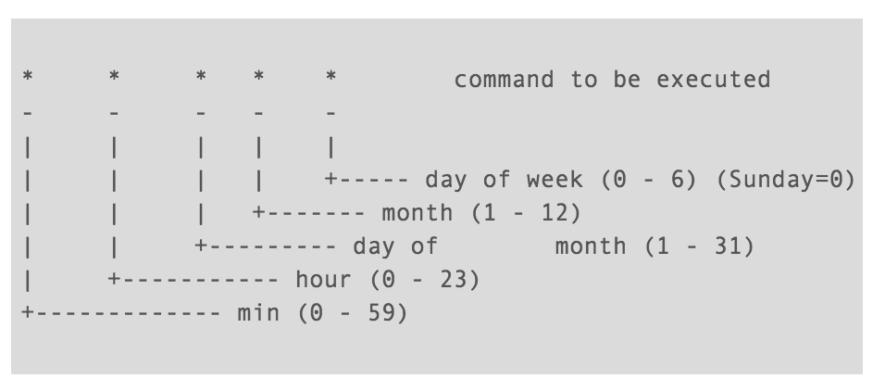
Basic Format

