Slide 1
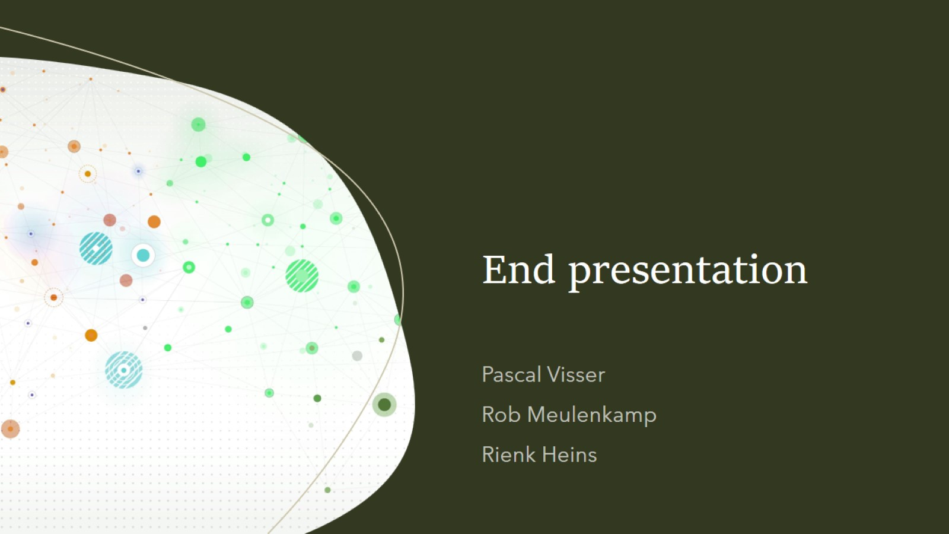
End presentation

Slide 2


Goal of the project
Create an algorithm that can determine the degradation of bioplastics
Create an app and pipeline to make it user-friendly

Slide 3
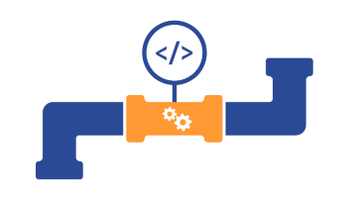
Created products this sprint: - Pipeline with HBDSCAN algorithm - Application

Slide 4
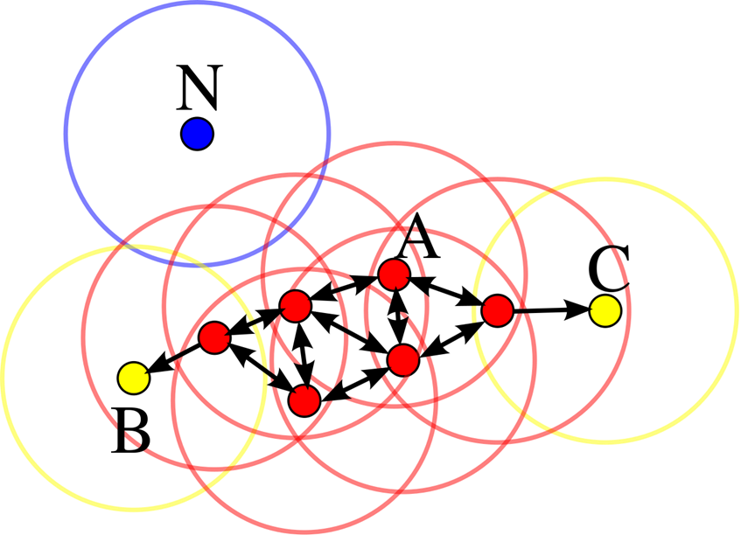
HDBcluster algorithm
Checks size of input data
If size is to big, random samples a set number of points
Select FSC and SSC columns
Replace all NAs with columns mean
Log2 transform data
Preform density-based clustering with NumOfPts
Return plot with clusters and statistics

Slide 5
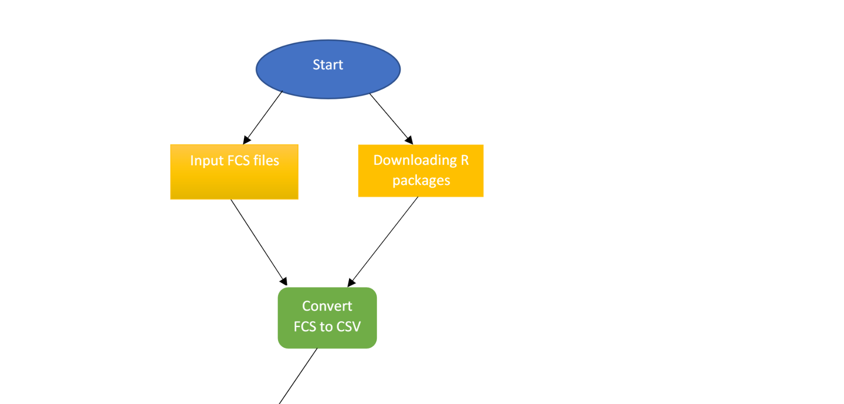
The pipeline

Slide 6

The pipeline

Slide 7
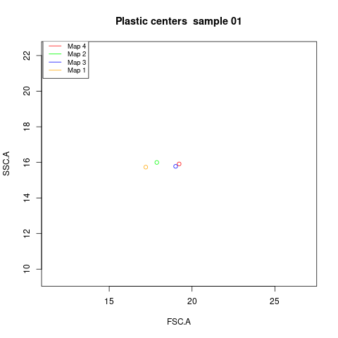

Slide 8

The application

Slide 9
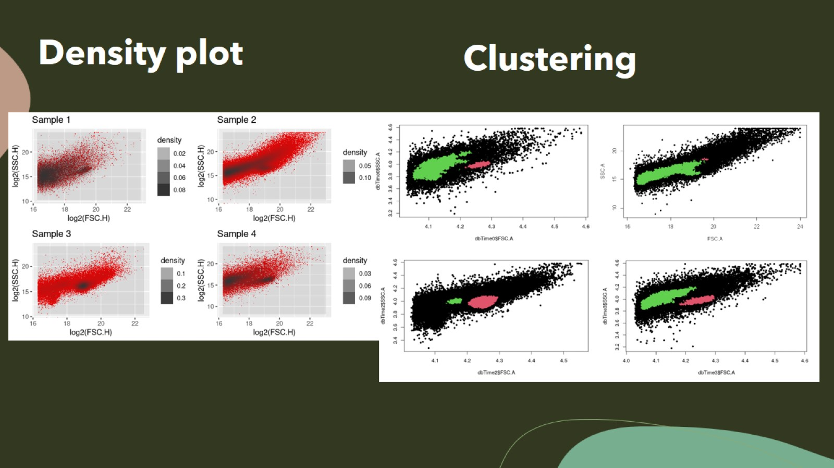
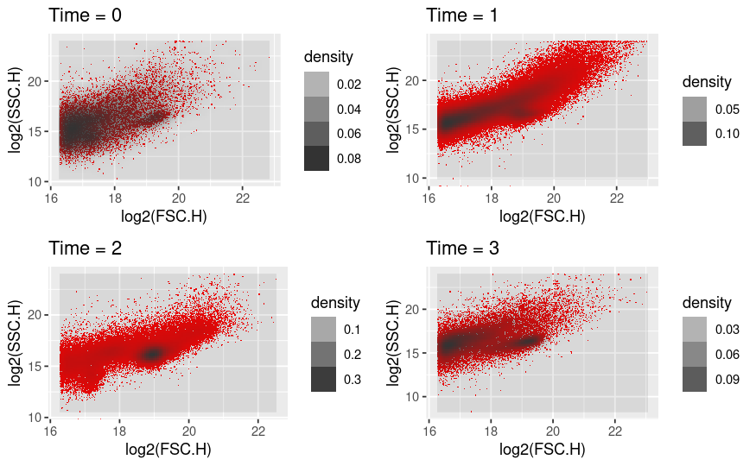

Slide 10
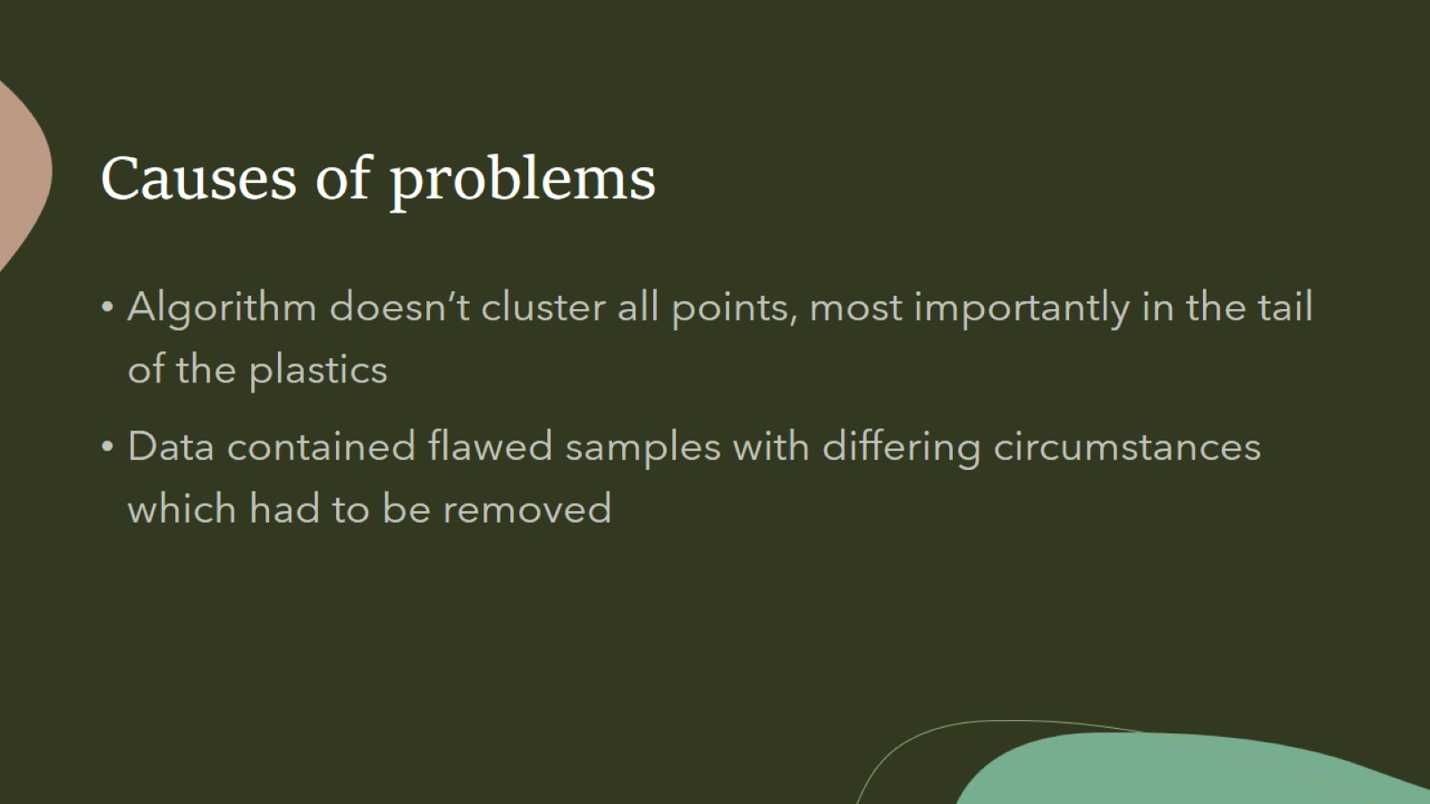
Causes of problems

Slide 11
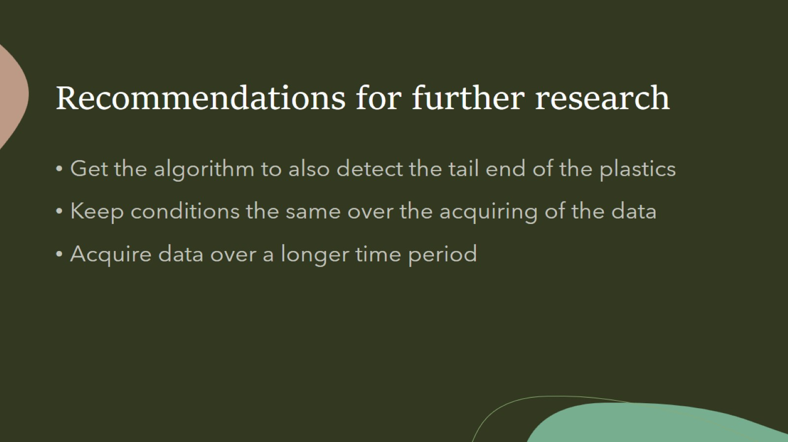
Recommendations for further research

Slide 12

Questions?

